Slide 1
Control System Studio Training
-
Archive System
Kay Kasemir
ORNL/SNS
kasemirk@ornl.gov
April 2013

Slide 2
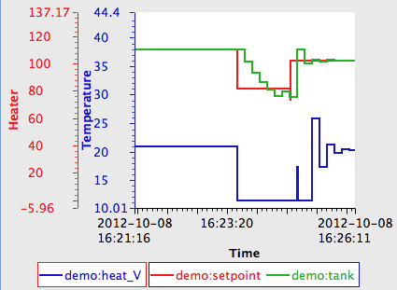
Archive System Interactions
End User?
  Look at PVs
  in Data Browser
  Complain when
  it doesn’t work
Administrator?
  Setup Data Store
  Create Configuration
  Run Archive Engine(s)

Slide 3
View Archive Data in CSS Data Browser
Open Data Browser Plot
Add PV
  If default archive setup lists data source with historic data for the PV, it will be displayed

Slide 4
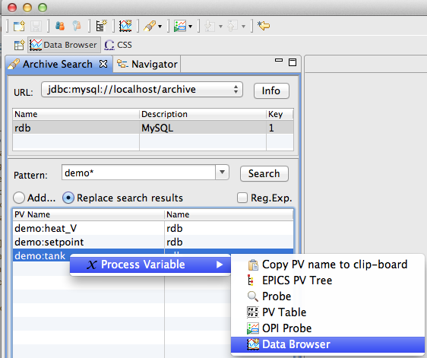
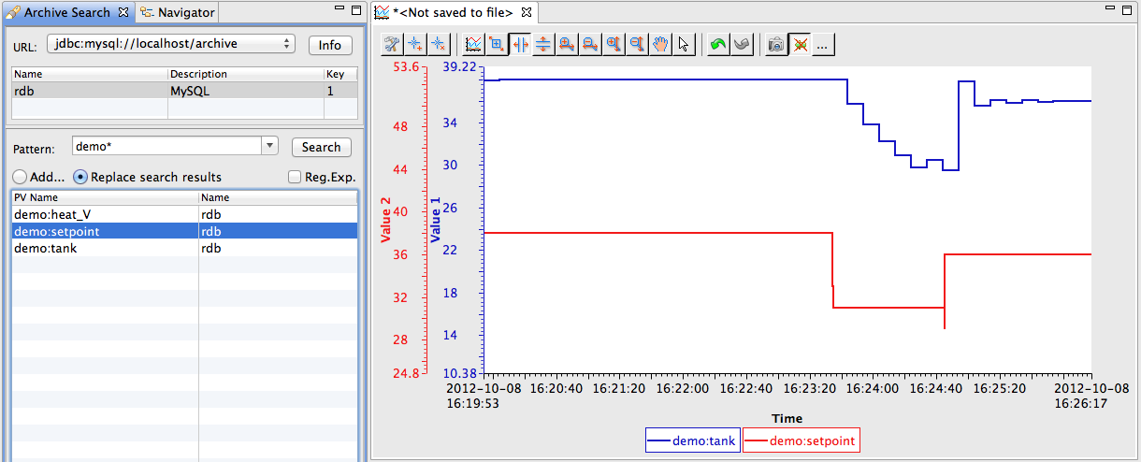
Searching for PVs in Archive
Open Archive Search View
  Data Browser Perspective,
  or Plot’s context menu
Search for channels
via pattern
Send to new Data Browser
  Via context menu
Send to
existing Plot
  Via drag
  & drop

Slide 5
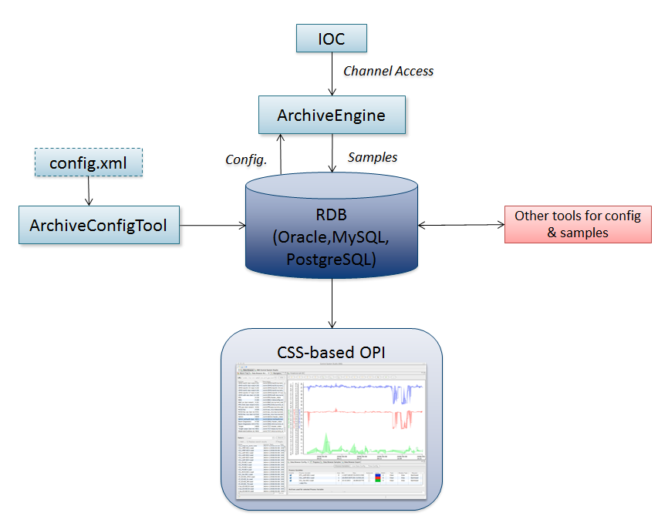
RDB-based Archive System Overview

Slide 6


Which one to use?
Channel Archiver
  Fast
  Can’t be maintained
RDB
  Slow
  Super easy to maintain
Worth a look: SLAC Archive ‘Appliance’

Slide 7
RDB Alternatives
Archive Engine
  Pluggable Configuration, pluggable ‘Write’ support
  Could write to other storage
SLAC Archive Appliance Work
  Started with same archive engine
  Hopefully will merge sources again
Data Browser
  Can read old Channel Archiver’s ArchiveDataServer.cgi
  Can read from Archive Appliance
  You may write site-specific ‘reader’ plugins

Slide 8
CSS Data Browser Configuration
Can be done via preference GUI
Better: plugin_customization.ini of CSS product:
# Read-only(!) archive access
org.csstudio.archive.rdb/url=jdbc:mysql://localhost/archive
org.csstudio.archive.rdb/user=report
org.csstudio.archive.rdb/password=$report
org.csstudio.archive.rdb/schema=
# URLs for archive search
org.csstudio.trends.databrowser2/urls=jdbc:mysql://localhost/archive
# Default data sources for newly added channels
# Format: <name>|<key>|<url>
org.csstudio.trends.databrowser2/archives=RDB|1|jdbc:mysql://localhost/archive

Slide 9
That’s it!
Look at data in Data Browser, no matter if “live” or “archived” data
.. unless you also setup and maintain the infrastructure ..

