Slide 1
MATLAB-based
Lattice Parser for
Accelerator Toolbox (AT)
—
Database and Lattice I/O
Peace Chang
January 2012

Slide 2
lattice_parser
Include the path or under ~/lattice_parser
Usage of the AT lattice parser
  > global Lattice_DB FAMLIST THERING GLOBVAL
  > lattice_parser(‘lattice-format’,‘lattice-file-name’);
Example 1
  [FAMLIST THERING GLOBVAL] = lattice_parser(‘MAD8’,’TPS24P18K1.MAD8’);
  plotbeta;
Example 2
  global Lattice_DB FAMLIST THERING GLOBVAL
  lattice_parser(‘MAD8’,’TPS24P18K1.MAD8’);
  plotbeta

Slide 3
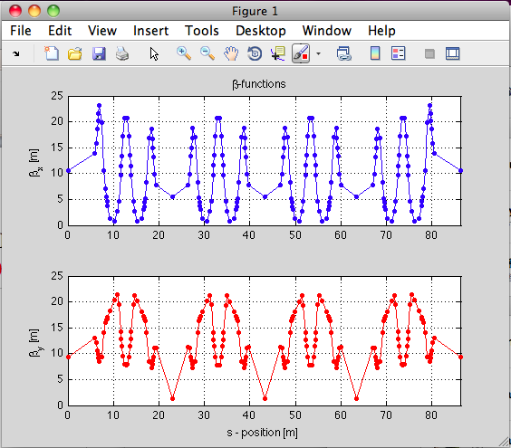
Exercise
> clear all
> global Lattice_DB FAMLIST THERING GLOBVAL
> lattice_parser(‘MAD8’,'TPS24P18K1.MAD8’);
> plotbeta;

