Slide 1

Truncated Power Series Algebra (TPSA) Toolbox for MATLAB
Chang, Ho-Ping

Slide 2
Outline
Object-Oriented Programming in MATLAB
Truncated Power Series (TPS)
Programming of TPSA Toolbox
Example and exercise

Slide 3
OOP in MATLAB
Using MATLAB (version 6)
  MATLAB Classes and Objects
Mastering MATLAB 6
  MATLAB Classes and Object-Oriented Programming

Slide 4
Designing User Classes in MATLAB
Setting Up Class Directories
  @class_name
Methods
  Operations defined to work with objects of a particular class are known as methods of that class.
  constructor, display, set, get
  Overloading operators and functions

Slide 5
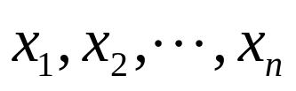
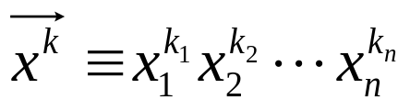
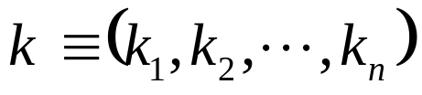
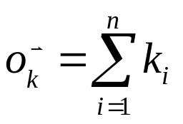
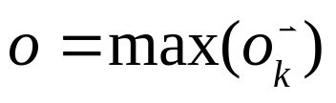

Truncated Power Series (TPS)
Number of small variables n:
One monomial term:
Power vector:
Order of a monomial term:
Order of a TPS:
Number of monomials of a TPS with n-variables and order o:

Slide 6
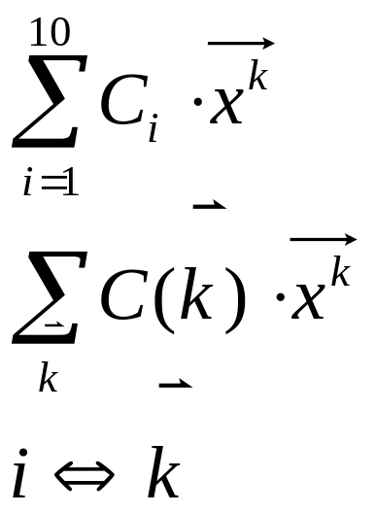
Monomial i | Power-vector k
1 | (0,0,0)
2 | (1,0,0)
3 | (0,1,0)
4 | (0,0,1)
5 | (2,0,0)
6 | (1,1,0)
7 | (1,0,1)
8 | (0,2,0)
9 | (0,1,1)
10 | (0,0,2)
An example of TPS:
Number of variables n=3
Max. order of TPS o=2
Number of Monomials:
(n+o)!/(n!o!) = 5!/(3!2!) = 10

Slide 7
Programming of TPSA Toolbox
One-step index pointers (OSIP) for the easy data access of TPS
TPS class

Slide 8
One-Step Index Pointer (OSIP)
— The nerves of TPSA
The OSIP was declared as a global object which is taken as the nerves of TPSA. The key-function, OSIP_Nerve(number-of-variables, maximum-order-of-TPS, canonical-dimension), is provided to build up the nerves of TPSA.
The number of monomials for a n-variable TPS, of order o, is given by m=(n+o)!/(n!o!).
The power-vector vs. its monomial-term
Begin and ended of homogeneous monomials of order o.
…

Slide 9
Truncated Power Series (TPS)
— Basic class of TPSA
One and only one class TPS (Truncated Power Series) is defined for MATLAB-based TPSA.
The definition of TPS class {n,o,c}
  n: number of variables (The same as the number-of-variable in OSIP)
  o: maximum order = maximum of
  c(1:m): coefficients of monomials, m = (n+o)!/(n!o!)
Default constructor TPS(arguments) and display(TPS).
Overloading operators such as +-*/
Overloading functions, e.g. sin, cos, tan, cot, sinh, cosh, exp, sqrt, log, …

Slide 10
Truncated Power Series (TPS)
— Basic class of TPSA
Variable-of-TPS, Variables-of-TPS
SetTPS, GetTPS, Non-Zero-Min-Order-TPS
Derivative, Integral, Homogeneous, …
Lie Algebra:
  Lie operator (Poisson bracket), BCH Theorem, Concatenation(s)
  Lie transformation (Hamiltonian Eqn.) TaylorMap-VPS (array of TPS)
  Jacobian-matrix, Linear-square-matrix
  DepritLie2VPS, VPS2DepritLie
  VPS2SymplecticLie, SymplecticLie-Integrator, SymplecticLie-Times
  SymplecticLie2DepritLie
  …

Slide 11
Structure of TPSA Toolbox in MATLAB
Root-Directory-Of-TPSA = Path-of-MATLAB-toolboxes\tpsa
Root-Directory-Of-TPSA\Contents.m
Root-Directory-Of-TPSA\Readme.m
Root-Directory-Of-TPSA\*.m (examples and applications)
Root-Directory-Of-TPSA\osip
Root-Directory-Of-TPSA\osip\*.m
One-Step Index Pointer (OSIP) is the nerves of TPSA
Root-Directory-Of-TPSA\@tps
Root-Directory-Of-TPSA\@tps\*.m
@tps means “tps” is a user-defined class.
MATLAB Classes and Object-Oriented Programming

Slide 12
Example and exercise
Root-Directory-Of-TPSA\OSIP_TPSA.m

