Slide 1
Navigating through Alloy relations
Roger L. Costello
September 21, 2017

Slide 2
What company does John work at?
John
employer
John$0
John$0
Google$0
Bill$0
Apple$0
Mary$0
Oracle$0

Slide 3
What company does John work at?
John
employer
John$0
John$0
Google$0
Bill$0
Apple$0
Mary$0
Oracle$0
John.employer
Evaluating this Alloy expression returns this
Google$0

Slide 4
John
employer
John$0
John$0
Google$0
Bill$0
Apple$0
Mary$0
Oracle$0
Singleton relation
Binary relation

Slide 5
Terminology
Relation means table
Singleton relation means a table with one column and one row
Binary relation means a table with two columns
Set means a table with one column and multiple rows
Ternary relation means a table with three columns

Slide 6
John.employer
join operator

Slide 7
Join operator
The join operator combines two relations
The result of a join is the concatenation of the matching parts of the two relations, minus the matching parts

Slide 8
John
employer
Google$0
John$0
John$0
Google$0
Bill$0
Apple$0
Mary$0
Oracle$0

Slide 9
Quintessential
Of the pure and essential essence of something.
Of or relating to the most perfect embodiment of something.

Slide 10
The quintessential relational operator is join.

Slide 11
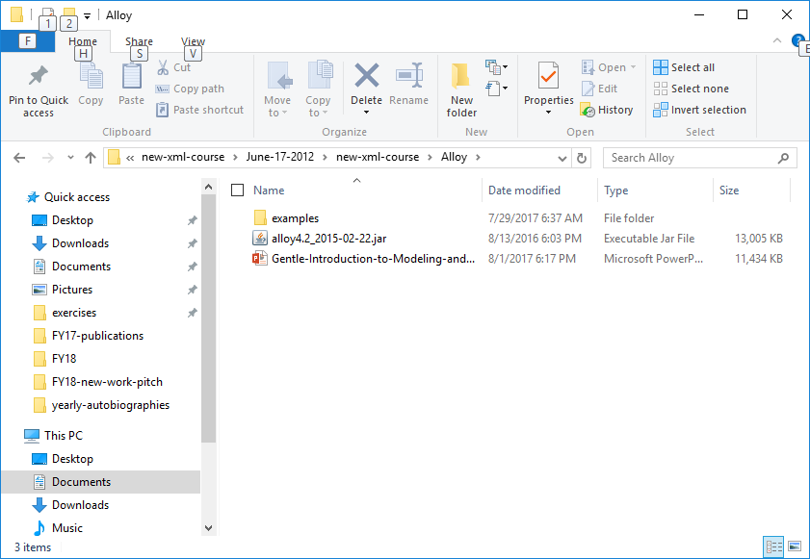
Double click on this jar file to start Alloy
The jar file can be downloaded from: http://alloy.mit.edu/alloy/download.html

Slide 12
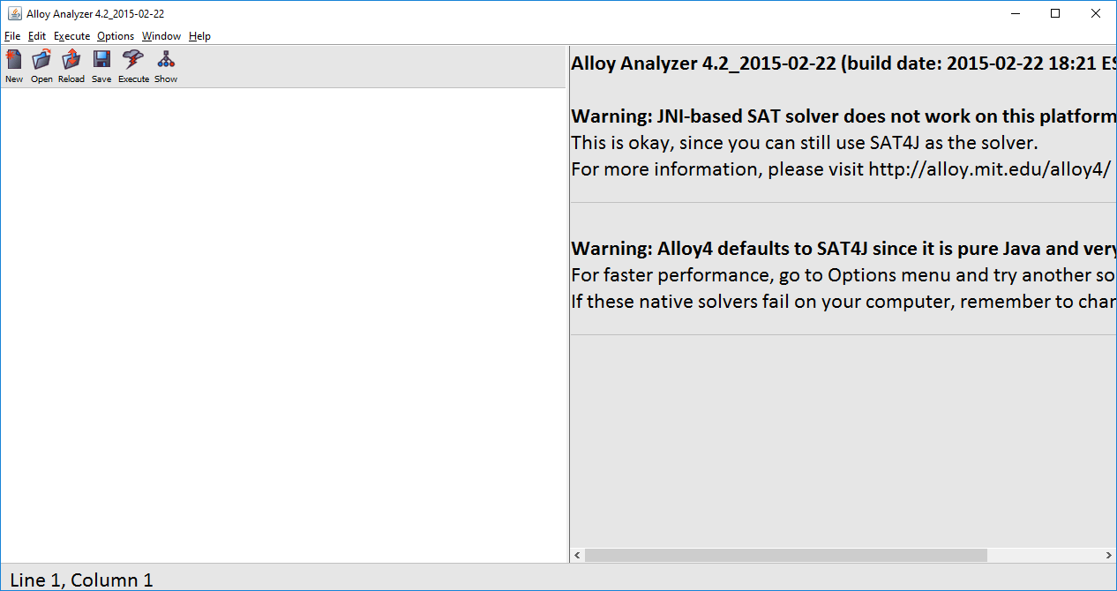
This is the Alloy tool

Slide 13
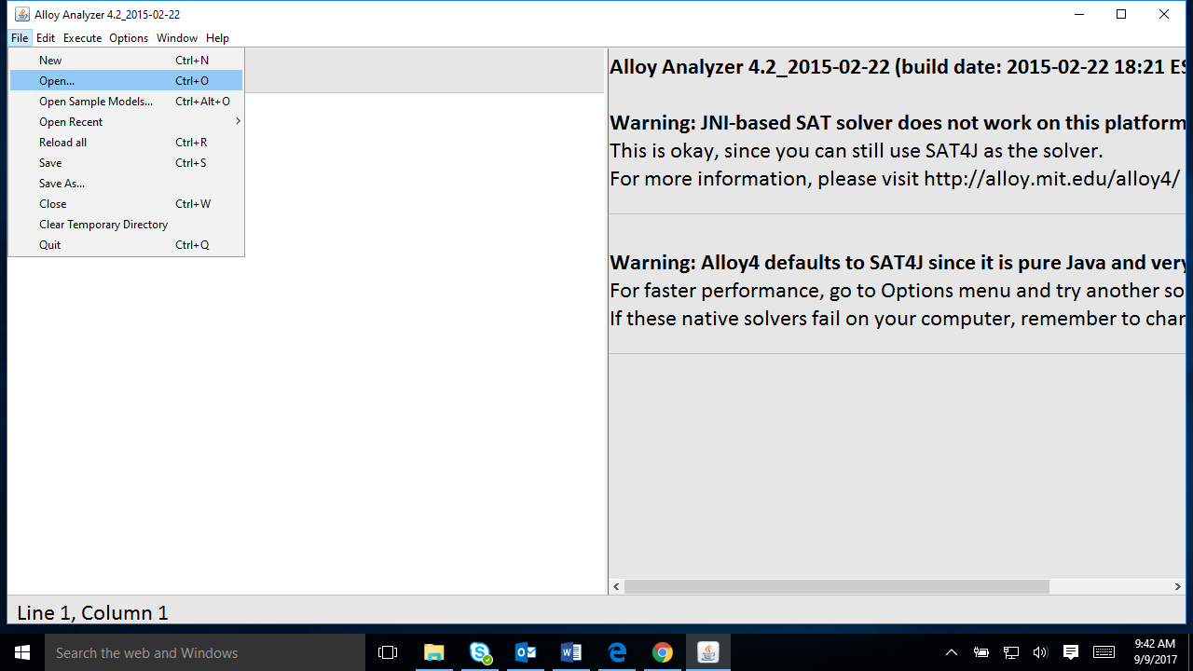
Select File >> Open …

Slide 14
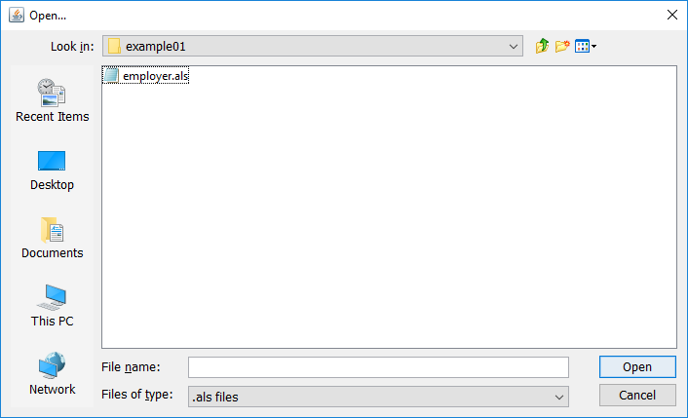
Select employer.als (in examples/navigation/example01)

Slide 15
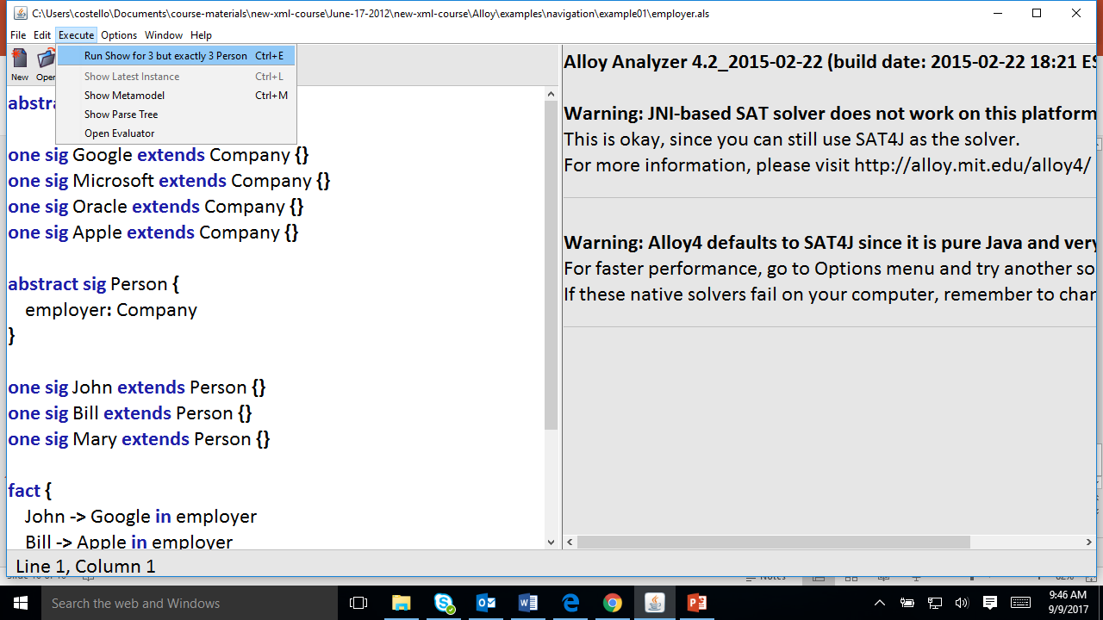
Select Execute >> Run Show for 3 but exactly 3 Person

Slide 16
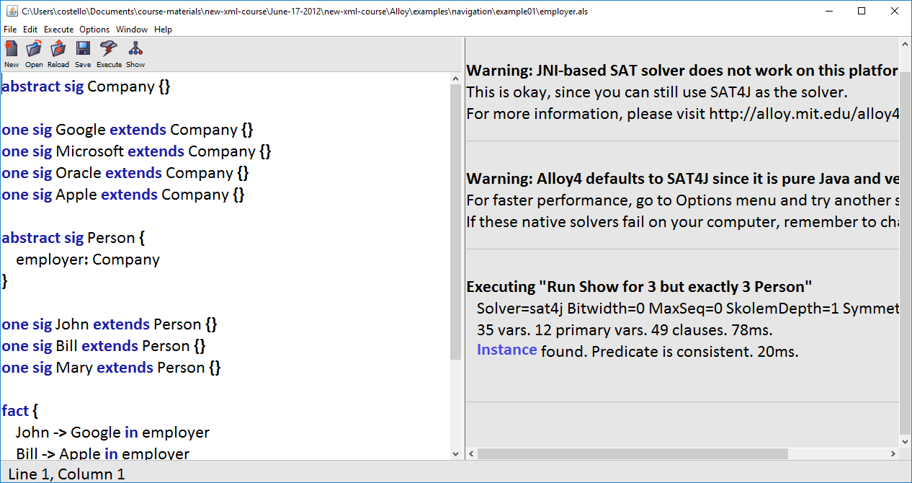
Click on Instance

Slide 17
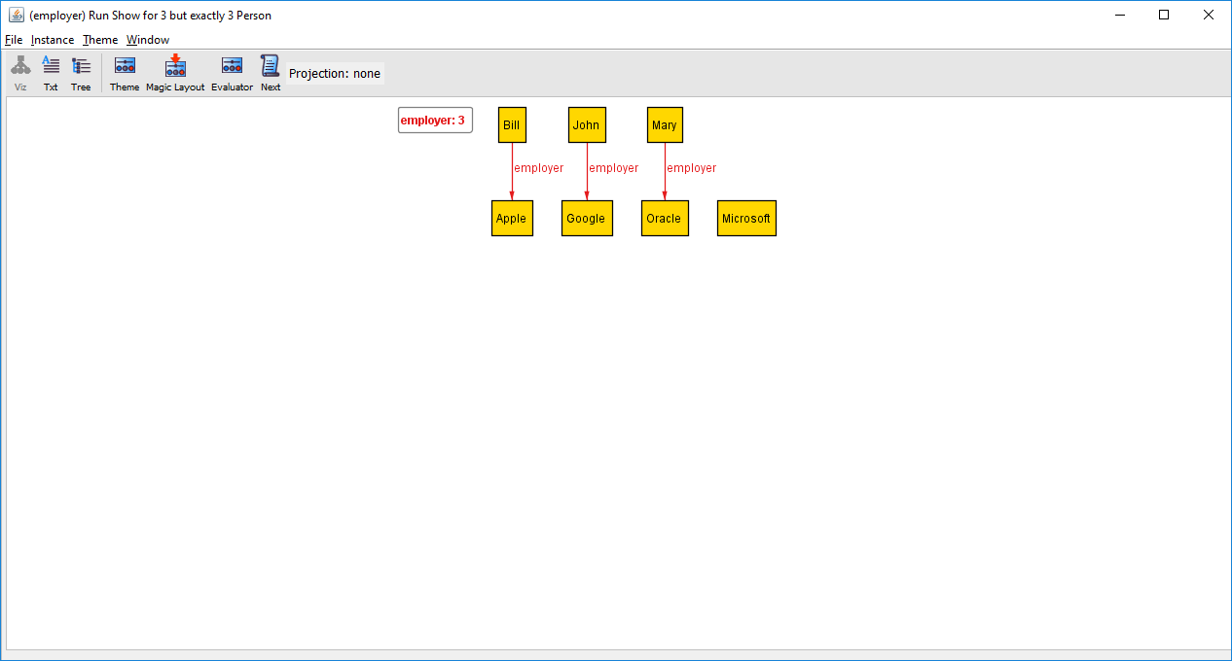
Click on Evaluator

Slide 18
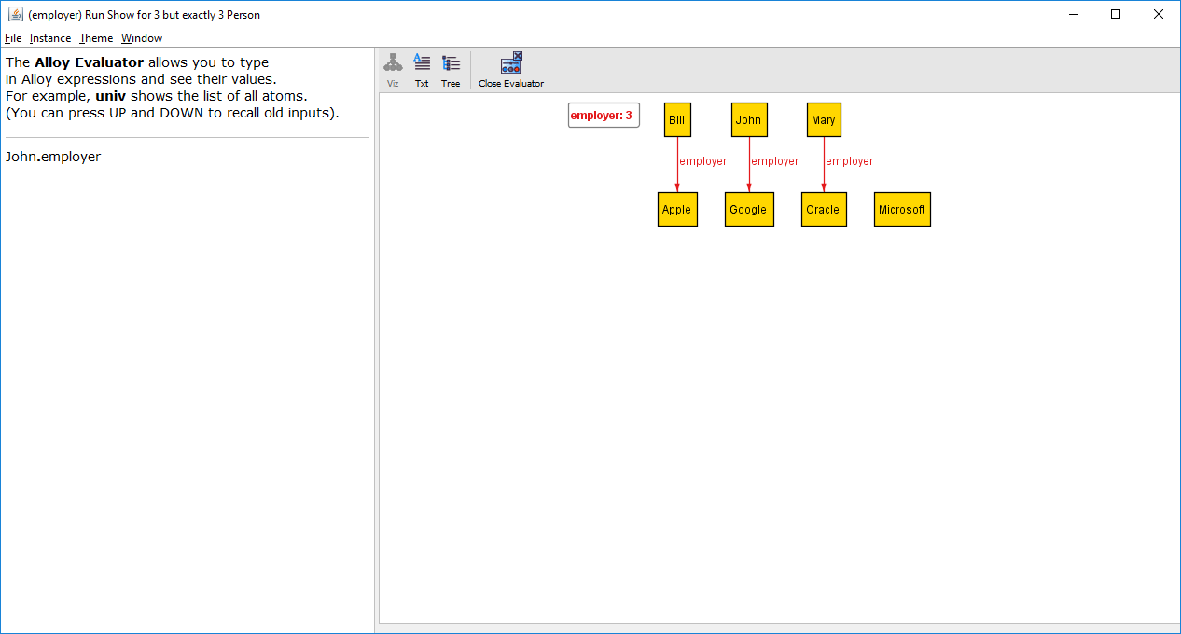
Type this expression

Slide 19
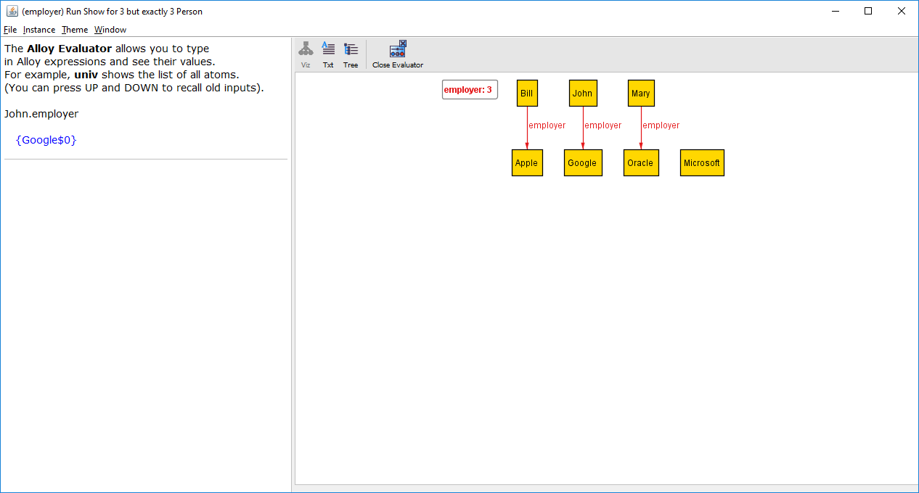
Alloy evaluated the expression and this is the result

Slide 20
Google$0
equivalent

Slide 21
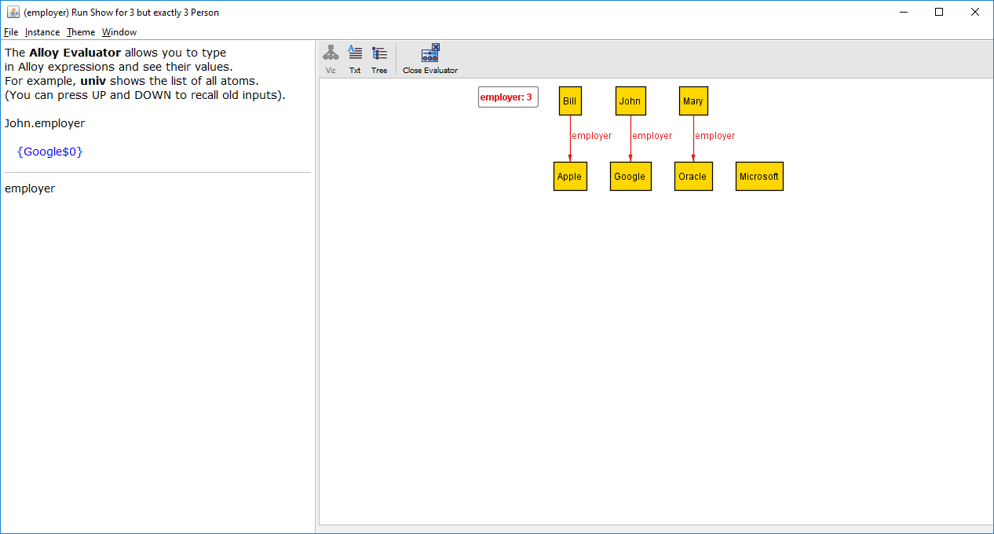
Type this expression (the expression is just the name of a binary relation)

Slide 22
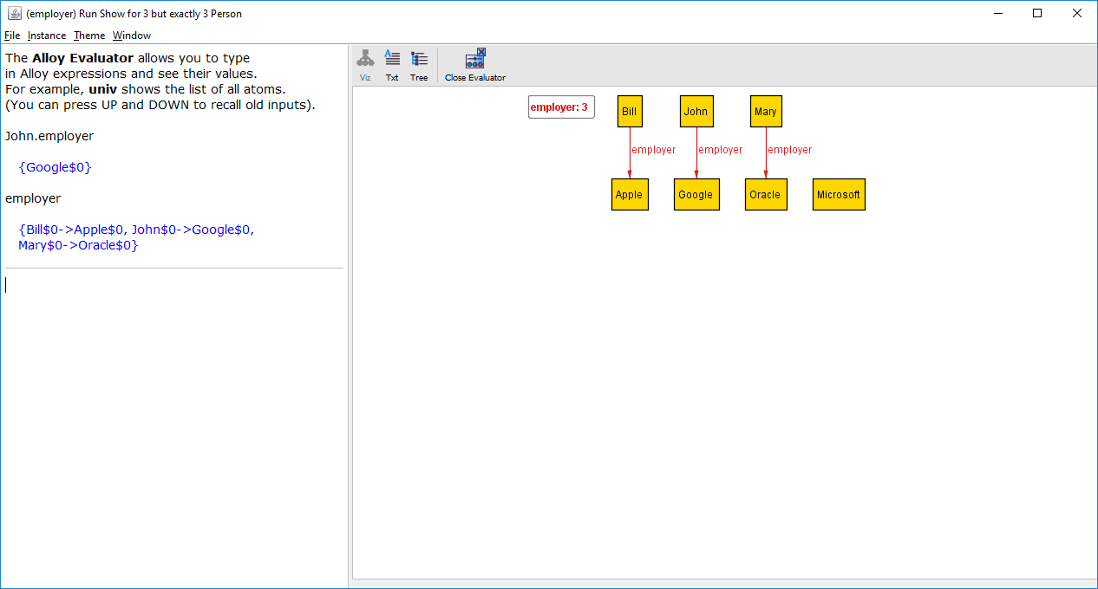
Bill works at Apple, John works at Google, Mary works at Oracle

Slide 23
John$0
Google$0
Bill$0
Apple$0
equivalent
Mary$0
Oracle$0

Slide 24
Internally, Alloy represents relations as sets

Slide 25

Type this

Slide 26
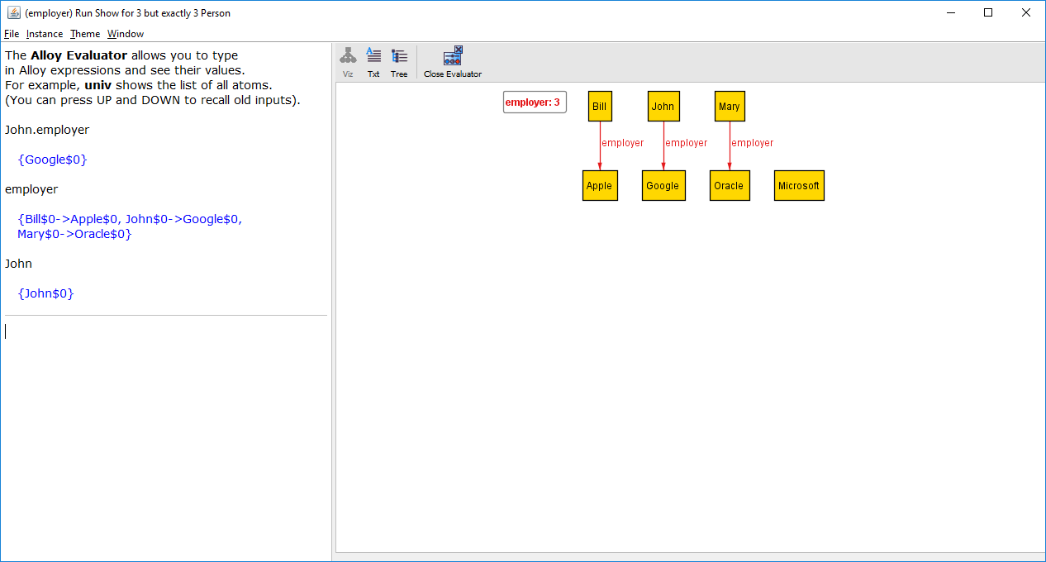
John is a singleton relation

Slide 27

Type this

Slide 28
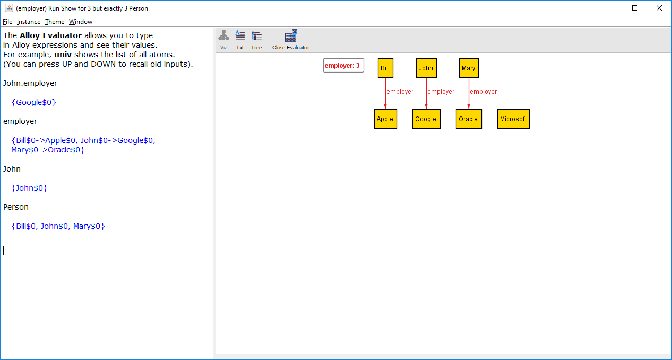
Person is a set, consisting of 3 persons

Slide 29
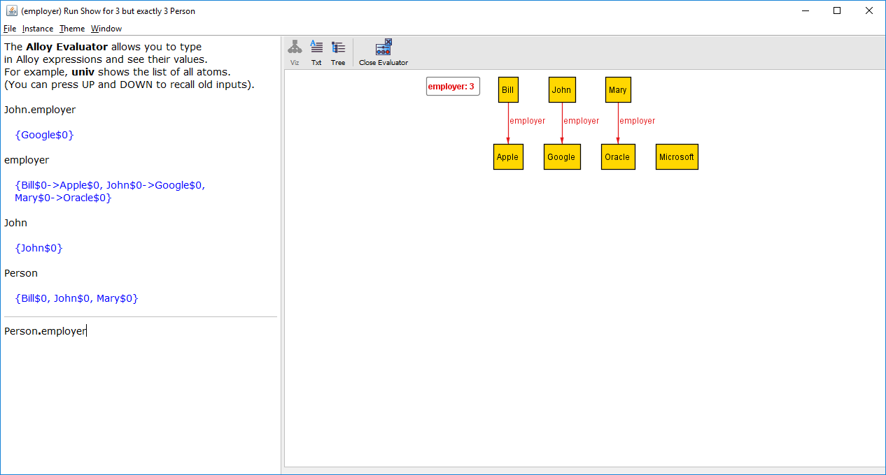
This expression is a join operation between all persons and employer (which has person/company mappings)

Slide 30
Google$0
Person
employer
Apple$0
John$0
John$0
Google$0
Oracle$0
Bill$0
Bill$0
Apple$0
Mary$0
Mary$0
Oracle$0
The set of employers for all persons.

Slide 31
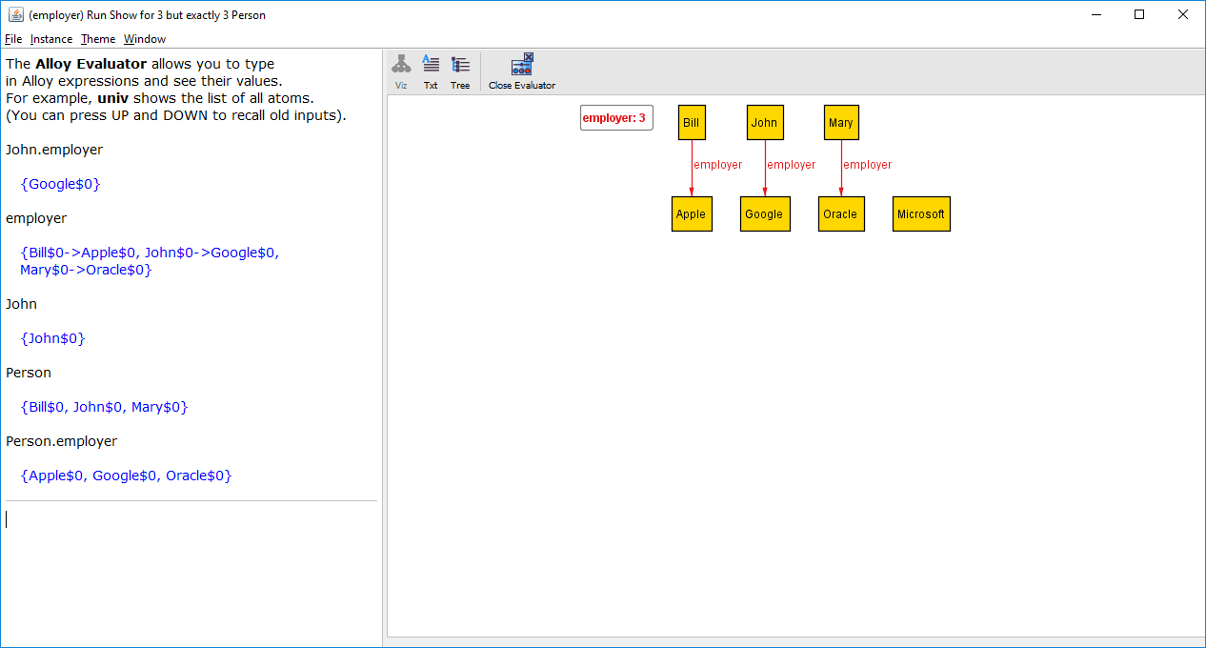
Result of Alloy evaluating the expression. Bill works at Apple, John works at Google, Mary works at Oracle

Slide 32
This is the VIZ (visualization) view. For this tutorial we will just use the Evaluator.

Slide 33
Who works at Google?
employer
Google
John$0
Google$0
Google$0
Bill$0
Apple$0
Mary$0
Oracle$0

Slide 34
Who works at Google?
employer
Google
John$0
Google$0
Google$0
Bill$0
Apple$0
Mary$0
Oracle$0
employer.Google

Slide 35
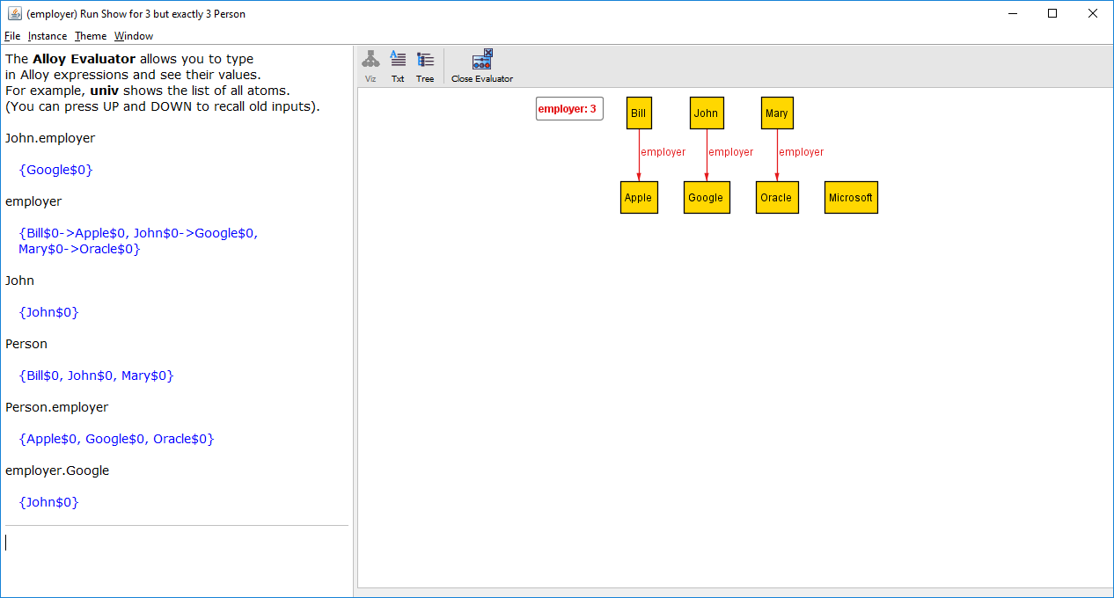
Result of Alloy evaluating the expression. John works at Google

Slide 36
Forward navigation
John
employer
John$0
John$0
Google$0
Bill$0
Apple$0
Mary$0
Oracle$0
John.employer

Slide 37
Backward navigation
employer
Google
John$0
Google$0
Google$0
Bill$0
Apple$0
Mary$0
Oracle$0
Employer.Google

Slide 38
Transpose operator ~
The transpose of a binary relation is the flipping of the columns: the second column becomes the first, the first column becomes the second.
employer
~employer
John$0
Google$0
Google$0
John$0
Bill$0
Apple$0
Apple$0
Bill$0
Mary$0
Oracle$0
Oracle$0
Mary$0

Slide 39
Equivalent
employer
Google
John$0
Google$0
Google$0
John$0
Bill$0
Apple$0
Mary$0
Oracle$0
Google
~employer
Google$0
Google$0
John$0
John$0
Apple$0
Bill$0
Oracle$0
Mary$0

Slide 40
Who is the occupant of Room$1 at Time$2?
FrontDesk
occupant
FrontDesk$0
FrontDesk$0
Room$0
Guest$2
Time$0
FrontDesk$0
Room$0
Guest$2
Time$1
FrontDesk$0
Room$0
Guest$2
Time$2
FrontDesk$0
Room$1
Guest$1
Time$0
FrontDesk$0
Room$1
Guest$1
Time$1
FrontDesk$0
Room$1
Guest$1
Time$2
FrontDesk$0
Room$2
Guest$0
Time$0
FrontDesk$0
Room$2
Guest$0
Time$1
FrontDesk$0
Room$2
Guest$0
Time$2

Slide 41
Who is the occupant of Room$1 at Time$2?
FrontDesk
occupant
FrontDesk$0
FrontDesk$0
Room$0
Guest$2
Time$0
FrontDesk$0
Room$0
Guest$2
Time$1
FrontDesk$0
Room$0
Guest$2
Time$2
FrontDesk$0
Room$1
Guest$1
Time$0
FrontDesk$0
Room$1
Guest$1
Time$1
FrontDesk$0
Room$1
Guest$1
Time$2
FrontDesk$0
Room$2
Guest$0
Time$0
FrontDesk$0
Room$2
Guest$0
Time$1
FrontDesk$0
Room$2
Guest$0
Time$2
FrontDesk.occupant

Slide 42
Who is the occupant of Room$1 at Time$2?
Room$0
Guest$2
Time$0
Room$0
Guest$2
Time$1
Room$0
Guest$2
Time$2
Room$1
Guest$1
Time$0
Room$1
Guest$1
Time$1
Room$1
Guest$1
Time$2
Room$2
Guest$0
Time$0
Room$2
Guest$0
Time$1
Room$2
Guest$0
Time$2
Room$1.(FrontDesk.occupant)

Slide 43
Who is the occupant of Room$1 at Time$2?
Guest$1
Time$0
Guest$1
Time$1
Guest$1
Time$2
Room$1.(FrontDesk.occupant).Time$2

Slide 44
Recap: Who is the occupant of Room$1 at Time$2?
FrontDesk
occupant
FrontDesk$0
FrontDesk$0
Room$0
Guest$2
Time$0
FrontDesk$0
Room$0
Guest$2
Time$1
FrontDesk$0
Room$0
Guest$2
Time$2
FrontDesk$0
Room$1
Guest$1
Time$0
FrontDesk$0
Room$1
Guest$1
Time$1
Alloy expression that navigates through the relations to obtain the answer
FrontDesk$0
Room$1
Guest$1
Time$2
FrontDesk$0
Room$2
Guest$0
Time$0
FrontDesk$0
Room$2
Guest$0
Time$1
FrontDesk$0
Room$2
Guest$0
Time$2
Room$1.(FrontDesk.occupant).Time$2

Slide 45
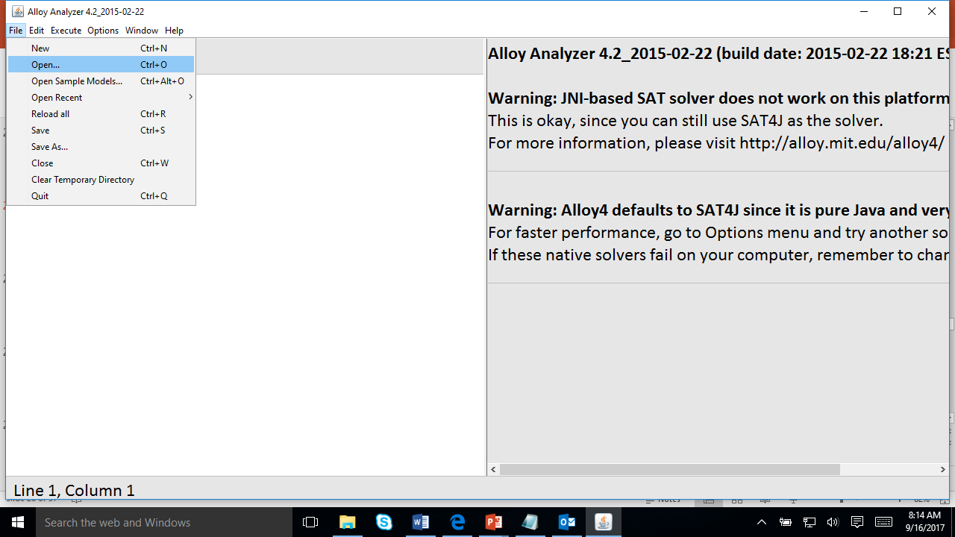
Select File >> Open …

Slide 46
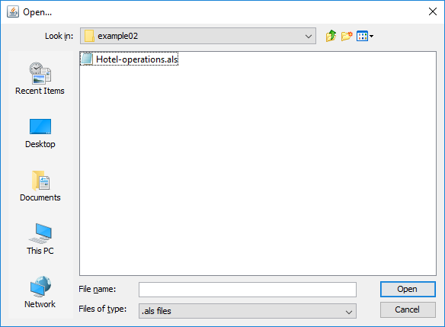
Select Hotel-operation.als (in examples/navigation/example02)

Slide 47
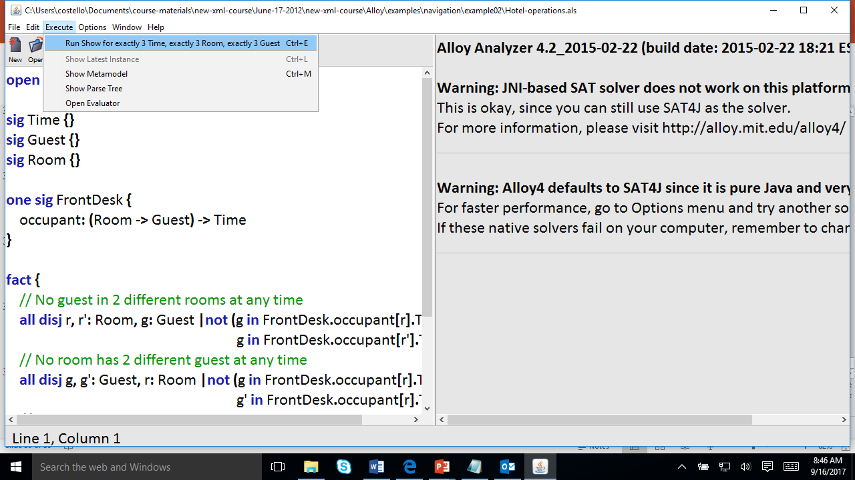
Select Execute >> Run Show for exactly 3 Time, exactly 3 Room, …

Slide 48
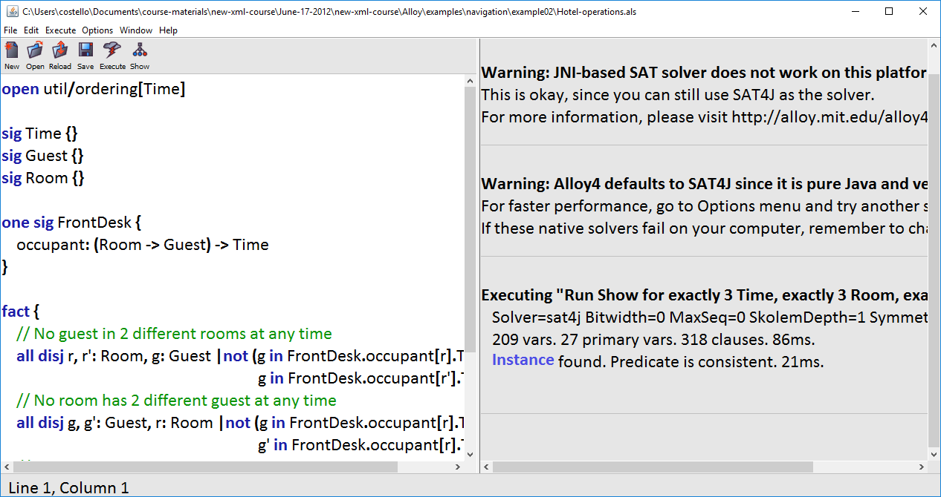
Click on Instance

Slide 49
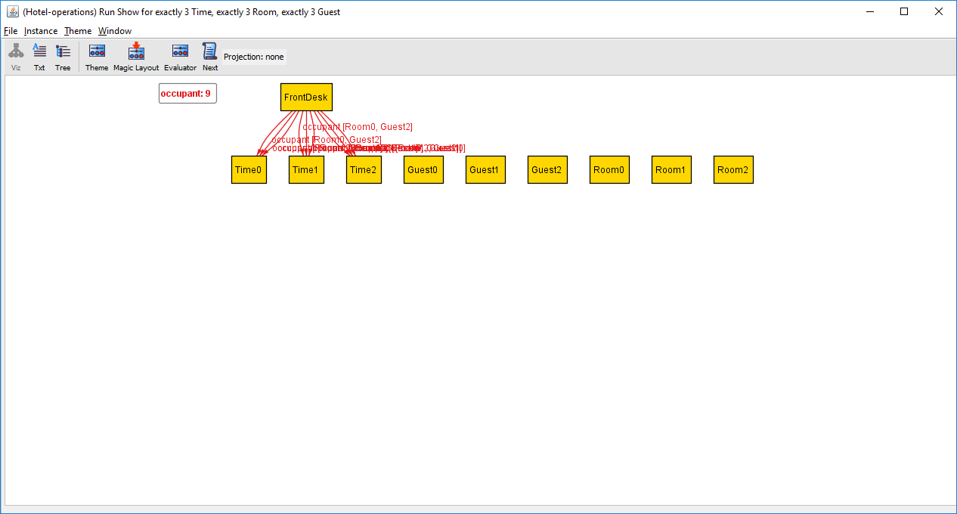
Click on Evaluator

Slide 50
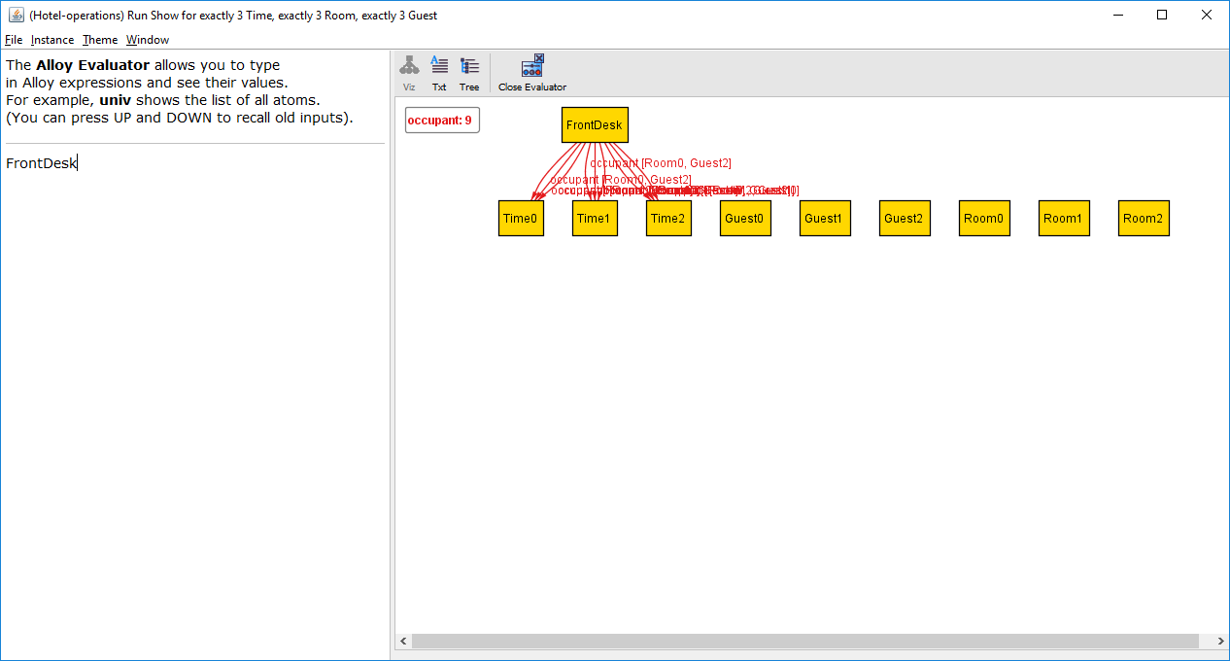
Type this expression

Slide 51
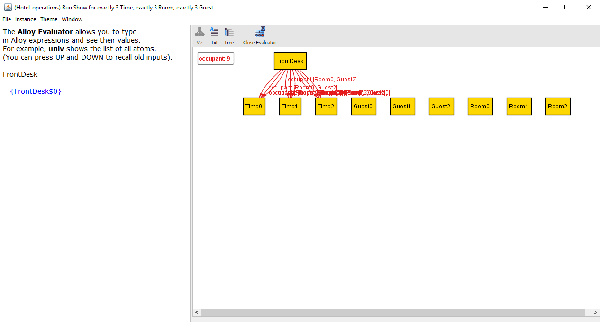
Alloy evaluated the expression and this is the result (a singleton relation)

Slide 52

Type this expression

Slide 53
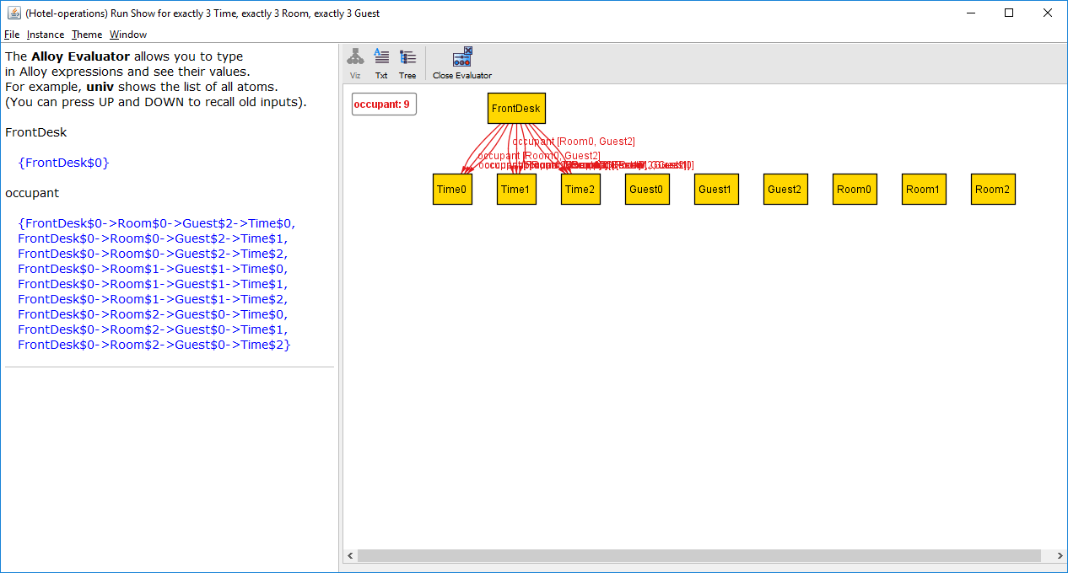
Alloy evaluated the expression and this is the result (a quaternary relation)

Slide 54

Type this expression

Slide 55

Alloy evaluated the expression and this is the result (a singleton relation)

Slide 56
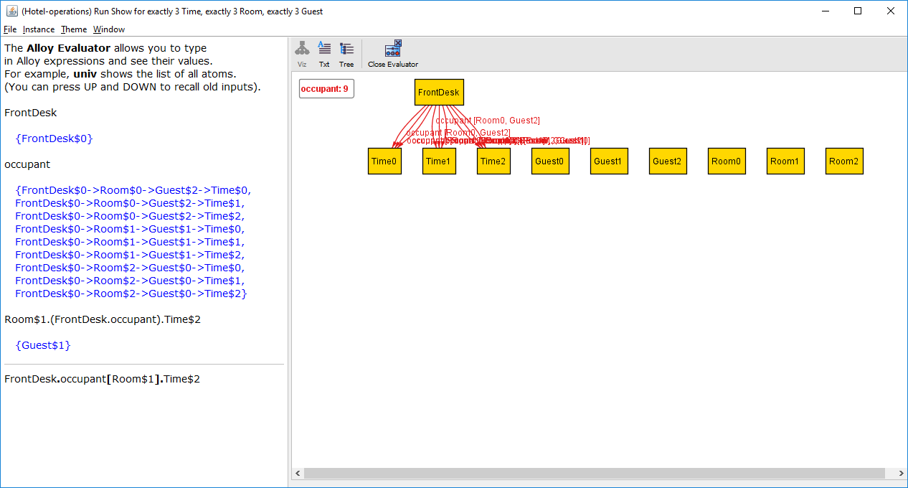
Type this expression

Slide 57
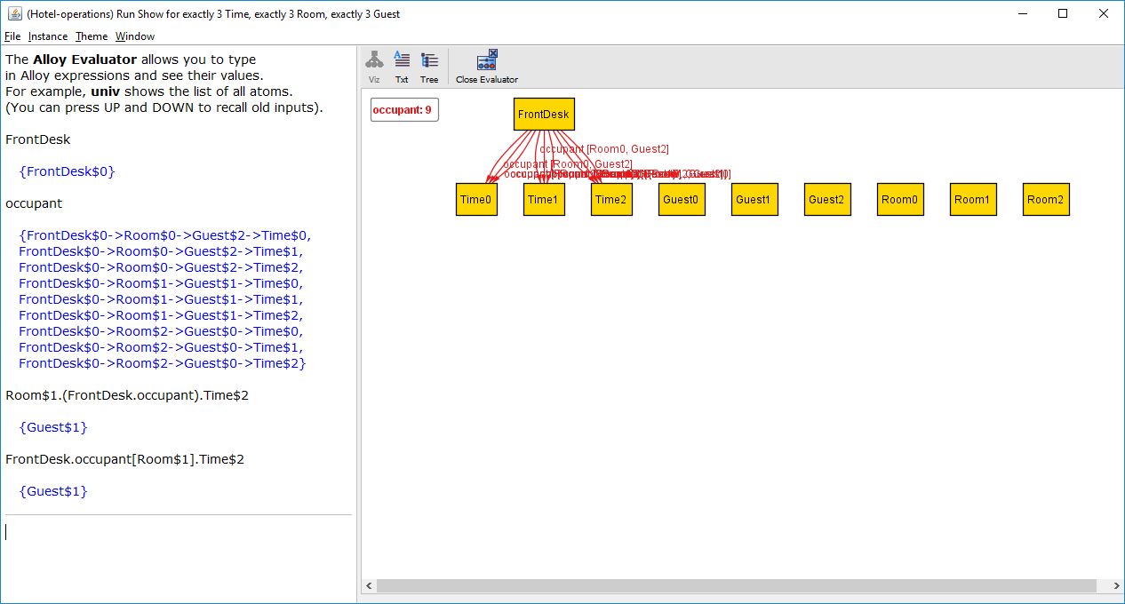
Same result as the previous expression!

Slide 58
Room$1.(FrontDesk.occupant).Time$2
equivalent
FrontDesk.occupant[Room$1].Time$2

Slide 59
Box operator
The box operator [ ] is semantically identical to join, but takes its arguments in a different order. The expression
e1 [e2]
has the same meaning as
e2.e1

Slide 60
Operator precedence: dot > box
Dot binds more tightly than box, so
a.b.c [d]
is evaluated as
(a.b.c) [d]
which is equivalent to
d.(a.b.c)

Slide 61
What processes can Process$0 reach?
succ
Process$0
Process$2
Process$1
Process$0
Process$2
Process$1

Slide 62
What processes can Process$0 reach?
succ
Process$0
Process$2
Process$1
Process$0
Process$2
Process$1

Slide 63
What processes can Process$0 reach?
succ
Process$0
Process$2
Process$1
Process$0
Process$2
Process$1
Process$0 can directly reach Process$2, which can reach Process$1, which can reach Process$0. So, Process$0 can reach all processes, including itself.

Slide 64
succ
Process$0
Process$2
Process$1
Process$0
Process$2
Process$1
In fact, each process can reach all other processes.

Slide 65
Process$1
succ
Process$0
Process$2
succ
Process$1
Process$0
Process$0
succ
Process$2
Process$1
succ
Process$2
The processes have a cylic topology.

Slide 66
What processes can Process$0 reach?
succ
Process$0
Process$2
Process$1
Process$0
Process$2
Process$1
Process$0.^succ returns all the processes reachable from Process$0.

Slide 67
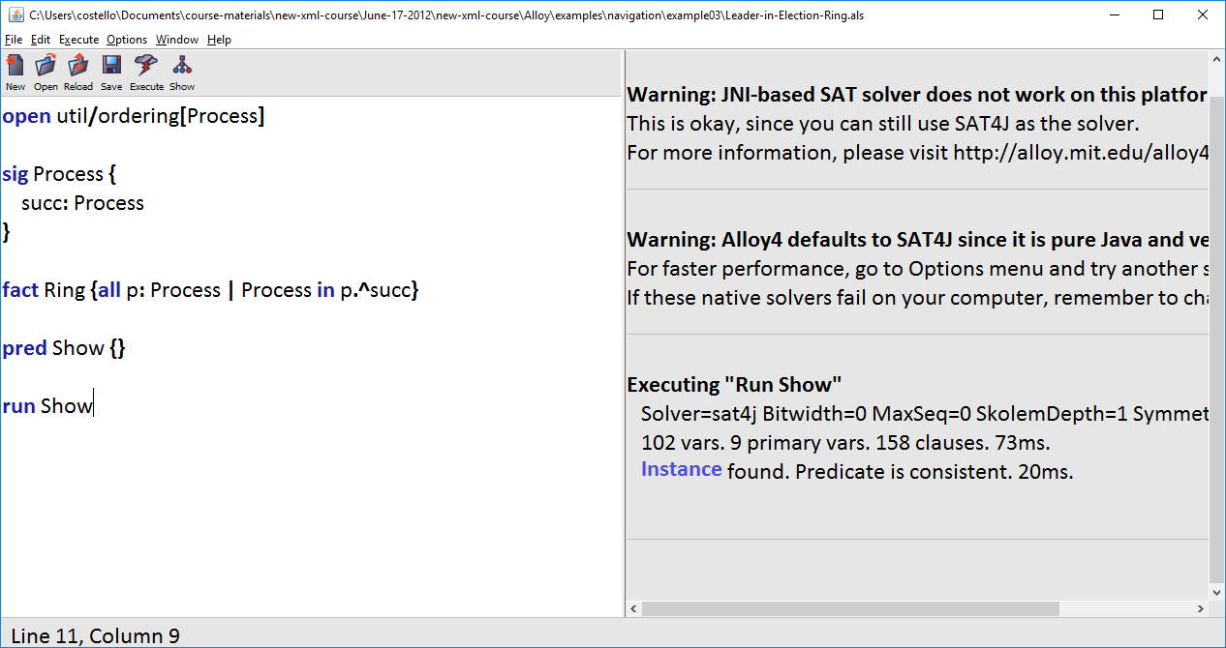
Open Leader-in-Election-Ring.als in the example03 folder. Then select Execute >> Show. Then click on Instance.

Slide 68
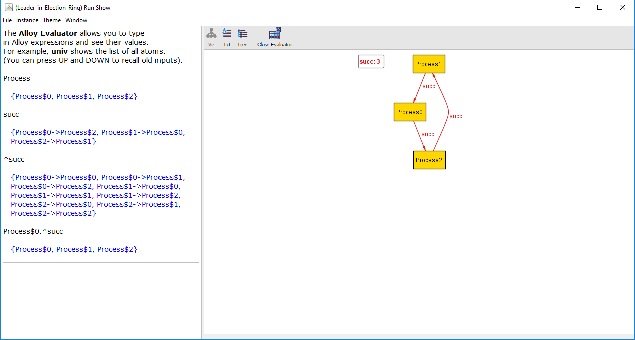

Slide 69
The set of processes

Slide 70
succ is a binary relation, mapping each process to a process

Slide 71
^succ is the transitive closure of the binary relation. That is, for each process, the processes it can reach.

Slide 72
Transitive closure operator ^
The transitive closure operator is applied to binary relations.
If a binary relation contains a -> b and b -> c, then the transitive closure returns a -> b and a -> c.

Slide 73
succ
^succ
Process$0
Process$2
Process$0
Process$0
Process$1
Process$0
Process$0
Process$1
Process$2
Process$1
Process$0
Process$2
Process$1
Process$0
Process$1
Process$1
Process$1
Process$2
Process$2
Process$0
Process$2
Process$1
Process$2
Process$2

Slide 74
succ
Process$0
Process$2
Process$1
Process$0
Process$2
Process$1
^succ
Process$0.^succ
Process$0
Process$0
Process$0
Process$0
Process$0
Process$1
Process$0
Process$1
Process$0
Process$2
Process$0
Process$2
Process$1
Process$0
Process$1
Process$0
Process$1
Process$1
Process$1
Process$1
Process$1
Process$2
Process$2
Process$0
Process$1
Process$2
Process$2
Process$0
Process$2
Process$1
Process$2
Process$1
Process$2
Process$2
Process$2
Process$2

Slide 75
What processes can Process$0 reach?
succ
Process$0
Process$1
Process$1
Process$2

Slide 76
What processes can Process$0 reach?
succ
Process$0
Process$1
Process$1
Process$2

Slide 77
What processes can Process$0 reach?
succ
Process$0
Process$1
Process$1
Process$2
Process$0 can directly reach Process$1, which can reach Process$2. So, Process$0 can reach all processes, excluding itself.

Slide 78
What processes can Process$0 reach?
succ
Process$0
Process$1
Process$1
Process$2
In fact, each process can reach its successor processes.

Slide 79
Process$0
succ
Process$0
Process$1
succ
Process$1
Process$2
Process$1
succ
Process$2
The processes have a linear topology.

Slide 80
What processes can Process$0 reach?
succ
Process$0
Process$1
Process$1
Process$2
Process$0.^succ returns all the processes reachable from Process$0.

Slide 81
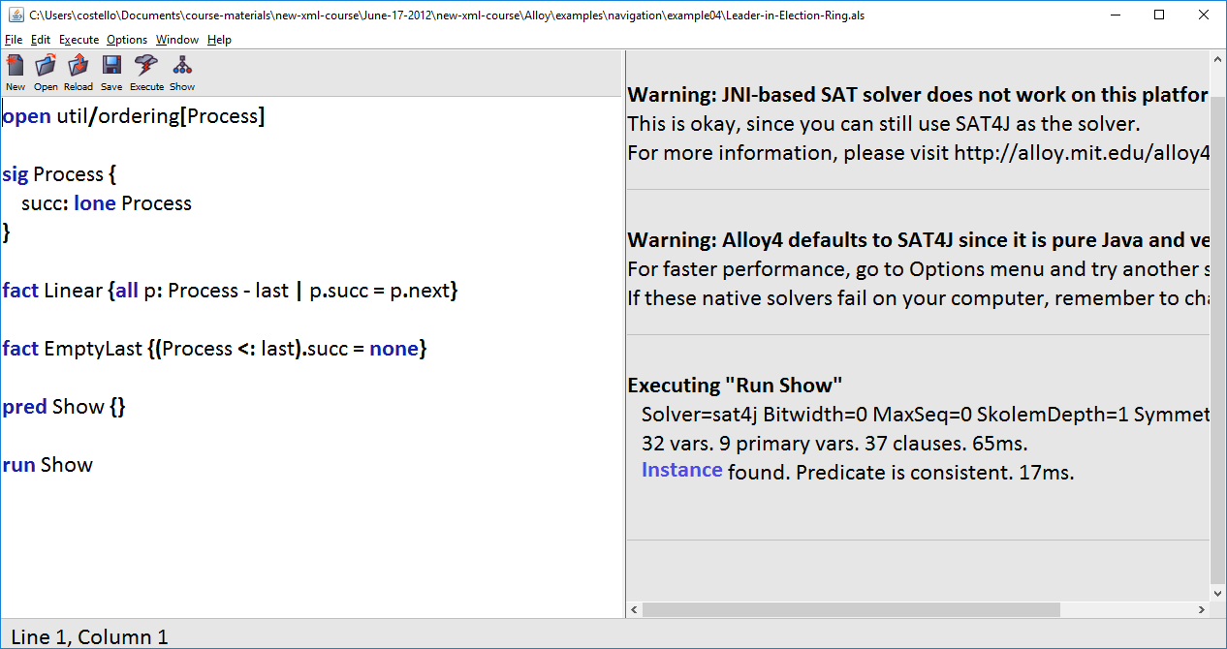
Open Leader-in-Election-Ring.als in the example04 folder. Then select Execute >> Show. Then click on Instance.

Slide 82
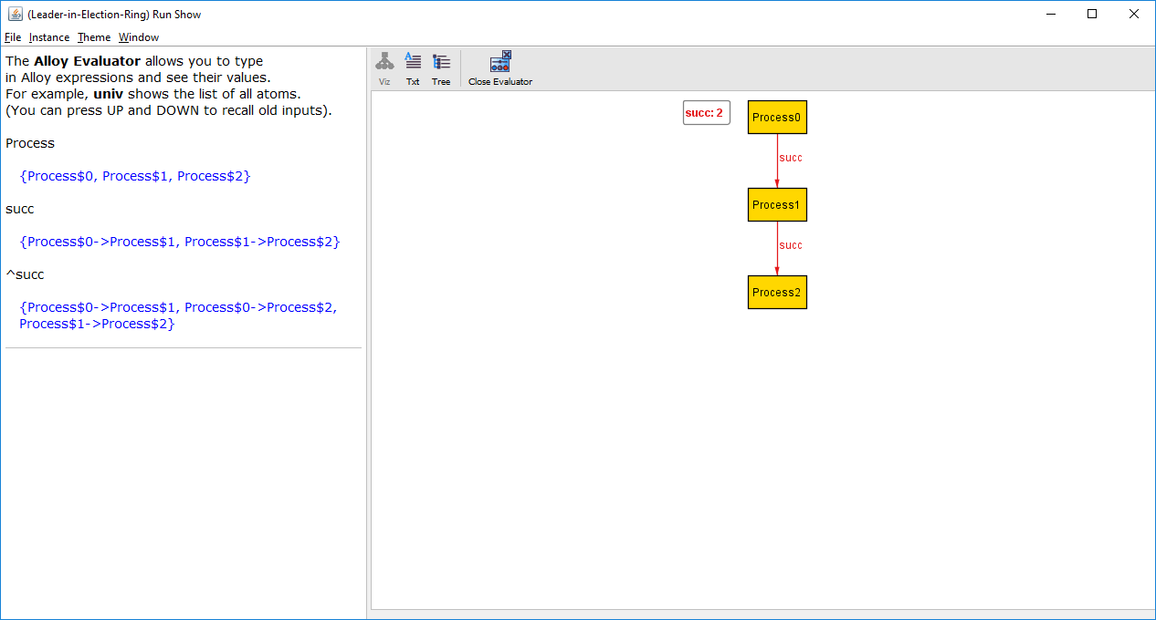
succ
^succ
Process$0
Process$1
Process$0
Process$1
Process$1
Process$2
Process$0
Process$2
Process$1
Process$2

Slide 83
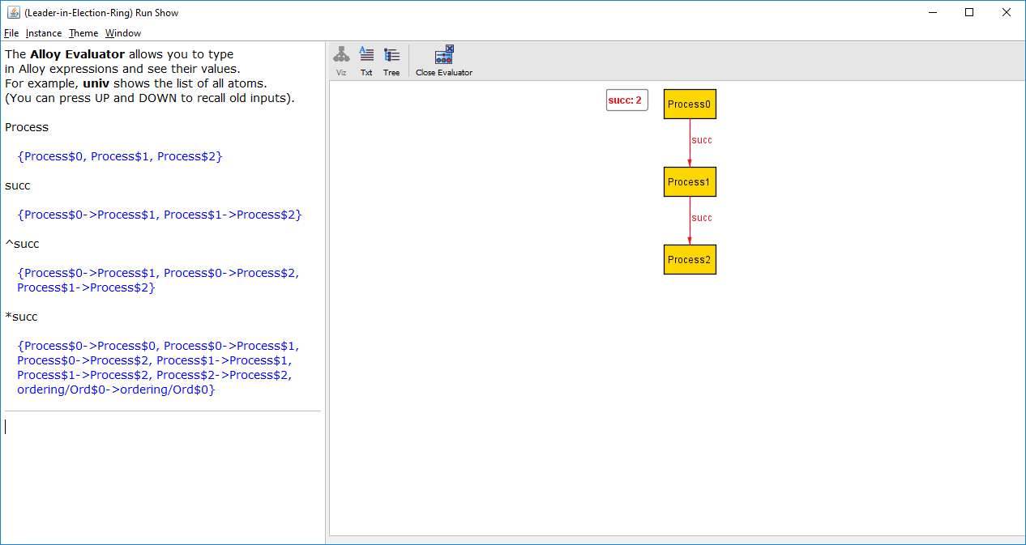
Type this expression

Slide 84
succ
*succ
Process$0
Process$1
Process$0
Process$0
Process$1
Process$2
Process$0
Process$1
Process$0
Process$2
Process$1
Process$1
Process$1
Process$2

Slide 85
What’s this? See the bottom of page 65 of Software Abstractions. The value ordering/Ord$0 comes from the ordering/util module. For this tutorial we will ignore this.

Slide 86
^succ
*succ
Process$0
Process$1
Process$0
Process$0
Process$0
Process$2
Process$0
Process$1
Process$1
Process$2
Process$0
Process$2
Process$1
Process$1
Process$1
Process$2

Slide 87
Reflexive transitive closure operator *
The reflexive transitive closure operator is applied to binary relations.
If a binary relation contains a -> b and b -> c, then the reflexive transitive closure returns a -> a, a -> b, and a -> c.
That is, * is exactly like ^ except * also returns each value mapped to itself.

Slide 88
What properties does Component$1 in iCalendarObject have?
iCalendarObject
properties
iCalendarObject$0
Component$0
dtstamp$0
Component$0
version$0
Component$1
dtstamp$0
components
Component$1
version$0
iCalendarObject$0
Component$0
Component$2
dtstamp$0
iCalendarObject$0
Component$1
Component$2
version$0
iCalendarObject$0
Component$2

Slide 89
What properties does Component$1 in iCalendarObject have?
iCalendarObject
properties
iCalendarObject$0
Component$0
dtstamp$0
Component$0
version$0
Component$1
dtstamp$0
components
Component$1
version$0
iCalendarObject$0
Component$0
Component$2
dtstamp$0
iCalendarObject$0
Component$1
Component$2
version$0
iCalendarObject$0
Component$2
iCalendarObject.components

Slide 90
What properties does Component$1 in iCalendarObject have?
iCalendarObject
properties
iCalendarObject$0
Component$0
dtstamp$0
Component$0
version$0
Component$1
dtstamp$0
components
Component$1
version$0
iCalendarObject$0
Component$0
Component$2
dtstamp$0
iCalendarObject$0
Component$1
Component$2
version$0
iCalendarObject$0
Component$2
iCalendarObject.components.Component$1

Slide 91
components
iCalendarObject$0
Component$0
iCalendarObject$0
Component$1
Component$1
empty
iCalendarObject$0
Component$2

Slide 92
components
iCalendarObject$0
Component$0
iCalendarObject$0
Component$1
Component$1
empty
iCalendarObject$0
Component$2
We don’t want that

Slide 93
components
iCalendarObject$0
Component$0
iCalendarObject$0
Component$1
?
Component$1
Component$1
iCalendarObject$0
Component$2
We want this

Slide 94
components
iCalendarObject$0
Component$0
iCalendarObject$0
Component$1
:>
Component$1
iCalendarObject$0
Component$1
iCalendarObject$0
Component$2

Slide 95
components
iCalendarObject$0
Component$0
iCalendarObject$0
Component$1
:>
Component$1
iCalendarObject$0
Component$1
iCalendarObject$0
Component$2
restricted range operator: the pairs in the binary relation that have range Component$1

Slide 96
iCalendarObject
properties
iCalendarObject$0
Component$0
dtstamp$0
Component$0
version$0
Component$1
dtstamp$0
components
Component$1
version$0
iCalendarObject$0
Component$0
Component$2
dtstamp$0
iCalendarObject$0
Component$1
Component$2
version$0
iCalendarObject$0
Component$2
iCalendarObject.(components :> Component$1)

Slide 97
What properties does Component$1 in iCalendarObject have?
iCalendarObject
properties
iCalendarObject$0
Component$0
dtstamp$0
Component$0
version$0
Component$1
dtstamp$0
components
Component$1
version$0
iCalendarObject$0
Component$0
Component$2
dtstamp$0
iCalendarObject$0
Component$1
Component$2
version$0
iCalendarObject$0
Component$2
iCalendarObject.(components :> Component$1).properties

Slide 98
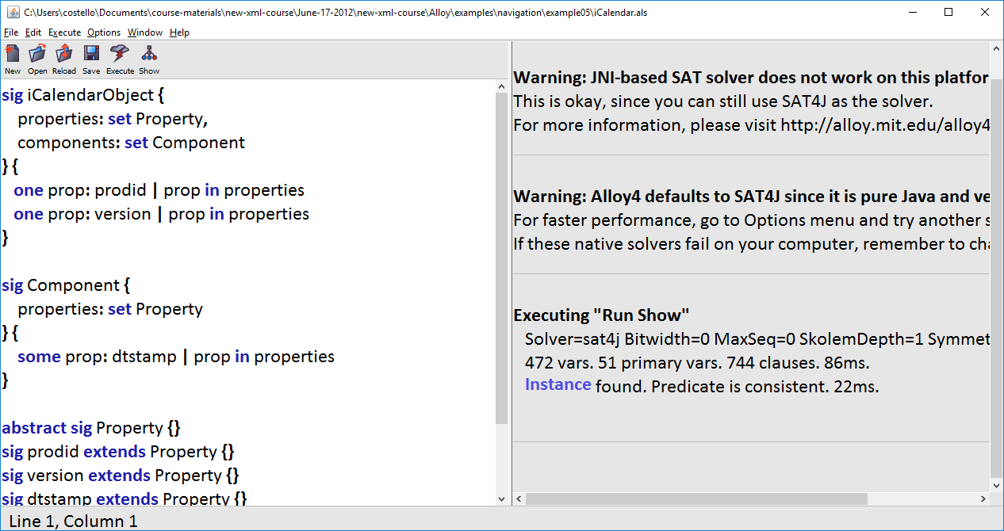
Open iCalendar.als in the example05 folder. Then select Execute >> Show. Then click on Instance.

Slide 99
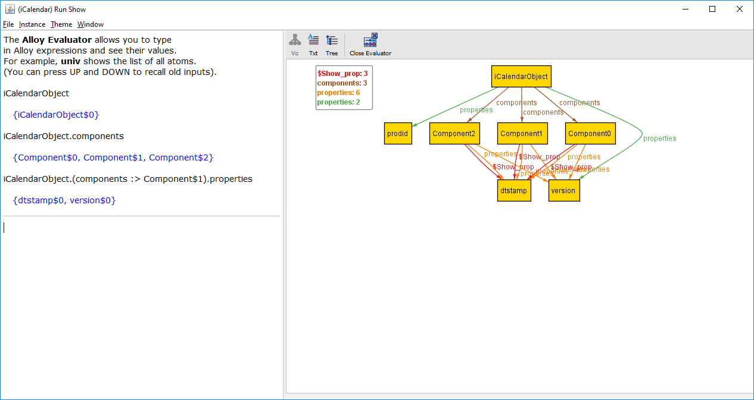

Slide 100
components
iCalendarObject$0
Component$0
iCalendarObject$0
Component$1
iCalendarObject$0
Component$2
As we learned earlier, this is a binary relation.

Slide 101
components
These are range values
iCalendarObject$0
Component$0
iCalendarObject$0
Component$1
iCalendarObject$0
Component$2

Slide 102
These are domain values
components
iCalendarObject$0
Component$0
iCalendarObject$0
Component$1
iCalendarObject$0
Component$2

Slide 103
Range restriction operator :> Domain restriction operator <:
binaryRelation :> rangeValue
Returns the pairs in binaryRelation that have a range matching rangeValue
domainValue <: binaryRelation
Returns the pairs in binaryRelation that have a domain matching domainValue

Slide 104
Navigating through Alloy relations is fun! I hope this tutorial has given you a sense for how to use the Alloy operators to navigate.
Roger L. Costello
September 21, 2017

