Slide 1
AteaLab 2.0

Slide 2
1 - Short term (0 – 3 mnd)
Hardware, Software & License refresh
Nasjonal lab
Lokal lab

Slide 3
2 - Short long term (0 – 9 mnd)
Skifte ut EoL-hardware
Etablere
Design
Dokumentasjon
Governance

Slide 4
3 - Long term (0 – 24 mnd)
Assess
As is
Hva finnes i byene rundt om
Hva skal være hvor
Hvem er ansvarlig for hva
Samle fagmiljøene
Bygge
«Shared Services layer» (NTP, DHCP, DNS, PKI, etc)
Integrert/Automatisert
POD’er for: PoV, PoC, Workshops, Training, labbing, etc
Rammeverk for innføring/bruk
Automatisert
Selvbetjeningsportal / Bookingportal

Slide 5
Regelmessig møter
Korte (30-45 min) info/diskusjons-møter

Slide 6
Cisco Live!

Slide 7
What is not?
SD-WAN og DNA Center er så mangt
Cisco CloudOps (AI, vAnalytics, DNA Spaces, etc)
Smart Licensing
Assurance
Client360 (DNAC)
Device360 (DNAC)
Application360 (DNAC)
vAnalytics (SD-WAN)
Er ikke tid til å dekke alt
Hvorfor ikke ZTP/PnP av SD-WAN og SDA-border?
Tid for å rigge...
PnP Portal
DHCP scope med option43
Day0 Template på DNAC

Slide 8
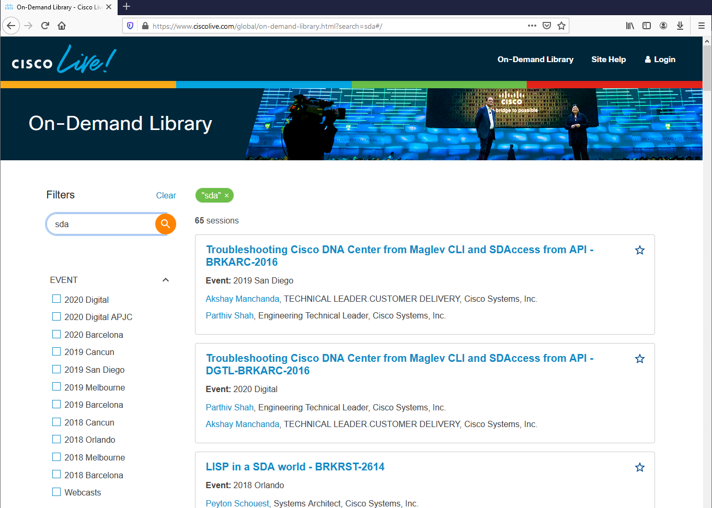
Cisco Live!

Slide 9
SD-WAN

Slide 10
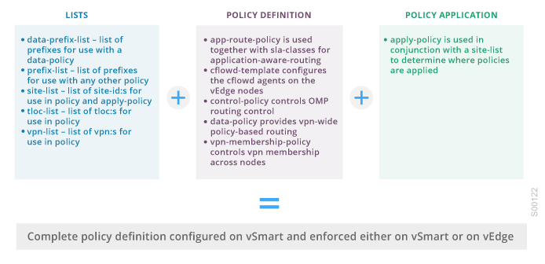
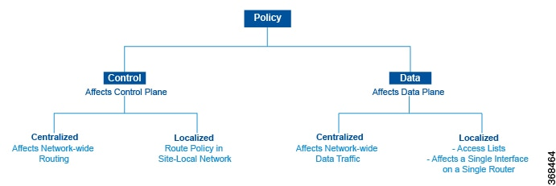
1.1 – Orchestration

Slide 11
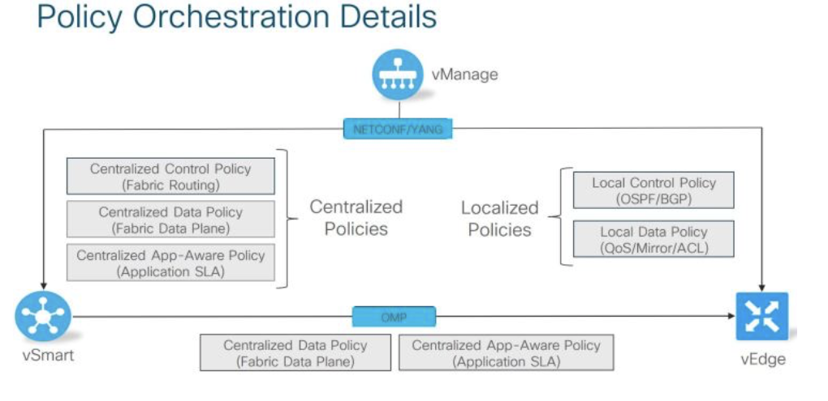
1.2 - Orchestration

Slide 12
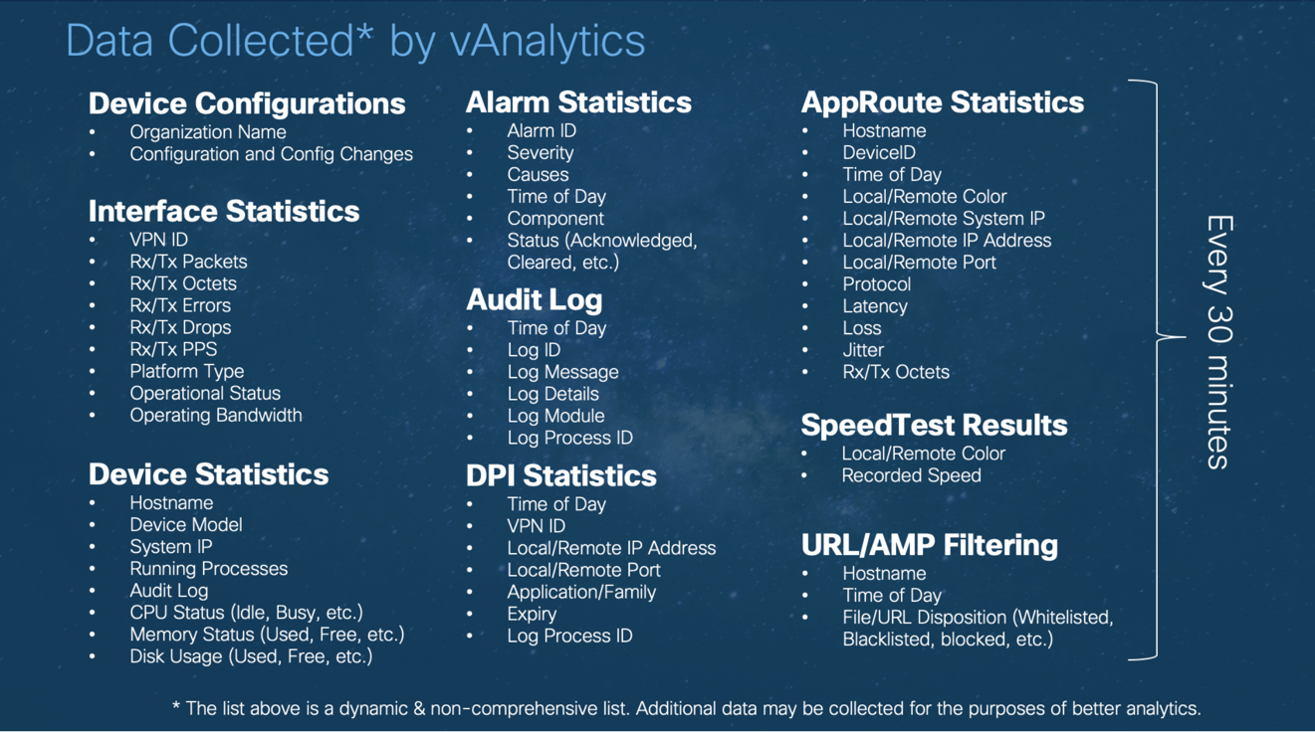
2 – Analytics

Slide 13
3 – SD-WAN vs other WAN options?
Router / Firewall based static IPSec VPN
DMVPN Phase 3
Cisco Prime, APIC-EM, FMC, CSM...

Slide 14
SDA / DNA Center

Slide 15
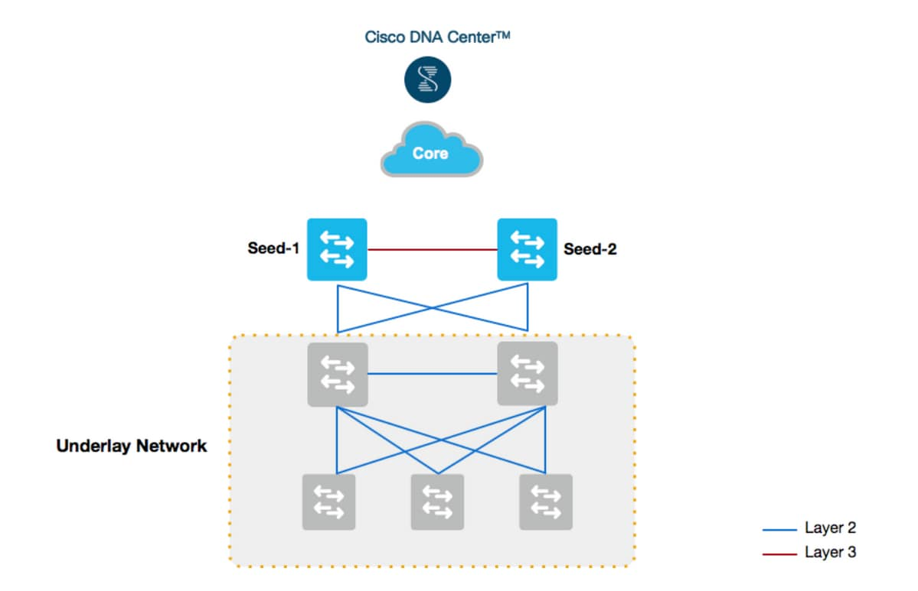
1 – LAN Automation
SDA Underlay
IS-IS
DNA Advantage (L3)
PnP / VLAN1

Slide 16
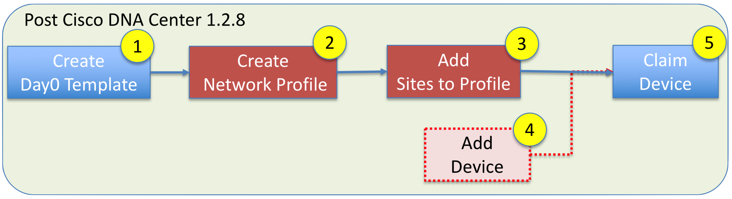
2 – PnP
Template based
Variables for IP, Hostname, etc
DNA Essentials (L2)
PnP / VLAN1
Self hosted DHCP with Option 43
Can be fusion/router/seed
Optional VLAN
pnp startup vlan x (global command on seed)
Optional PnP discovery
Plug and Play Connect
DNS / FQDN
DHCP > DNS > PnP Connect

Slide 17
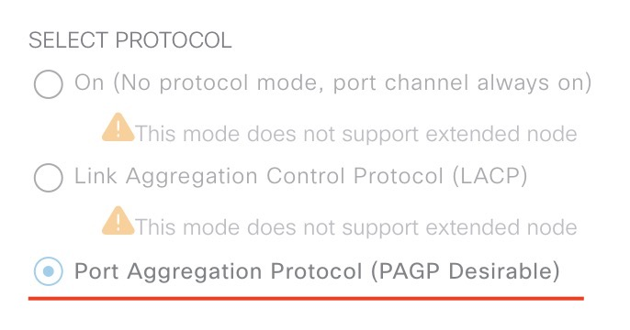
3 – PnP and PnP in SDA
Same for Extended Node and Fabric Edge Wireless Access Point;
IP-Scope (AP/Extended) in INFRA_VN
DHCP-scope with Option43
Transported in LISP/VXLAN (in fabric)
Difference
Interface for AP is set in the right VN/Scope with open auth
Interface for Extended node must be PAgP port-channel with open auth

Slide 18

WE BUILD THE FUTURE WITH IT.

