Slide 2
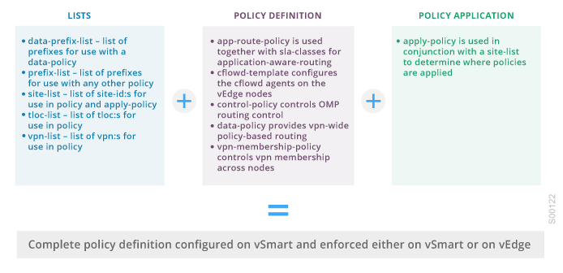
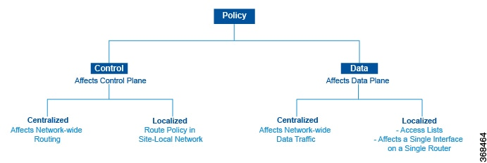
1.1 – Orchestration

Slide 3
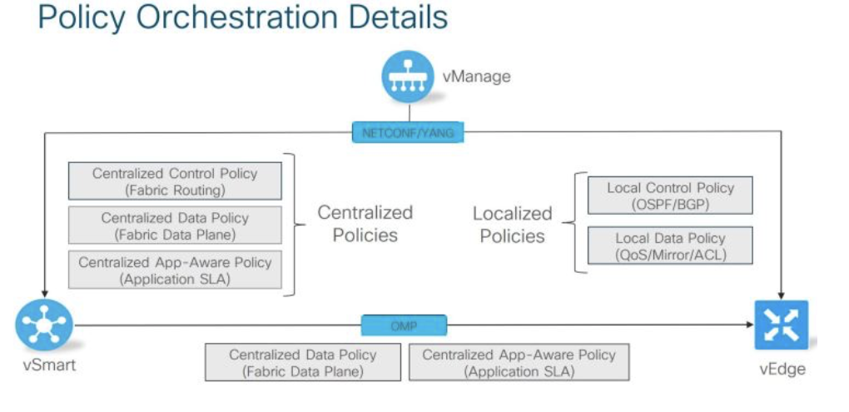
1.2 - Orchestration

Slide 4
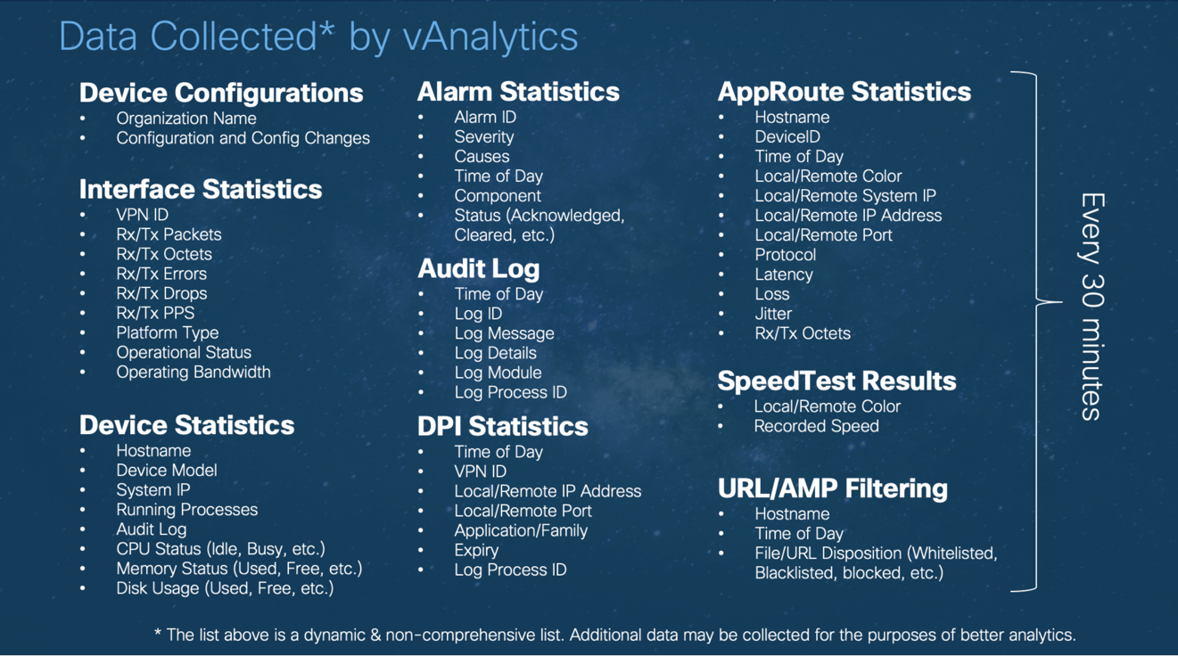
2 – Analytics

Slide 5
3 – SD-WAN vs other WAN options?
Router / Firewall based static IPSec VPN
DMVPN Phase 3
Cisco Prime, APIC-EM, FMC, CSM...

Slide 6

WE BUILD THE FUTURE WITH IT.

