Slide 2
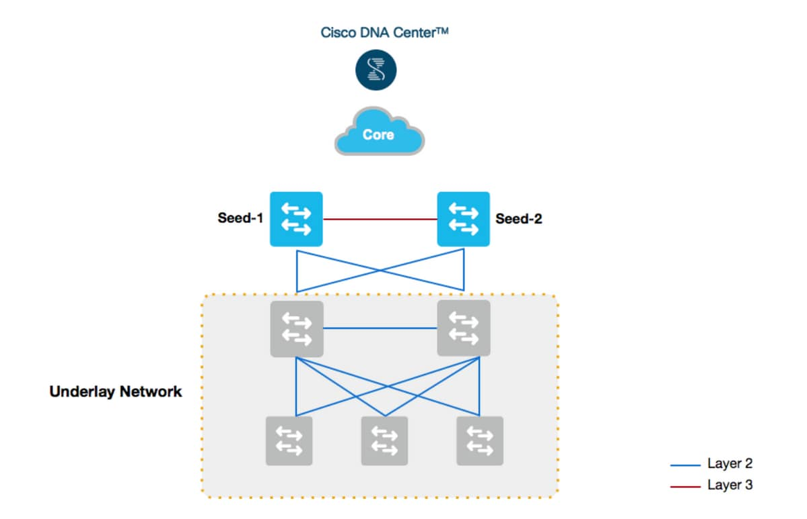
1 – LAN Automation
SDA Underlay
IS-IS
DNA Advantage (L3)
PnP / VLAN1

Slide 3
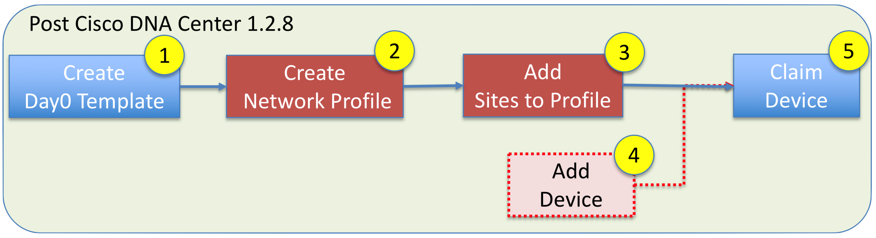
2 – PnP
Template based
Variables for IP, Hostname, etc
DNA Essentials (L2)
PnP / VLAN1
Self hosted DHCP with Option 43
Can be fusion/router/seed
Optional VLAN
pnp startup vlan x (global command on seed)
Optional PnP discovery
Plug and Play Connect
DNS / FQDN
DHCP > DNS > PnP Connect

Slide 4
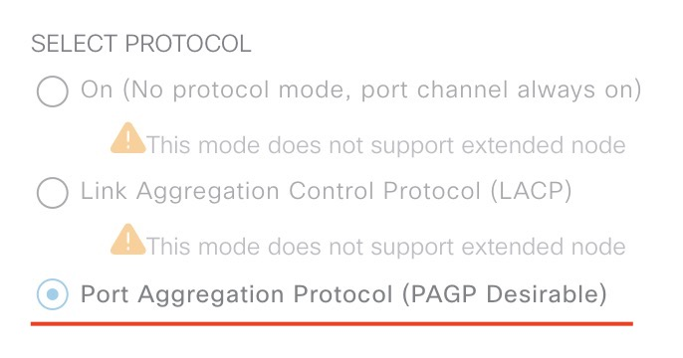
3 – PnP and PnP in SDA
Same for Extended Node and Fabric Edge Wireless Access Point;
IP-Scope (AP/Extended) in INFRA_VN
DHCP-scope with Option43
Transported in LISP/VXLAN (in fabric)
Difference
Interface for AP is set in the right VN/Scope with open auth
Interface for Extended node must be PAgP port-channel with open auth

Slide 5

WE BUILD THE FUTURE WITH IT.

