Slide 2

SDN - Historie

Slide 3
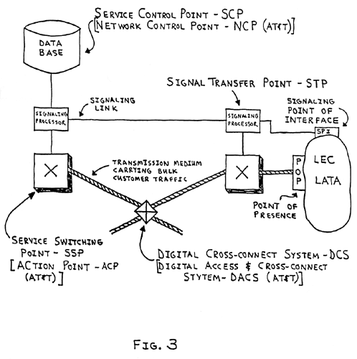
SDN - Historie
SS7 - Signalling System No. 7
PSTN - public switched telephone network
IP address = point code
DHCP = Global Title Translation
1980s = «Software Defined» (Intelligent Networking)
AT&T, Bell, etc
SCP - Service Control Points (SCP)
INAP interface (Intelligent Network Application Protocol)
The telephone switches were reduced to only hold the control and forwarding functions, while getting service intelligence from the SCP

Slide 4
5.2 SDN Controller
SDN Controller:
SDN controllers are the software used to control a software-defined network (SDN).
The controller software communicates with applications with northbound APIs.
The controller software communicates with the network infrastructure with southbound APIs.
SDN controller platforms are software modules that can be assembled to perform all of the tasks a controller must do.

Slide 5
5.1 Cisco Model Driven Programmability
OpenFlow:
OpenFlow uses an imperative SDN model, where a centralized controller sends detailed and complex instructions to the control plane of the network elements to implement a new application policy
Open vSwitch (OVS) project using the OVS Database (OVSDB) management protocol and the OpenFlow protocol
OpFlex:
OpFlex uses a declarative SDN model. The controller, sends a more abstract policy to the network elements. The controller trusts the network elements to implement the required changes using their own control planes.
E.g. Cisco Application Policy Infrastructure Controller (APIC)

Slide 6
5.1 Cisco Model Driven Programmability
NETCONF:
YANG is a IETF standardized modelling language that describes the configuration changes.
NETCONF:
IETF standardized network management protocol.
provides mechanisms to install, manipulate, and delete the configuration of network devices via remote procedure call (RPC).
The messages are encoded by using XML or JSON.
RESTCONF: In simplest terms, RESTCONF adds a REST API to NETCONF.
SNMP:
Simple Network Management Protocol (SNMP) is used to communicate management information between the network management stations and the agents in the network elements.
Vendor-specific protocols:
NX-API for the Cisco Nexus family
OnePK

Slide 7
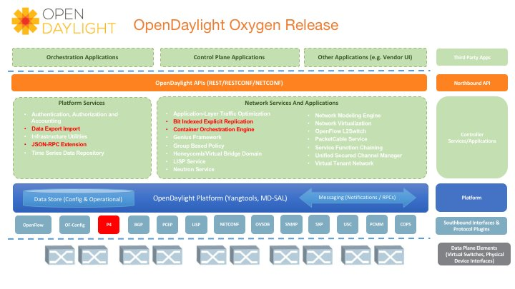
5.2 SDN controllers
POX, Ryu, Trema, Floodlight, OpenDayLight
OpenFlow
Open vSwitch (OVS) project using the OVS Database (OVSDB) management protocol and the OpenFlow protocol

Slide 8
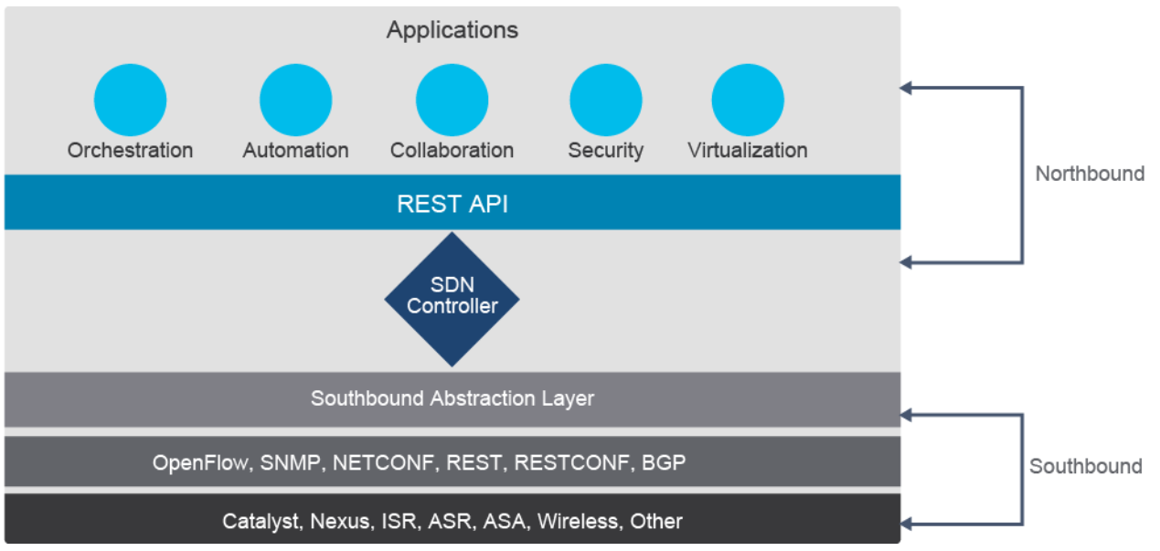
5.2 SDN = Software Defined Networking

Slide 9
5.2 SDN-planes…
Orchestration plane
assists in the automatic onboarding of devices into the overlay.
Management plane
is responsible for central configuration and monitoring.
Control plane
builds and maintains the network topology and makes decisions on where traffic flows.
Data plane
is responsible for forwarding packets based on decisions from the control plane.

Slide 10
5.2 Cisco SDN
Cisco APIC (Cisco Application Policy infrastructure Controller)
Use area : Data Center
Management plane : APIC – OpFlex/SSL
Orchestration plane : APIC
Control plane : BGP/EVPN
Data plane / Overlay : VXLAN
Underlay : IS-IS
Cisco DNA Center (Digital Network Architecture)
Use area : Enterprise Networking (LAN/WLAN)
Management plane : DNA Center - NETCONF/SSH/SNMP
Orchestration plane : DNA Center
Control plane : LISP
Data plane / Overlay : VXLAN
Underlay : IS-IS
Cisco SD-WAN (tidligere Viptela)
Use area : WAN
Management plane : vManage/vSmart - NETCONF
Orchestration plane : vBond
Control plane : DTLS / OMP (vSmart)
Data plane / Overlay : IPsec
Underlay : L3 (IPVPN, Internet, Whatever)

Slide 11
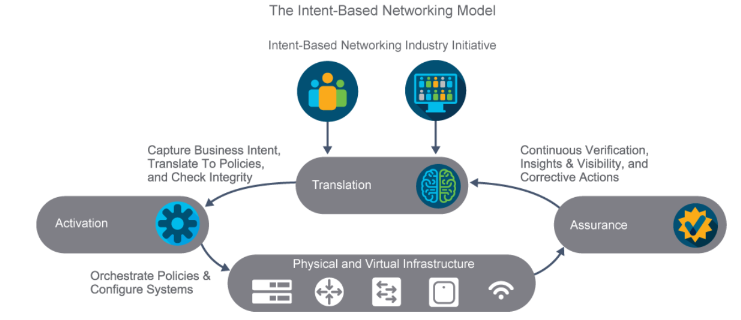
5.2 IBN = Intent Based Networking

Slide 12
5.2 IBN 3 pillars
WHAT?
The translation element enables the operator to focus on "what" they want to accomplish, and not "how" they want to accomplish it. The translation element takes the desired intent and translates it to associated network policies and security policies. Before applying these new policies, the system checks if these policies are consistent with the already deployed policies or if they will cause any inconsistencies.
DEPLOY!
Once the new policies are approved, the activation element automatically deploys the new policies across the network.
ASSURANCE…
With the assurance element, an intent-based network performs continuous verification that the network is operating as intended. Any discrepancies are identified; root-cause analysis can recommend fixes to the network operator. The operator can then "accept" the recommended fixes to be automatically applied, before another cycle of verification. Assurance does not occur at discrete times in an intent-based network. Continuous verification is essential because the state of the network is constantly changing. Continuous verification assures network performance and reliability.

Slide 13
5.2 IBN benefints…
Reduces complexity:
Management and maintenance of an IBN network becomes much simpler.
Simplifies deployment:
Additional network services deploy faster by abstracting network actions. You do not need to specify what, where, or how to configure specific devices or services; you only request the final state.
Strengthens security:
Machine-learning algorithms and artificial intelligence can learn and respond to new threats before they become an issue.
Improves agility:
Having network data in one place helps the network to quickly adapt to changes and have all services available despite failures.
Eliminates repetition:
Any repetition is prone to errors. Even by using APIs, programmers can make errors. Automation is essential to eliminating repetitive tasks and keeping manual labor to a minimum.

Slide 14
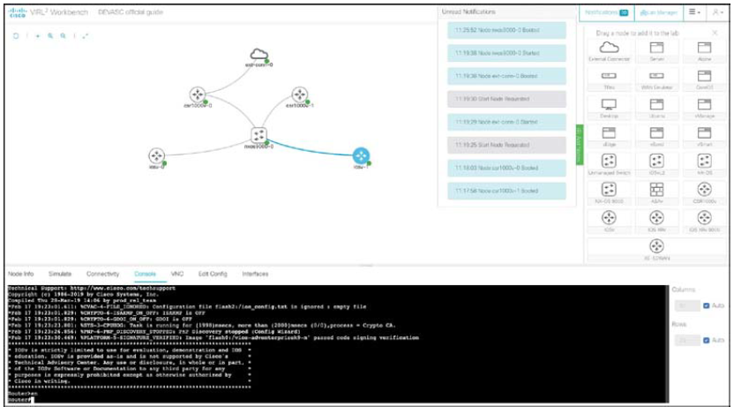
5.3 Simulation and Test tools
VIRL/CML2/GNS3
pyATS

Slide 15
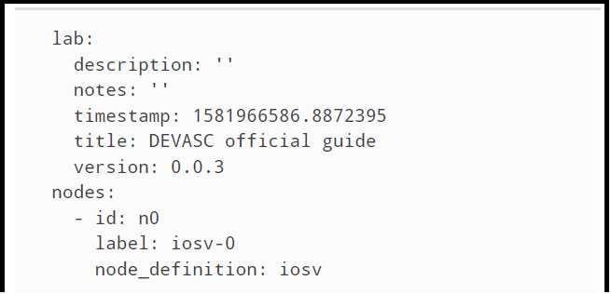
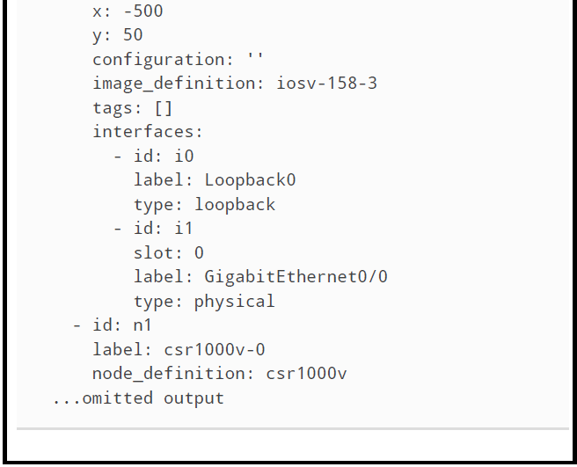
5.3 Simulation and Test tools

Slide 16
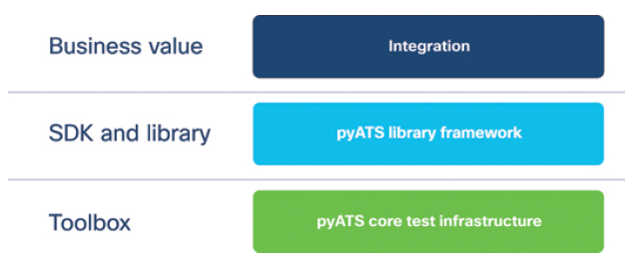
5.3 Simulation and Test tools
Python Automated Test System (pyATS)
pyATS and the pyATS library together form the Cisco test and automation solution, a vibrant ecosystem that aims to standardize how automated network tests are set up and run.
pyATS was developed by Cisco in 2014 and is used extensively internally by thousands of engineers to run unit tests, regression tests, and end-to-end and integration tests for a large number of Cisco products.
The solution is completely developed in Python3, making it easy to work with, scalable, and extensible.

Slide 17
5.3 Simulation and Test tools
Some of the most common use cases for pyATS are as follows:
Profiling the current status of a network and taking a snapshot of both the configuration status as well as the operational data of the network.
Automating configuration changes and monitoring of devices.
pyATS can be easily integrated in day-to-day DevOps activities and CI/CD automation pipelines.
Notes:
Profiling the current status of a network and taking a snapshot of both the configuration status as well as the operational data of the network:
This can be done before and after a configuration change or a software upgrade/downgrade is performed to ensure that the network still performs within desired parameters. For example, a snapshot of the network is taken with pyATS before a software upgrade is performed, and key metrics are noted, such as number of BGP sessions in the established state or the number and type of routing table entries or any other metric that is considered critical for that environment. The software upgrade is completed, and then a new pyATS snapshot is taken to ensure that those critical metrics have values within expected parameters. pyATS offers all the tooling to be able to automatically perform the network snapshots, compare key metric values, set pass/fail criteria, and even generate reports.
Automating configuration changes and monitoring of devices:
By using the Conf module within the pyATS library, configuration changes can be performed in a uniform fashion across different devices from different vendors. Together with the profiling capabilities, pyATS offers a full set of capabilities for infrastructure automation, including creating a snapshot of the network pre-change, performing the changes, taking another snapshot post-change, and continuously monitoring for any performance outliers.

Slide 18
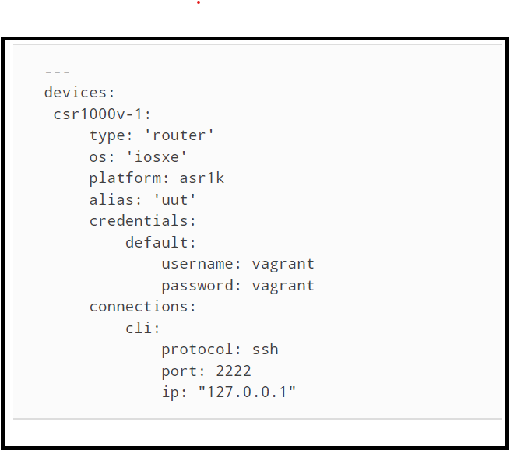
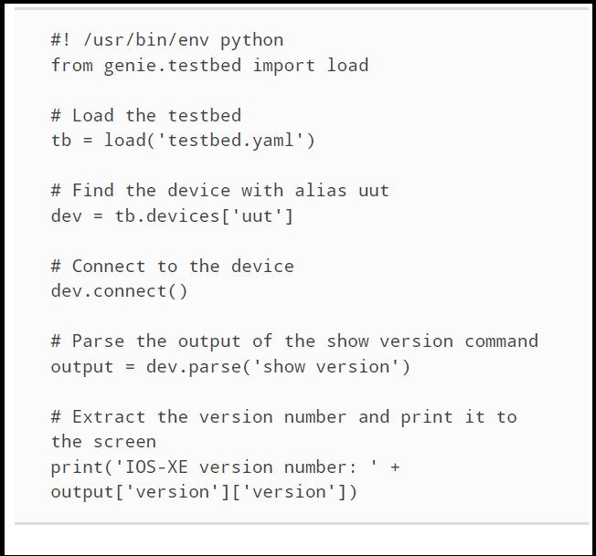
5.3 Simulation and Test tools
* pyATS Testbed File * pyATS Test

Slide 19
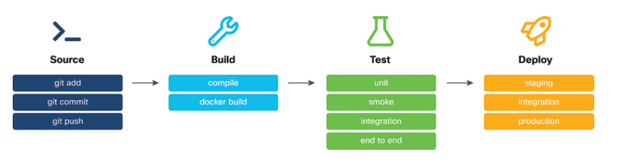
5.4 CI/CD in infrastructure automation
continuous integration/continuous delivery (CI/CD) pipeline
Is a series of automated steps that code goes through from the IDE of an individual developer, through building, testing, and finally deployment to staging and production environments.
An environment with an automatic software development and deployment pipeline.
Notes:
* Github.com as a cloud-based version control system or Gogs as a selfhosted Git option could be used to store the configurations.
* Travis CI as a cloud-based build server or Drone as a self-hosted build server could be used to orchestrate the whole CI/CD pipeline.
* Cisco CML/VIRL could be used to create a test network and verify the impact of the configuration changes in the network.
* Ansible could be used to automate the configuration of all the elements in the network.

Slide 20
5.5 IaC - Infrastructure as code
IaC Benefits
Capturing your actions "as code" allows you to capture the result or desired state configuration.
The declarative model allows you to focus on the state instead of which actions are needed to get there.
Life-cycle management helps you with evolution of your code from concept to creation to collaboration and use.

Slide 21
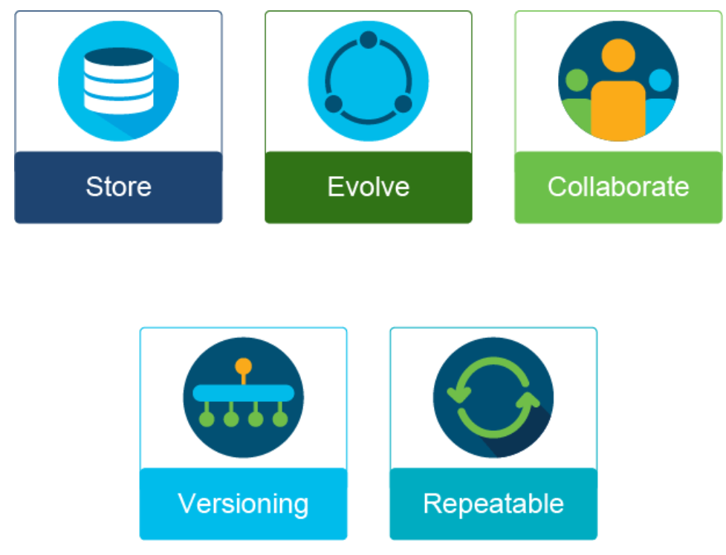
5.5 IaC - Infrastructure as code
Store your code in a repository for safekeeping as a backup of your network configuration.
Evolve as your needs change or your network grows, because you are able to update and add to your code to meet these changes.
Collaborate with others in your team and around the world as you work toward that final desired state.
Versioning allows the developers within your team to create a copy of the existing repository or an entirely new "fork."
Repeatable; once perfected, this code is your product that can be repeated wherever and whenever needed.

Slide 22
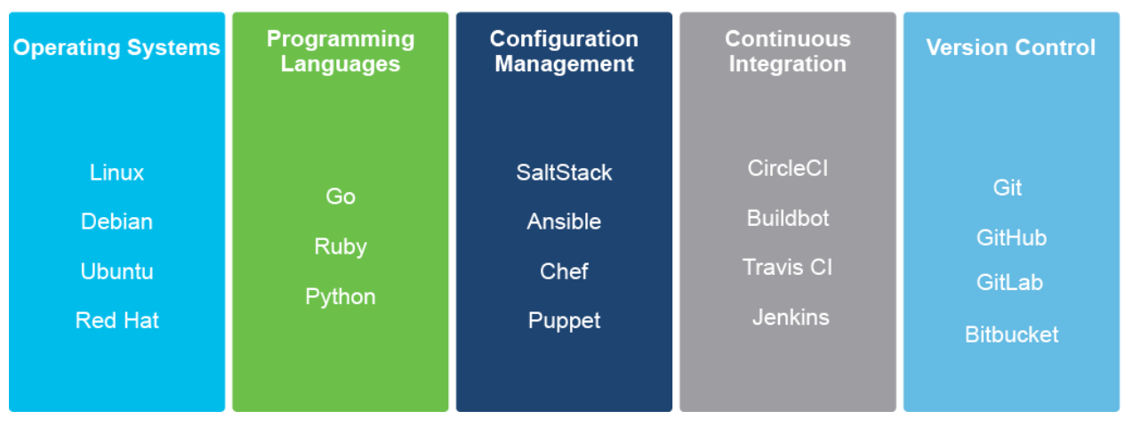
5.5 IaC - tools

Slide 23
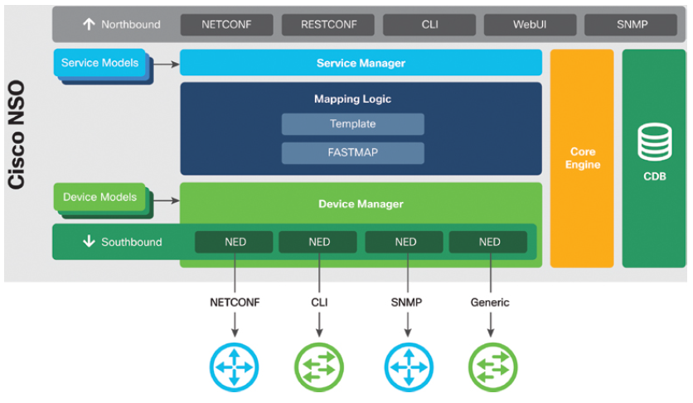
5.6 Tools
Ansible
Agent-less
Can run from anywhere (your laptop)
Written in Python
Like Python – has modules to be installed
Puppet
Agent based
Chef
Agent based
Cisco NSO
Agent-less
Multivendor
NETCONF/YANG

Slide 24

WE BUILD THE FUTURE WITH IT.

