Slide 1

ALARM CLOCK MOBILE APPLICATION
Submitted by-
Ateek Narang

Slide 2
INTRODUCTION TO ALARM CLOCK
MAIN SCREEN DISPLAYING FEATURES OF APPLICATION
SMS ALARM- User are allowed to send SMS to contacts by setting up Alarm.
SHAKE ALARM-Alarm can be set off with a simple SHAKE.
PUZZLE ALARM-Alarm can be set off by solving a puzzle.
ALARM TONE-User can set tone of his/her choice.
SETTINGS-Allows user to set Text and Time to SEND SMS

Slide 3
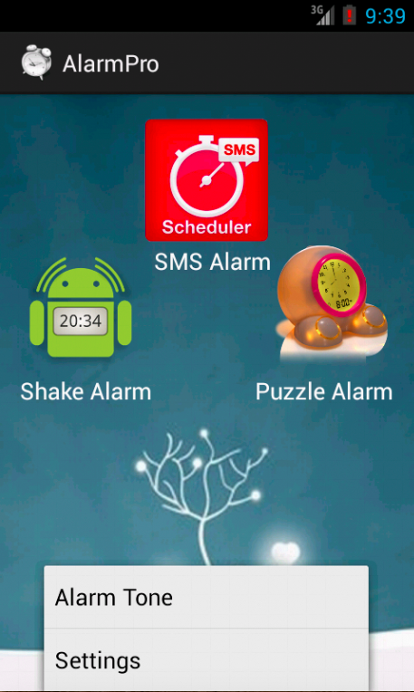

Slide 4
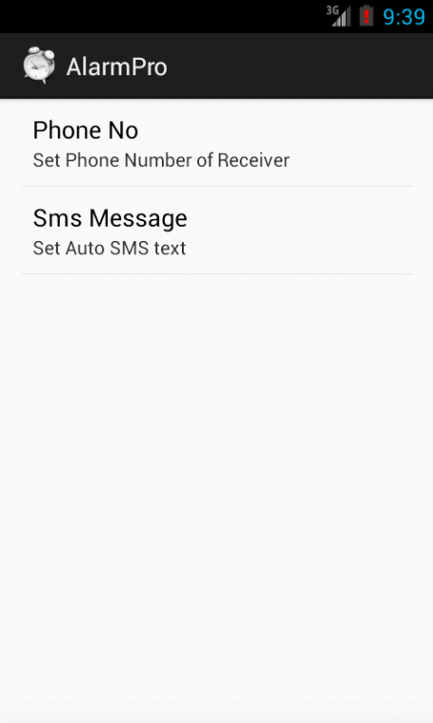
SMS ALARM

Slide 5
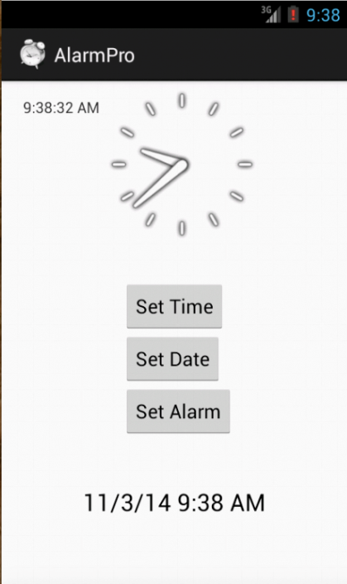
INTERFACE TO SET DATE AND TIME FOR ALARM

Slide 6
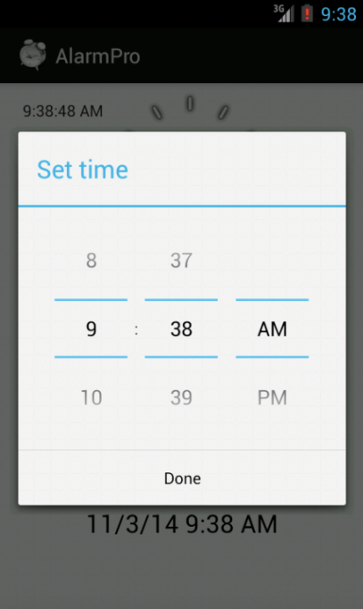
INTERFACE OF SET TIME DISPLAY

Slide 7
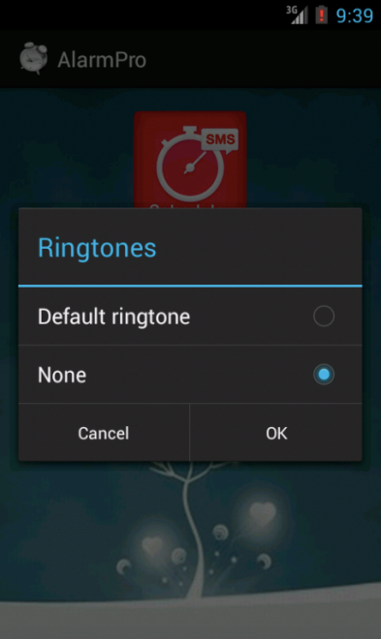
SETTING ALARM TONE

Slide 8
THANK
YOU

