Slide 1
Life Expectancy Prediction using IBM Watsonx.ai
Team Member:
Ateendra Pratap Solanki

Slide 2
Introduction
This project utilizes IBM Watson Studio's AutoAI capabilities to analyze a global Life Expectancy dataset.
The objective is to automatically preprocess the data, select relevant features, train multiple machine learning models, and identify the best-performing pipeline for predicting life expectancy.
AutoAI streamlines the process by handling data cleaning, algorithm selection, and hyperparameter optimization.
The final model is evaluated for accuracy and deployed as a REST API for real-time predictions.

Slide 3

Problem Statement
Manual estimation of life expectancy is complex and error-prone.
Predicting life expectancy accurately is complex due to the involvement of diverse and interdependent features like GDP, education, immunization, and health expenditure.
The goal is to leverage AI to find meaningful patterns in the data and predict life expectancy reliably for different countries and years.

Slide 4
Objectives
Build a machine learning model to predict life expectancy.
Use IBM Watsonx.ai Studio for model training and deployment.
Analyze feature importance and model accuracy.
Create a simple frontend webpage for public interaction and testing.

Slide 5

Technology Stack
IBM Watsonx.ai Studio – Model training, evaluation, and deployment.
AutoAI – Automated model selection and hyperparameter tuning.
Watson Machine Learning API – For scoring deployed models.
Next.js (React) – Frontend for user interaction with the model.

Slide 6
System Architecture
Dataset upload
AutoAI in Watsonx.ai
Train-Test Split + Model Training
AutoAI selects best model
Model Deployment via Watson Machine Learning
API Call Integration in Web App

Slide 7
Modules / Features
IBM Watsonx.ai Studio:
AutoAI experiment creation
Model training and leaderboard
Model deployment as REST API

Slide 8
Dataset Used
Name: Life Expectancy Data
Source: WHO & United Nations data (via Kaggle)
Features: Country, Year Status (Developing/Developed) Adult Mortality, GDP, Schooling Immunization %, Alcohol use, BMI And many more (~20 features)
Target: Life Expectancy (in years)

Slide 9
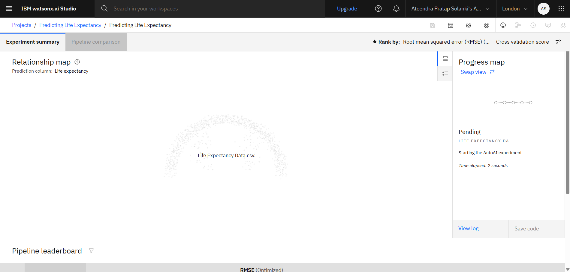
Implementation Screenshots

Slide 10
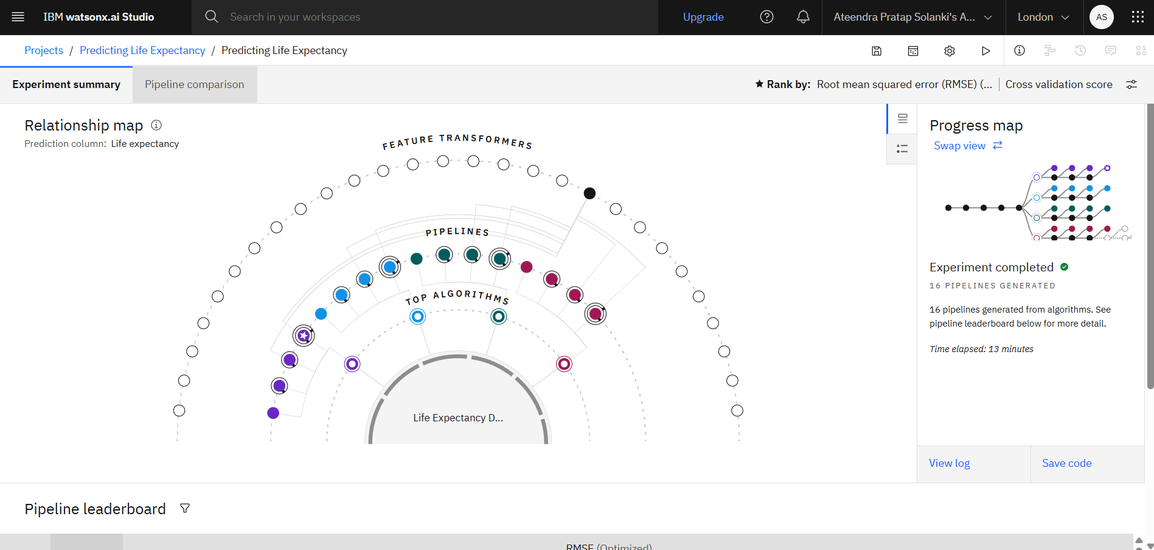
Implementation Screenshots

Slide 11
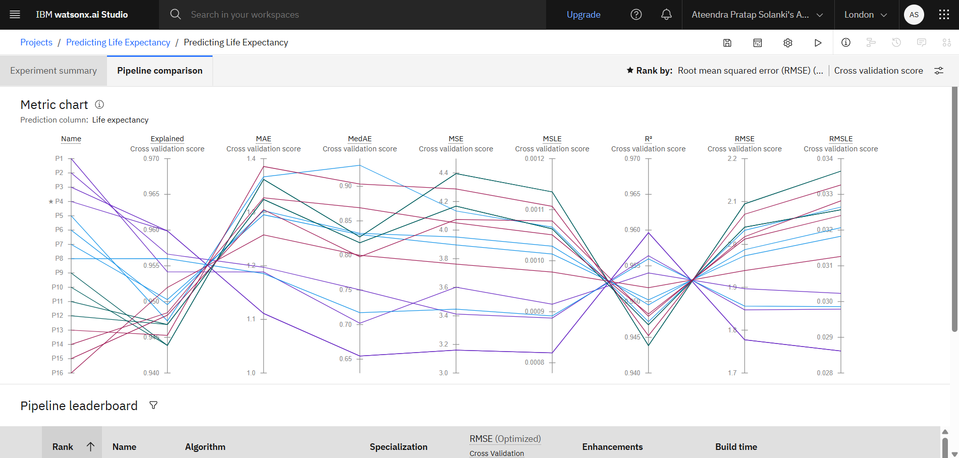
Implementation Screenshots

Slide 12
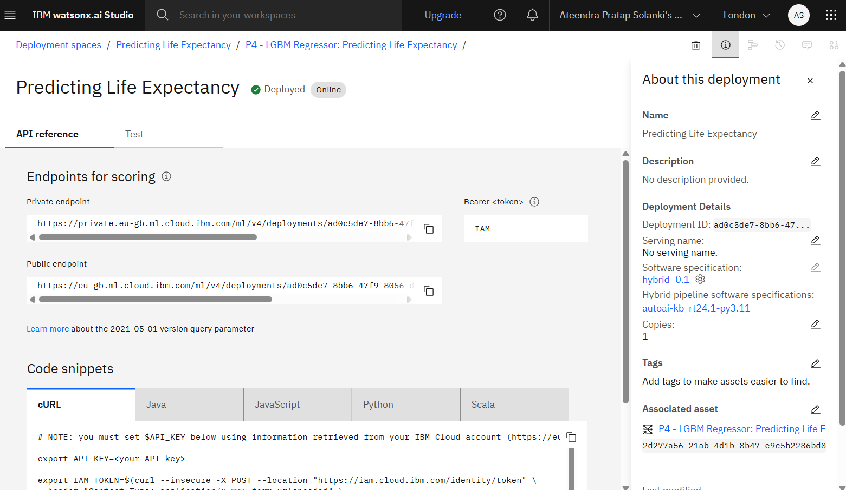
Implementation Screenshots

Slide 13
Challenges Faced
Data Preprocessing: Needed feature encoding (Status), normalization, and missing value handling.
API Authentication: Required obtaining access token via https://iam.cloud.ibm.com/identity/token.
Data Preprocessing: Needed feature encoding (Status), normalization, and missing value handling.

Slide 14
Conclusion & Future Work
Conclusion:
- IBM Watsonx.ai Studio enables rapid and powerful AI model development.
- Our model predicts life expectancy with high accuracy and is accessible via a clean, responsive web interface.
Future Work:
- Add multi-country batch prediction.
- Visualize country-wise trends.
- Expand to regional or disease-specific life expectancy analysis.
- Integrate model update capability from new datasets.

Slide 15
Thank you
By: Ateendra Pratap Solanki github.com/ateendra24

