Slide 1
Project-4 Feature Extraction and Price Prediction for Mobile Phones
By Mohammed Ateeq

Slide 2
Project Scenario:
To build a predictive model that can accurately estimate the price of a mobile phone based on its features.

Slide 3
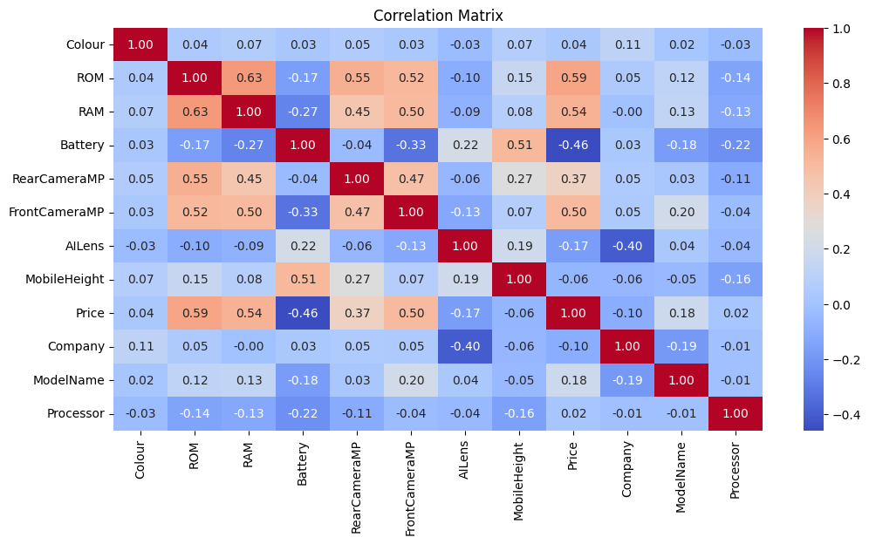
Data Exploration and Visualizations: Correlation Heat map and other plots to visualize the relationships between variables.
Positive correlation seen in Rom, Ram, Rear Camera, Front Camera, Price with each other.
And Battery and Mobile Height also seen positive correlation.

Slide 4
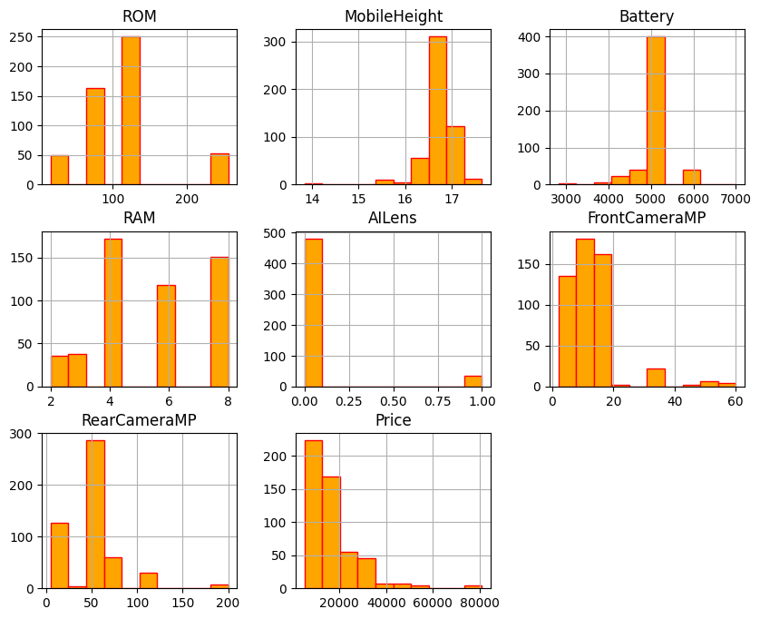
Distribution of Numeric Features:
Rom: Most phone have a Rom 64 and 128 GB.
Mobile Height: Distribution concentrated around 16 to 17 inch.
Battery: Majority having 5000 mah battery.
RAM: Most phone Fall in 4 to 8 GB of RAM.
Front Cam: Mostly concentrated within 16MP.
Rear Cam: Mostly have 50MP cam.
Price: Price have right skewed indicating most phone have lower price point and some phone have higher price point.

Slide 5
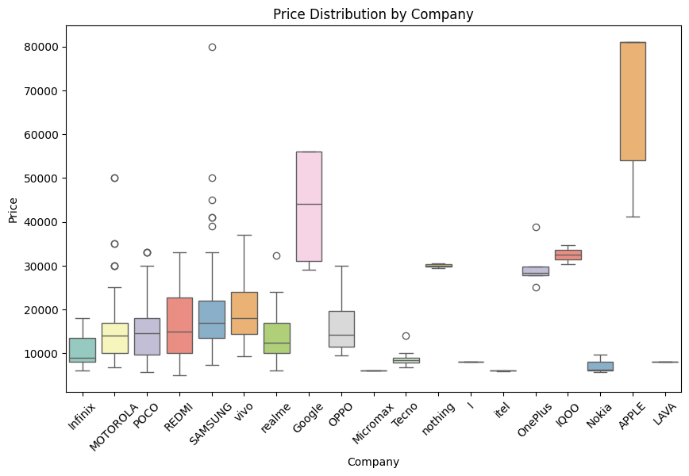
Price Distribution by Company:
APPLE typically has a higher median price and a larger IQR, implying a wider range of prices for their devices.
SAMSUNG also has a relatively higher median price and a considerable IQR, although not as high as APPLE.
Companies like vivo, OPPO, REDMI, and realme offer models across a lower price range.
Some brands with narrow boxes and outliers, like Infinix and Motorola, offer budget-friendly options along with some high-end models.

Slide 6
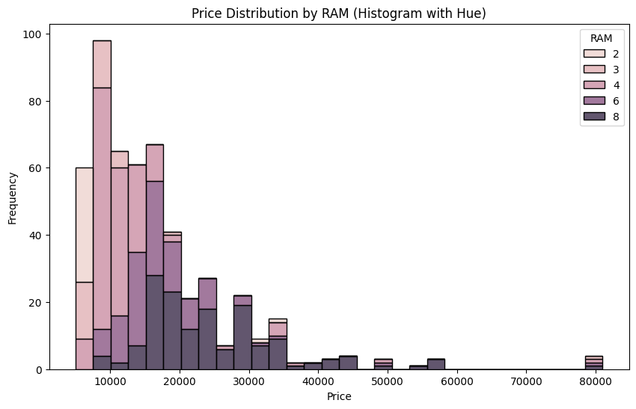
Price Distribution By Ram:
Interpretation
The histogram shows the distribution of phone prices across different RAM sizes.
It indicates that higher RAM sizes tend to be associated with higher prices.
This suggests that phones with more RAM are generally more expensive, likely due to their increased performance and capabilities.

Slide 7
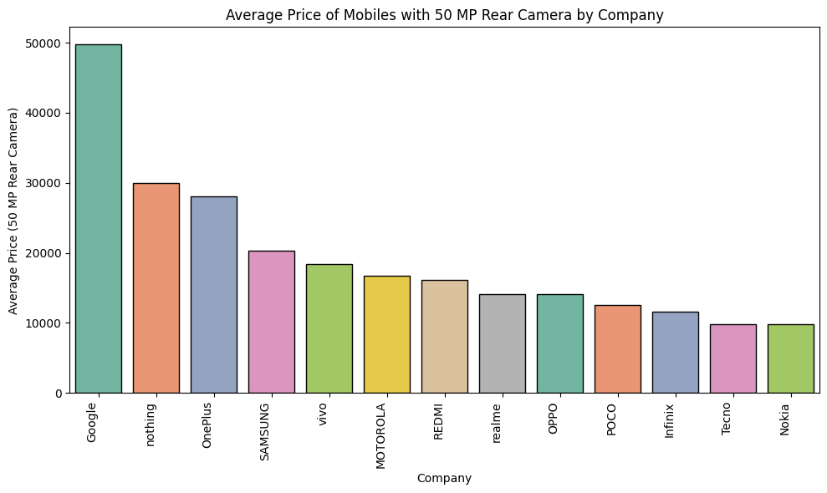
Average Price of Mobiles with 50 MP Rear Camera by Company:
Key Observations:
**Companies like Google, Nothing, and OnePlus** demonstrate higher average prices for 50MP rear camera phones.
**Companies like vivo, SAMSUNG, MOTOROLA** have moderately priced options for 50MP camera devices.
**Some brands like realme, OPPO, POCO** fall in a lower price bracket for models with 50MP rear cameras, potentially indicating more budget-friendly options.

Slide 8
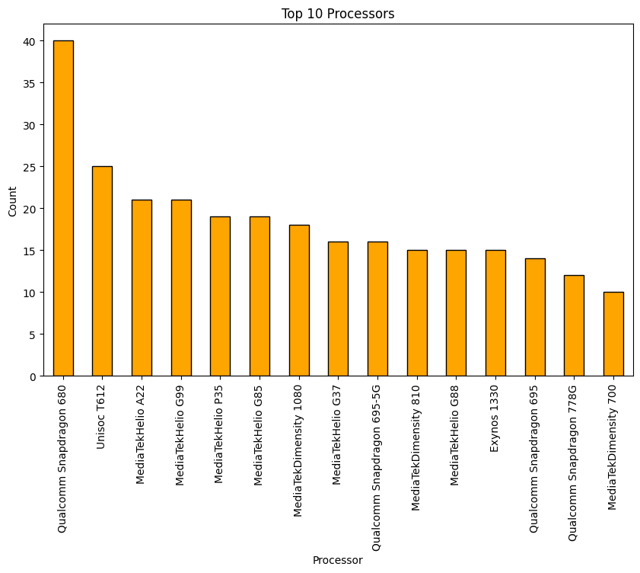
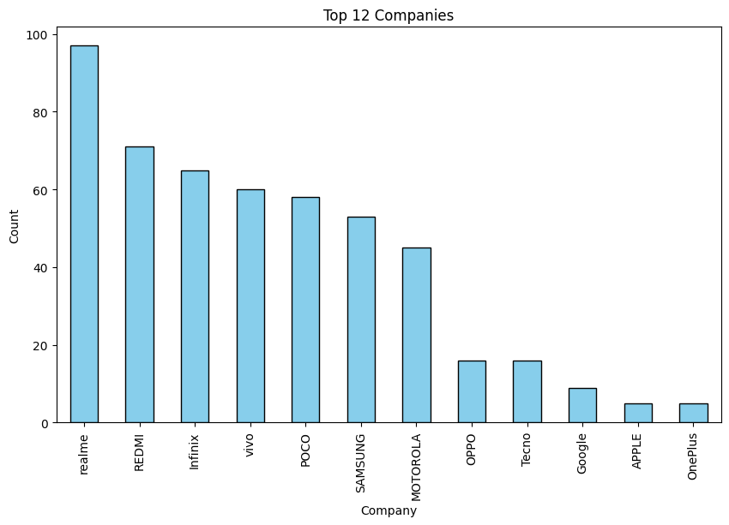
Top 10 Processor In DataFrame in terms of count:
Top 12 Companies In DataFrame in terms of mobile counts:
Most of the mobile phone companies are used these Top 10 processor for their mid range mobile phones segment.
Realme, REDMI, Infinix, vivo, POCO, Samsung and Motorola have the number of models available in the market as compare to others.

Slide 9
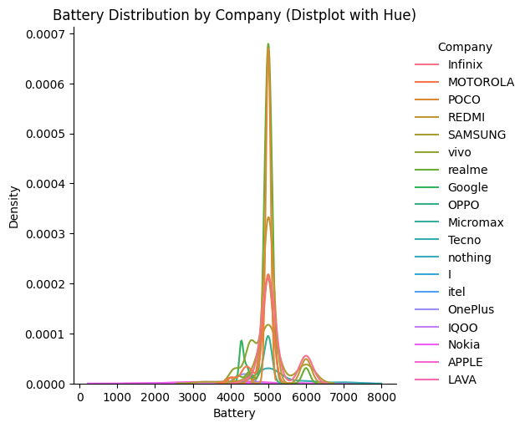
Battery Distribution by Company:
Plot suggest that most of the company offering 5000 mah batteries, and some offer 6000 mah.

Slide 10
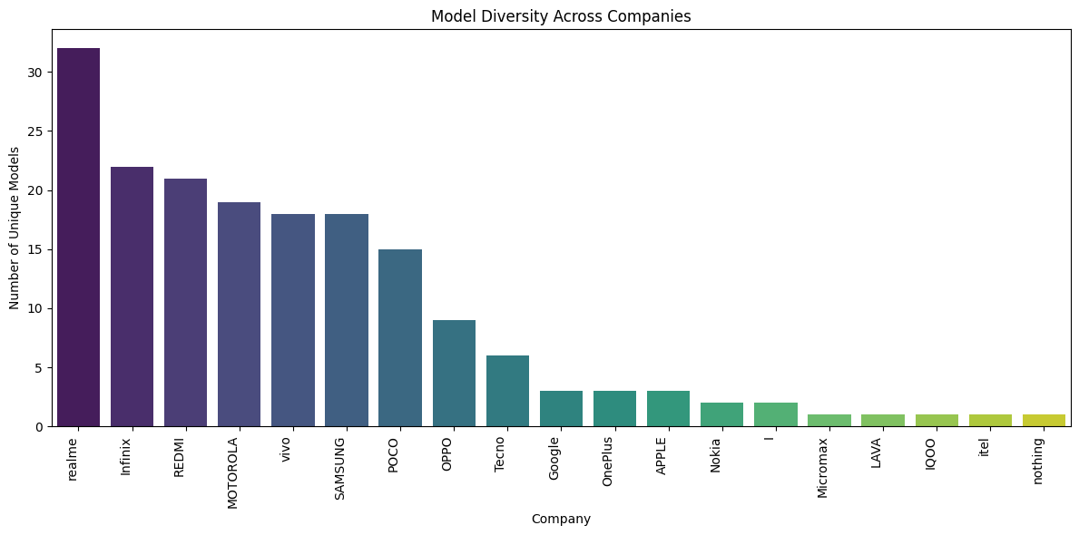
Model Diversity Across Companies:
Companies like realme, REDMI, SAMSUNG, and OPPO, Motorola, vivo, POCO shows significant model diversity, indicating a wide range of offerings targeting different market segments and preferences.
On the other hand, several companies have only a few unique models, potentially specializing in specific phone categories or having a limited product portfolio or a Premium category.
High model diversity suggests an aggressive market strategy to cater to a broader audience.
Companies with high model diversity may be more likely to innovate and introduce new features or designs to maintain market share and compete with rivals.
Model diversity benefits customers by offering more choices and options, especially when it comes to features, price points, and design preferences.

Slide 11
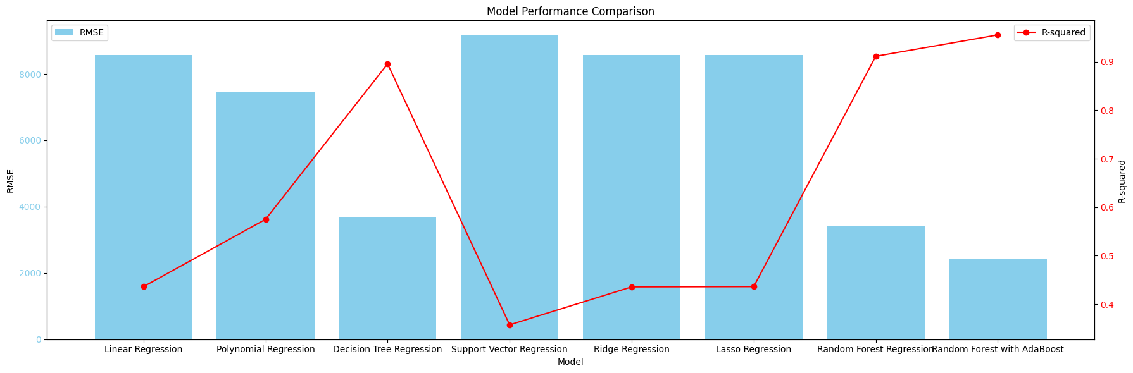
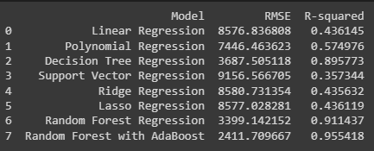
Model Building and Performance:

Slide 12
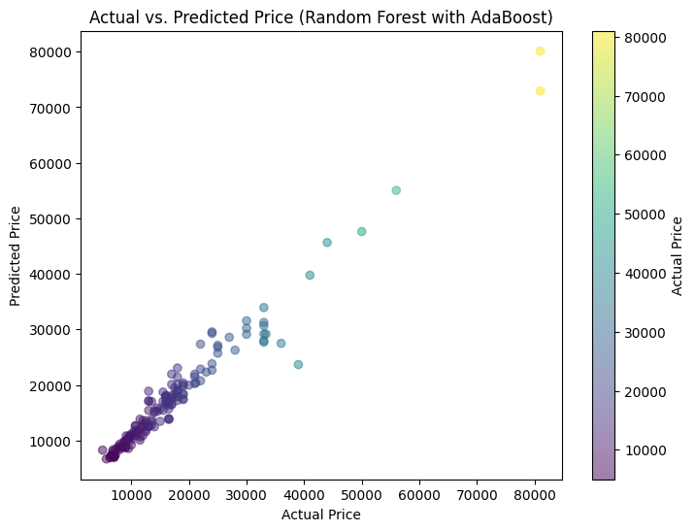
Actual Price v Predicted Price:

Slide 13
Final Conclusions:
Insights Based on the analysis and model building, we can draw the following conclusions:
Insights:
RAM and ROM are key factors impacting the price. Phones with higher RAM and ROM are generally more expensive.
Processor type influences price. Models with high-end processors tend to have a higher average price.
Company and model name significantly contribute to the price variation. Certain companies and models are associated with higher average prices.
Battery and Mobile Height have a lesser impact on price but some models with larger batteries are slightly more expensive.
The models with AILens = 1 are expensive than models with AILens = 0.
The most used processors are Octa-core and Quad-core which are less expensive than others.
Key Observations of Processor:
Snapdragon 8 Gen 2, 8+ Gen 1, 8 Gen 1** exhibit a higher average price, suggesting they are incorporated into more premium devices.
Snapdragon 888Plus, 865, 888, 7+Gen2** have a relatively moderate average price.
Processors like Snapdragon 439, 720G, 680, 685, 750G** are positioned at the lower end of the price spectrum.
MediaTek Dimensity 8200** also holds a high average price point, indicating that it's likely a powerful processor for this camera configuration.
Other processors like Snapdragon 8Gen1, Exynos 1380, and Dimensity 8100** demonstrate a similar trend.
Processors lower down on the list** might represent more budget-friendly or less powerful options.
we observe that Unisoc Processor is budget friendly Processor and we see mostly Unisoc T616, T700, T612 are used by Mobile Company.

Slide 14
Learning Outcomes:
From this project, we have learned how to:
Load and preprocess data** from a CSV file.
Explore and visualize data** using correlation heat maps and other plots.
Perform feature selection** to identify the most influential variables for predicting the mobile phone price.
Apply dimensionality reduction techniques** such as PCA to reduce the number of features and enhance model efficiency.
Develop and train various regression models** including Linear Regression, Polynomial Regression, Decision Tree Regression, Support Vector Regression, Ridge Regression, Lasso Regression, and Random Forest Regression.
Employ ensemble methods** such as AdaBoost to enhance the predictive capabilities of the models.
Evaluate and compare model performance** based on metrics like RMSE and R-squared.
Interpret and visualize model results** to understand how features influence price prediction.
Draw insights and recommendations** from the analysis that can be used to inform business decisions in relation to mobile phone pricing and product development.
Gain insights into** the correlation between various features and the price of mobile phones.
Utilize** Machine learning techniques to predict the prices of mobile phones with a higher degree of accuracy.
Develop** regression models to anticipate the prices of mobile phones.
Improve the predictive capabilities** of regression models through the usage of ensemble methods.
Understand the significance** of different aspects that contribute to the price of mobile phones.
Formulate informed choices** in relation to pricing and product development.

