Slide 1
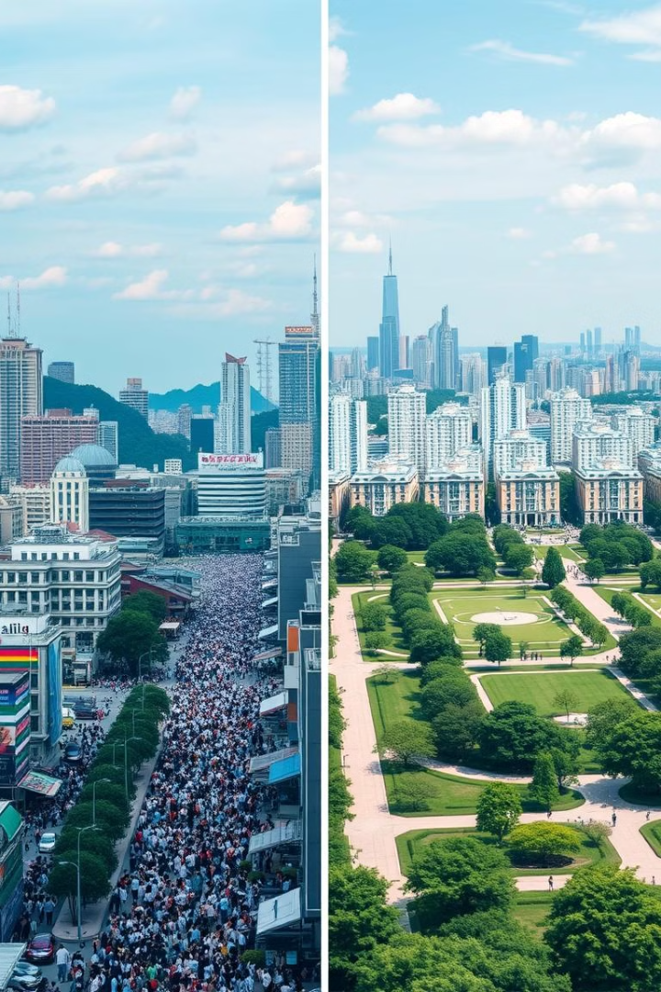
A Tale of Two Cities: AndroidOS vs. MacOS
Understanding Operating Systems Through an Urban Analogy
Ateeq Ur Rehman
221475

Slide 2

AndroidOS – The Open-Market City
Vendor Variety
Rapid Adaptation
Market Diversity
Apps set up shops freely with dynamic
rules
Innovation and change constantly
happening
Open-source nature allows for
customization

Slide 3
MacOS – The Gated Community
Strict Entry Rules
Seamless Ecosystem
Controlled Environment
App vetting for security, high standards
Uniformity and organization for ease
of use
Emphasis on stability and user trust

Slide 4
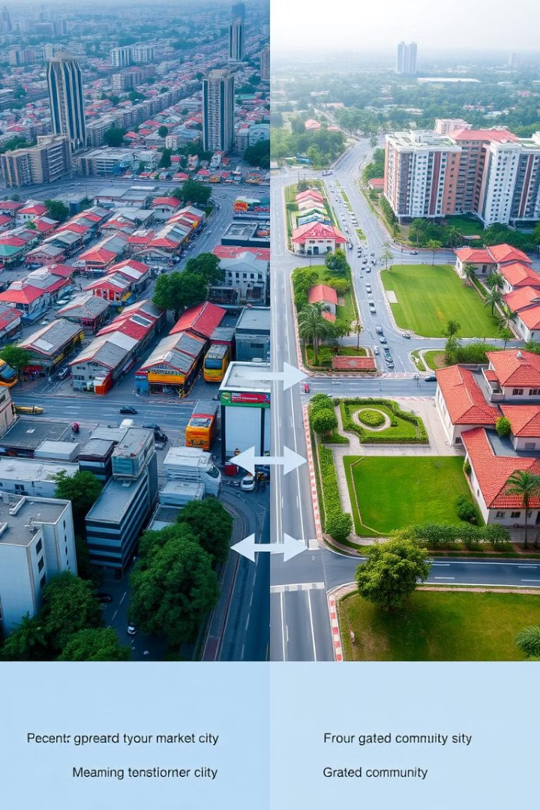
Side-by-Side Comparison
Flexibility
Control
Open-source AndroidOS
Curated MacOS experience
Wide Compatibility
Curated Experience
AndroidOS supports a wide range of devices
MacOS focuses on Apple products

Slide 5
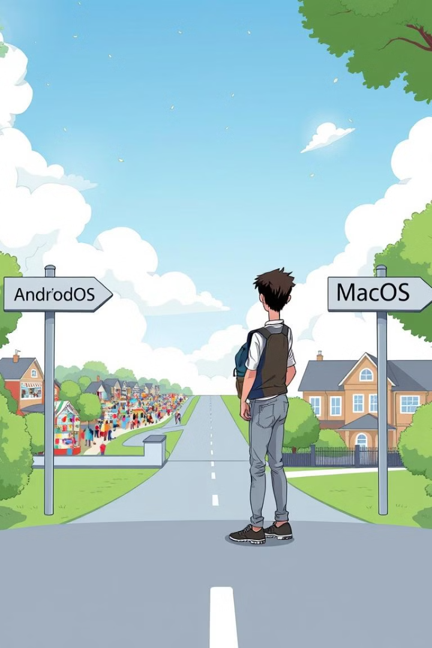
Choosing Your City
AndroidOS or MacOS: which OS fits your priorities?

