Slide 1
Moisture Minds
PARSEC: A Paradigm Shift, IIT Dharwad
Soil Moisture Prediction
TEAM - KLESAGA
Team Members
Akhilesh G
Ateeth K J
Gururaj Hegade
Satwik Kulkarni

Slide 2

Introduction
Soil moisture is the amount of water present in the soil and is critical for plant growth, crop production, and soil health.
The amount of soil moisture is influenced by various factors including rainfall, temperature, humidity, wind, soil type, vegetation cover, and topography.
Soil moisture is essential for the germination of seeds, nutrient uptake, and plant growth.

Slide 3
Objectives
Collect soil moisture, temperature, and humidity data for a specific location for adequate time period.
Develop a machine learning model that can predict soil moisture levels based on the collected data.
Validate the model’s performance using a separate dataset.
Analyze the accuracy and efficiency of the model and compare it to other prediction models.

Slide 4
Problem Statement
To predict soil moisture level at specific location based on temperature and humidity values. The challenge is to develop an accurate and efficient ML model that can handle complexity of the data and produce reliable predictions.

Slide 5
Dataset Description
The soil moisture predicting dataset is a collection of data points that provide information about various environmental factors and soil moisture levels. It is typically used to build models that can predict soil moisture levels based on the input variables. Here is a possible description of the dataset:
pm - Particulate matter (1,2,3 is categorised into different sizes)
am - Atmospheric moisture
sm - Soil moisture
st - Soil temperature
lum - Luminosity
temp - Temperature
humd - Humidity
pres - Pressure

Slide 6
Data Pre-processing
Data preprocessing is a critical step in preparing a dataset for analysis and modeling. Here are some steps we have taken for preprocessing soil moisture dataset:
Data cleaning
Feature selection
Handling outliers
Splitting into training and testing sets

Slide 7
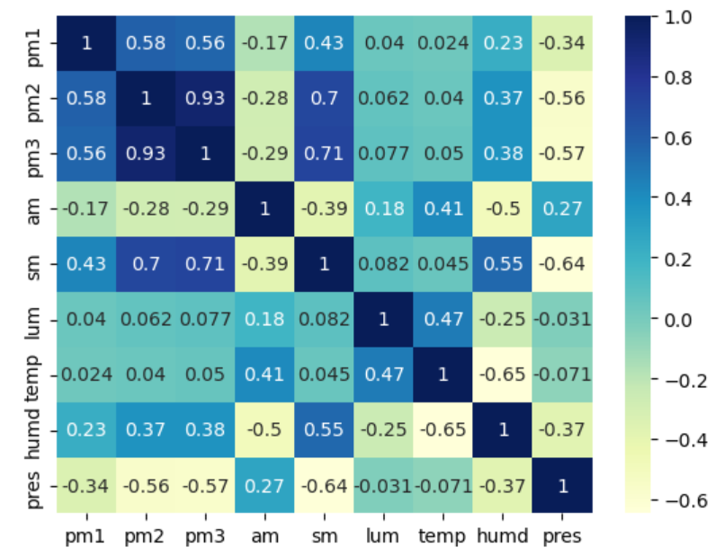
Heatmap describing the relationship between various attributes

Slide 8
DESCRIPTION OF THE MODELS USED
Multiple linear Regression
Multiple linear regression is a statistical method used to analyze the relationship between a dependent variable and two or more independent variables. It is an extension of simple linear regression, which only considers the relationship between a dependent variable and a single independent variable.
y = b0 + b1x1 + b2x2 + ... + bnxn + e
2. Polynomial Regression
Polynomial linear regression is a variant of linear regression in which the relationship between the dependent variable and the independent variable(s) is modeled as an nth-degree polynomial function. It is used when the relationship between the variables is not linear and cannot be captured by a straight line.
y = b0 + b1^x + b2x^2 + ... + bnx^n + e

Slide 9
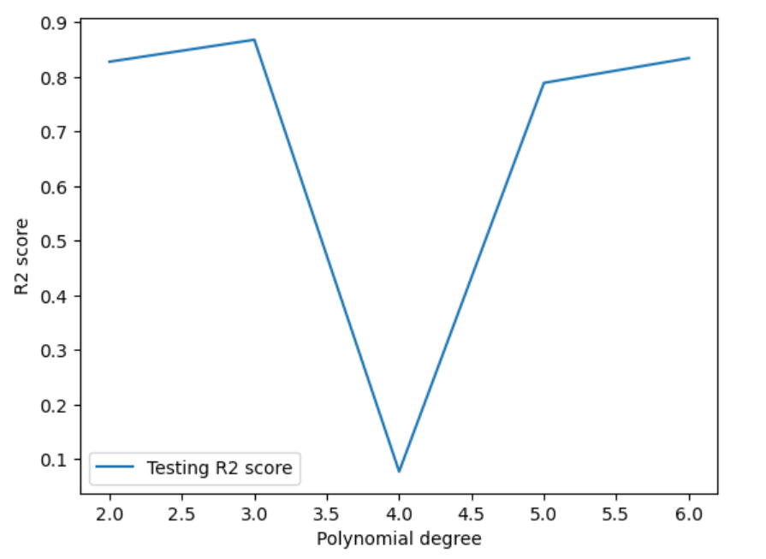
Line Chart showing a variance of accuracy with respect to change in degree polynomial

Slide 10
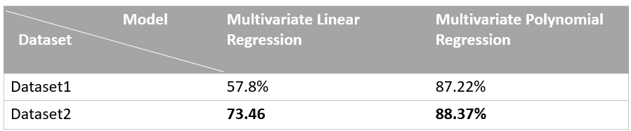
Results
Based on our analysis of the provided data, it has been observed that the Multivariate Polynomial Regression model outperforms the Multivariate Linear Regression model. The Multivariate Polynomial Regression model has achieved an accuracy of 88.37%, which indicates that it can better predict the dependent variable compared to the Multivariate Linear Regression model. We can observe the results in the below table

Slide 11
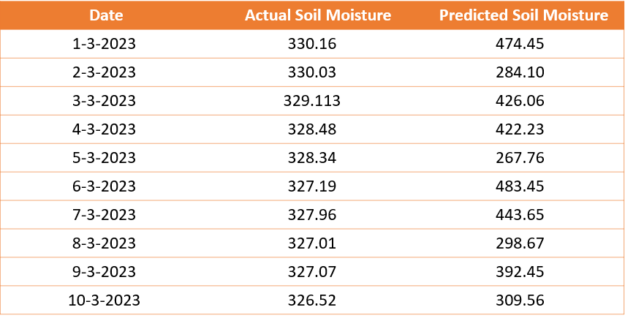
Soil Moisture Prediction for March 2023
Average 328.1 380.13

Slide 12
Thank You

