Slide 1

ATEF MORTADA Task 1
Introduction to programming

Slide 2

History of Programming and Computation
In the past programmer was codsing in machine language …. This way was so difficult and slow
Then, programmer was coding in low level language … this way was some easy than machine code but still difficult
After that , the high level language was used in coding … those language is so easy than previous ways
Notes:
Machine language is bainry code

Slide 3

Low level language :
This type is near to machine language than human language
It give the developer more access to hard ware component so it use usually in embedded system (when manipulate with micro controller)
It is some difficult more than high level language
As example : Assembly language , in this language we work with registers and location of storage directly

Slide 4

High level language :
It near to human language more than machine language
this language is more easy than low level language
This language is more common between developer and it use in most of field these day as Ai , web development ,…ect
As example : c++ , python , c (use in embedded too) ….ect

Slide 5


Meanig of algorithms :
Algorithms is a way of thinking that using to reach solving for problem in specific sequence steps
The most common way use to write algorithms is pseudo code or flowchart

Slide 6

Types of Algorithms :
Three main type are :
Sorting algorithms : this use in arrange data
Searching algorithms : this use in finding element in large data
Dynamic programming algorithms : use in solve big problem

Slide 7

Algorithms Role in Problem-Solving :
Algorithms is a logical way of thinking that help us in organization the steps we do to solve problems
As example when we write pseudo code first for any problem then excute it by any programming language

Slide 8
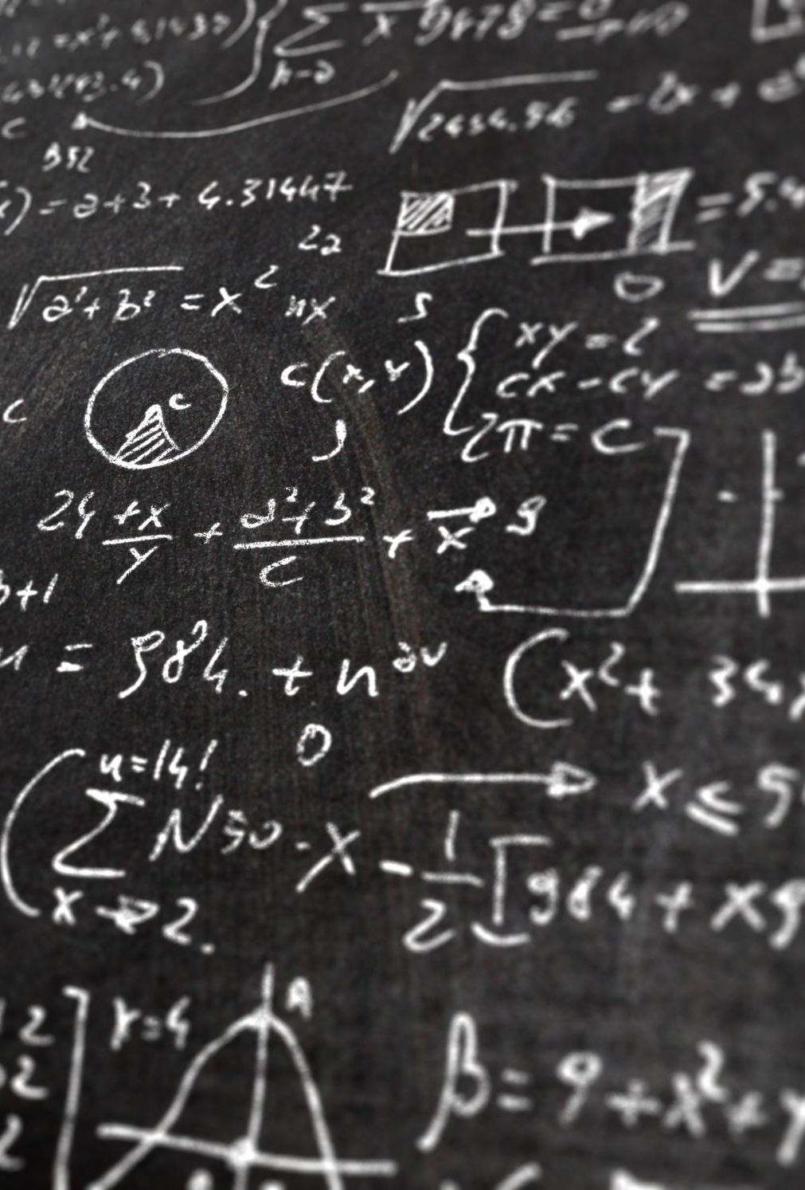
Types of Errors in Programming :
1- syntax error : when we write instruction wrong or not of the rule of the programming language As example : in c++ don’t write semicolon at the end of instruction and in python write “prit” instead of “print”
2- logical error : when we solve the problem wrong (write the algorithms wrong) or when we confuse in using variable As example : use “/” instead of “*” or write equation wrong
3- run time error : as when devide by zero

Slide 9
Errors solutions :
Syntax error : compiler or interpreter can detect it easy (interpreter easier) and give recommendation for resolve this error
Logical error : cant’t detect by compiler or interpreter and must the developer detected it by examine each instruction and resolve it without recommendation → the hardest error
Run time error : operation system can detected these error and Sometimes interpreter can detected it

Slide 10

Python’s advantages:
Simple language : it’s close to English so it’s easy
Dynamic typing : define the types of variable automatic
Cross platform : available for all platform as windows, mac, …ect
Libraries: python have a lot of libraries that are useful in various of tech field
Multi-uses : python available in many field
Ai and data analysis : python is very high efficiency in Ai and data analysis

Slide 11

Python and other programming languages:
Usability : python is more usability than any language
Libraries : python have a lot of libraries more than any language and this is the most strong point in python
Efficiency : because python is cross platform ,so Is more efficiency than other language

Slide 12

Python and AI in Engineering:
Real-world examples :
1- opensees -> simulate the performance of structural and geotechnical systems subjected to earthquakes
2- ArcGIS : -> Analyzes geographical data to assist in decision-making
3- GridLab- D : Simulates load distribution in electrical networks to detect potential faults and ensure network stability

Slide 13

Python and AI in Engineering:
examples demonstrating their impact:
1- Predictive Maintenance in Manufacturing
2- Earthquake Prediction
3- Autonomous driving

