Slide 1
CODEBLUE
From a recorded meeting to verified minutes
Offline speech-to-minutes for clinical rounds and business meetings — Romanian with Russian insertions, medical vocabulary, no audio leaving the building.
HealthTech Hackathon · 2026 | Angular 22 · ASP.NET Core (.NET 10) · Whisper · sherpa-onnx · Qwen2.5 (local)
Notes:
CodeBlue turns an audio recording into a transcript with speakers, corrected terminology and meeting minutes that are checked against the transcript. Everything runs locally.

Slide 2
THE PRODUCT
What CodeBlue does
The problem
Ward rounds and meetings are spoken in Romanian with Russian words mixed in, full of drug names and abbreviations.
Writing minutes by hand takes time; cloud speech services are not an option for patient data.
The answer
Upload a recording, describe it in one form, and get back a transcript split by speaker.
A local LLM fixes misheard medical terms, writes the minutes, then checks them against the transcript.
Export to PDF, send by e-mail, copy as text.
100%
9
offline
pipeline steps
Every model runs in-process on the server
Orchestrated by WorkflowCore, progress in %
3
RO + RU
record types
mixed speech
Medical, administrative, financial profiles
Whisper large-v3 forced to Romanian

Slide 3
WORKFLOW
End-to-end: four steps for the user
1
Upload
2
Configure
3
Process
4
Review & share
POST /files
POST /jobs
GET /jobs/{id}
GET /document/…
File is stored in its own job folder and probed with ffprobe. Nothing is processed yet.
Title, number of speakers and discussion type. This call starts the pipeline.
UI polls every 3 s and shows percent and the current step.
Minutes with verification, transcript, speaker linking, PDF and e-mail.
Job status (Jobs.Status in healthtech.db — the single source of truth for the UI)
Uploaded
Pending
Running
Completed
Failed
any step can fail →
Uploaded rows are hidden from the list and survive a restart; Pending/Running rows left over after a crash are marked Failed at startup.

Slide 4
ARCHITECTURE
One browser app, one API, everything else local
CodeBlue UI
HealthTech API
Workflow engine
Local AI
Angular 22 · signals · zoneless
ASP.NET Core · .NET 10
WorkflowCore
in-process models
Pages: /new and /rec/:id
Stores survive navigation
ProcessingTracker polls jobs
Dev proxy → API paths
Thin controllers → services
IExceptionHandler → RFC 7807
Record profiles & prompts
PDF via PDFsharp/MigraDoc
9 JobSteps, % per step
Terminate on error, no retry
Failed guard on every step
Orphans failed at startup
FFmpeg / ffprobe
Silero VAD
Whisper large-v3 (Vulkan)
sherpa-onnx diarization
Qwen2.5-7B GGUF
healthtech.db
workflow.db
per-job folders
Jobs, Persons, SpeakerBindings — Dapper over SQLite, schema.sql re-run idempotently at startup.
WorkflowCore's own state. A separate file so engine polling and UI polling never fight over one SQLite lock.
assets/input/<jobId>, assets/processed/<jobId>, transcripts/<jobId> — no shared "first file wins".

Slide 5
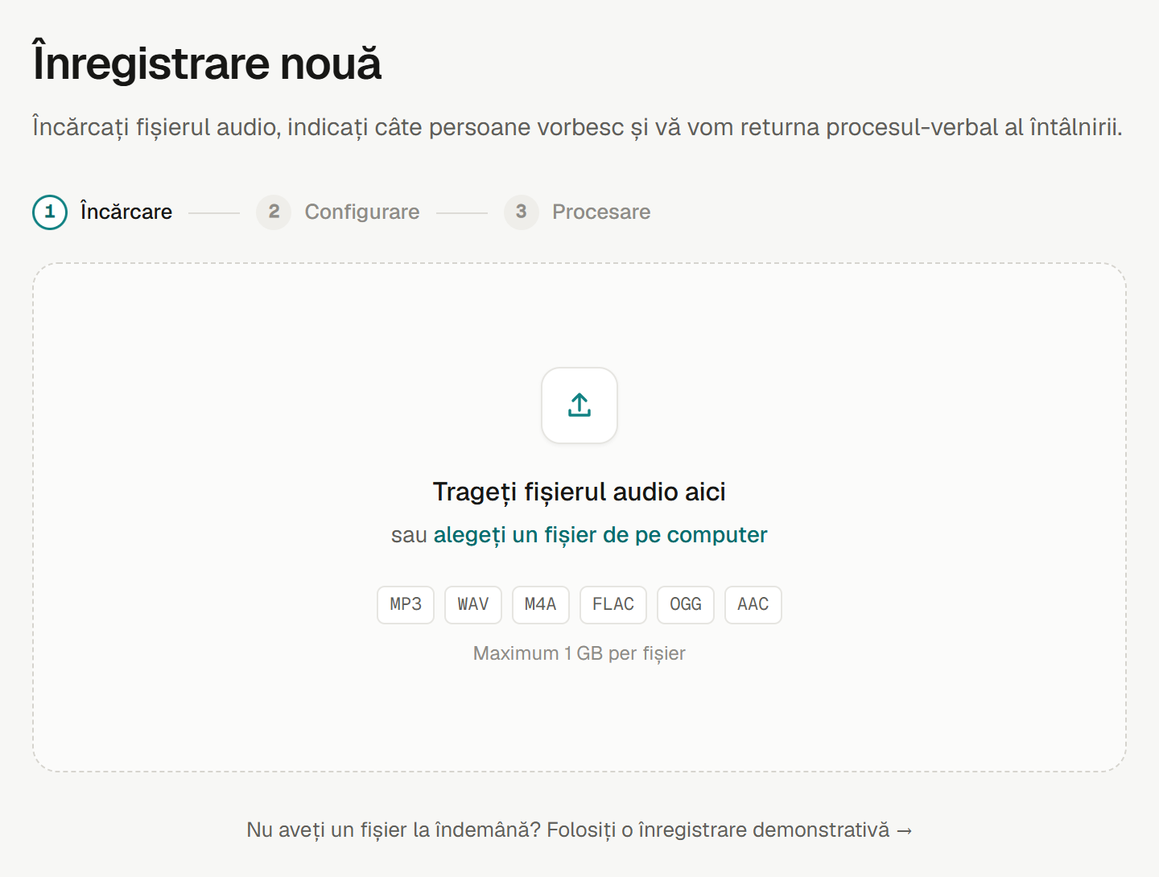
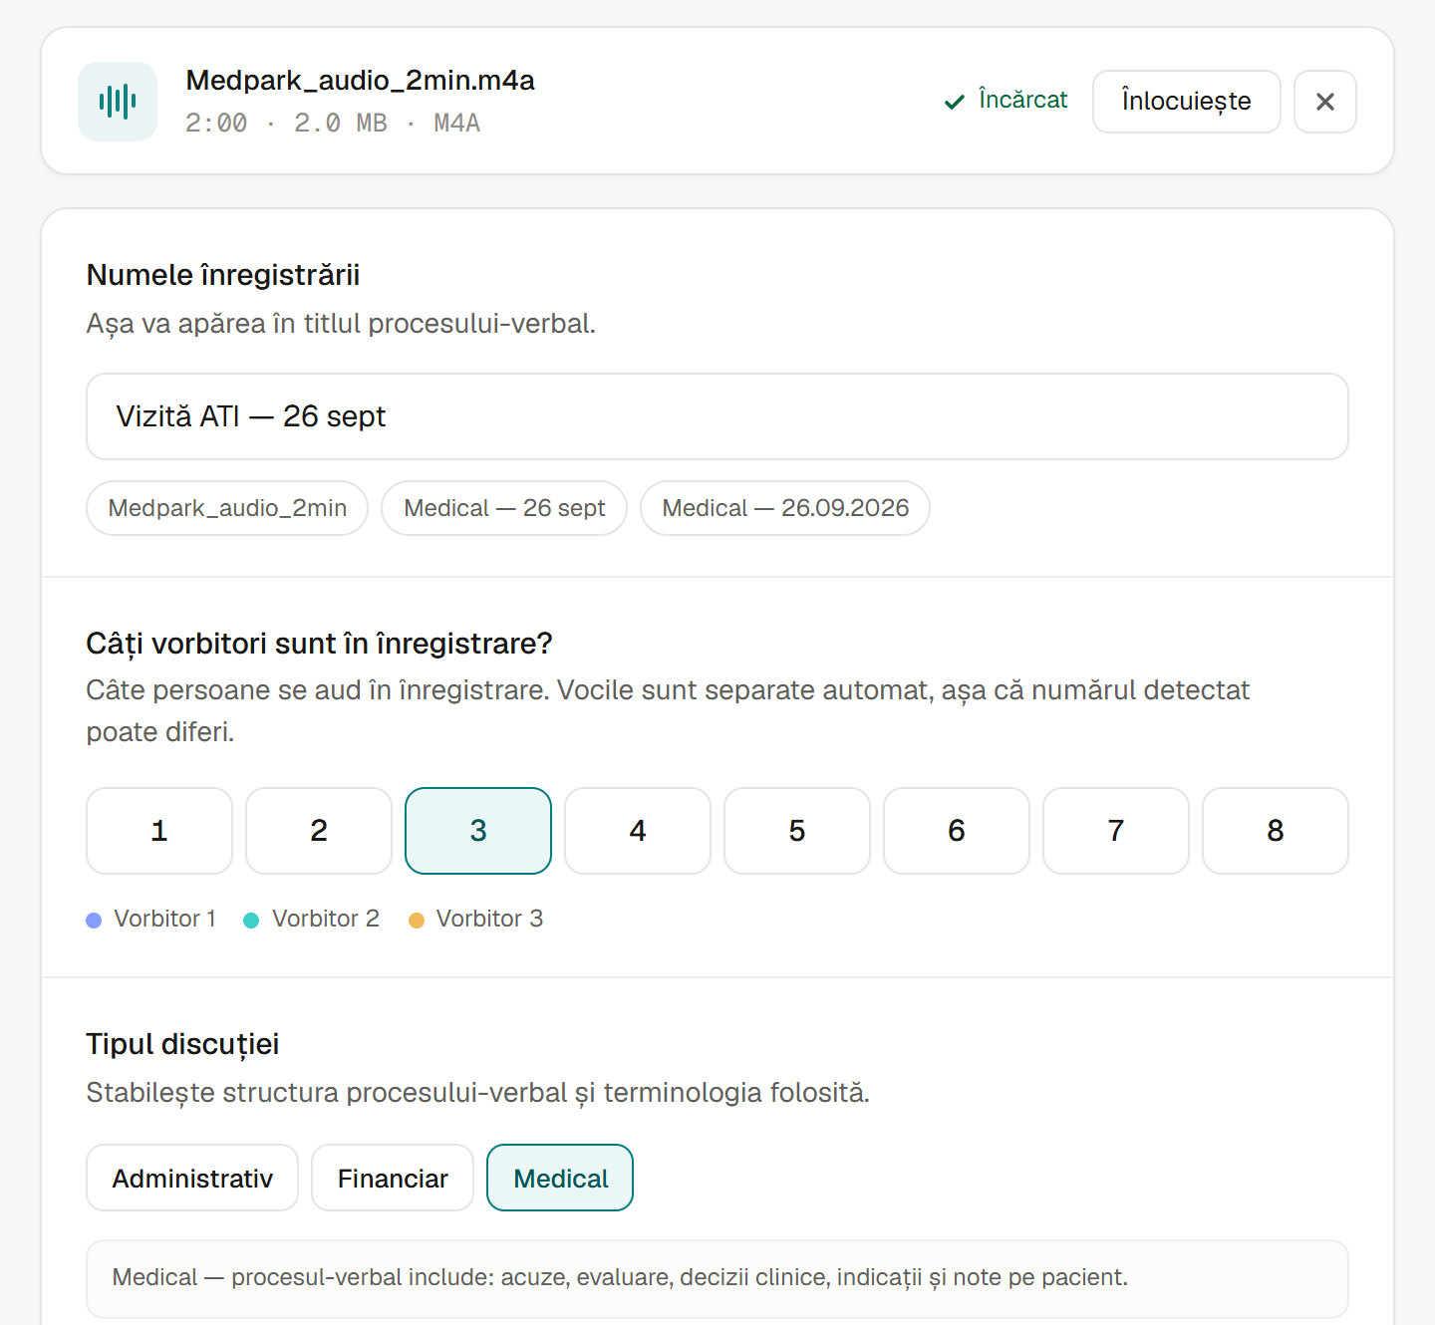
SCREENS · 1 & 2
Upload, then describe the record
Drag-and-drop with upload progress (XHR). Content is validated server-side — a non-audio file is rejected with 422 right away.
The probe fills duration, size and format. The user picks a title, speaker count and discussion type, which selects prompts and glossaries.

Slide 6
WORKFLOW · UPLOAD
Why the upload is split into two calls
POST /files
Store and probe
POST /jobs
Describe and start
Saved under a sanitized name in assets/input/<jobId>/
ffprobe checks the content, not the extension: no audio stream → 422 NotAudio
A Jobs row in status Uploaded; the folder is removed on every failure path
Returns fileId, size, format and duration for the form
Validates discussionType against the profiles and speakersCount 1..20
Checks the file is still on disk before touching the status
Moves Uploaded → Pending and starts the workflow
fileId is the job id — there is no separate file entity
UPDATE Jobs SET Status = 'Pending' … WHERE Id = @id AND Status = 'Uploaded'
One atomic statement: two simultaneous saves of the same file give one job and one 409 — never two workflows on the same audio.

Slide 7
WORKFLOW · PROCESSING
Nine steps, one progress bar
Audio analysis · 0–15%
Transcription · 15–55%
Speakers · 55–78%
Terms + minutes · 78–100%
The UI shows four stages; each backend step owns a slice of the bar, weighted by how long it takes.
1
Normalize audio
5%
2
Prepare model input
10%
3
Detect speech
15%
FFmpeg → PCM WAV; keeps rate and bit depth, copies PCM as-is
One 16 kHz mono WAV shared by every model
Silero VAD → 15–25 s chunks cut at pauses
4
Transcribe
55%
5
Diarize
75%
6
Align speakers
78%
Whisper large-v3, language ro, chunk by chunk on the GPU
sherpa-onnx: pyannote segmentation + WeSpeaker
Each segment goes to the speaker it overlaps most
7
Correct terms
90%
8
Save result
92%
9
Generate minutes
100%
Qwen2.5-7B + glossaries, every change validated
.speakers.json — the transcript the UI reads
Extract facts → write document → verify

Slide 8
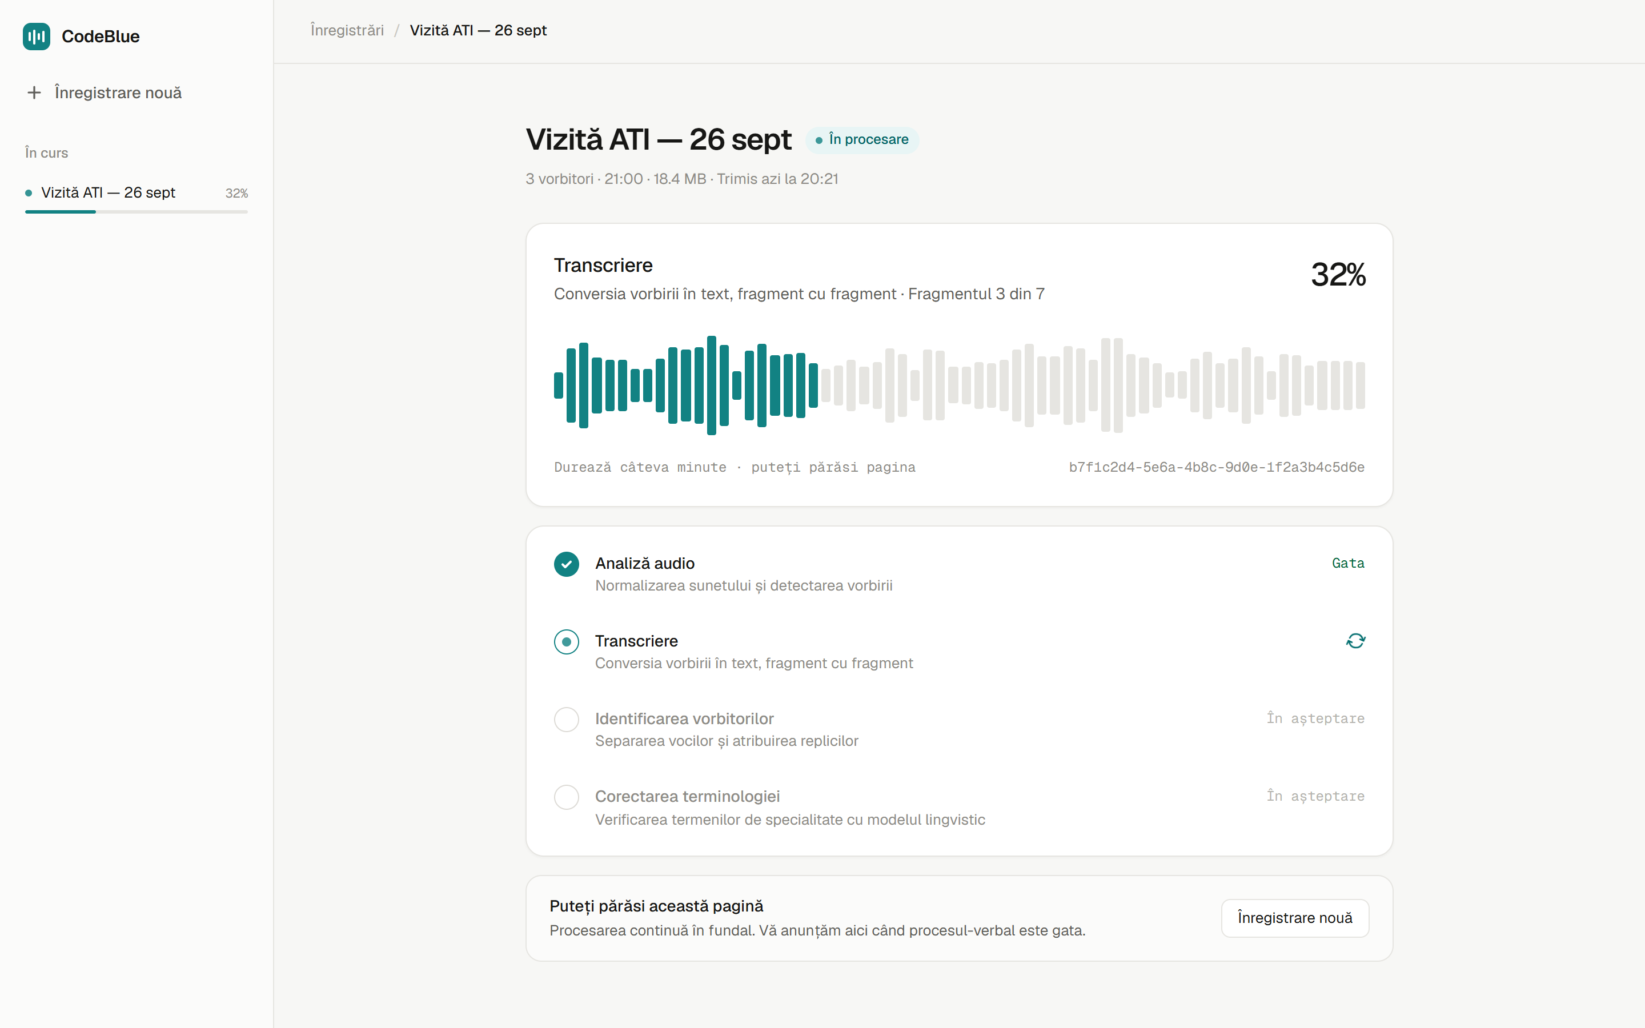
SCREENS · 3
Processing you can walk away from
1
Polling, not sockets
GET /jobs/{id} every 3 s — steps take minutes, so that is plenty.
2
Progress never goes backwards
Slow steps report inside their band: "chunk 3 of 7", "batch 2 of 5", minutes phases.
3
Nine steps → four stages
The UI maps percent bands to readable Romanian stage names.
4
Leave the page
The "În curs" sidebar tracks every running job and raises a toast when it is ready or failed.

Slide 9
INSIDE THE PIPELINE
From sound to "who said what"
audio
VAD chunks
chunk 1 · ~20 s
chunk 2 · ~20 s
chunk 3 · ~20 s
speakers
Speaker 1
Speaker 2
Speaker 1
Speaker 2
Speaker 1
1
Chunk with Silero VAD
2
Transcribe with Whisper
3
Diarize and align
Speech regions grouped at pauses into 15–25 s chunks, padded 0.25 s per side
Pause-less speech is cut at the quietest 100 ms frame
Stops Whisper repetition loops from spreading across the recording
large-v3 with language forced to ro: auto-detect misfires per chunk and translates to Russian; turbo loops more
Vulkan GPU, CPU fallback
Words with p < 0.5 are flagged as lowConfidence
sherpa-onnx: pyannote segmentation 3.0 + WeSpeaker embeddings
Exclusive turns — the shorter overlapping turn wins
Each Whisper segment goes to the speaker with the largest overlap; labels are Speaker 1..N in order of appearance

Slide 10
INSIDE THE PIPELINE
Correcting medical terms with a local LLM
1
Split
Three glossaries, per profile
Turns cut into sentence pieces that cover the text exactly
850
medical terms
hidrocefalie | гидроцефалия | hydrocephalus
2
Batch
387
Moldovan speech — "NOT errors"
A few pieces per request, previous pieces as context
davai | давай | hai, bine, de acord
seed
known ASR mishearings
Pick glossary lines
mio cardic → miocardic
3
Only lines sharing 5-letter prefixes with the batch
CorrectionValidator rejects a change when…
4
Ask Qwen2.5-7B
any number changed
it looks like translation (Cyrillic share shifts by > 0.15, word runs reordered)
length changes by more than 30%
edit distance exceeds 25%
Semantic Kernel + LLamaSharp, GGUF on CPU
5
Validate
Reject risky edits, retry bad output, else keep original

Slide 11
WORKFLOW · MINUTES
Minutes that are checked against the transcript
Extract facts
Write the minutes
Verify vs transcript
Verification has three outcomes
92%
94%
98%
Checked, consistent
no discrepancies found
The last pipeline step; the same local LLM, three passes.
Stored as a Quill Delta; the PDF is rendered from that Delta (PDFsharp/MigraDoc).
If the model fails, the job still completes — the transcript is the result, and POST /document/save/{id} regenerates the minutes (6–10 min).
Transcripts over 6,000 characters are rejected, never silently truncated.
Checked, findings
shown with quotes and a fix
Could not verify
document saved, marked unverified
Finding kinds
Unsupported a claim with no basis in the transcript
Omission something important left out
Contradiction document and transcript disagree

Slide 12
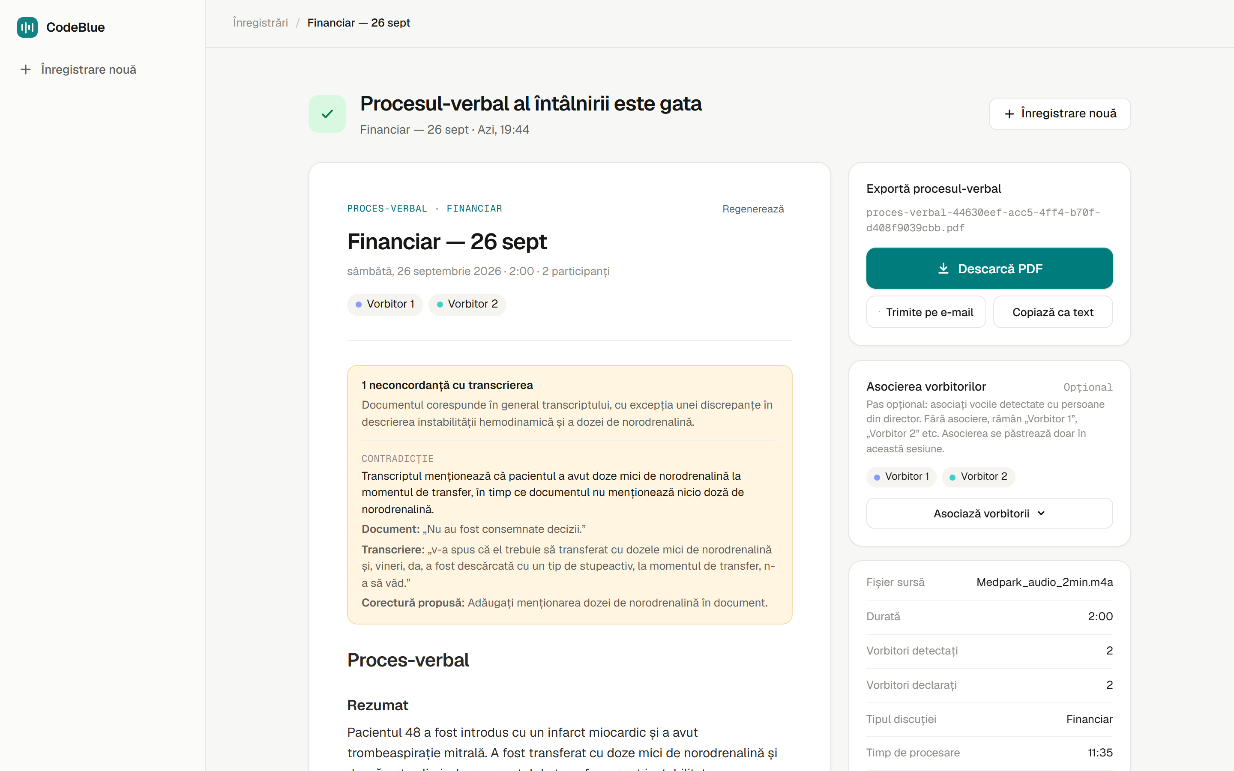
SCREENS · 4
The minutes, with the verification up front
1
Discrepancies first
A contradiction is shown with both quotes and a proposed correction before the text.
2
Proces-verbal
Summary, decisions, actions — structure depends on the discussion type.
3
One-click PDF
GET /document/downloadpdf/{id}, rendered from the saved document, no LLM involved.
4
Record facts
Duration, detected vs declared speakers, type and processing time.

Slide 13
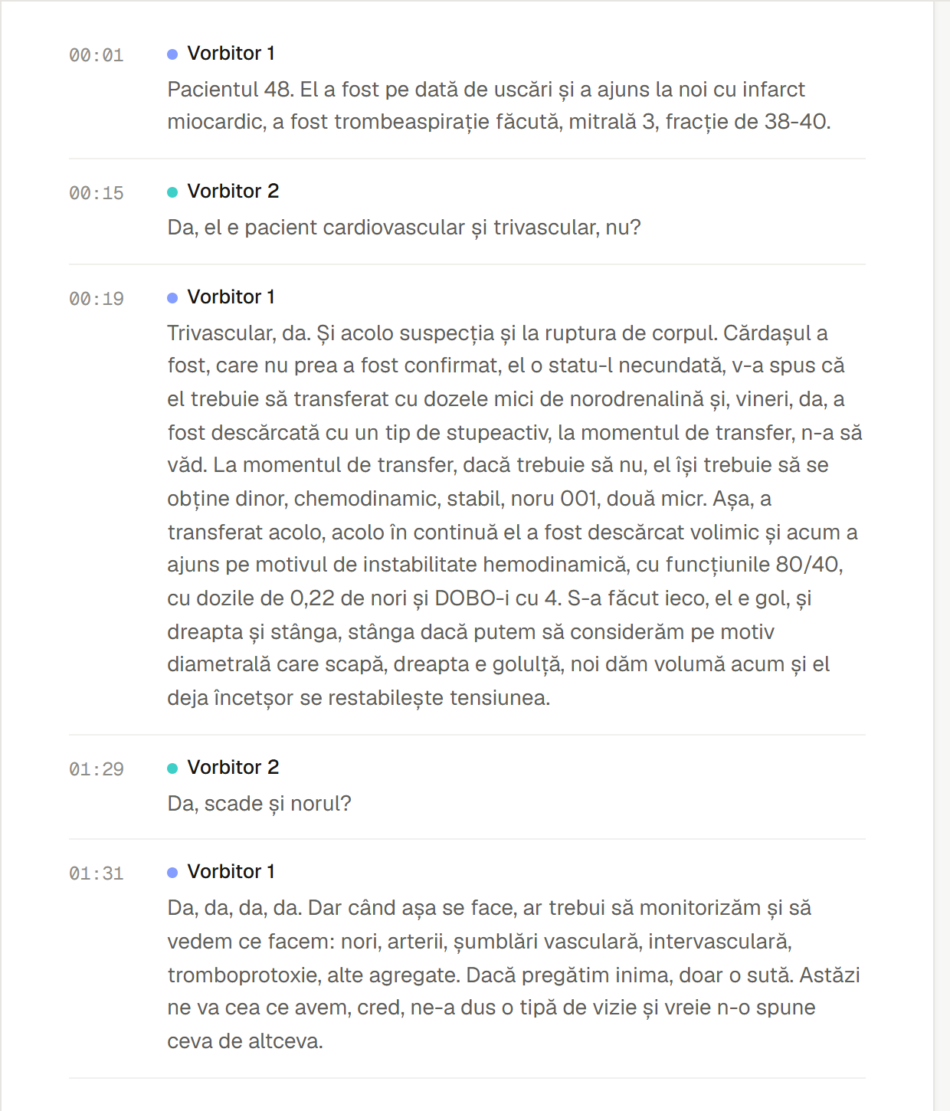
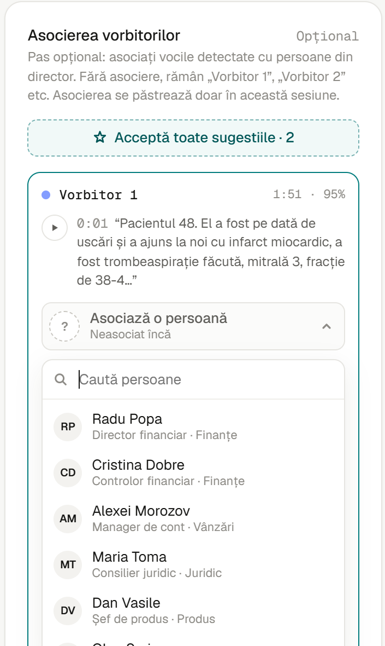
SCREENS · 5
Transcript by speaker, and who the speakers are
Transcript
Turns with time codes and a color per speaker, straight from GET /jobs/{id}/result.
Speaker linking
Each voice shows talk time and a sample quote. Pick a person from the directory, or accept all suggestions at once.
Backend
GET /persons and PUT /jobs/{id}/speakers store bindings; names are substituted on the fly, files are never rewritten.

Slide 14
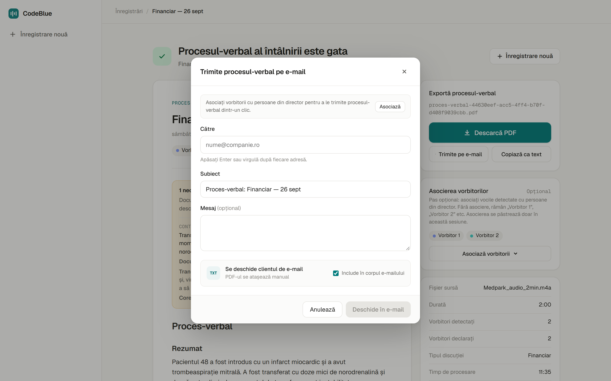
SCREENS · 6
Share it
1
E-mail
Opens the mail client with subject and text filled in; the PDF is attached by hand.
2
Recipients from speakers
Once speakers are linked to people, they become one-click recipients.
3
Copy as text
The minutes as plain text for chat or an EHR note.

Slide 15
ENGINEERING
Decisions that keep long jobs honest
1
2
3
No automatic retry
No zombie jobs
Failed stays failed
Steps cost minutes and fail for reasons a retry will not fix. The engine terminates, the job goes to Failed with a message.
Pending/Running rows are failed at startup, before the engine resumes, so nothing spins in Running forever.
Each step checks for Failed before its first progress report; status only rises out of Pending/Running.
4
5
6
Fail at startup, not at step 7
Errors as ProblemDetails
Originals never touched
Missing models, prompts or glossaries abort startup (ValidateOnStart, eager profile catalog).
Domain errors map to RFC 7807 in exception handlers; the UI shows Romanian text by title.
ffmpeg writes .partial then renames; per-job folders; the input file is never modified.

Slide 16
TECHNOLOGY
The stack
Frontend
Backend
AI, all local
Angular 22, standalone components
ASP.NET Core Web API, .NET 10
FFmpeg / ffprobe
Signals, zoneless change detection
WorkflowCore on SQLite
Silero VAD, Whisper.net (large-v3, Vulkan)
HttpClient with XHR for upload progress
Dapper + Microsoft.Data.Sqlite
sherpa-onnx: pyannote 3.0 + WeSpeaker
Quill delta rendering
Serilog, OpenAPI + Swagger UI
Semantic Kernel + LLamaSharp
Vitest + Prettier
PDFsharp / MigraDoc
Qwen2.5-7B-Instruct Q4_K_M

Slide 17
WHAT'S NEXT
Authentication
Built for a hackathon, shaped for a hospital
Every endpoint is open today.
Glossaries beyond medicine
Mechanism exists for administrative and financial records; content does not.
Grow the mishearing list
Thank you
Filled by hand from the correction reports.
Speaker identification by voice
Linking is manual now; suggestions are a UI stub.
Longer minutes
Lift the 6,000-character transcript limit.

