Slide 1


CodeBlue
For doctors who write up rounds and meetings by hand, CodeBlue turns a recording into a transcript by speaker and verified minutes, fully offline, so patient audio never leaves the hospital.
CHALLENGE
TEAM
HealthTech · Medpark: meeting and ward-round minutes from audio
CodeBlue · Anastasia Televca, Denis Briceag
Notes:
TIME 0:15
Hook: "This morning a doctor in the ATI ward finished a round with two colleagues. They spoke Romanian, dropped Russian words in the middle of sentences, named five drugs and three diagnoses. Now she has to write all of it down."
Then: CodeBlue does that for her, and nothing leaves the hospital.

Slide 2

The problem
WHO HAS THIS PROBLEM?
Medpark doctors and staff who must turn ward rounds, consultations and meetings into written minutes.
RO+RU+EN
WHAT HAPPENS TODAY?
After an ATI round the doctor types the minutes from memory. Speech mixes Romanian, Russian, English and drug names, and generic speech-to-text garbles it.
Three languages in one sentence, plus Latin drug names: off-the-shelf speech-to-text misreads it
WHY DOES IT MATTER TO THE CHALLENGE PROVIDER?
Clinician hours go to paperwork, details get lost, and cloud transcription is not allowed for patient data.
Notes:
TIME 0:45
Who: doctors and administrative staff at Medpark.
Example: after a round in intensive care, one doctor writes the minutes from memory.
Why it's hard: Moldovan clinical speech is Romanian with Russian insertions and dense medical vocabulary. Auto language detection flips to Russian and even translates. And patient audio cannot go to a cloud API.

Slide 3
Our solution
Upload a recording, describe it in one short form, and get a transcript split by speaker plus minutes checked against what was actually said, all on local models.
1
2
3
Mixed RO/RU/EN speech
Fixes medical terms
Verified minutes
Whisper large-v3 transcribes Romanian with Russian and English words. Voices are separated and linked to doctors by name.
A local LLM corrects misheard terms with 850 medical terms, 12,350 ICD-10 diagnoses and a Moldovan-speech list.
Minutes are checked against the transcript and discrepancies come with quotes. PDF on Medpark letterhead.
Notes:
TIME ~0:20, then straight to the demo.
Innovation: it is not just speech-to-text. A second model fixes the medical vocabulary, and a third pass checks the minutes against the transcript, so the doctor reviews instead of writing. Everything runs on-premise.

Slide 4
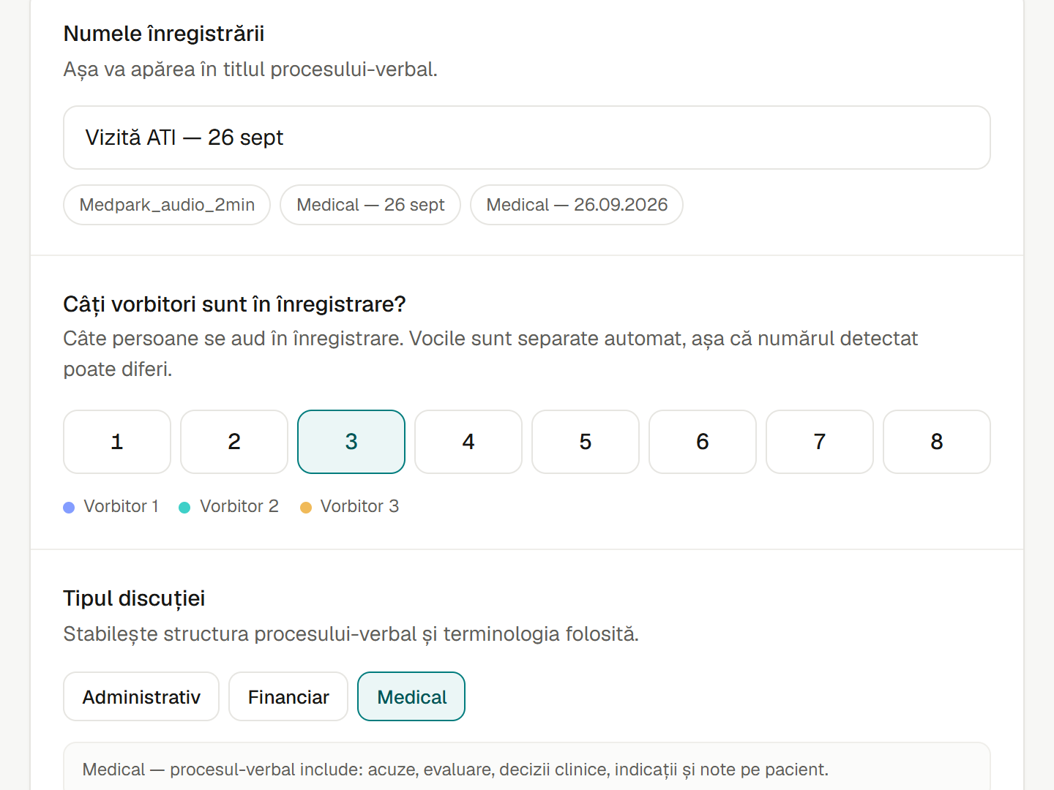
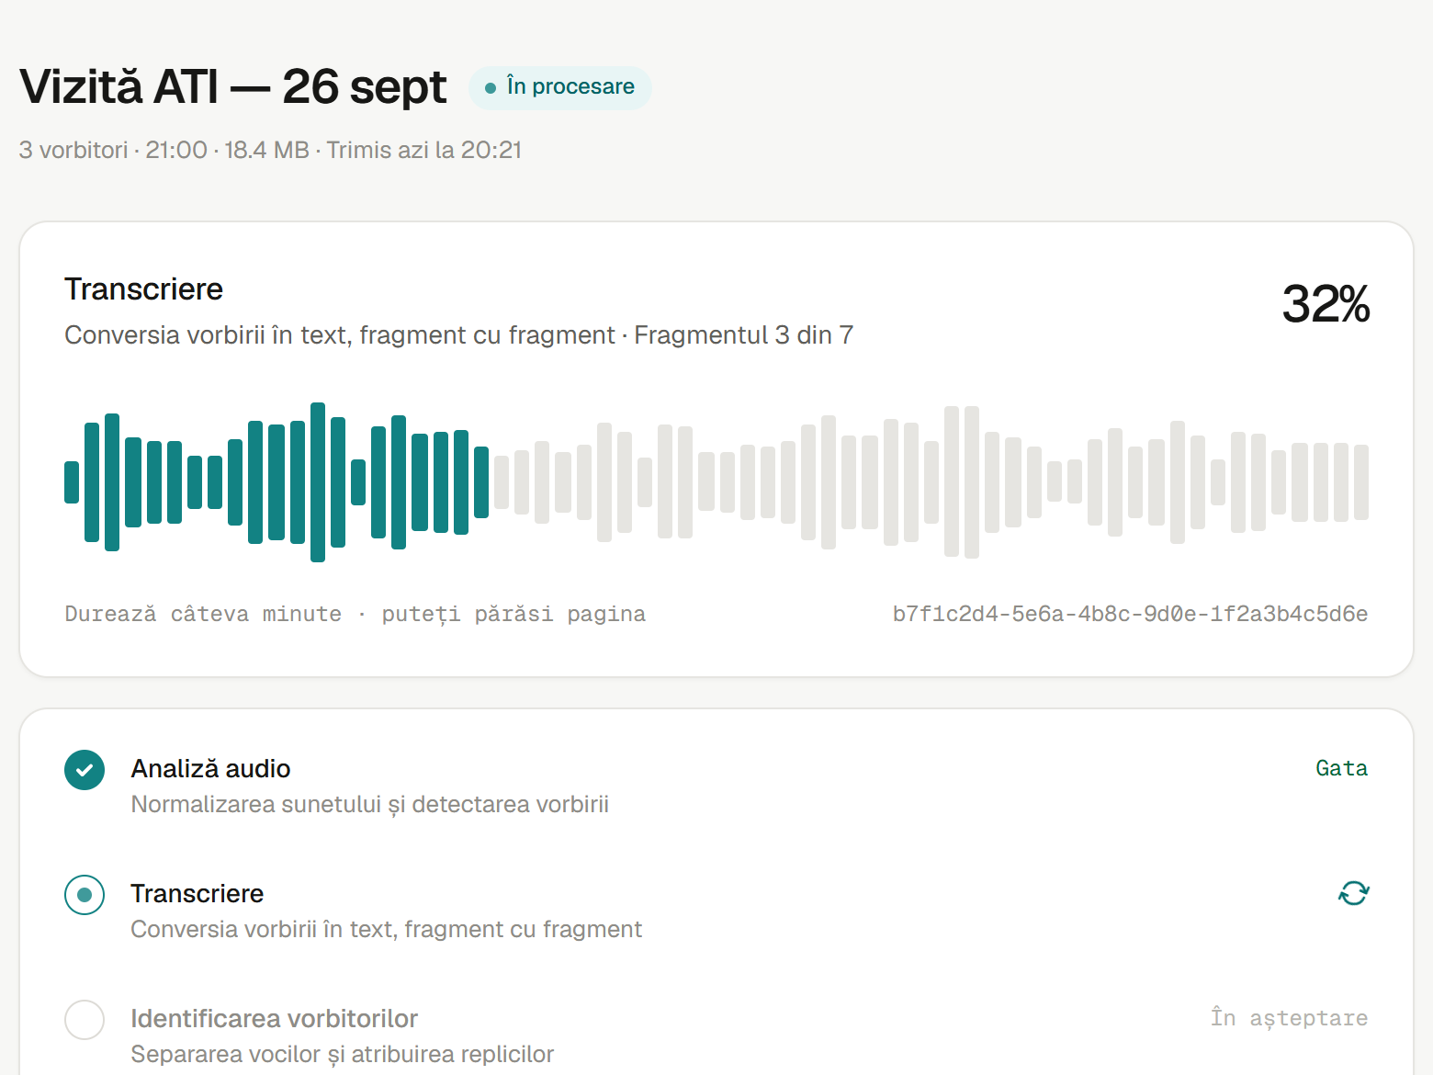
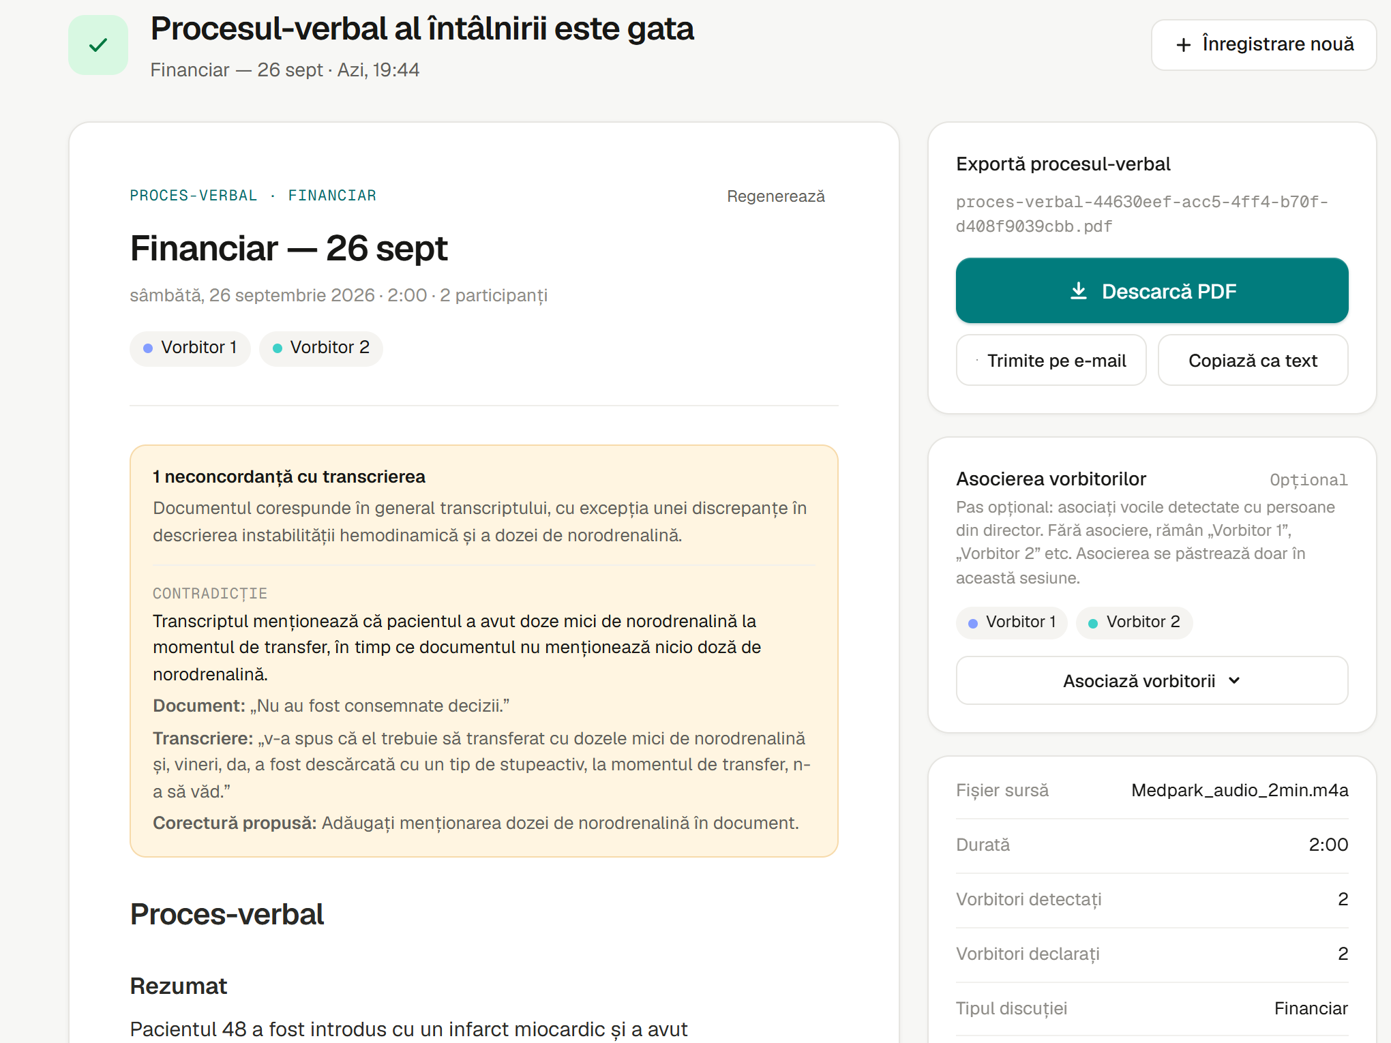
Demo
1 Upload and describe
2 Processing
3 Verified minutes
Title, speaker count, record type
Walk away; progress by step
Discrepancy with quotes, then PDF
Notes:
TIME ~1:40
One flow, start to finish, on the real Medpark recording (Medpark_audio_2min.m4a):
1. Drop the file. The server checks it is audio by content, not by extension.
2. Name it, pick 2 speakers and 'Medical'. That choice selects the prompts and glossaries.
3. Processing: audio analysis, transcription chunk by chunk, speakers, term correction, minutes. You can leave the page; a toast tells you when it is ready.
4. The minutes open with the verification result: here it found a contradiction about noradrenaline doses and shows both quotes and a proposed fix.
5. Download the PDF on Medpark letterhead.
Processing takes about 12 minutes for 2 minutes of audio on a laptop, so show a finished job live and keep the demo video open in another tab.

Slide 5
How it works
INPUT
OUR ENGINE
OUTPUT
An audio recording of a round or meeting (MP3, M4A, WAV, FLAC..., up to 1 GB) plus title, speaker count and record type
→
FFmpeg, Silero VAD, Whisper large-v3, sherpa-onnx diarization, Qwen2.5-7B correction and minutes. 9 steps, all on-premise
→
Transcript by speaker, a report of corrected terms, and minutes verified against the transcript, editable and as PDF
WHAT'S REAL
WHAT'S STILL MOCKED
The full flow on real Medpark recordings (2 to 3 min, 2 to 6 speakers), about 12 min per 2-min file on a laptop. Speaker linking to doctors, PDF export.
No login yet. Speakers are linked to doctors by hand. Administrative and financial glossaries are empty. Email opens the mail client.
Notes:
TIME 0:45
Constraint we respected: nothing goes to the cloud. Every model runs in-process on the server.
Whisper is forced to Romanian: auto-detect misfires per chunk and translates to Russian.
The LLM may only fix terms: a validator rejects any edit that changes numbers, translates, or rewrites more than 25% of a sentence.
Honest about gaps: no authentication, manual speaker linking, and it is slow on a laptop CPU.

Slide 6
Impact
0
13,200
3 steps
bytes of patient audio sent outside the hospital
medical terms and ICD-10 diagnoses the corrector knows
from recording to PDF minutes: upload, describe, review
WHAT THIS MEANS FOR THE CHALLENGE PROVIDER
Doctors review minutes instead of writing them, and each statement is checked against the transcript. These numbers come from the product itself; time saved per doctor is what we will measure in the pilot.
Notes:
TIME 0:25
0: privacy is built in, not promised. 13,200: 850 curated medical terms plus the full Romanian ICD-10 list of 12,350 diagnoses. 3 steps: that is all the doctor does.
We did not invent a time-saved number. We will measure it in the pilot.

Slide 7
Next steps
NEXT WEEK
NEXT MONTH
IN 3 MONTHS
Run CodeBlue on 10 real rounds with Medpark doctors and grow the mishearing list from their fixes
Add login and roles, fill the administrative and financial glossaries, move to a GPU server
On-premise pilot in one department, speaker identification by voice, export to the EHR
WHAT WE NEED
Anonymized recordings with a clinician to review the output, a server inside the Medpark network, and one pilot department.
Notes:
TIME 0:20
If Medpark says yes, on Monday we install it on one server in their network and run it on real rounds with one doctor reviewing the output.

Slide 8
Team
AT
DB
BUILT AT GIGAHACK IN 48 HOURS
2 apps: an Angular 22 UI and an ASP.NET Core (.NET 10) API
5 local AI models in a 9-step orchestrated pipeline
Tested end to end on real Medpark recordings
Runs on Windows (Vulkan GPU) and macOS (Metal)
53 commits, Romanian UI, PDF on Medpark letterhead
Anastasia Televca
Denis Briceag
Frontend & AI
Backend & pipeline
Angular UI, LLM term correction, ICD-10 glossary, PDF minutes
Workflow engine, speech pipeline, speaker linking, long recordings
Notes:
TIME 0:15
Anastasia built the UI, the medical term correction and the PDF minutes. Denis built the processing pipeline and speaker linking. We both stay on for the pilot.

Slide 9
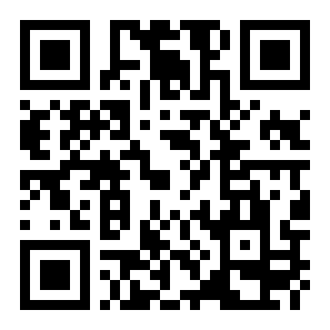
CodeBlue turns a hospital recording into verified minutes, offline, in Romanian and Russian.
Thank you!
Team CodeBlue · github.com/atelevca/codeblue
Notes:
TIME 0:15
Repeat the sentence, then: "Thank you, we are team CodeBlue."
Q&A split: Denis answers pipeline and infrastructure questions, Anastasia answers product, LLM and minutes questions.

Slide 10
Backup slides
Not part of the 5 minutes. Show them only if the jury asks.
Notes:
Put technical details, extra screenshots, data sources or a business model here. Use them to answer Q&A questions quickly.

Slide 11
Backup: details for Q&A
TECHNICAL DETAILS
BUSINESS / SUSTAINABILITY
ASP.NET Core (.NET 10) API, Angular 22 UI, WorkflowCore on SQLite
Silero VAD cuts 15 to 25 s chunks at pauses, which stops Whisper repetition loops
Whisper.net large-v3 on Vulkan GPU, language forced to Romanian, low-confidence words flagged
sherpa-onnx: pyannote 3.0 segmentation and WeSpeaker embeddings
Qwen2.5-7B (GGUF, LLamaSharp + Semantic Kernel). Edits that change numbers, translate or rewrite over 25% are rejected
Minutes: extract facts, write, verify; PDF via MigraDoc
Runs on one on-premise server: no per-minute cloud fees and no patient data leaving the network.
Open models only (Whisper, Qwen2.5, pyannote), so there is no vendor lock-in.
One engine, several record types: the same pipeline serves administrative and financial meetings once their glossaries are filled.
Possible model: a per-hospital installation with setup and glossary tuning, then support.
Notes:
Likely questions:
- Different from existing tools? Offline, Romanian with Russian, medical glossary, and minutes verified against the transcript.
- Real vs mocked? See 'How it works'.
- Real data? Yes, Medpark recordings, 2 to 6 speakers.
- To go live? Authentication, a GPU server in the hospital network, a pilot department.

Slide 12
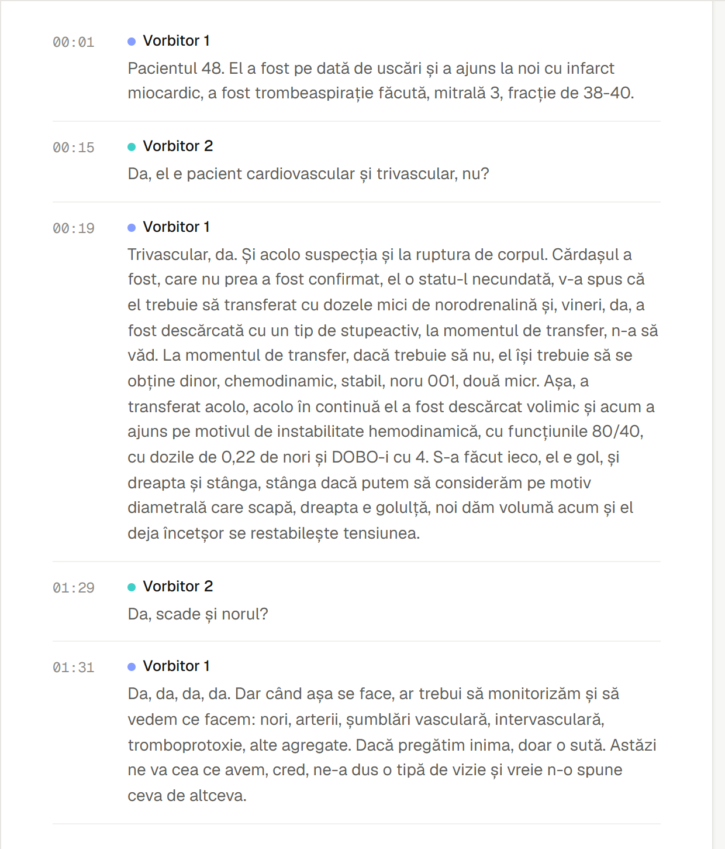
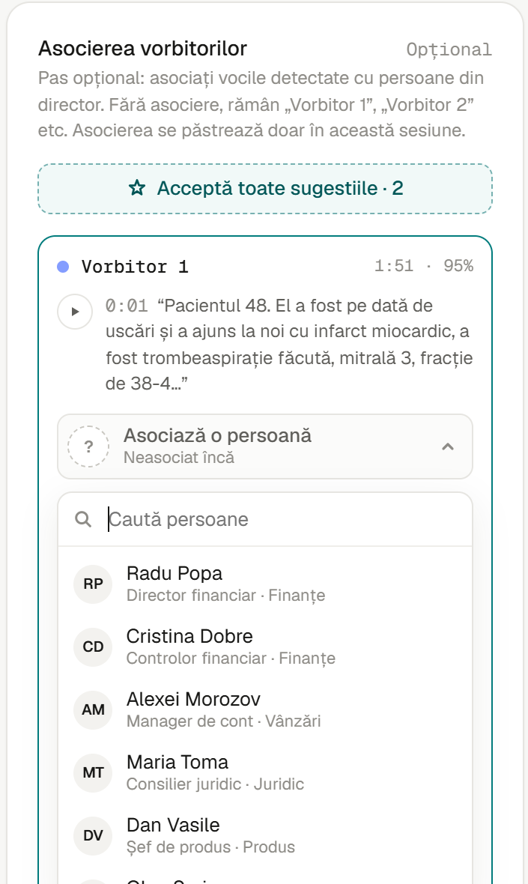
Backup: transcript and speakers
TRANSCRIPT
Turns with time codes and a colour per speaker.
SPEAKER LINKING
Each voice shows talk time and a sample quote. Pick a doctor from the directory.
NO REPROCESSING
Names are substituted on the fly. Links can change any number of times.
Notes:
Show if asked how speakers are identified: diarization separates voices automatically; linking a voice to a doctor is a manual pick today.

