Slide 1

Image Processing for beginners
-Prassanna Ganesh Ravishankar

Slide 2
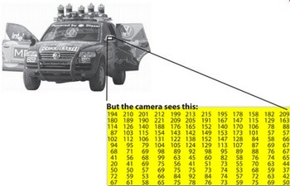
The Basics
Image : The reaction of light reflect/transmitted of reality in your brain / camera.
WIKI: In imaging science, image processing is processing of images using mathematical operations by using any form of signal processing for which the input is an image, such as a photograph or video frame; the output of image processing may be either an image or a set of characteristics or parameters related to the image. Most image-processing techniques involve treating the image as a two-dimensional signal and applying standard signal-processing techniques to it.
N00B? - Any operation on the image results in image processing.
Libraries - Skimage / OpenCV /Scikit-learn

Slide 3
Filters and what not
Filters - Wiki Definition
  A tool to play around with frequencies in a signal(1D,2D,3D...)
  The speech processing analogy - Specific filters/transforms to (de)enhance sound/speech on your telephone or your headphone
  Frequency in Sound signal - Pitch . Frequency in Image signals - Variation of pixel intensities.
High Pass filter on Images - Allows High Frequencies, blocks low ones. Highly useful in Edge detection.
Low Pass Filter on Images - Allows low frequencies, blocks high ones. Useful for blurring, De-Noising

Slide 4
Back to (super)Pixels
The human Eye - Rods and Cones as intensity and Colour sensors
Pixels - Artifact of digitization (Quantization and sampling) of Images
Makes sense to represent groups of similar pixels together?
Enter Superpixels - Grouping of similar pixels into regions

Slide 5
From Image processing to Computer Vision
Computer vision is a field that includes methods for acquiring, processing, analyzing, and understanding images and, in general, high-dimensional data from the real world in order to produce numerical or symbolic information, e.g., in the forms of decisions. A theme in the development of this field has been to duplicate the abilities of human vision by electronically perceiving and understanding an image. This image understanding can be seen as the disentangling of symbolic information from image data using models constructed with the aid of geometry, physics, statistics, and learning theory. Computer vision has also been described as the enterprise of automating and integrating a wide range of processes and representations for vision perception.
tldr - Making computers see like humans
Usually involves (Machine) Learning

Slide 6
Machine learning as a black box
Data is god.
Teach computer to make predictions or take decisions
Handwriting Recognition - Too hard?

Slide 7
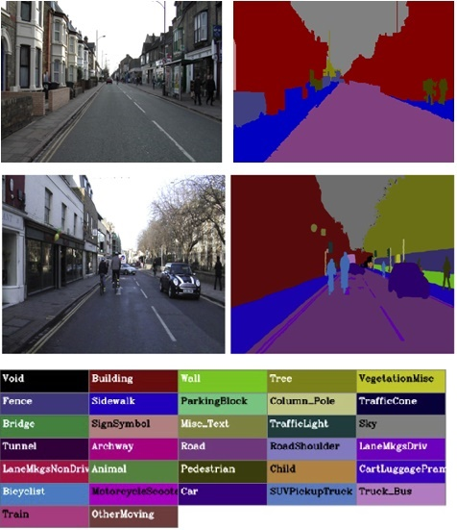
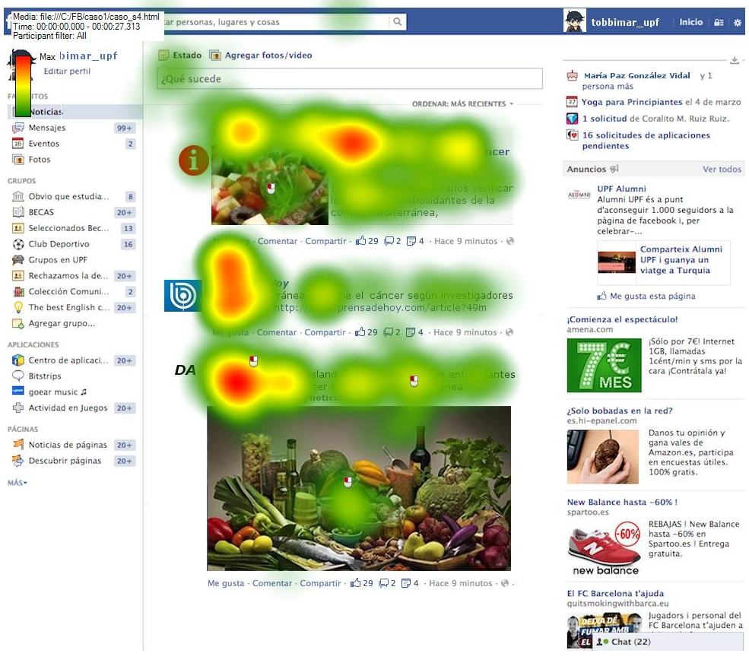
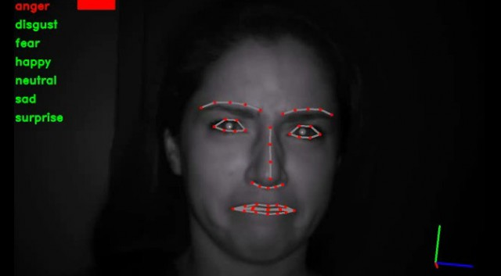
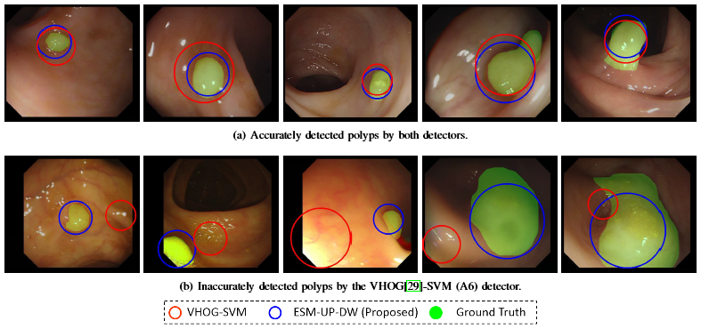
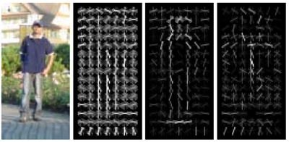
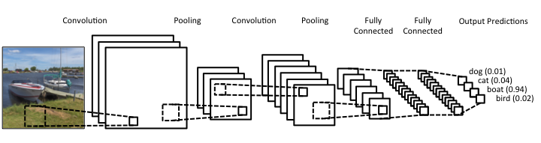
What's next?
Neural Networks
Object Detection
Semantic Segmentation
Eye Gaze Estimation
Detecting stuff in your body with cameras that you can eat
Emotion Classification

Slide 8

?
Mucho Colours. Give Me a Break!
https://github.com/atemysemicolon
atemysemicolon@gmail.com

