Slide 1
Computer Vision
Fall 2017
Problem Set #4
ZHI Zhang
zhizhang@gatech.edu
Computer Vision @ GT

Slide 2

1a: Base Shift0 and ShiftR2
ps4-1-a-1.png
Computer Vision @ GT

Slide 3

1a: Base Shift0 and ShiftR5U5
ps4-1-a-2.png
Computer Vision @ GT

Slide 4
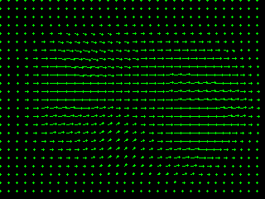
1b: Base Shift0 and ShiftR10
ps4-1-b-1.png
Computer Vision @ GT

Slide 5
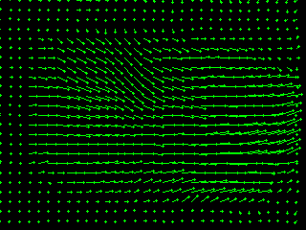
1b: Base Shift0 and ShiftR20
ps4-1-b-2.png
Computer Vision @ GT

Slide 6
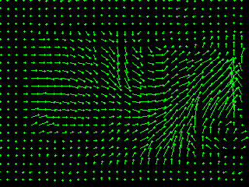
1b: Base Shift0 and ShiftR40
ps4-1-b-3.png
Computer Vision @ GT

Slide 7
1b: Text Response
Does LK still work? Does it fall apart on any of the pairs? Try using different parameters to get results closer to the ones above. Describe your results and what you tried.
LK does’t work well, yes, it falls apart on the pars of “shift0, shiftR20”, and “shift0, shiftR40”. What I did is to apply additional smoothing on imput images before apply the LK, I used a gaussian smoothing with kernel size “17*17” and sigma “14”, and I also adjust the kernel size in the LK, basically, giving relative large kernel size, which allows me to see the arrows.
Computer Vision @ GT

Slide 8
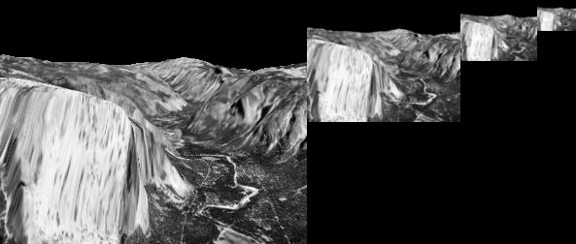
2a: Gaussian Pyramid
ps4-2-a-1.png
Computer Vision @ GT

Slide 9
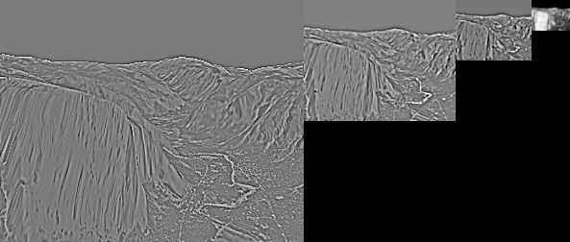
2b: Laplacian Pyramid
Laplacian Pyramid Image - ps4-2-b-1.png
Computer Vision @ GT

Slide 10
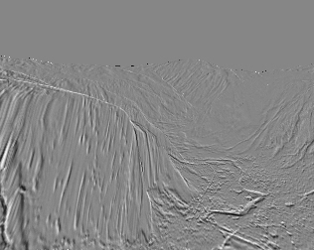
3a: Difference images
ps4-3-a-1.png
Computer Vision @ GT

Slide 11
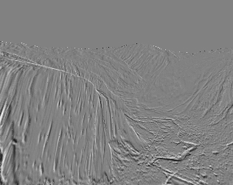
3a: Difference images (cont.)
ps4-3-a-2.png
Computer Vision @ GT

Slide 12
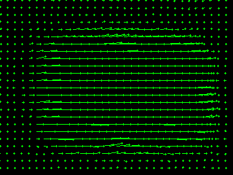
4a: Hierarchical LK
ps4-4-a-1.png
Computer Vision @ GT

Slide 13
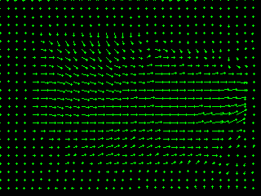
4a: Hierarchical LK (cont.)
ps4-4-a-2.png
Computer Vision @ GT

Slide 14
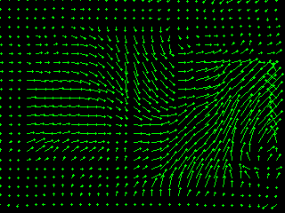
4a: Hierarchical LK (cont.)
ps4-4-a-3.png
Computer Vision @ GT

Slide 15
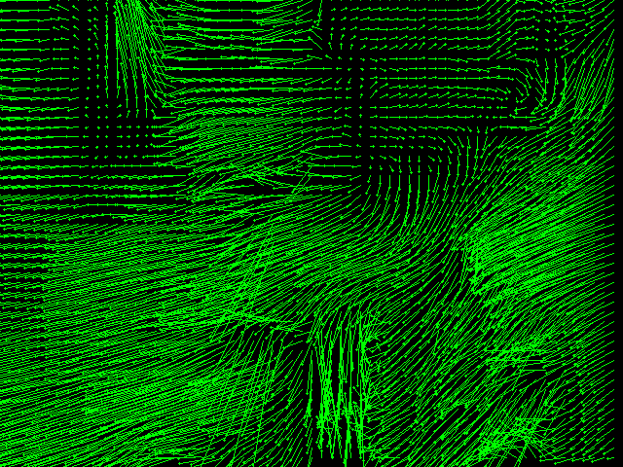
4b: Hierarchical LK (cont.)
ps4-4-b-1.png
Computer Vision @ GT

Slide 16
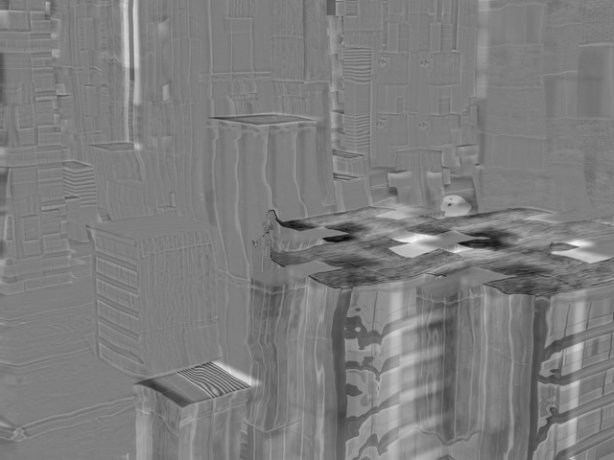
4b: Hierarchical LK (cont.)
ps4-4-b-2.png
Computer Vision @ GT

Slide 17
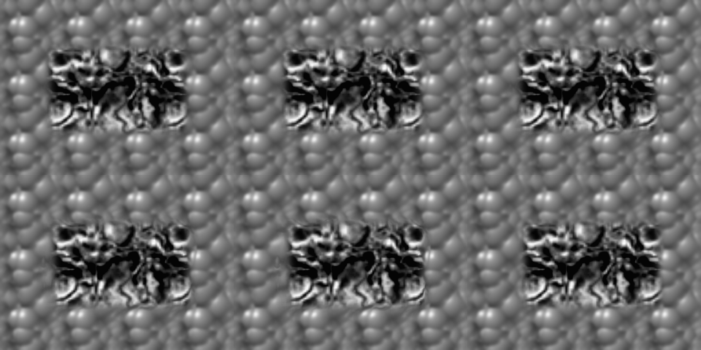
5a: Frame Interpolation
ps4-5-a-1.png
Computer Vision @ GT

Slide 18
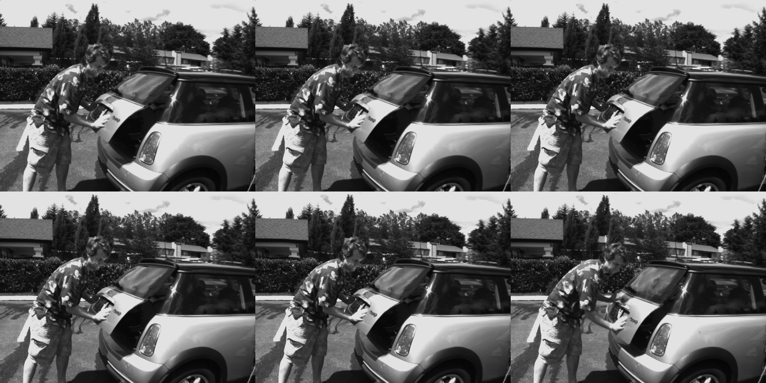
5b: Frame Interpolation
ps4-5-b-1.png
Computer Vision @ GT

Slide 19
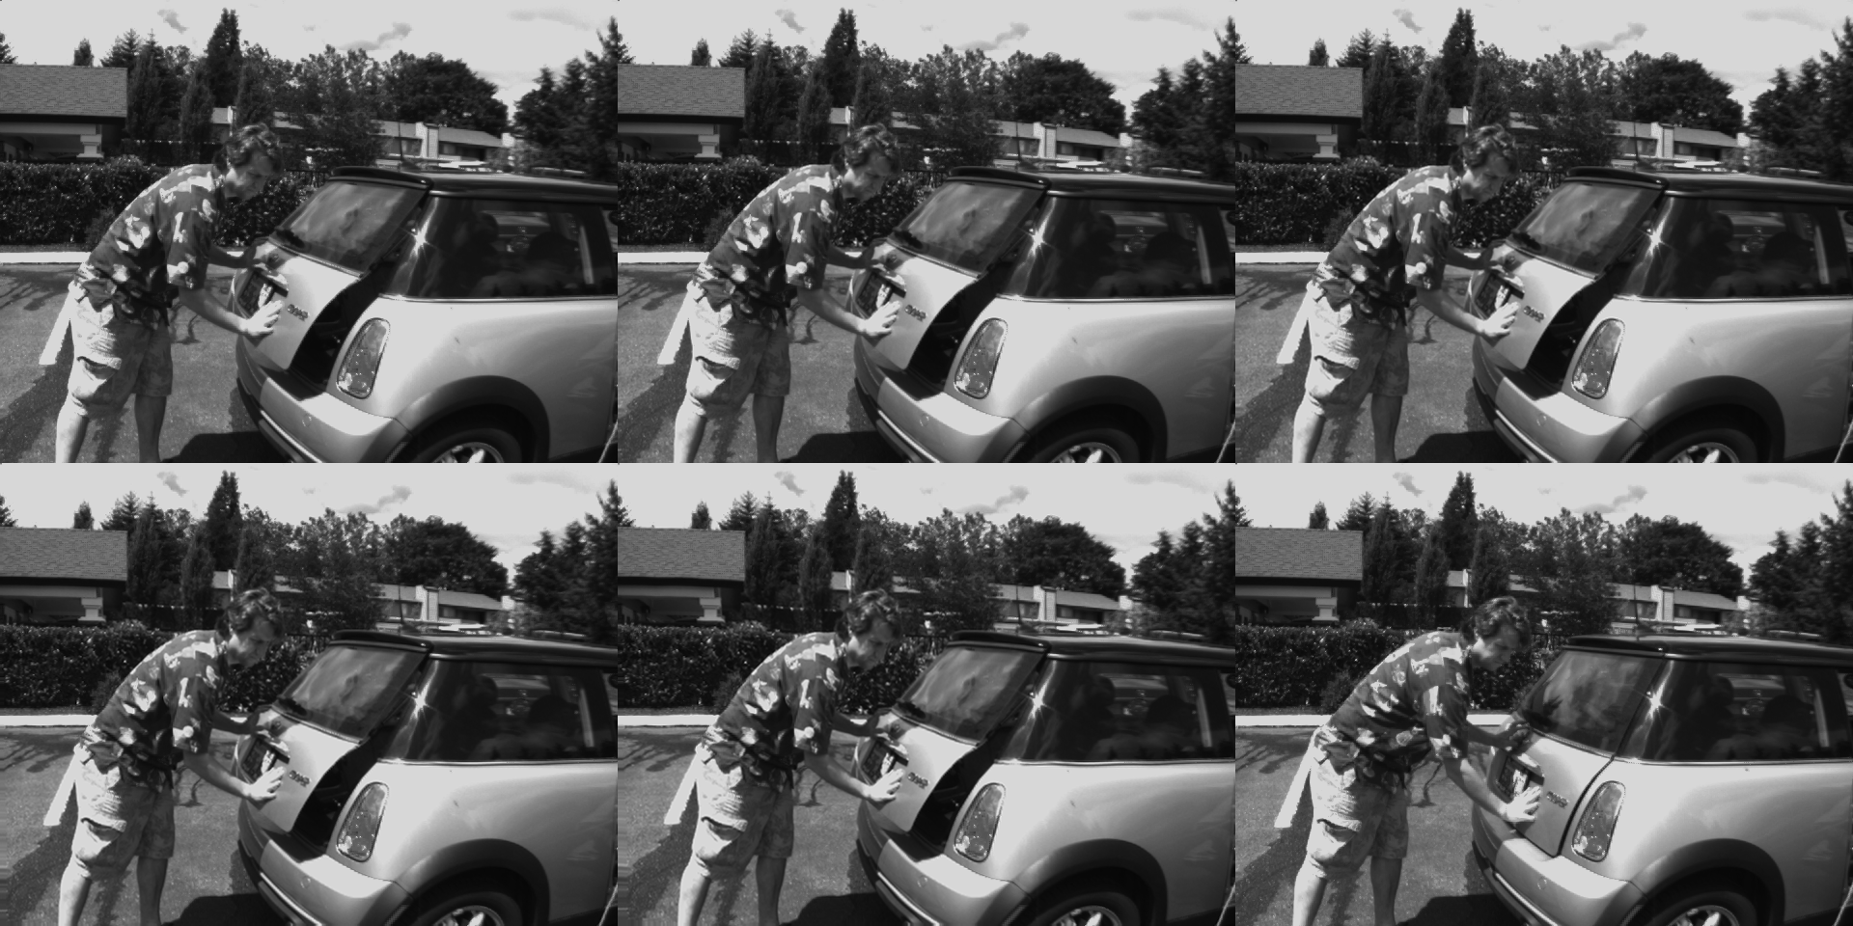
5b: Frame Interpolation
ps4-5-b-2.png
Computer Vision @ GT

Slide 20
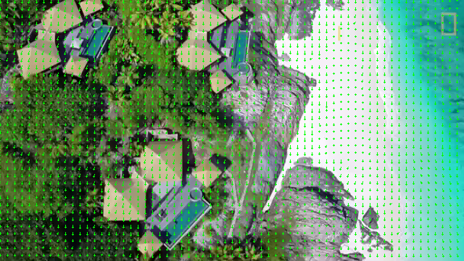
6: Challenge Problem
ps4-6-a-1.png
Computer Vision @ GT

Slide 21
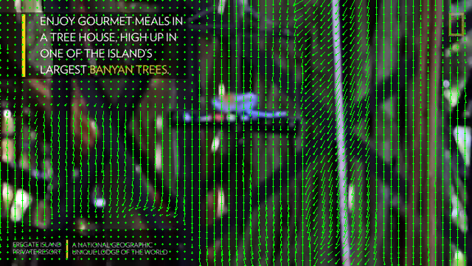
6: Challenge Problem (cont.)
ps4-6-a-2.png
Computer Vision @ GT

Slide 22
6: Challenge Problem (cont.)
https://youtu.be/wm6CaBrocDU
Computer Vision @ GT

Slide 23
If your pdf is larger than 7MB
Please compress it using (or something similar):
https://smallpdf.com/compress-pdf
Verify that all images are still visible for grading.

