Slide 1
Computer Vision
Fall 2017
Problem Set #6
Zhi Zhang
zhizhang@gatech.edu
Computer Vision @ GT

Slide 2
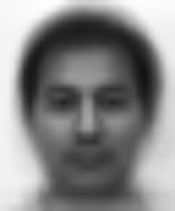
1a: Average face
ps6-1-a-1.png
Computer Vision @ GT

Slide 3
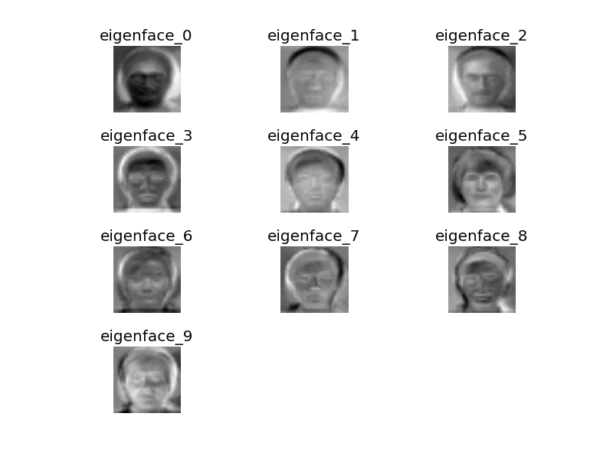
1b: Eigenvectors
ps6-1-b-1.png
Computer Vision @ GT

Slide 4
1c: Analysis
Do these “predictions” perform better than randomly selecting a label between 1 and 15?
Yes, they perform better than randomly selecting. Below is the result using “rand_y = np.random.randint(low=1, high=16, size=len(ytest))” compared to using engivectors. The p is 0.5, and k = 8.
Random:(Random) Testing accuracy: 4.82%
PCA: Good predictions = 65 Bad predictions = 18
78.31% accuracy
Computer Vision @ GT

Slide 5
1c: Analysis
Are there any changes in accuracy if you try low values of k? How about high values?
Yes, it changes. Left is the results for different k holding P as 0.5. As shown, lower k gives worse accuracy, and larger k gives better until to a point where it will converge.
K | Accuracy
1 | 27.71%
3 | 33.73%
5 | 67.47%
8 | 78.31%
10 | 71.08%
15 | 73.49%
Computer Vision @ GT

Slide 6
1c: Analysis
Does this algorithm improve changing the split percentage p?
Yes, it changes. Left is the results for different P at same K. As shown, we don’t want P to be too small because too little training samples, but, at certain point, the training sample is enough, then the accuracy will not change too much.
K | P | Accuracy
8 | 0.1 | 47.65%
8 | 0.2 | 56.82%
8 | 0.3 | 78.45%
8 | 0.5 | 78.31%
8 | 0.7 | 70.00%
8 | 0.8 | 75.76%
8 | 0.9 | 82.35%
Computer Vision @ GT

Slide 7
2a: Average accuracy
Report the average accuracy over 5 iterations. In each iteration, load and split the dataset, instantiate a Boosting object and obtain its accuracy. Below result using the P as 0.8, and num_iterations as 10
 |  | 1 | 2 | 3 | 4 | 5 | Average
Training | Random | 48.98% | 48.67% | 49.45% | 51.96% | 48.83% | 49.58%
 | Weak | 87.32% | 87.95% | 87.95% | 89.05% | 87.32% | 87.92%
 | Boosting | 98.28% | 97.81% | 98.90% | 99.06% | 99.22% | 98.65%
Testing | Random | 48.75% | 51.88% | 55.00% | 56.25% | 43.12% | 51.00%
 | Weak | 89.38% | 84.38% | 86.88% | 80.00% | 86.88% | 85.50%
 | Boosting | 99.38% | 98.12% | 98.75% | 95.62% | 97.50% | 97.87%
Computer Vision @ GT

Slide 8
2a: Analysis
Analyze your results. How do the Random, Weak Classifier, and Boosting perform? Is there any improvement when using Boosting?
As shown below, using P as 0.8, and num_iterations as 10, the random just guess half percent correctly, the weak classifier is doing better, but the boosting can achieve even better.
Methods | Testing Accuracy
Random | 51.00%
Weak Classifier | 85.50%
Boosting | 97.87%
Computer Vision @ GT

Slide 9
2a: Analysis
How do your results change when selecting different values for num_iterations?
As shown below, holding the P as 0.8, as the number of iterations increase, the random and weak classifier results keep relative stable, but the boosting can get better results.
Iterations | Random Testing Accuracy | Weak Testing Accuracy | Boosting Testing Accuracy
5 | 49.38% | 87.50% | 90.62%
8 | 41.25% | 90.62% | 95.00%
10 | 49.38% | 89.38% | 96.25%
15 | 49.38% | 88.75% | 97.50%
20 | 55.62% | 89.38% | 100.00%
Computer Vision @ GT

Slide 10
2a: Analysis
Does it matter the percentage of data you select for training and testing (explain your answers showing how each accuracy changes).?
As shown below, holding the num_iterations as 20, as the P increases, the random and weak classifier results are up and down, but the boosting can get better results, and will converge eventually.
P | Random Testing Accuracy | Weak Testing Accuracy | Boosting Testing Accuracy
0.2 | 53.12% | 87.19% | 97.03%
0.35 | 46.35% | 84.81% | 97.50%
0.5 | 50.25% | 87.75% | 97.75%
0.7 | 53.33% | 90.00% | 98.33%
0.9 | 55.00% | 88.75% | 100.00%
Computer Vision @ GT

Slide 11

3a: Haar Features
ps6-3-a-1.png
Computer Vision @ GT

Slide 12

3a: Haar Features
ps6-3-a-2.png
Computer Vision @ GT

Slide 13
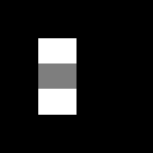
3a: Haar Features
ps6-3-a-3.png
Computer Vision @ GT

Slide 14

3a: Haar Features
ps6-3-a-4.png
Computer Vision @ GT

Slide 15

3a: Haar Features
ps6-3-a-5.png
Computer Vision @ GT

Slide 16


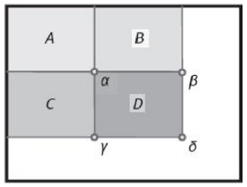
3c: Analysis
How does working with integral images help with computation time? Give some examples comparing this method and np.sum.
Integral image can improve the computing efficiency because once the summed-area table has been computed, any sum of intensities over any rectangular area can be calculated by means of exactly four array references regardless of the area size. In the following example, the sum of rectangle D is
If using np.sum, it needs sum times, also, in the feature calculation, each feature will need a sum of pixels under white and black rectangles, the number of features is very big, so the computation time will significantly incresed if without working with integral images.
W
H
Computer Vision @ GT

Slide 17
4b: Viola Jones Features
ps6-4-b-1.png
Computer Vision @ GT

Slide 18
4b: Viola Jones Features
ps6-4-b-2.png
Computer Vision @ GT

Slide 19
4b: Analysis
Report the classifier accuracy both the training and test sets with a number of classifiers set to 5. What do the selected Haar features mean? How do they contribute in identifying faces in an image?
Prediction accuracy on training: 95.71%
Prediction accuracy on testing: 65.71%
The selected Haar features mean the most relevant features that can represent the properties of the face. They have the minimum error rate for classification, and they are the features that best classify the face and non-face images. The two features selected relies on the property that the bridge of the nose is darker than the eyes. By using these selected features, a lot of irrelevant features are eliminated, which increased the prediction accuracy and computation efficiency.
Computer Vision @ GT

Slide 20

4c: Viola Jones Face Recognition
ps6-4-c-1.png
Computer Vision @ GT

