Slide 1
CS 4476 Project 1
Sebastian
seb.Hollister@gatech.edu
shollister7
903304661

Slide 2
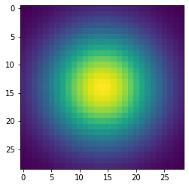
Part 1: Image filtering
<insert visualization of Gaussian kernel from proj1.ipynb here>
<Describe your implementation of my_imfilter() in words.>
The goal of my_imfilter() was to apply a filter to an image. The first step was to pad the image, which was padded to ½ the height and width of the filter. Then I looped through the number of channels, and for each channel I looped through the entire image row rise. At each of these indexs, I created a window to apply the filter to using slices, and then applied the filter by using np multiply and sum. The resulting value replaced the center of the window for each index.

Slide 3
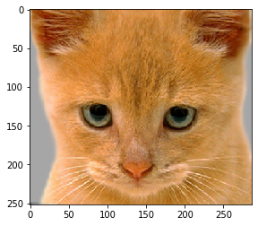

Part 1: Image filtering
Identity filter
<insert the results from proj1_test_filtering.ipynb using 1b_cat.bmp with the identity filter here>
Small blur with a box filter
<insert the results from proj1_test_filtering.ipynb using 1b_cat.bmp with the box filter here>

Slide 4
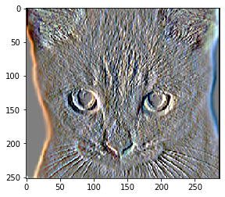
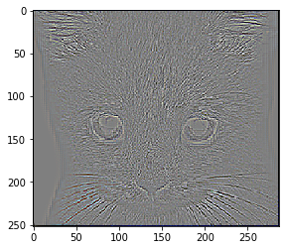
Part 1: Image filtering
Sobel filter
<insert the results from proj1_test_filtering.ipynb using 1b_cat.bmp with the Sobel filter here>
Discrete Laplacian filter
<insert the results from proj1_test_filtering.ipynb using 1b_cat.bmp with the discrete Laplacian filter here>

Slide 5
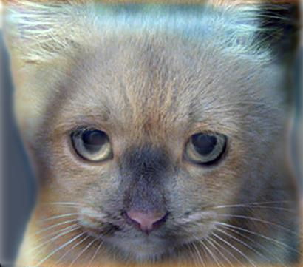
Part 1: Hybrid images
<Describe your implementation of create_hybrid_image() here.>
To get the low freq image, I use my_imfilter() and applied the low freq filter to image 1. Then, to get the high freq of image2, I subtracted out the result of the low freq filter applied on image2 from image 2. To get the hybrid image, I added together the two images (low and high freq), and clipped the image to be between 0 and 1.
Cat + Dog
<insert your hybrid image here>
Cutoff frequency: <insert the value you used for this image pair> 7

Slide 6
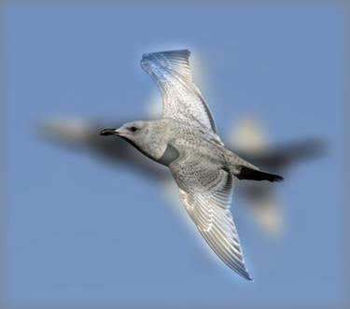
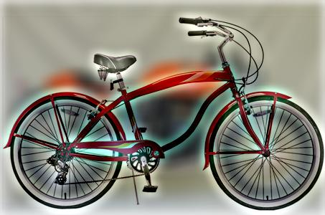
Part 1: Hybrid images
Motorcycle + Bicycle
<insert your hybrid image here>
Cutoff frequency: <insert the value you used for this image pair> 7
Plane + Bird
<insert your hybrid image here>
Cutoff frequency: <insert the value you used for this image pair> 7

Slide 7
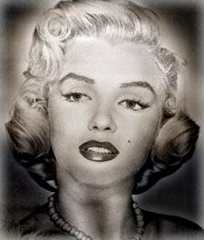
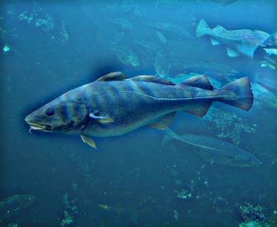
Part 1: Hybrid images
Einstein + Marilyn
<insert your hybrid image here>
Cutoff frequency: <insert the value you used for this image pair> 7
Submarine + Fish
<insert your hybrid image here>
Cutoff frequency: <insert the value you used for this image pair> 7

Slide 8
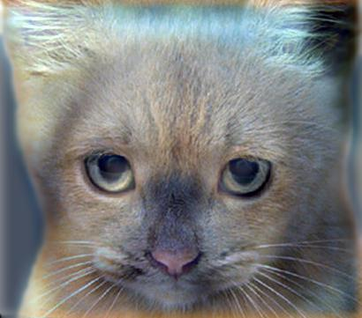
Part 2: Hybrid images with PyTorch
Cat + Dog
<insert your hybrid image here>
Motorcycle + Bicycle
<insert your hybrid image here>

Slide 9
Part 2: Hybrid images with PyTorch
Plane + Bird
<insert your hybrid image here>
Einstein + Marilyn
<insert your hybrid image here>

Slide 10
Part 2: Hybrid images with PyTorch
Submarine + Fish
<insert your hybrid image here>
Part 1 vs. Part 2
<Compare the run-times of Parts 1 and 2 here, as calculated in proj1.ipynb. What can you say about the two methods?>
Part 1 Runtime: 6.87 seconds
Part 2 Runtime: 0.61 seconds
Part 2 runtime is much faster, as torch has been optimized and is much more efficient.

Slide 11
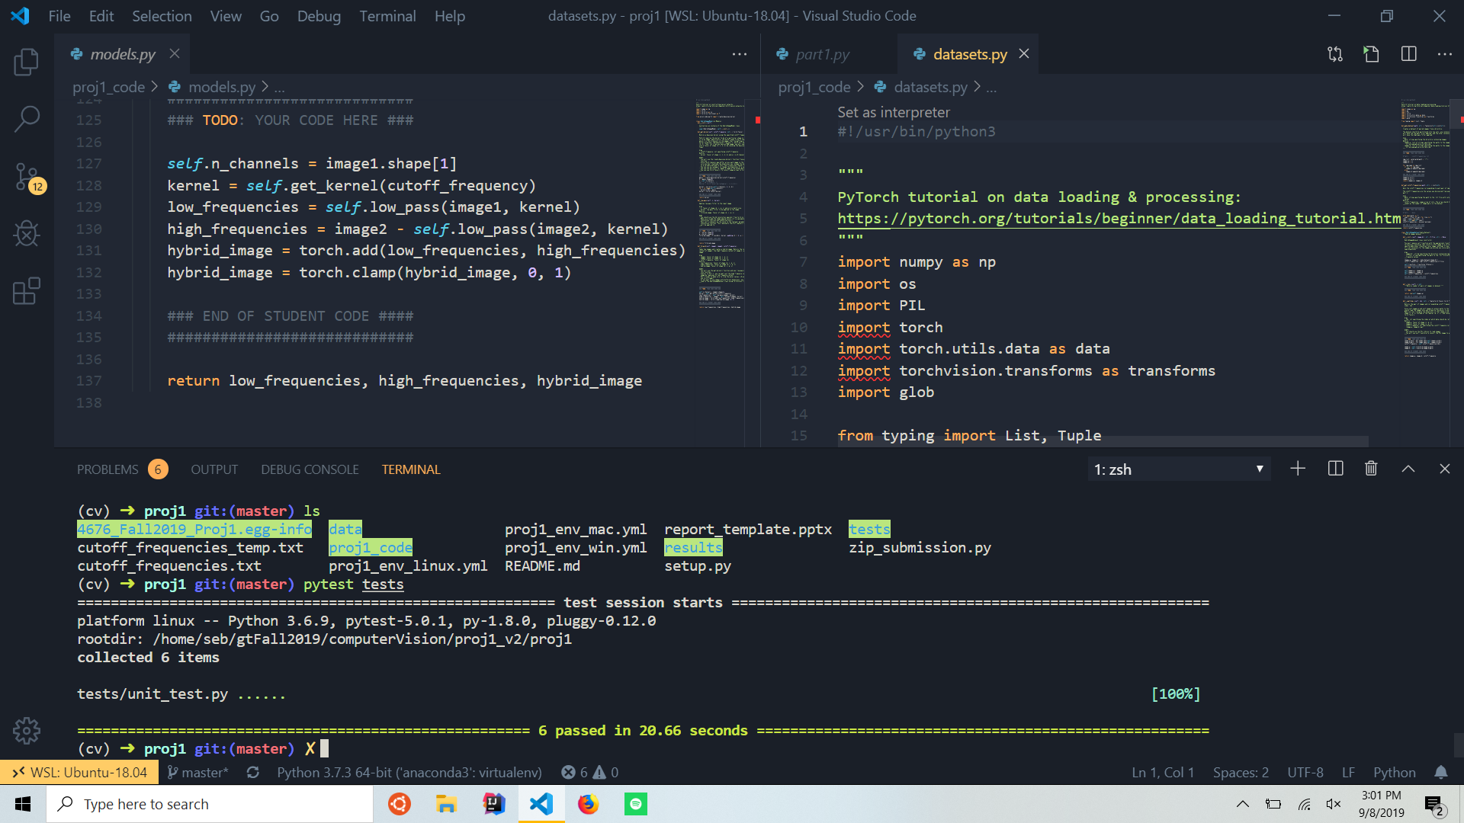
Tests
<Provide a screenshot of the results when you run `pytest tests` on your final code implementation (note: we will re-run these tests).>

Slide 12
Conclusions
<Describe what you have learned in this project. Consider questions like how varying the cutoff frequency value or swapping images within a pair influences the resulting hybrid image. Feel free to include any challenges you ran into.>
Working on this project taught me a couple things. First, it was interesting to see how filters are actually applied to images both with how the kernel “slides” across and the actual linear algebra behind it. Also, this project was the first time I used pytorch so I learned a lot about how image manipulation works within an established framework, as well as how much more effecent libraries like pytorch can make the workflow. I ran into many challenges trying to get jupyter notebook to work right.

