Slide 1
CS 4476 Project 2
Sebastian Hollister
Seb.hollister@gatech.edu
shollister7
903304661

Slide 2
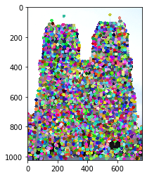
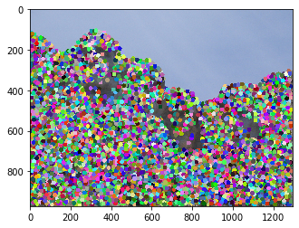
Part 1: HarrisNet
<insert visualization of Notre Dame interest points from proj2.ipynb here>
< insert visualization of Rushmore interest points from proj2.ipynb here >

Slide 3
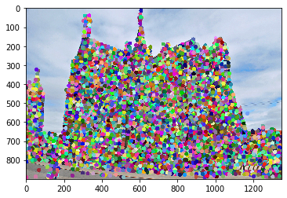
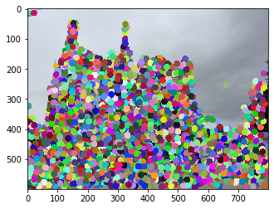
Part 1: HarrisNet
< insert visualization of Gaudi interest points from proj2.ipynb here >

Slide 4
Part 1: HarrisNet
<Describe how the HarrisNet you implemented mirrors the original harris corner detector process. (First describe Harris) What does each layer do? How are the operations we perform equivalent?)>
The HarrisNet we implemented mirrors the original harris net corner detector process by splitting the computations up into five layers. In the first layer, we compute the horizontal and vertical derivatives Ix and Iy using a sobel kernel and convolving that with the original image. Then, the channelProductLayer takes the Ix and Iy results, multiplies them between channels and returns Ixx, Iyy and Ixy. The SecondMomentMatrixLayer then takes this result, and calculates the second moment matrix which is {S_xx, S_xy, S_xy, S_yy}. This is done by convolving the Gaussian over the previous layer’s output. Next, the CornerResponseLayer takes in the second moment matrix and computes R=det(M) – alpha(trace(M))^2, assigning score to each pixel on how “good of a corner they are”. The last layer takes these score and performs non-maximum suppression, so only the strongest corners show up.

Slide 5
Part 2: SiftNet
<Describe how the SiftNet you implemented mirrors the Sift Process. (First describe Sift) What does each layer do? How are the operations we perform equivalent?)>
SIFT is a feature descriptor, which means it assigns a unique description or “fingerprint” to each feature. These fingerprints should be unique and consistent despite scale, rotation, or other factors which allows consistent identification of features between images. In our first layer, we compute the gradient at each pixel by convolving the image with the sobel filter. Next, we project these gradients onto orientation vectors, which are angles covering the entire unit circle. This gives us the contribution of each gradient to each orientation bin (angle). The Histogram Layer then takes the result of these projections and bins them, returning a weighted histogram at every pixel. Finally, the SubGridAccumulation Layer takes a region, and accumulates the histograms for each pixel for the entire region, creating the unique description of the pixel.

Slide 6
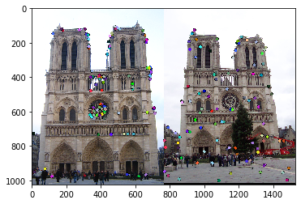
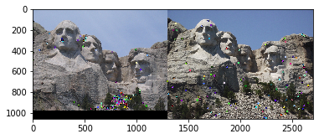
Part 3: Feature Matching
<insert feature matching visualization of Notre Dame from proj2.ipynb>
<insert feature matching visualization of Rushmore from proj2.ipynb >

Slide 7
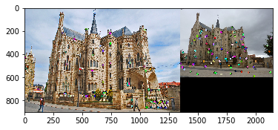
Part 3: Feature Matching
<insert feature matching visualization of Gaudi from proj2.ipynb >
<Describe your implementation of feature matching.>
The first step in feature matching was to compute the distances between each feature in both the images. I did this using np.outer and np.hypot. Next, to actually match the features, we implemented the raio test which uses the nearest neighbor distance ratio. To calculate this, I found the nearest neighbors of the current feature, d1 and d1, then took d1 / d2. If this value was less than the threshold of 0.8, the feature was a match. Unfortunately, even though I passed all the tests and found 100/100 matches, I could not figure out how to get my accuracy above 0.

Slide 8
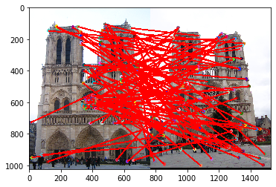
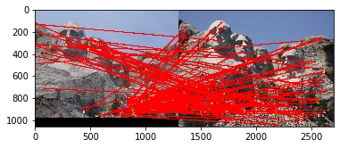
Results: Ground Truth Comparison
<Insert visualization of ground truth comparison with Notre Dame from proj2.ipynb here>
<Insert visualization of ground truth comparison with Rushmore from proj2.ipynb here>

Slide 9
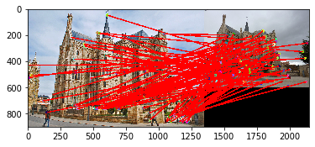
Results: Ground Truth Comparison
<Insert visualization of ground truth comparison with Gaudi from proj2.ipynb here>
<Insert numerical performances on each image pair here. Also discuss what happens when you change the 4x4 subgrid to 2x2, 5x5, 7x7, 15x15 etc?>
On all of the pictures, I got:
Matches: 100/100
Accuracy: 0.000
Increasing the size of the sub grid would give a more accurate description of the feature, but would increase computation cost.

Slide 10
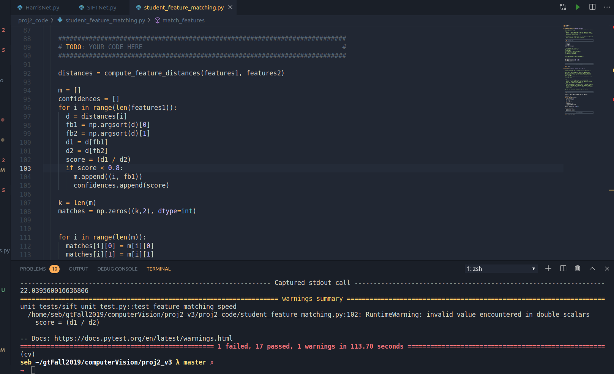
Tests: 1-failed 17pass. test_get_siftnet_features failed but had the correct sum and shape

Slide 11
Conclusions
Although the project was very frustrating, I learned a lot. I feel like I gained substantial high level understanding, and I could see how each net worked together to identify features (Harris), describe them so they can be found between images (Sift), and then matched using the ratio test. I ran into many issues with this project, and spent many many hours lost. The most frustrating thing was I implemented everything so that all the tests were passing (even the additional unit tests), and found 100/100 matches for the images, but always had accuracy of 0. My hunch is somewhere in get interest points or in siftnet get_coordinates I switched x and y, but I simply ran out of time and couldn’t work the bug out. Additionally, to run the test I couldn’t figure out how to full vectorize my code, so trying to test my implementations took about 5 min which made for a slow development process.

