Slide 1
Computer Vision
Fall 2018
Problem Set #6
James Peruggia
jperuggia@gatech.edu
Computer Vision @ GT

Slide 2
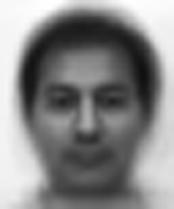
1a: Average face
ps6-1-a-1.png
Computer Vision @ GT

Slide 3
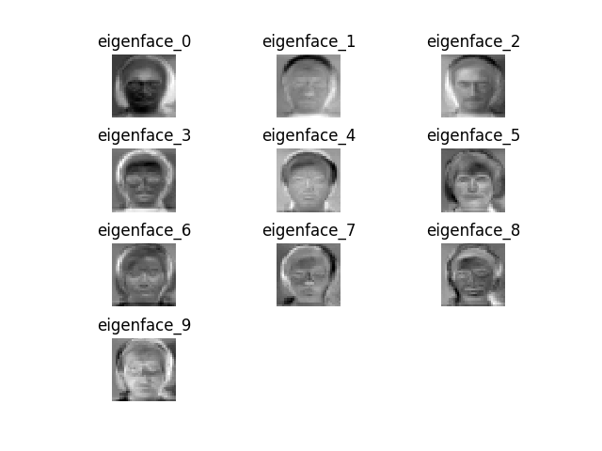
1b: Eigenvectors
ps6-1-b-1.png
Computer Vision @ GT

Slide 4
1c: Analysis
The predictions here perform much better than randomly selecting a value between 1 and 15. To validate this I randomly selected a value of 1 to 15 and compared the results to the PCA selector. The results obtained were as follows
Type | Good | Bad | Percent Correct
Random Value | 5 | 78 | 6.02%
PCA (Eigenvectors) | 57 | 26 | 68.67%
Computer Vision @ GT

Slide 5
1c: Analysis
K | Percent Accuracy
1 | 14.46%
3 | 45.78%
5 | 63.86%
7 | 74.70%
9 | 75.90%
11 | 72.29%
13 | 77.11%
15 | 79.52%
17 | 75.90%
19 | 56.63%
21 | 75.90%
23 | 80.72%
While changing the values of k we can see that the resulting accuracy is impacted. At low K values we see very low accuracy in our predictions. As K increases our accuracy increases, but tends to stabilize around 75 – 80% range for accuracy.

Slide 6
1c: Analysis
As we change the percent of data that is allowed to be trained on, we can also see that our accuracy increases. For this method, I left k=15 (Based on previous results), and enumerated over new values of P. Our most accurate result was when p = 0.9. It is important to note the huge increase in accuracy when we went from 0.1 to 0.3 as well. This might indicate that although we increase our training set size, the increase in accuracy falls off to not be as drastic as the size of our training data increases.
P | Accuracy %
0.1 | 38.93%
0.3 | 75.86%
0.5 | 80.72%
0.7 | 84.00%
0.9 | 88.24%

Slide 7
2a: Average accuracy
Training Result Set
Type | 1 | 2 | 3 | 4 | 5 | Average
Random | 48.51% | 48.36% | 51.33% | 49.92% | 52.74% | 50.172%
Weak | 87.48% | 87.32% | 86.70% | 87.48% | 86.23% | 87.042%
Boosting | 92.49% | 91.55% | 93.74% | 94.21% | 92.64% | 92.926%
Testing Result Set
Type | 1 | 2 | 3 | 4 | 5 | Average
Random | 52.50% | 50.62% | 50% | 48.75% | 51.88% | 50.75%
Weak | 86.25% | 88.75% | 89.38% | 86.25% | 90.00% | 88.126%
Boosting | 92.50% | 89.38% | 94.38% | 92.50% | 95.00% | 92.752%
Computer Vision @ GT

Slide 8
2a: Analysis
We can see that our random classifier is by far the worst method achieving an accuracy of 50.75% on average on our testing set. Our boosting model is the most accurate achieving an average accuracy of over 92%. This isn’t vastly superior to our Weak classifier which obtains an average accuracy of 88%.
Computer Vision @ GT

Slide 9
2a: Analysis
Iterations | Training | Testing
1 | 86.85% | 88.75%
3 | 90.45% | 90.00%
5 | 93.58% | 94.38%
7 | 97.50% | 96.88%
9 | 99.37% | 97.50%
Different values of our num_iterations causes the boosting method to increase in accuracy as expected. The large number of Iterations we allow to happen we can see that our accuracy increases vastly. I iterated for up to 10 iterations and found that the best case was using a value of 9, achieving an accuracy of over 99% on the training set and an accuracy of 97.5% on the testing data.

Slide 10

3a: Haar Features
ps6-3-a-1.png
Computer Vision @ GT

Slide 11

3a: Haar Features
ps6-3-a-2.png
Computer Vision @ GT

Slide 12
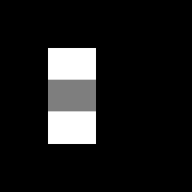
3a: Haar Features
ps6-3-a-3.png
Computer Vision @ GT

Slide 13

3a: Haar Features
ps6-3-a-4.png
Computer Vision @ GT

Slide 14

3a: Haar Features
ps6-3-a-5.png
Computer Vision @ GT

Slide 15
3c: Analysis
Working with integral images improves our computation time by an order of magnitude so it is worth using. The difference in computation is negligible when dealing with small sets, but once we get to a size of over 10,000 iterations , a noticable change can be observed. When using np.sum(), the total time was roughly 2.116 seconds, but when using integral images, we can see the average time decrease to roughly 1 second.
This can be attributed to the fact that when using np.sum() the values need to be recalculated every time whereas the use of integral images allows the values to be calculated once and reused for all iterations.
Computer Vision @ GT

Slide 16
4b: Viola Jones Features
ps6-4-b-1.png
Computer Vision @ GT

Slide 17
4b: Viola Jones Features
ps6-4-b-2.png
Computer Vision @ GT

Slide 18
4b: Analysis
Type | Accuracy
Training | 80.00%
Testing | 82.86%
As indicated by the table above, there is a training accuracy of 80% and testing accuracy of 82.86%. I attempted to achieve higher training accuracy, but in doing so I would loose testing accuracy due to possible over fitting.
Computer Vision @ GT

Slide 19
4b: Analysis
The selected haar features represent the best haar features that were used to find the properties of a face. They have the lowest error rate for classification and are deemed the best to classify face and non-face images. By using these selected features, a lot of irrelevant properties of a face are eliminated thus increasing the accuracy of our classifiers.

Slide 20

4c: Viola Jones Face Recognition
ps6-4-c-1.png
Computer Vision @ GT

