Slide 1
Computer Vision
Fall 2018
Problem Set #4
James Peruggia
jperuggia@gatech.edu
Computer Vision @ GT

Slide 2
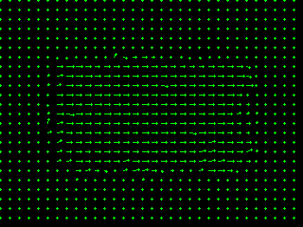
1a: Base Shift0 and ShiftR2
ps4-1-a-1.png
Computer Vision @ GT

Slide 3
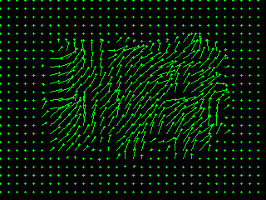
1a: Base Shift0 and ShiftR5U5
ps4-1-a-2.png
Computer Vision @ GT

Slide 4
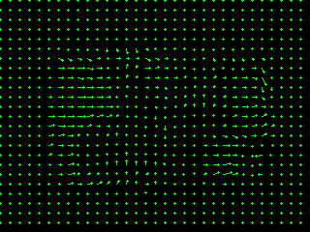
1b: Base Shift0 and ShiftR10
ps4-1-b-1.png
Computer Vision @ GT

Slide 5

1b: Base Shift0 and ShiftR20
ps4-1-b-2.png
Computer Vision @ GT

Slide 6

1b: Base Shift0 and ShiftR40
ps4-1-b-3.png
Computer Vision @ GT

Slide 7
1b: Text Response
Does LK still work? Does it fall apart on any of the pairs? Try using different parameters to get results closer to the ones above. Describe your results and what you tried.
LK appears to fall apart when there is a large amount of change between frames. I noticed that when there was a large movement in the image, that the optic flow was difficult to capture since the kernel size had to increase to capture such movement. When increasing the kernel size, the area of motion increased, as well as the flow being skewed into improper directions at times. To assist with the tuning of the K value, code was written to help visualize which kernel size would lead to the best results.
Computer Vision @ GT

Slide 8
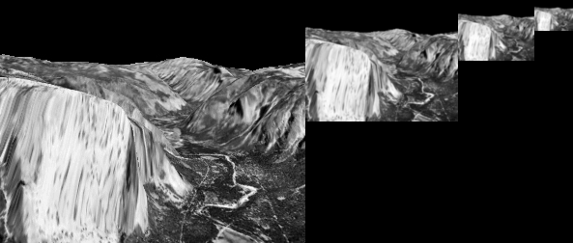
2a: Gaussian Pyramid
ps4-2-a-1.png
Computer Vision @ GT

Slide 9
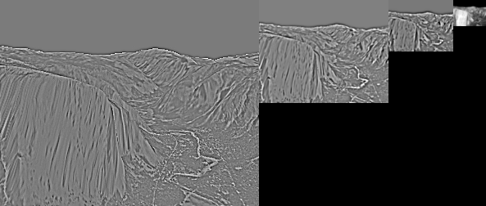
2b: Laplacian Pyramid
Laplacian Pyramid Image - ps4-2-b-1.png
Computer Vision @ GT

Slide 10
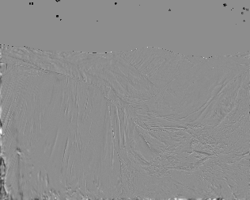
3a: Difference images
ps4-3-a-1.png
Computer Vision @ GT

Slide 11
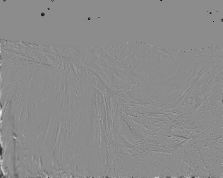
3a: Difference images (cont.)
ps4-3-a-2.png
Computer Vision @ GT

Slide 12
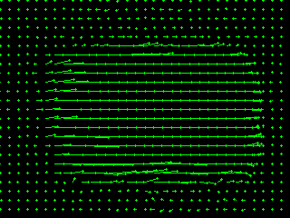
4a: Hierarchical LK
ps4-4-a-1.png
Computer Vision @ GT

Slide 13
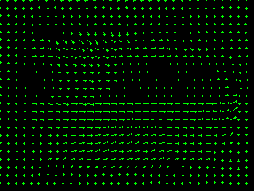
4a: Hierarchical LK (cont.)
ps4-4-a-2.png
Computer Vision @ GT

Slide 14
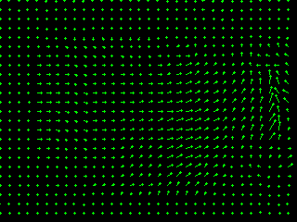
4a: Hierarchical LK (cont.)
ps4-4-a-3.png
Computer Vision @ GT

Slide 15
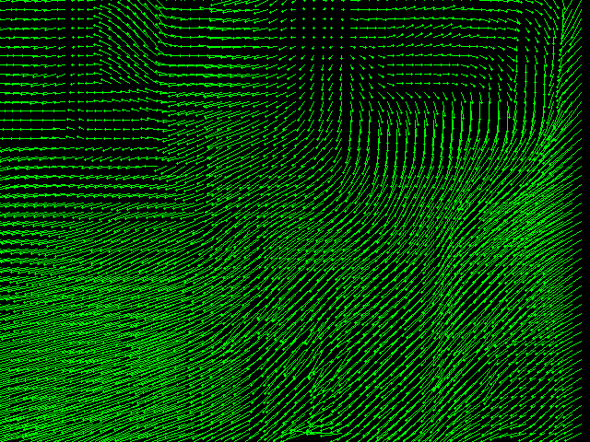
4b: Hierarchical LK (cont.)
ps4-4-b-1.png
Computer Vision @ GT

Slide 16
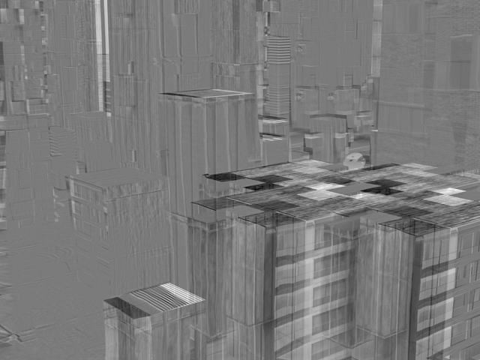
4b: Hierarchical LK (cont.)
ps4-4-b-2.png
Computer Vision @ GT

Slide 17
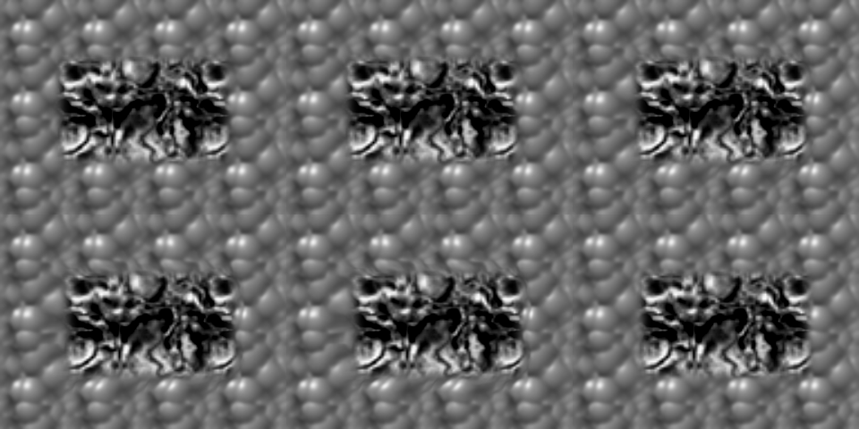
5a: Frame Interpolation
ps4-5-a-1.png
Computer Vision @ GT

Slide 18
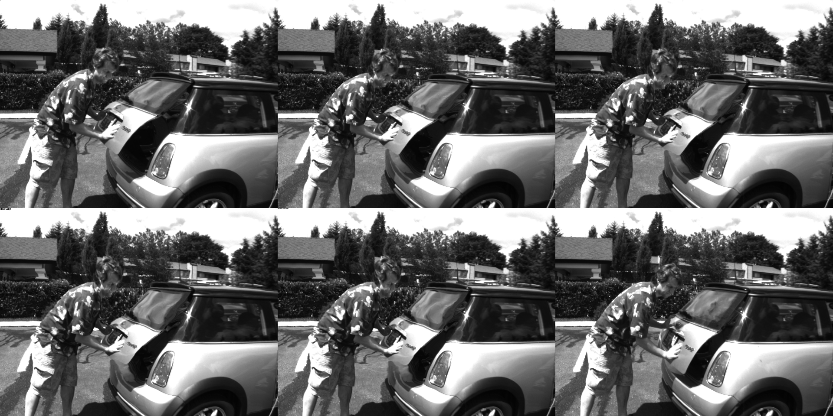
5b: Frame Interpolation
ps4-5-b-1.png
Computer Vision @ GT

Slide 19
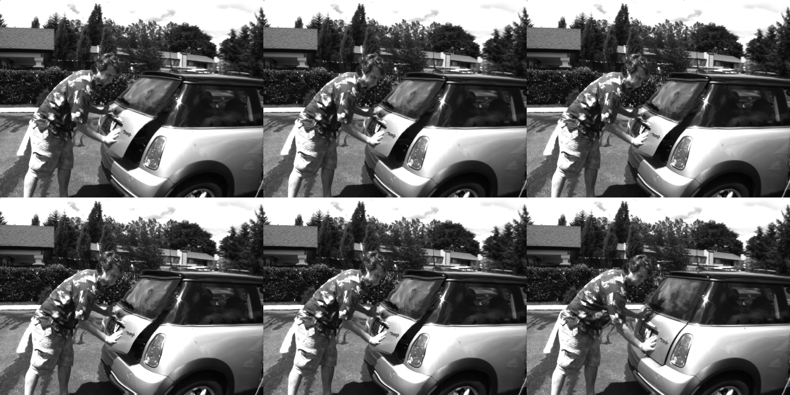
5b: Frame Interpolation
ps4-5-b-2.png
Computer Vision @ GT

Slide 20
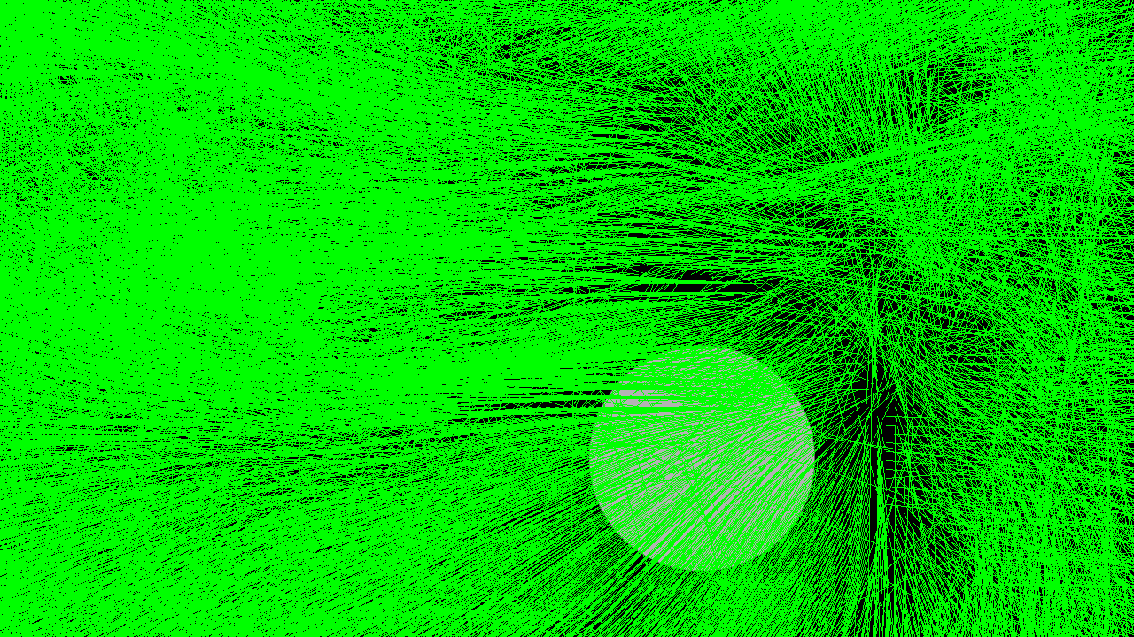
6: Challenge Problem
ps4-6-a-1.png
Computer Vision @ GT

Slide 21
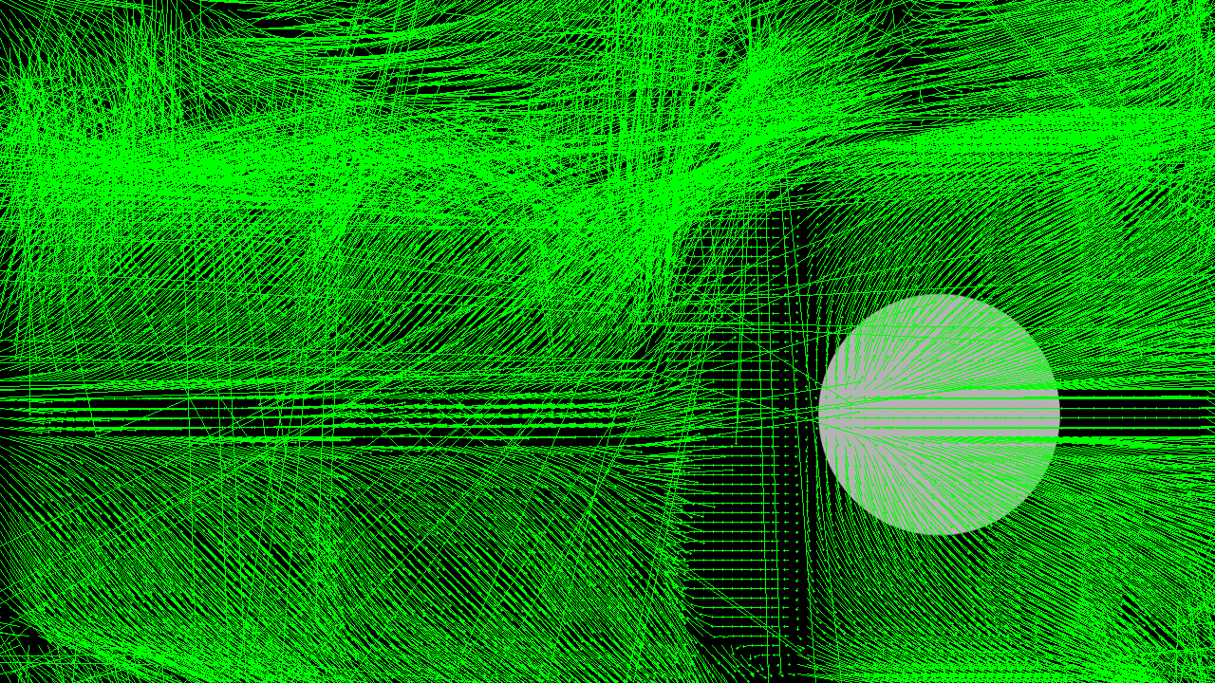
6: Challenge Problem (cont.)
ps4-6-a-2.png
Computer Vision @ GT

Slide 22
6: Challenge Problem (cont.)
My output video wouldn’t run on computer. Much time was spent trying to understand why without reason.
Computer Vision @ GT

Slide 23
If your pdf is larger than 7MB
Please compress it using (or something similar):
https://smallpdf.com/compress-pdf
Verify that all images are still visible for grading.

