Slide 1

Early Prediction of At-Risk Students
27.4%
At-Risk students
YadYar Lite • Topic T-29 • Phase 2
30 days
Lightweight ML Study
OULAD AAA/2013J
Early activity only
Members: Mahdieh Tajbakhsh; Atena Molaee; Fatemeh Masoomi
Presentation order: Atena Molaee -> Fatemeh Masoomi -> Mahdieh Tajbakhsh
YadYar Lite • T-29 At-Risk Student Prediction
1

Slide 2
Problem: find students who may need early support
Task definition and class imbalance
105
First 30 days
activity + enrollment
ML model
risk probability
Human support
review + intervention
At Risk
278
Not At Risk
At Risk = Fail or Withdrawn
Not At Risk = Pass or Distinction
Minority class is the one the project cares about
Goal: warning signal, not automatic judgment
YadYar Lite • T-29 At-Risk Student Prediction
2

Slide 3
Features: only what is known by day 30
Leakage prevention is central to the experiment
Allowed features
Excluded from inputs
Day 0
Day 30
Final result
Enrollment & demographics
previous attempts, credits
education, region, age band
VLE activity
total clicks, active days
resources visited
Early assessments
submitted count
average score before day 30
final_result and all post-day-30 behavior are never used as model inputs
YadYar Lite • T-29 At-Risk Student Prediction
3

Slide 4
Models and evaluation
A simple baseline plus one bonus comparison model
Baseline models
Majority Dummy
Standard Logistic Regression
Balanced Logistic Regression
Bonus models
Standard LightGBM
Balanced LightGBM
small trees to reduce overfitting
Decision thresholds
0.50 = default
0.30 = higher recall
same test split for all models
Recall
PR-AUC
Cost
5×FN + FP
primary metric
ranking under imbalance
illustrative cost
Reason: a missed at-risk student is treated as more harmful than an unnecessary support alert.
YadYar Lite • T-29 At-Risk Student Prediction
4

Slide 5
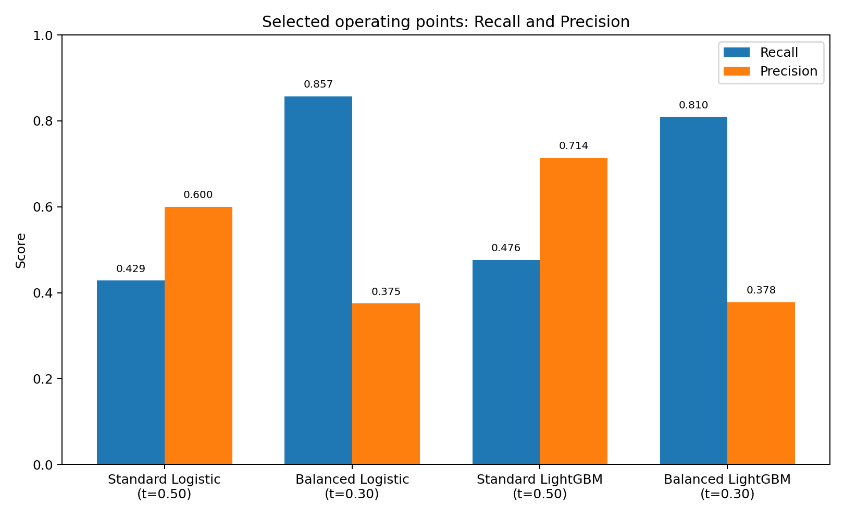
Main result: operating point matters
High recall vs. high precision
Choice | Model | Recall | Precision | Cost
High recall | Bal. Logistic @0.30 | 0.857 | 0.375 | 45
High precision | Std. LightGBM @0.50 | 0.476 | 0.714 | 59
Best PR-AUC | Bal. LightGBM | — | — | 0.654
Balanced Logistic finds 18 of 21 at-risk students.
Standard LightGBM has fewer false alerts.
This is an operating-policy decision, not just a model contest.
YadYar Lite • T-29 At-Risk Student Prediction
5

Slide 6
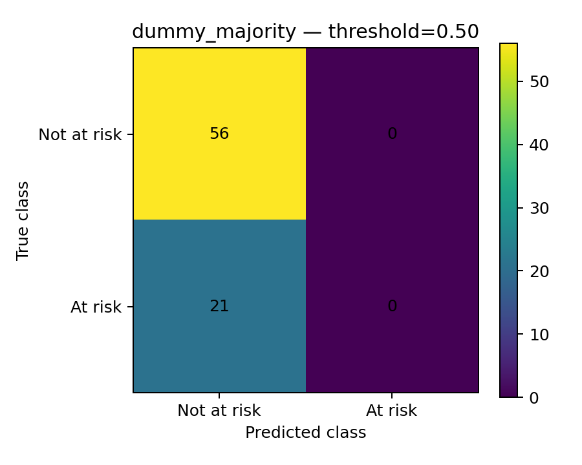
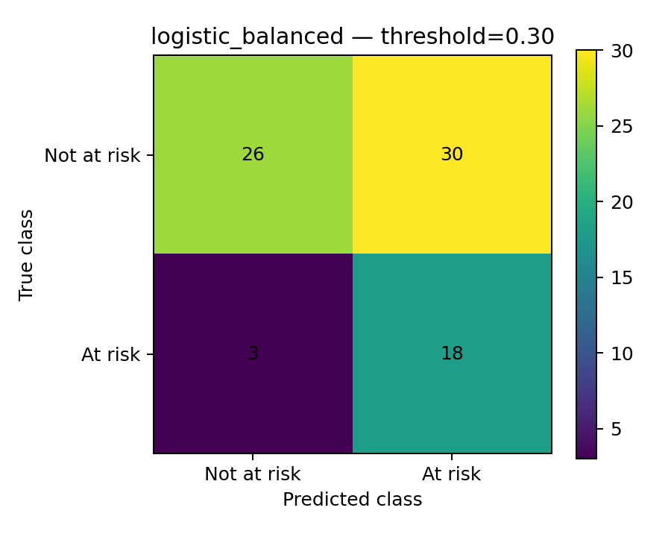
Why Accuracy alone is misleading
The majority model looks acceptable but misses every at-risk student
72.7% Accuracy, 0% Recall
85.7% Recall, only 3 FN
YadYar Lite • T-29 At-Risk Student Prediction
6

Slide 7
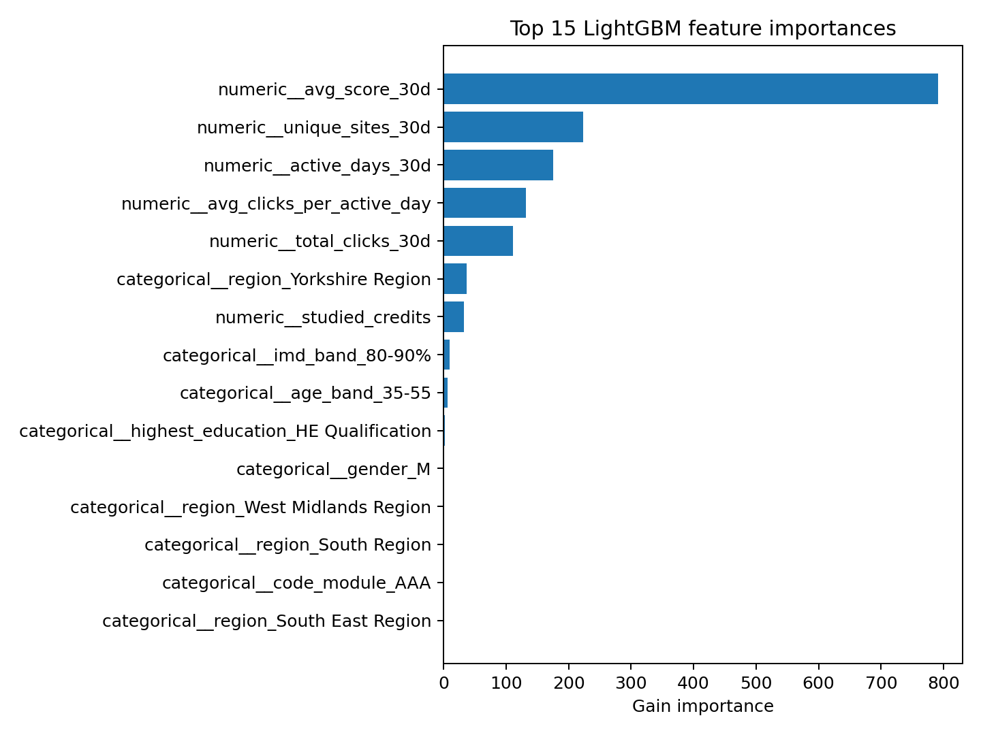
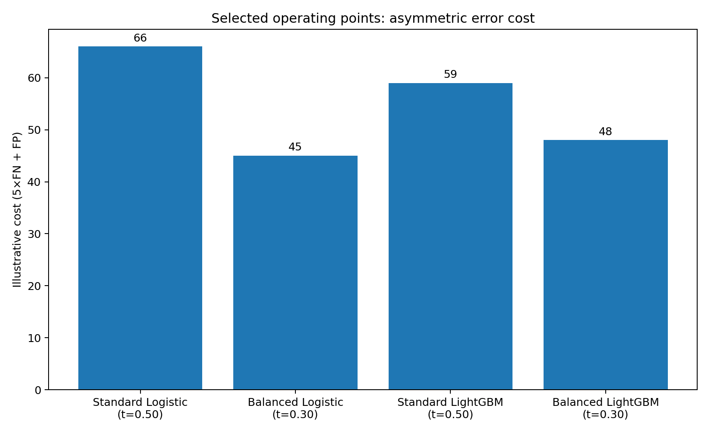
Threshold trade-off and LightGBM explanation
Lower threshold reduces missed students but increases support alerts
Cost falls from 105 for the majority classifier to 45 at the high-recall Logistic operating point.
YadYar Lite • T-29 At-Risk Student Prediction
7

Slide 8
Error analysis: missed and over-flagged students
Representative mistakes and engagement groups
False negatives
Most serious: at-risk students not flagged
Some look active early, then fail or withdraw
False positives
Low early activity or missing early score
Some students later recover and pass
Main slice finding
Low engagement has the highest at-risk rate
YadYar Lite • T-29 At-Risk Student Prediction
8

Slide 9
Demo and future integration
A lightweight warning component for a learning assistant
Input
first-30-day
student features
Risk model
probability +
threshold
Output
at-risk flag
for tutor review
Limitations and future work
One course presentation only
Small test set: 21 at-risk students
Threshold and cost ratio are illustrative
Future: temporal split, tutor-capacity threshold, calibration and fairness checks
{ risk_probability: 0.74, prediction: "At Risk", action: "Early academic support" }
Use the model as a configurable, human-reviewed early-warning signal — not as an automatic decision system.
YadYar Lite • T-29 At-Risk Student Prediction
9

