Slide 1
Mortgage Loan approval

Slide 2

Introduction
The Home Mortgage Disclosure Act (HMDA) requires many financial institutions to maintain, report, and publicly disclose information about mortgages.This dataset covers all mortgage decisions made in 2017 United states.
Dataset was compiled by the Consumer Finance
Protection Board.

Slide 3
Feature Analysis
Provided data could be group by as following, I created some new features to create a more accurate analysis:
Location describes the State, County of the property
Purchaser type and Loan actions in each states and county
Number of people who got loan approved/rejected in different gender /Race / Ethnic in each state
Salary level: describe whether people in same salary level got the loan, this also has the county , race , sex and ethnic information

Slide 4
Feature Analysis
Different reason for not getting approved in different sex/race /ethnicity in states and county
population of women who requested for mortgage, approval and rejection in each race and ethnicity by state and county
Loan describes the action taken on the Loan, purpose of the Loan , Type of the loan ,Loan’s lien status.

Slide 5
Feature Analysis
Property Type describes the Property Type and Occupancy of the property. Property type values include One-to-four family ,Manufactured housing and Multifamily . This also answers the question “Will the owner use the property as their primary residence ?” . The values include Owner occupied as principal dwelling , Not owner occupied as principal dwelling and Not Applicable.

Slide 6
Feture Analysis
Lender describes the lender associated with the loan and the Federal agency associated with the loan.
Applicant describes the demographic information for the applicants and the co-applicants.This has the applicant sex , co- applicant sex , applicant race and ethnicity, co- applicant race and ethnicity
Loan purpose in different states

Slide 7
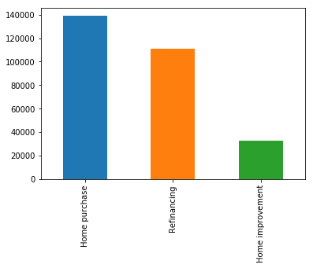
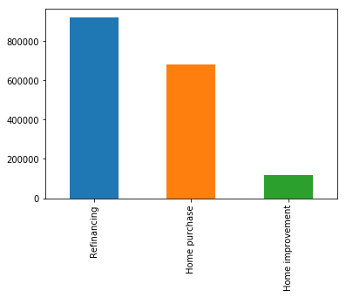
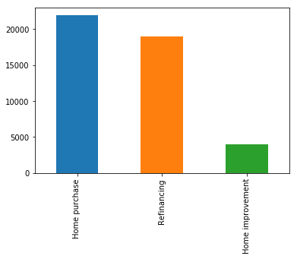
Some Interesting Graphs
The initial thought for loan purpose would be: buy a property!
but the result was quite different!
Ex In MA CA HA

Slide 8
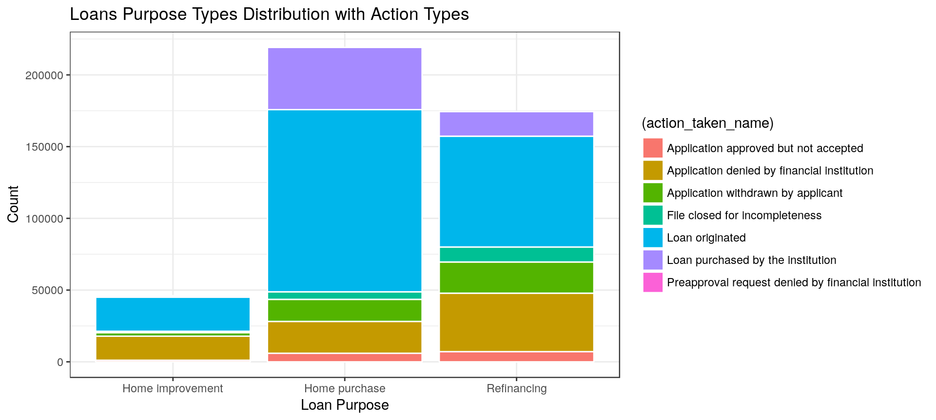
Loan purpose type and Action
While overall purpose of getting loan is :

Slide 9
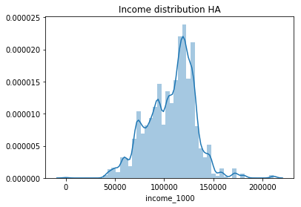
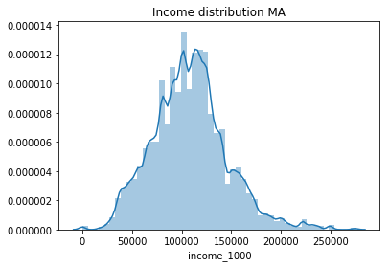
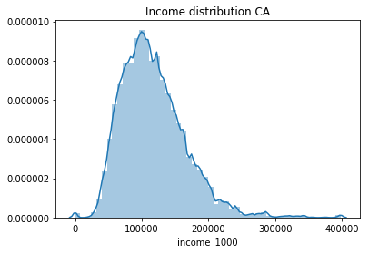
Income distribution in Selected states

Slide 10
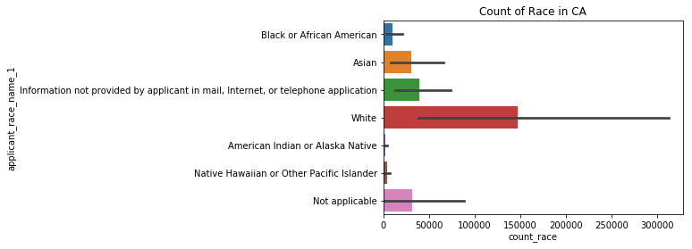
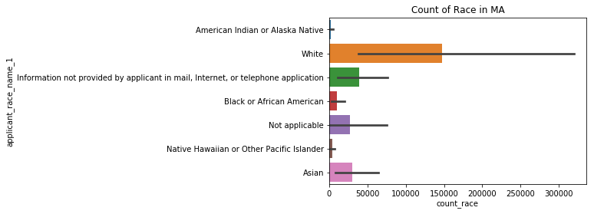
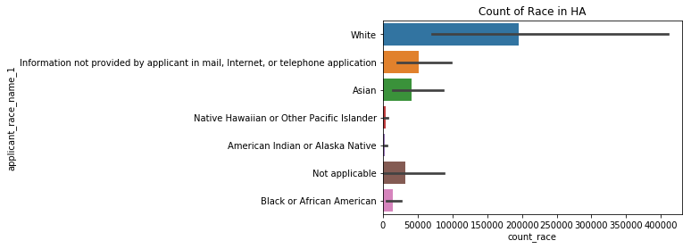
Race Distribution

Slide 11
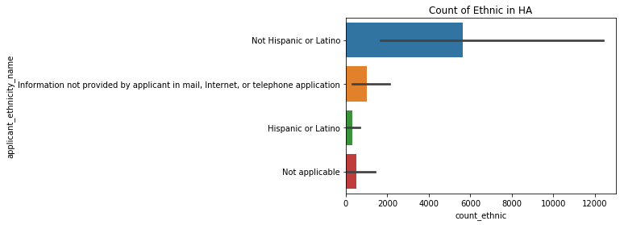
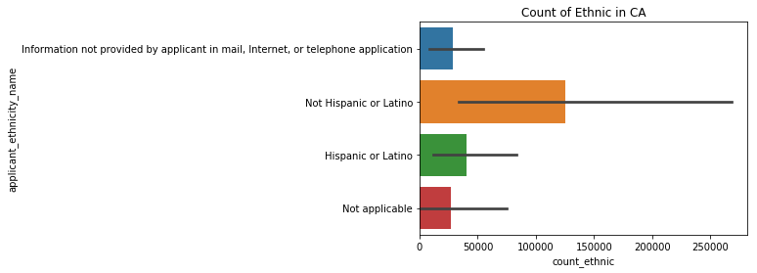
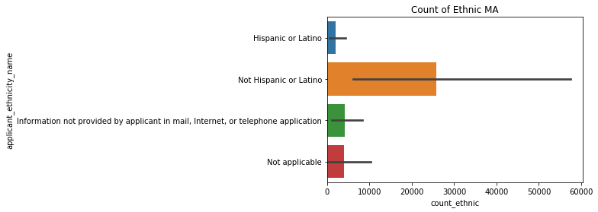
Ethnic Distribution

Slide 12
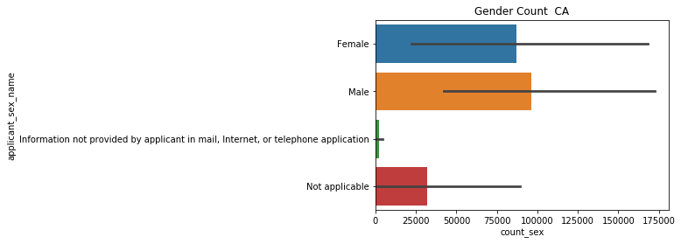
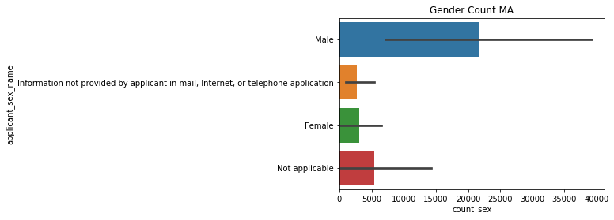
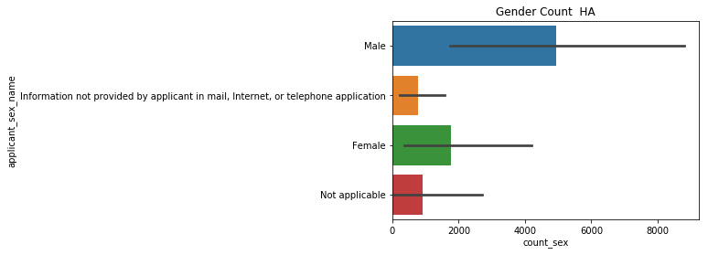
Gender distribution

Slide 13
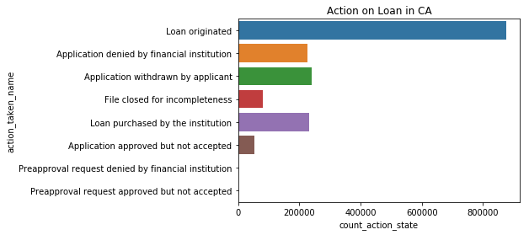
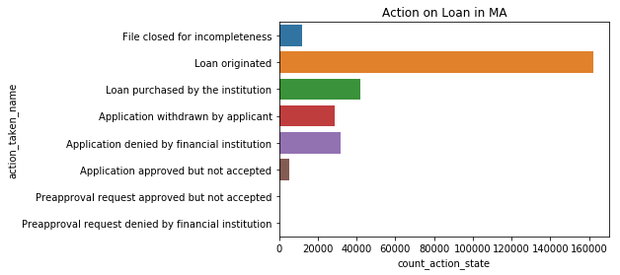
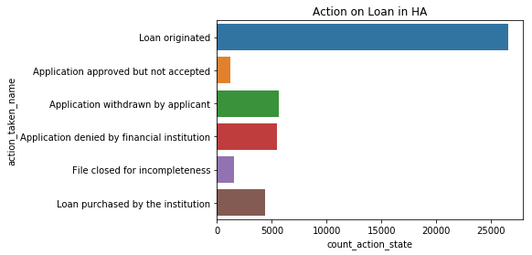
Action taken on loan

Slide 14
Classification model
I would like to find out which factors influence the decision that the loan would have the final status of Loan Origination. I extracted Important features
by defining a function and apply it on XGBoost model.

Slide 15
XGBoost Model and performance
I used XGBoosting and took 30% of the data for test set.
XGBoost provided following info:
Accuracy Score : 0.8834129952202868
classification_erro : 0.11658700477971322
Sensitivity : 0.8344486414226202
specificity : 0.9353280978319091
false_positive_rate : 0.0646719021680909
Precision : 0.9318817999939242

Slide 16
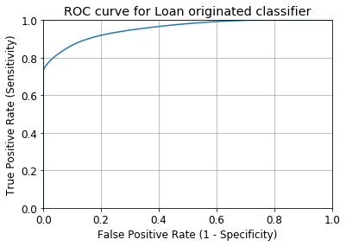
Roc Curve
Roc curve

Slide 17
AUC
AUC is the percentage of the ROC plot that is underneath the curve = 0.9559588757821277

