Slide 1
SSO
Danial Mustofa Habibi (danztensai@gmail.com)(089655394054)

Slide 2
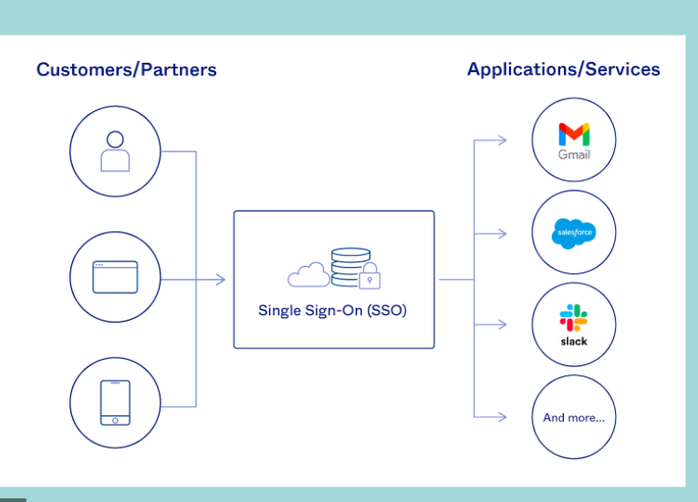
What is SSO

Slide 3
SSO Login Flow
The login flow usually looks like this:
A user browses to the application or website they want access to, aka, the Service Provider.
The Service Provider sends a token that contains some information about the user, like their email address, to the SSO system, aka, the Identity Provider, as part of a request to authenticate the user.
The Identity Provider first checks to see whether the user has already been authenticated, in which case it will grant the user access to the Service Provider application and skip to step 5.
If the user hasn’t logged in, they will be prompted to do so by providing the credentials required by the Identity Provider. This could simply be a username and password or it might include some other form of authentication like a One-Time Password (OTP).
Once the Identity Provider validates the credentials provided, it will send a token back to the Service Provider confirming a successful authentication.
This token is passed through the user’s browser to the Service Provider.
The token that is received by the Service Provider is validated according to the trust relationship that was set up between the Service Provider and the Identity Provider during the initial configuration.
The user is granted access to the Service Provider.

Slide 4
Is SSO secure?
When single sign-on best practices are followed, a reliable SSO solution can hugely improve security. It ensures that:
IT teams can leverage SSO to protect users with consistent security policies that adapt to their behavior, while simplifying the management of usernames and passwords.
Built-in security tools automatically identify and block malicious login attempts, improving the safety of business networks.
Organizations can deploy security tools like MFA in tandem with SSO, and can quickly oversee user access rights and privileges.
In addition, an SSO solution from a proven provider should give companies peace of mind through verified security protocols and service at scale.

Slide 5
The benefits of SSO
Organizations that deploy SSO reap a wide range of benefits, from avoiding the risks presented by password recycling to delivering a seamless user experience. Key benefits of single sign-on include:
Decreased attack surface: SSO does away with password fatigue and poor password practices, meaning your business is immediately less vulnerable to phishing. It enables users to focus on memorizing one strong, unique password and reduces time-consuming and costly password resets.
Seamless and secure user access: SSO provides real-time insight into which users accessed applications when, and where from, allowing enterprises to protect the integrity of their systems. SSO solutions also address security risks such as an employee losing their corporate device, enabling IT teams to immediately disable the device’s access to accounts and critical data.
Simplified user access auditing: Ensuring the right people have the right level of access to sensitive data and resources can be tricky in an ever-changing business environment. SSO solutions can be used to configure a user’s access rights based on their role, department, and level of seniority. This ensures transparency and visibility into access levels at all times.
Empowered and productive users: Users increasingly demand quick and seamless access to the applications they need to get their jobs done. Managing requests manually is a painstaking process that only serves to frustrate users. SSO authentication removes the need for manual oversight, enabling immediate access to up to thousands of apps with a single click.
Future-proofing: SSO is the first step in securing your company and its users. On the foundation of SSO, your organization can implement other security best practices such as deploying multi-factor authentication (MFA) and hooking into identity proofing, risk ratings, and consent management tools to address compliance needs and mitigate fraud. Starting off on the right foot with SSO sets your business up for future security.

Slide 6
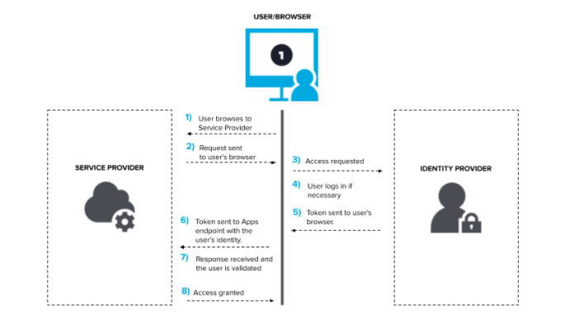
Diagram SSO

Slide 7
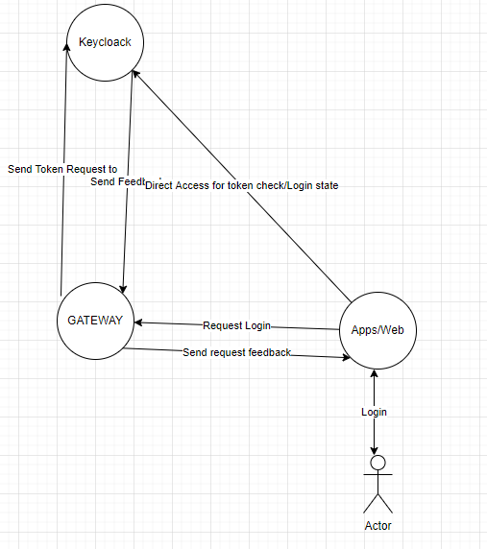
Proposed Solution

