Slide 1
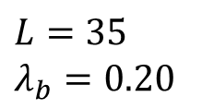
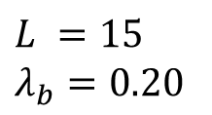

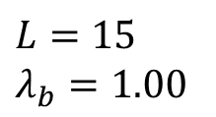
$$L =15$$
$$λ_{b}=0.20$$
Upstream river
Increasing
size
Link
$$L=35$$
$$λ_{b}=0.20$$
Habitat
Total river length $L$
$$L=15$$
$$λ_{b}=1.00$$
Increasing
complexity

