Slide 1
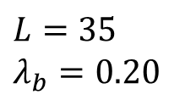
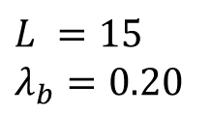
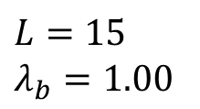
$$L =15$$
$$λ_{b}=0.20$$
Increasing
size
Upstream river
$$L=35$$
$$λ_{b}=0.20$$
Link
$$L=15$$
$$λ_{b}=1.00$$
Increasing
complexity
Habitat

