Slide 1

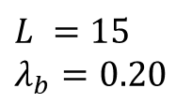
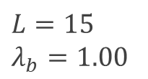
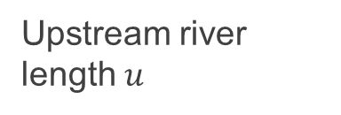
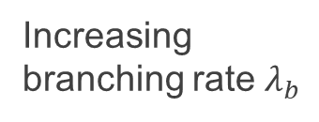
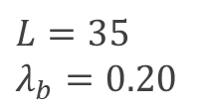
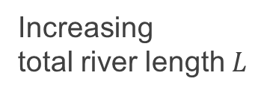

Increasing
total river length $L$
$$L=35$$
$$λ_{b}=0.20$$
Upstream river length $u$
…
Network distance $d$
$$L =15$$
$$λ_{b}=0.20$$
Diameter $ℒ$
…
Increasing
branching rate $λ_{b}$
$$L=15$$
$$λ_{b}=1.00$$
Random topology, link number,
and link length

