Slide 1

Credit Card Fraud Detection
Course : Advanced Machine Learning
Authors : Shveta Sharma, Varshita Kyal, Ujjwal Upadhyay

Slide 2
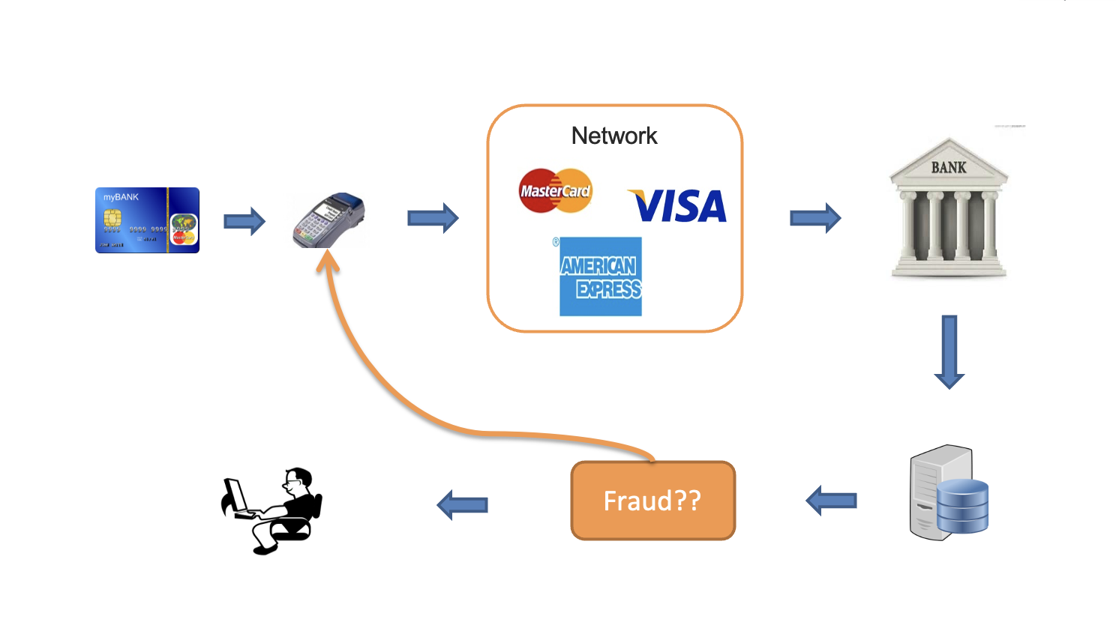
Background

Slide 3

Introduction
Credit card companies need to detect fraudulent transactions to prevent customers from being charged for items they did not purchase.
This dataset contains credit card transactions made by European cardholders in September 2013.

Slide 4

Dataset Information
Contains 284,807 transactions that occurred in two days.
The dataset is highly unbalanced with only 492 frauds out of 284,807 transactions.
The positive class (frauds) account for 0.172% of all transactions.
Only numerical input variables are provided, which are the result of a PCA transformation.
The features V1-V28 are principal components obtained with PCA, while 'Time' and 'Amount' are not transformed.
'Time' represents the seconds elapsed between each transaction and the first transaction in the dataset.
'Amount' represents the transaction amount, and can be used for cost-sensitive learning.
The response variable is 'Class', with a value of 1 indicating fraud and 0 indicating no fraud.

Slide 5
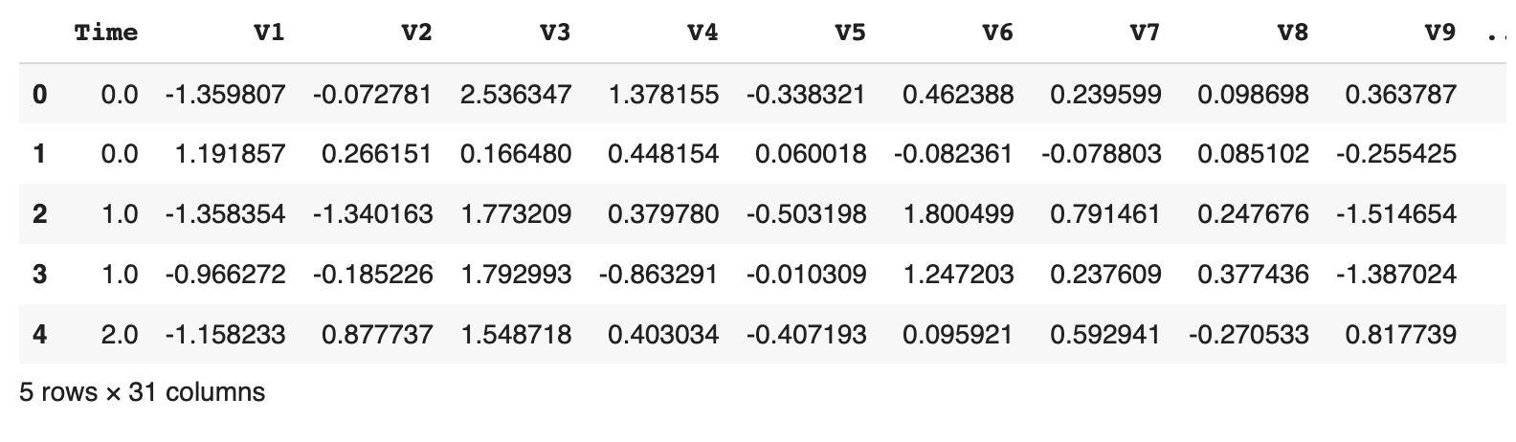
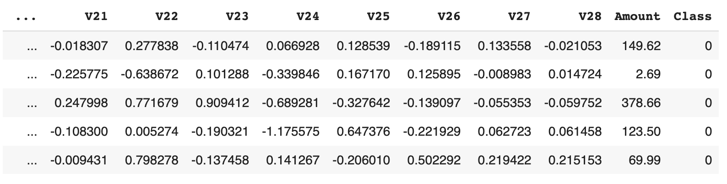
Glimpse of Dataset

Slide 6

Research Objectives
To compare and evaluate the performance of multiple machine learning algorithms, including Logistic Regression, LSTM, Dense Neural Network, and MLP RNN, for credit card fraud detection.
To investigate the impact of feature engineering techniques, specifically PCA dimensionality reduction, on the performance of credit card fraud detection models.
To develop and evaluate methods to address the issue of class imbalance, such as SMOTE oversampling, to improve the accuracy of credit card fraud detection models.
To investigate the effectiveness of various data augmentation techniques, such as oversampling and undersampling, to improve the performance of credit card fraud detection models.
To develop real-time credit card fraud detection systems using advanced machine learning techniques, such as Logistic Regression, LSTM, Dense Neural Network, and MLP RNN, that can handle large volumes of transactions and provide timely alerts to customers and card issuers.

Slide 7
Experimental Procedure
Data Collection: Collect the credit card transaction data for a specific period, preferably including a balanced number of fraudulent and non-fraudulent transactions.
Data Preprocessing: Preprocess the data by removing duplicates, handling missing values, and converting categorical data into numerical data.
Data Exploration and Visualization: Explore and visualize the data to identify patterns and relationships among the features.
Feature Engineering: Perform feature engineering techniques, such as PCA dimensionality reduction, to extract meaningful features from the data.
Data Splitting: Split the data into training, validation, and testing sets.
Model Selection: Select multiple machine learning algorithms, such as Logistic Regression, LSTM, Dense Neural Network, and MLP RNN, and train them on the training set.
Model Evaluation: Evaluate the performance of each model on the validation set using metrics such as accuracy, precision, recall, and F1-score.
Hyperparameter Tuning: Fine-tune the hyperparameters of the selected models to optimize their performance.
Class Imbalance Handling: Implement methods to handle class imbalance, such as SMOTE oversampling, to improve the accuracy of the models.
Data Augmentation: Implement data augmentation techniques, such as oversampling and undersampling, to further improve the performance of the models.
Final Model Selection: Select the best-performing model based on its performance on the testing set.
Real-time Deployment: Deploy the final model into a real-time fraud detection system that can handle large volumes of transactions and provide timely alerts to customers and card issuers.
Ongoing Monitoring: Continuously monitor the performance of the model in the real-time system and update it regularly to maintain its effectiveness over time.

Slide 8
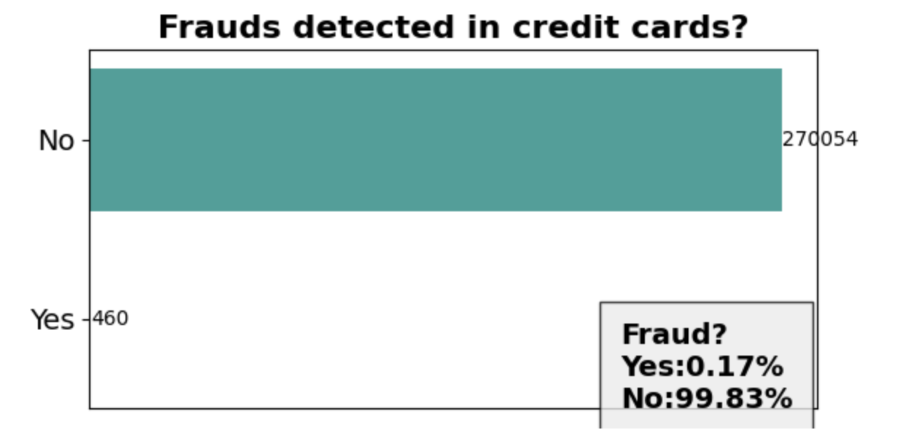
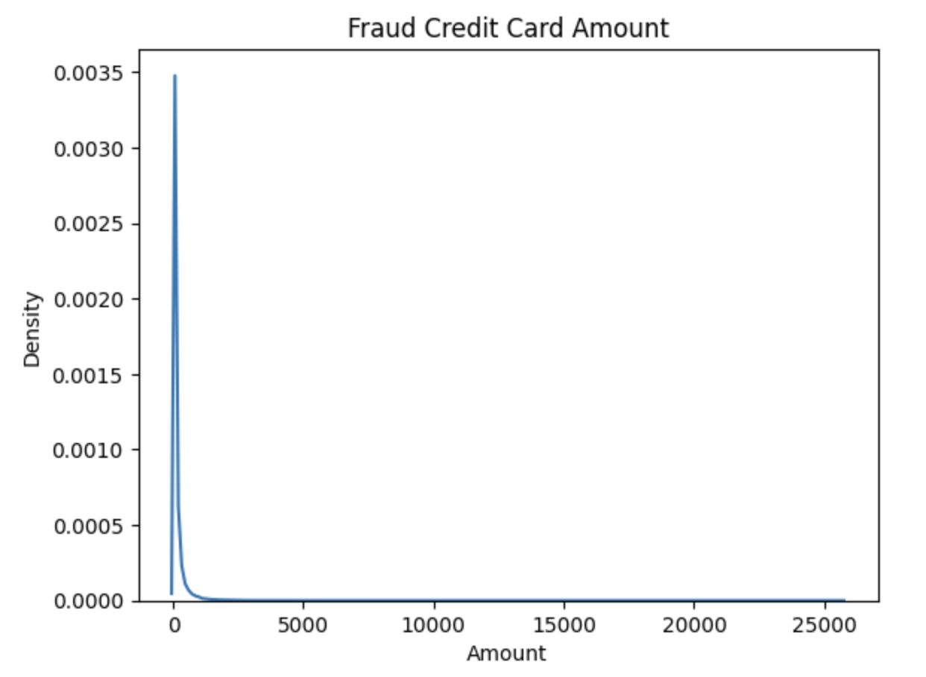
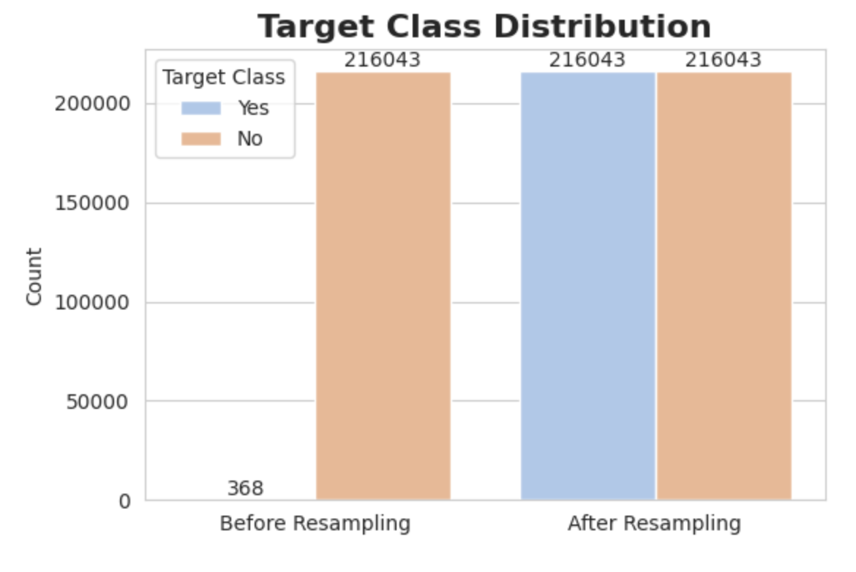
Visualization
Imbalanced Classes of Frauds in dataset
Classes balanced after using
Smote with Oversampling
KDE of Fraud Amount in dataset

Slide 9
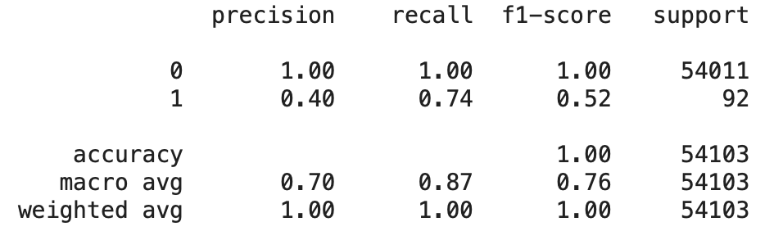
Logistic Regression
A logistic regression model is trained on the oversampled training set.
The classification report includes precision, recall, F1-score and support metrics for both classes (0 and 1).
The evaluation shows that the model has high accuracy for the majority class (0) but performs poorly for the minority class (1).

Slide 10
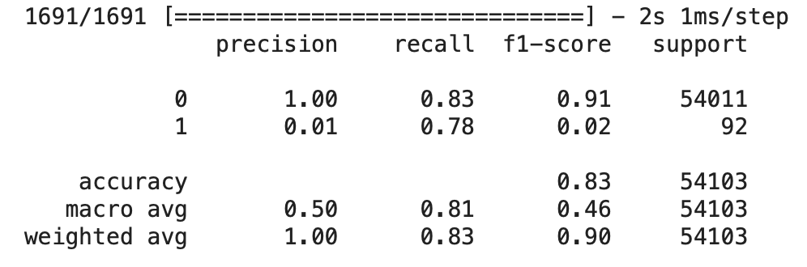
Artificial Neural Network(ANN)
The model is a sequential neural network with three fully connected layers.
It uses the binary cross-entropy loss function and the Adamax optimizer.
The training is done for 20 epochs with a batch size of 32 and a validation split of 0.2.
The model achieves a high accuracy of 0.83 on the test set.
However, it has lower precision and recall for class 1, indicating that it may not be effective at identifying instances belonging to this class.

Slide 11
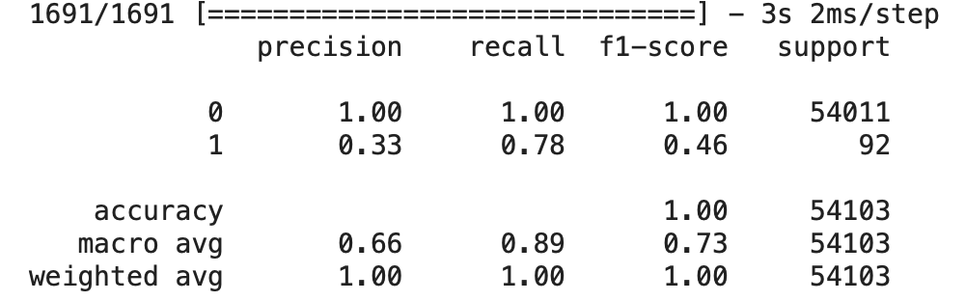
Hyper-Parameters Tunned ANN
The hyperparameter-tuned model has a more complex architecture, with 4 additional hidden layers compared to the previous model.
Regularization techniques (L2 regularization) have been added to prevent overfitting.
Dropout layers have been added to reduce overfitting.
The number of epochs has been reduced to 5 to prevent overfitting due to the increased complexity of the model.
The optimizer has been changed to Adam, which is known to perform well in deep learning models.

Slide 12
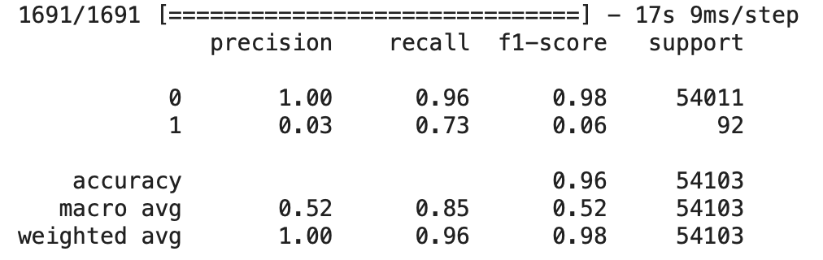
Long Short-Term Memory (LSTM)
The dataset is first preprocessed by scaling and restoring the original feature space using PCA
The LSTM model is trained using the preprocessed data with binary cross-entropy as the loss function and Adam as the optimizer.
The trained model is used to predict the classes of the test dataset, and the classification report is printed out.
The classification report shows that the model achieved an accuracy of 96% on the test dataset.
The report also shows that the model had a high precision (1.00) for class 0, but a low precision (0.03) for class 1, indicating that the model had difficulty correctly predicting samples from class 1.

Slide 13
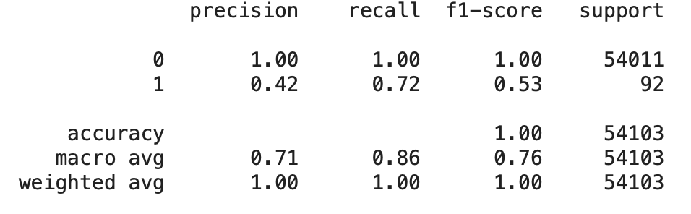
Multi-Layer Perceptron (MLP)
The MLP is initialized with three hidden layers of 200, 250, and 280 neurons, respectively.
The activation function used in the hidden layers is the hyperbolic tangent function ('tanh'), and the optimizer used is the Adaptive Moment Estimation ('adam’).
The maximum number of iterations allowed for the MLP to converge is set to 500, and a random state of 1 is specified to ensure the reproducibility of the results.
The classification report shows that the model has high accuracy (1.00) for the majority class (0) but lower accuracy (0.53) for the minority class (1). The precision, recall, and f1-score are
all higher for the majority class than for the minority class, indicating that the model performs better at identifying the majority class.

Slide 14

Conclusion & Future Work
We want to tune our ANN model further to get f1-score of 0.7 or above for Class 1
We want to tune our hyper parameters further to get a better Classes.

