Slide 1
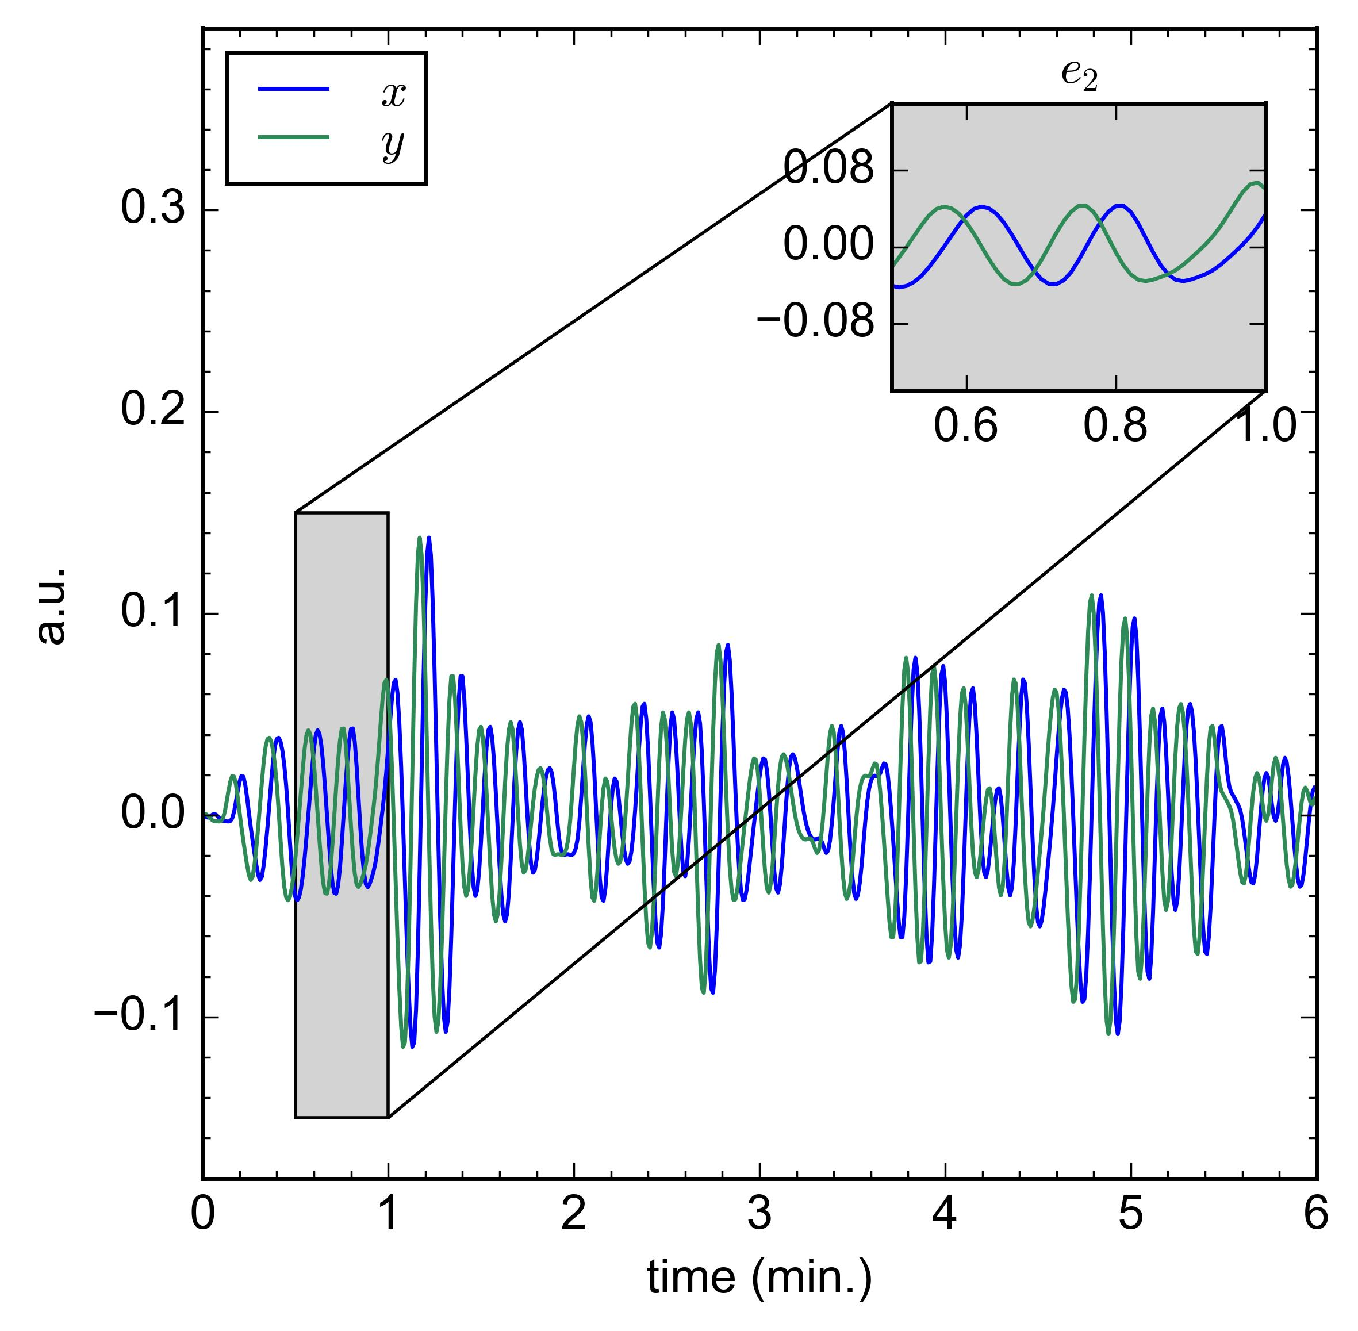
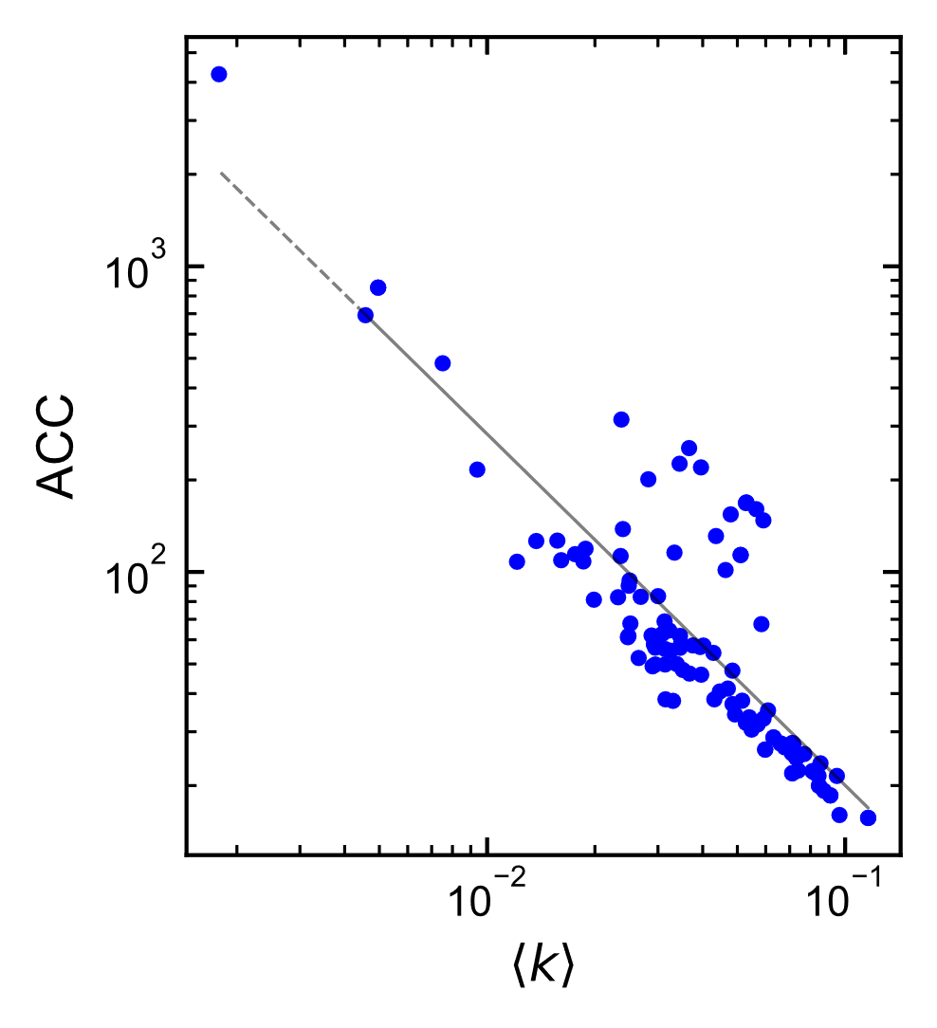







Let $e_{i}=$ sequence of indices for segment $i$ of $x,y$
For each $e_{i}$
Compute LPHVGs:
$$G_{x,i}←\text{LPHVG}\left(x\left[e_{i}\right]\right)$$
$$G_{y,i}←\text{LPHVG}\left(y\left[e_{i}\right]\right)$$
$$s_{x}=\left\{s_{x,1},s_{x,2},…,s_{x,q}\right\}$$
$$s_{y}=\left\{s_{y,1},s_{y,2},…,s_{y,q}\right\}$$
CSM Analysis
Partition $G_{x,i}, G_{y,i}$ into Leiden communities
Compute final score: $ℛ\left(s_{x},s_{y}\right)$
Select CSM
Compute CSM for each community in $G_{x,i}$, then take the average value $s_{x,i}$
Compute CSM for each community in $G_{y,i}$, then take the average value $s_{y,i}$

