Slide 1

TMall Repeat Buyers Prediction
Big Data Intelligence – Tsinghua University
Armando Fortes, David Pissarra, Gabriele Oliaro
14 December 2021

Slide 2

How promotions work
Offer discounts on particular occasions
Attract a large number of new customers
Expect some of the new buyers to become regular customers
Avoid one-time deal hunters as much as possible
Maximize return on investment (ROI) by targeting people most likely to become loyal customers

Slide 3
How promotions work
Offer discounts on particular occasions
Attract a large number of new customers
Expect some of the new buyers to become regular customers
Avoid one-time deal hunters as much as possible
Maximize return on investment (ROI) by targeting people most likely to become loyal customers
Big Data!

Slide 4

When to use Big Data
Predicting repeated buyers requires a lot of data
Difficult to do for individual stores
Readily available for large e-commerce platforms, such as TMALL
Models trained on data from large platforms can be used by individual stores, if made available

Slide 5
The competition details
Data from Tmall.com user behavior in the 6 months leading up to 11/11 promotion
Given a training and testing dataset
Need to predict labels for testing dataset and upload results in CSV format
Use AUC (Area Under the ROC Curve) to evaluate predictions

Slide 6


The competition dataset
The dataset contains two types of data:
Customer demographic information, such as age and gender
Customer-merchant interaction data:
Label indicating whether the customer is a repeated buyer (training dataset)
Activity log: one record (with timestamp, category, brand and item number, plus the action type) for each item that was clicked, added to cart, purchased or added to favorite

Slide 7
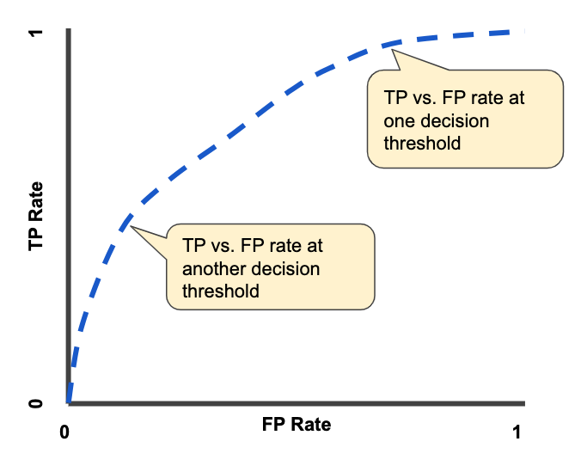
The evaluation criteria
We use the AUC (Area Under the ROC Curve) to benchmark our solutions
The ROC curve is obtained by plotting the True Positive (TP) rate as a function of the False Positive (FP) rate, with one point for each classification threshold
The AUC is the integral of the curve, evaluated from (0,0) to (1,1).
AUC is a good measure because it is scale-invariant
Image credits: developers.google.com

Slide 8
The roadmap
01
03
Clean data
Training
The first step was to reorganize the dataset to optimize memory usage, and replace invalid (nan) values
We train several classifier models (CatBoostClassifier, LGBMClassifier, XGBClassifier) and optimize their hyperparameters
04
Predicting
02
Feature
Engineering
Before training, we need to arrange the data in a way that makes training most effective. This involves creating features of interest by organizing and transforming the data with various techniques
We predict using an ensemble of the trained classifier models, taking their best instances, and optimizing the weight of each model.

Slide 9

Feature Engineering

Slide 10
Feature Engineering
There’s no strong correlation between users and merchants in the initial dataset
Solution: Create features!
Counting features (counting user purchase frequency, etc.)
Statistical analysis features based on counting features
Time period features (time span analysis, double 11 features)
Principal component analysis features (PCA features)

Slide 11
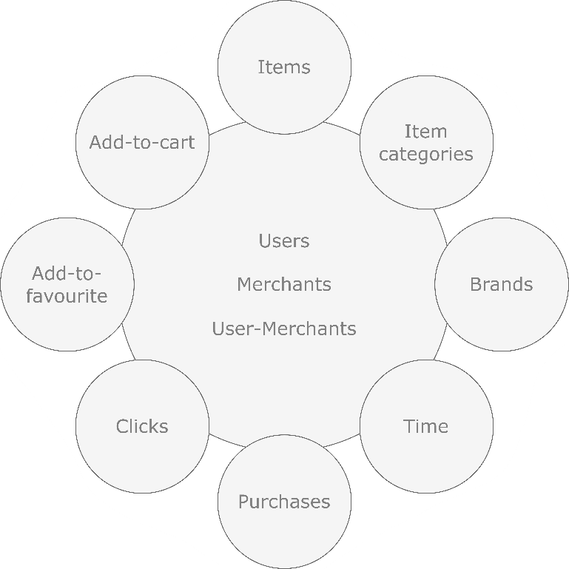
Counting Features
Interactions regarding users, merchants or even both together.
User ID | Items | Categories | Brands | Days | Months
263947 | 36 | 26 | 20 | 22 | 6
338674 | 68 | 14 | 34 | 23 | 6
9058 | 42 | 18 | 19 | 16 | 5
237186 | 20 | 9 | 18 | 6 | 4
100871 | 56 | 22 | 35 | 17 | 6
… | … | … | … | … | …
49472 | 17 | 12 | 11 | 7 | 4
28974 | 129 | 43 | 61 | 21 | 4
359629 | 223 | 55 | 64 | 34 | 5
216711 | 1950 | 319 | 726 | 126 | 6
61119 | 153 | 46 | 72 | 34 | 5

Slide 12
Statistical Analysis Features
Over the calculated user-merchant counting features:
Max
Mean
Median
Standard deviation
User ID | Merchant ID | Purchases
34176 | 3906 | 1
34176 | 121 | 1
34176 | 4356 | 6
34176 | 2217 | 1
User ID | 34176
max | 6
mean | 2.25
median | 1
std | 2.5

Slide 13
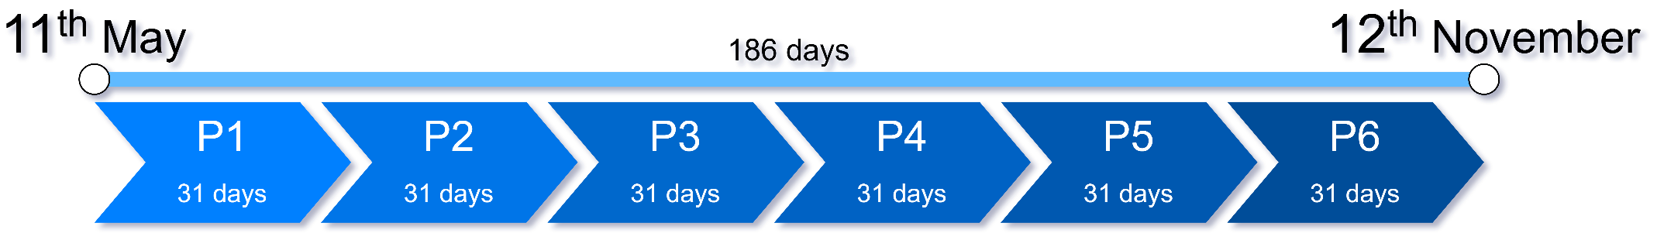
Time Period Features

Slide 14
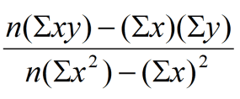
Period | Purchases
1 | 2
2 | 10
3 | 5
4 | 21
5 | 19
6 | 50
Period | Clicks
1 | 347901
2 | 125048
3 | 101852
4 | 150874
5 | 70247
6 | 90115

Slide 15
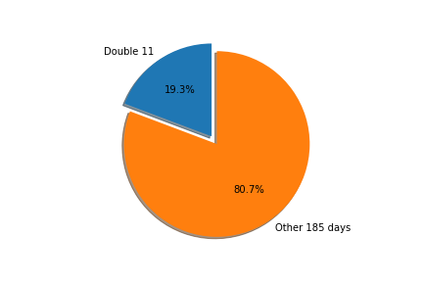
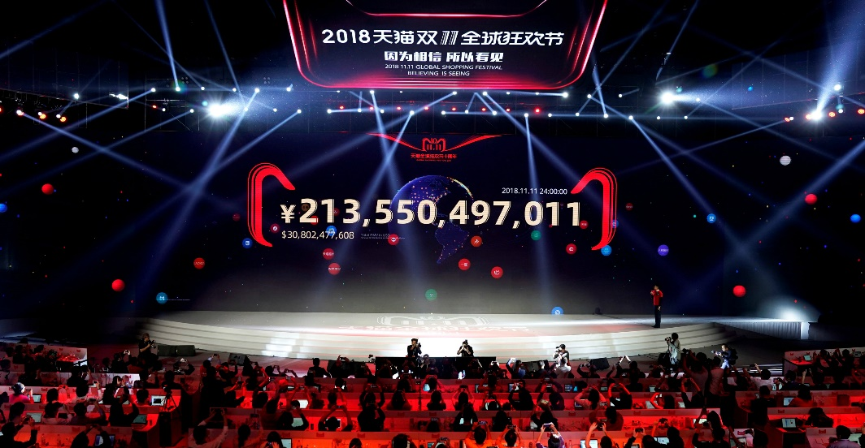
Double 11 Features
11th November – shopping festival
Huge volume of online transactions
One-time deal hunters

Slide 16
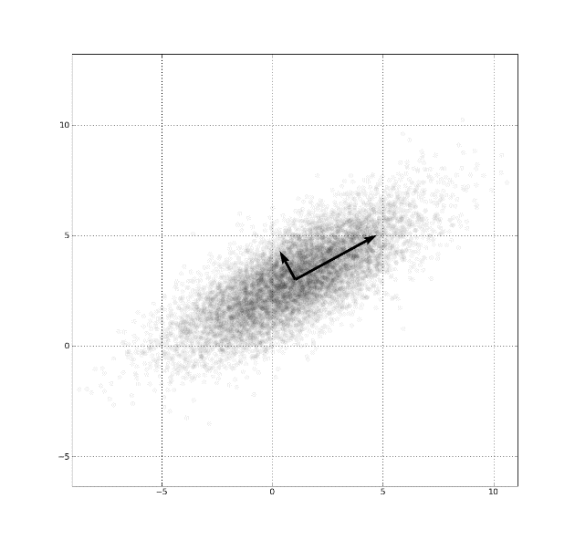
PCA Features
285 features
5 PCA features
User ID | Merchant ID | … | …
263947 | 3636 | … | …
338674 | 1452 | … | …
9058 | 3285 | … | …
237186 | 2697 | … | …
100871 | 5626 | … | …
… | … | … | …
49472 | 1787 | … | …
28974 |  | … | …
359629 | 223 | … | …
216711 | 1950 | … | …
61119 | 1532 | … | …
PCA features
…
…
…
…
…
…
…
…
…
…
…
+
Summarize all features in 5 dimensions using Principal Component Analysis and append it to the other features

Slide 17
Training Models

Slide 18



Gradient Boosting
Gradient Boosting is a stage-wise additive model which generates weak-learners during the learning process.
Decision trees are gradually added one at a time, each of them being trained using the residual errors of their predecessors as labels.
The contribution of a given decision tree to the ensemble is based on the gradient descent optimization process, where we attempt to minimize the overall error of the strong-learner.
$$+ α×$$
$$+ α×$$
$$+ …$$

Slide 19



Gradient Boosting Implementations
Stands for eXtreme Gradient Boosting. Initially started as a research project by Tianqi Chen in March 2014, becoming famous by 2016.
Developed by Microsoft, being first released in January 2017. Specifically designed to achieve faster training speeds and higher efficiency.
Open-sourced by Yandex, one of Russia’s leading tech companies in April 2017. Provides an innovative algorithm for processing Categorical features.

Slide 20
K-Fold Cross Validation
Avg Score: 0.6916
Best Score: 0.7067
Avg Score: 0.6773
Best Score: 0.6876
Avg Score: 0.6871
Best Score: 0.7011

Slide 21
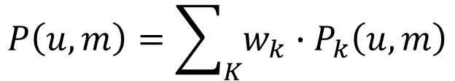
Ensemble Model
$$P\left(u, m\right)=\sum_{K}{w_{k}∙P_{k}\left(u, m\right)}$$

Slide 22
Ensemble Model
$$P\left(u, m\right)=\sum_{K}{w_{k}∙P_{k}\left(u, m\right)}$$
Model | ROC-AUC Score
XGBoost | 0.6916
LightGBM | 0.6773
CatBoost | 0.6871
Ensemble Model | 0.6924

Slide 23
Fetching Best Features
using XGBoost
Feature | Importance
items_user_merchant | 5.358978
purchases_user_merchant_period_5 | 5.250384
purchases_user_merchant | 5.186556
categories_user_merchant | 4.047388
periods_user_merchant | 4.018932
double11_periods_user_merchant_ratio | 2.951180
categories_merchant | 2.078619
favourites_merchant_user_max | 2.042979
... | ...

Slide 24
Fetching Best Features
using XGBoost
Feature | Importance
items_user_merchant | 5.358978
purchases_user_merchant_period_5 | 5.250384
purchases_user_merchant | 5.186556
categories_user_merchant | 4.047388
periods_user_merchant | 4.018932
double11_periods_user_merchant_ratio | 2.951180
categories_merchant | 2.078619
favourites_merchant_user_max | 2.042979
... | ...
290
Features
150 Features

Slide 25
Final Scores
Model | Every Feature (290) | Best Features (150)
XGBoost | 0.6913 | 0.6916
LightGBM | 0.6773 | 0.6757
CatBoost | 0.6871 | 0.6882
Ensemble Model | 0.6924 | 0.6925

Slide 26
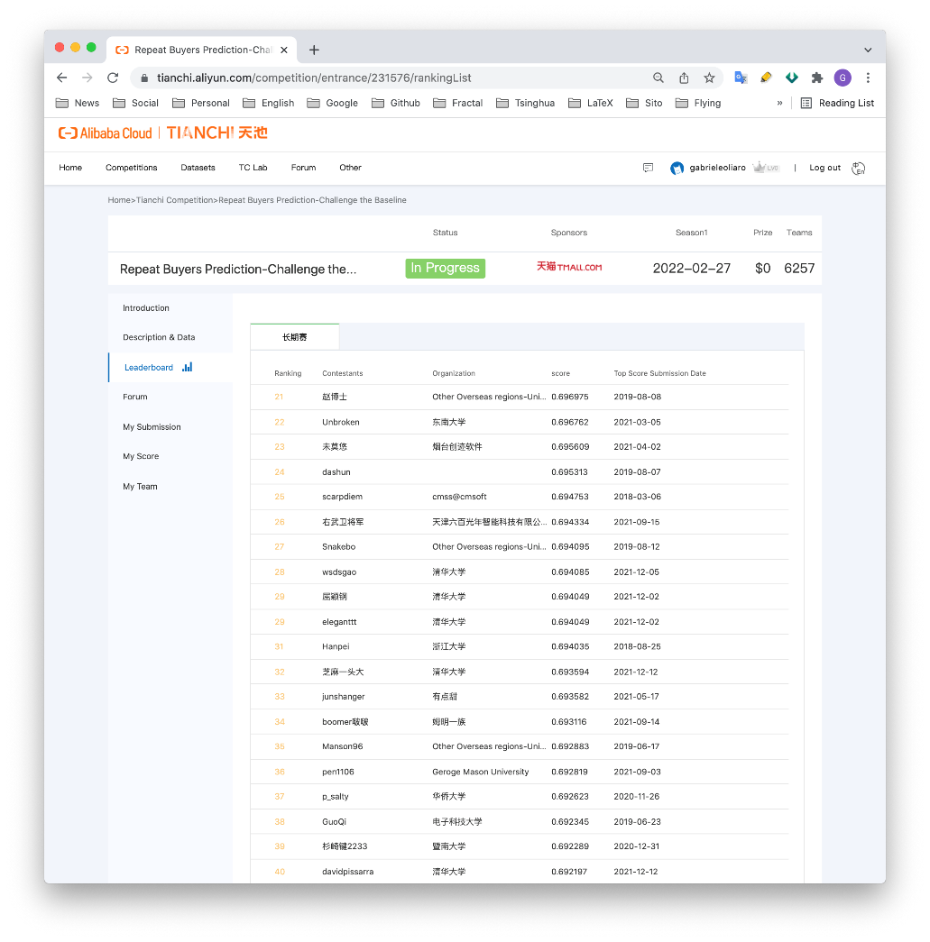
Conclusion
Analyzed and cleaned large dataset
Performed feature engineering to extract a variety of features of different complexity levels
Implemented prediction model based on ensemble of classifiers
Submitted our solution on tianchi.aliyun.com and made it to the Top 40 Leaderboard!

