Slide 1

IS219 Data Visualization
Andrew G – Midterm

Slide 2
Project Description
Large data set on STEM degrees awarded from 2011-2021
Broken down by year, race, gender, and degree type
Picked out degrees awarded to minorities
Goal is to find how to foster diversity in University STEM Programs

Slide 3
Progress so far
Found that Hispanics have had the most growth
Why is this the case?
Accessibility
More Hispanics finishing high school and being prepared for college
Affordability
More scholarships to Hispanic STEM Students
More grants to HSI STEM programs
Suitability
HSIs on a consistent rise (60% from 2011-2021)

Slide 4
Future Plans
Find more specific data sets
STEM Grants/Scholarships
College readiness/high school completion
Reach solid conclusions
Why exactly do Hispanics lead in STEM degree growth
Find how to apply Hispanic initiatives to other demographics
Obviously something is working
How can we make it so everyone wins?

Slide 5
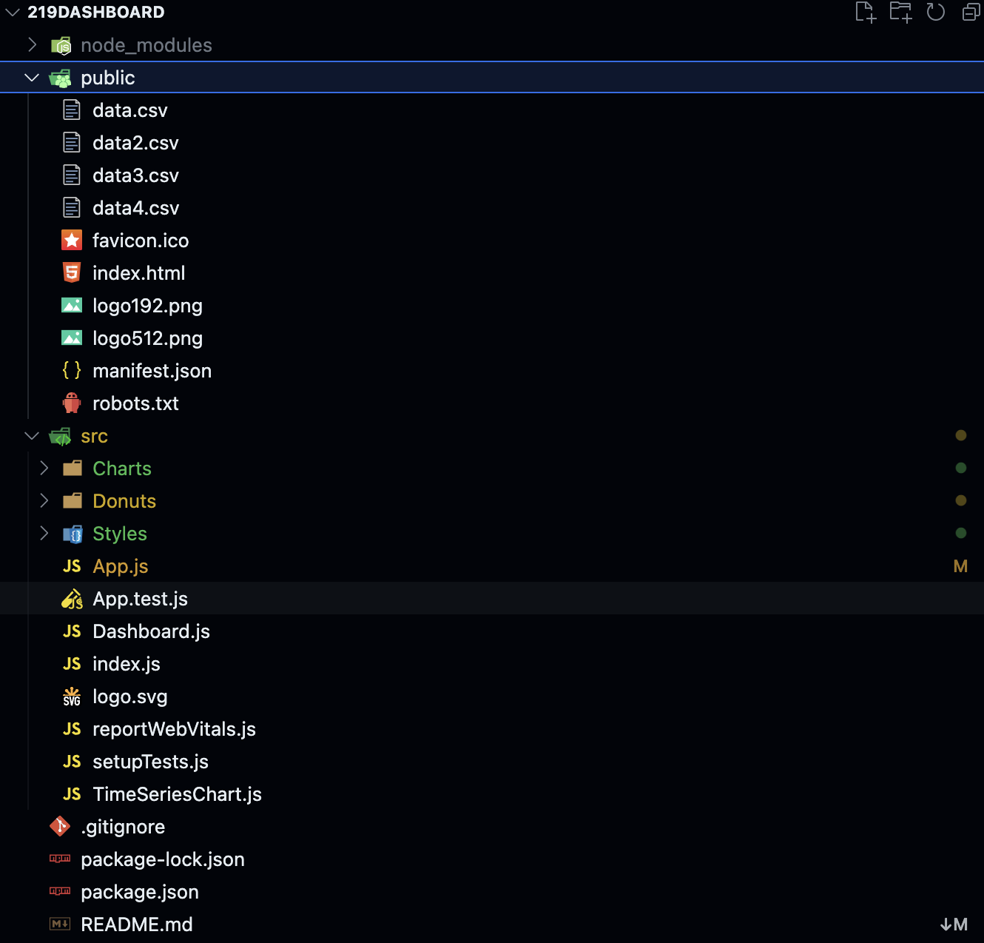
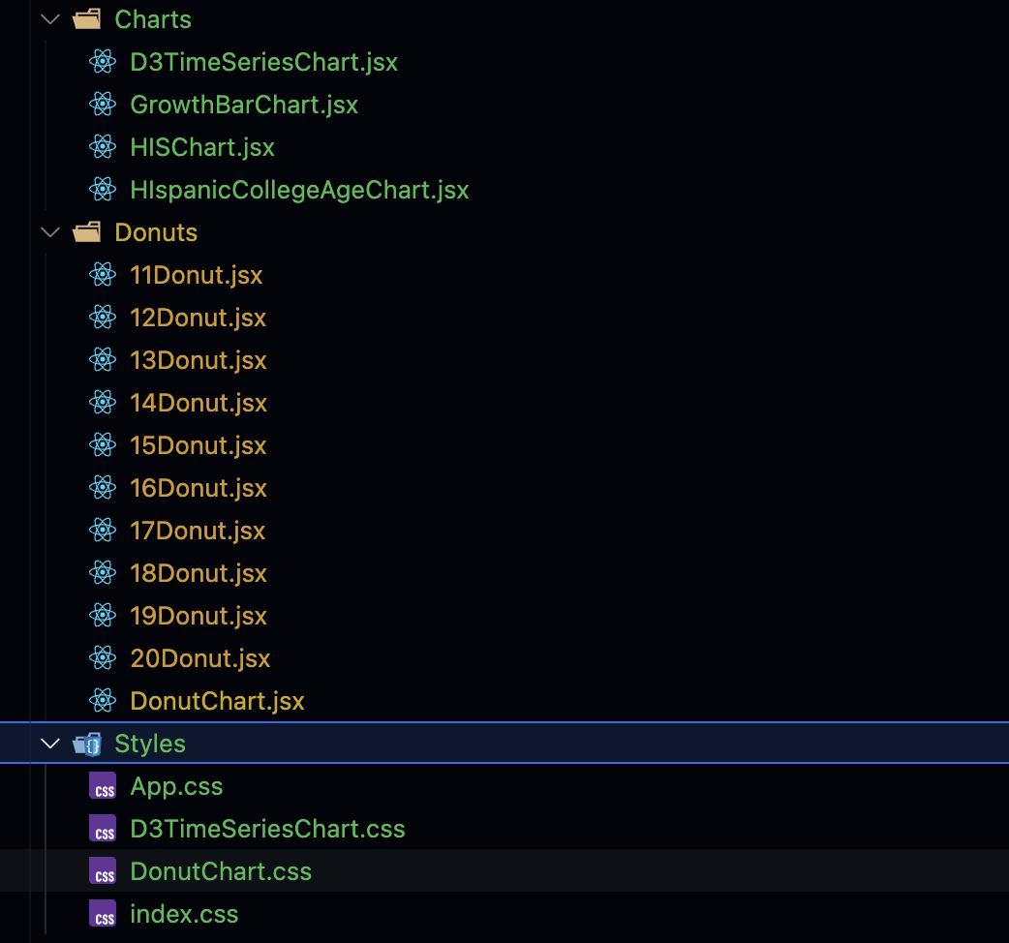
IDE Setup

Slide 6
Development Workflow
Find data set & make CSV
Copy/create React component
Add description/context
Commit to GitHub and site data
Find next step and repeat

Slide 7
Lessons Learned
Data set names can be misleading
Eventually a data set is the source
Data will fill the gaps in your story
Organization is key
Find data before relying on its story

