Slide 1
Oauth2.0

Slide 2
Overview
Oauth 2.0 is a delegated authorization protocol
A user can give permission to a client to act on behalf of the user when accessing a resource
The user only provides credentials to the resource owner
The resource owner then allows the client certain access to the users resources

Slide 3
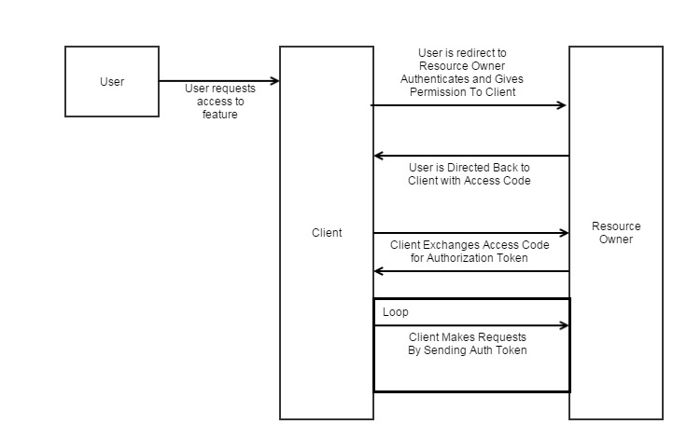
Basic flow
State variable used to prevent CSRF
Client secret can be verified at this step

Slide 4
Key Things to Note
The user never has access to the access token in this flow
The client has no idea what authentication process took place at the resource provider
The client may not get any information about who the user is

Slide 5
There are Other Less Secure Flows
Some flows give an authorization token directly to the user
What if the user passes that token onto a different site?
Some flows do not require a client secret
This is a password shared between the client and resource owner
This is passed to the resource owner so it can confirm the client is who it says it is

