Slide 1

Automatic n-buffering for Big Data processing
Asbjørn Thegler
Department of Computer Science

Slide 2
Before I start
This presentation is on GitHub
The thesis is on GitHub
The nbuf library is on GitHub
My GitHub username is ath88
Thanks for showing up

Slide 3
Presentation Content
Introduction
Motivation
Abstract Overview
Examples
Benchmarking Results
[Live demo]

Slide 4
Introduction
What have I done?
Generally applicable library built in C++11
Efficient real-time processing of generic streams
Abstracted concurrency away from programmers, to some extend
Promises a sharp upper limit on memory usage

Slide 5
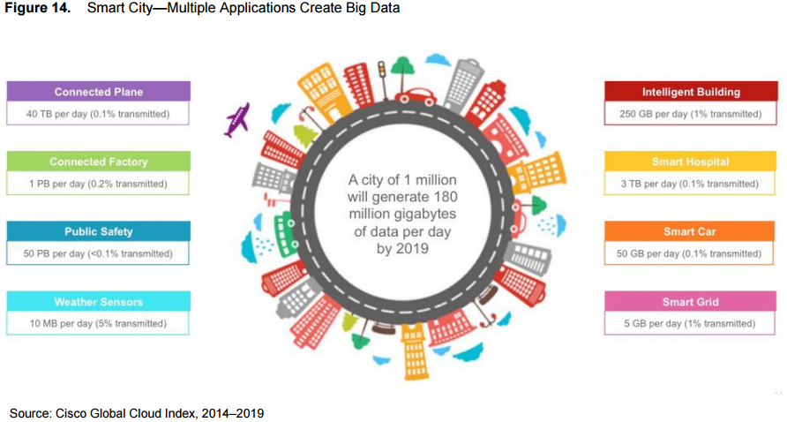
Motivation

Slide 6
Motivation
So, whats the problem?
Huge amounts of data
Data needs to be processed
Won’t fit inside system RAM at once.

Slide 7
Motivation
So, whats the problem?
Huge amounts of data
Data needs to be processed
Won’t fit inside system RAM at once.
Current solutions include
Custom built double or triple buffering
Hadoop Streaming libraries with machine clusters

Slide 8
Abstract Overview
Processing strides of data

Slide 9
Abstract Overview
Processing strides of data
Master thread for initialization
Worker threads with local buffers

Slide 10
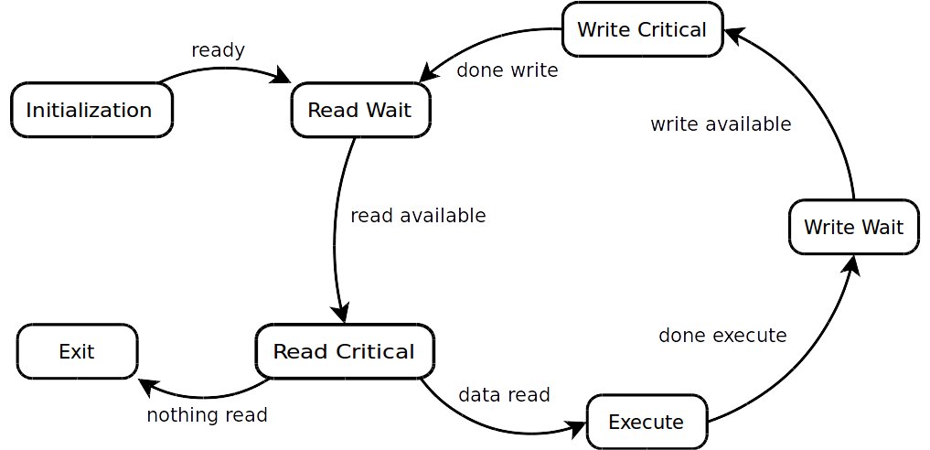
Abstract Overview
Processing strides of data
Master thread for initialization
Worker threads with local buffers

Slide 11
Examples
Calculating SHA1 of a huge file
The entire file must be processed in sequence
A stride is 512 bits
Current GNU-implementation is sequential

Slide 12
Examples
Calculating SHA1 of a huge file
The entire file must be processed in sequence
A stride is 512 bits
Current GNU-implementation is sequential
Processing data from measurement instruments
Frames can be processed in parallel
A stride could be a the size of a frame
Minimum, maximum and average values can be gathered
Transformations could include compressing for storage
  gzip can be done in parallel*
  * http://zlib.net/pigz/

Slide 13
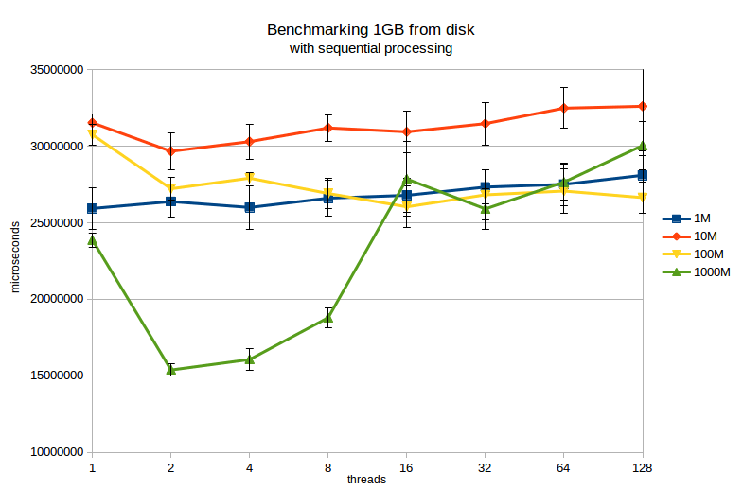
Benchmarking Results
Tasks:
Reading: 13.4s
Processing: 4.8s
Writing: 0.5s
Total: 18.7s

Slide 14
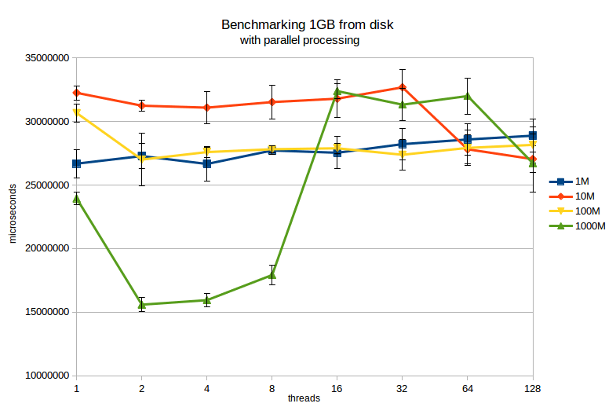
Benchmarking Results
Tasks:
Reading: 13.4s
Processing: 4.8s
Writing: 0.5s
Total: 18.7s

Slide 15
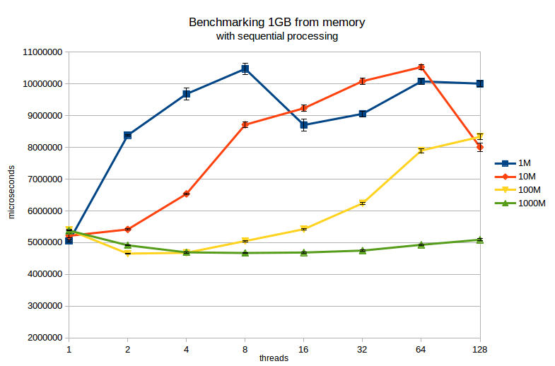
Benchmarking Results
Tasks:
Reading: 0.2s
Processing: 4.8s
Writing: 0.2s
Total: 5.2s

Slide 16
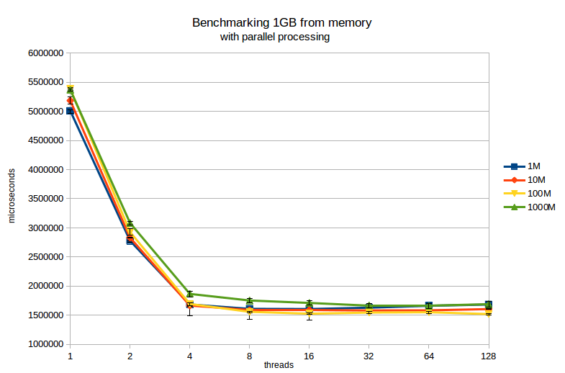
Benchmarking Results
Tasks:
Reading: 0.2s
Processing: 4.8s
Writing: 0.2s
Total: 5.2s

Slide 17

Live demo

Slide 18
Thank you for listening
Questions?
Send me an email on: asbjoern@thegler.dk

