Slide 1
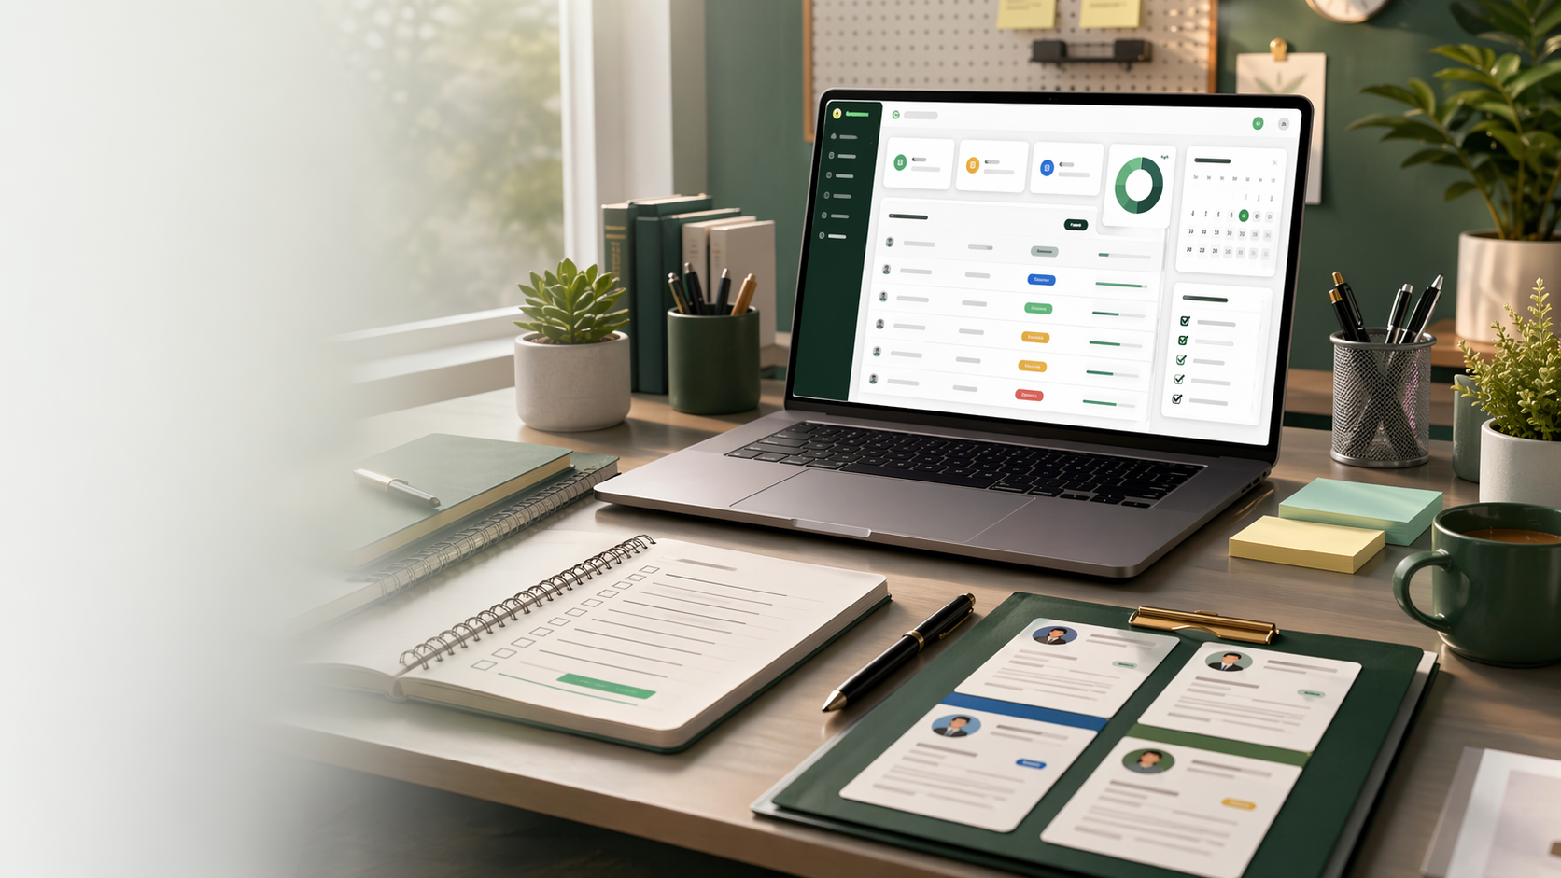
Final project presentation
Smart Internship Tracker
A Flask and MySQL web app that helps students organize applications, deadlines, statuses, and notes in one place.
Team collaboration: GitHub repository for shared code, project files, and documentation.
Team: Alhaji Kargbo, Renae Washington, Langston Gwinn, Quincy King, Ali-Andro Thaxter

Slide 2
Rubric-Aligned Roadmap
10 minutes for presentation and live demo, then up to 5 minutes for Q&A.
1
Problem
2
Scope + features
3
Methodology
4
Design
5
Code structure
6
Collaboration
7
Testing
8
Live demo
9
Team contribution
Smart Internship Tracker | Final Presentation | 02

Slide 3
1. Problem Statement
Internship searches create scattered information, missed deadlines, and unclear next steps.
Problem
Motivation
Target users
Students often track companies, roles, statuses, deadlines, and notes in too many places.
A single dashboard makes the search less stressful and reduces missed follow-ups.
Students applying for internships, co-ops, and entry-level roles.
Goal: give each student a private, searchable command center for their internship process.
Smart Internship Tracker | Final Presentation | 03

Slide 4
2. Scope and Features
We built a focused tracker, not a full recruiting platform.
In Scope
Out of Scope
Since Deliverable 2
Register/login
Private dashboard
Add/view/update/delete applications
Search, filter, deadlines, notes
Employer portal
Automatic job scraping
Cloud deployment
Resume upload storage
Password hashing
Stronger validation
Polished dashboard UI
Completed test plan/results
Promised features: registration, login, dashboard, add, update status, delete, search/filter, deadline and notes tracking.
Smart Internship Tracker | Final Presentation | 04

Slide 5
3. Software Development Methodology
We followed an iterative Agile-style process: build, review, test, improve.
Plan
Build
Review
Test
Improve
roles + scope
feature increments
GitHub updates
20 cases
fix + document
Why this methodology: it let each role work on a clear part while the team integrated and tested features as the app grew.
Smart Internship Tracker | Final Presentation | 05

Slide 6
4. Design Artifacts
Context diagram, architecture diagram, ERD, and workflow explain how the system fits together.
Context
Student user
Smart Internship Tracker
Local browser + MySQL
Architecture
HTML/CSS templates
Flask routes + sessions
MySQL database
ERD
users table
internships table
1 user -> many records
Workflow
Register
Login
Dashboard CRUD
Logout
These designs guided database ownership, protected routes, and the demo workflow.
Smart Internship Tracker | Final Presentation | 06

Slide 7
4. Architecture Diagram
A simple Flask web app connects protected user routes to a MySQL-backed application database.
Frontend
Flask Backend
MySQL Database
HTML templates + CSS
Responsive dashboard UI
Routes, sessions, validation
CRUD application logic
users table
internships table
Key implementation details
Password hashing with pbkdf2:sha256
Protected routes through a login_required decorator
Parameterized SQL queries for safer database access
User-specific dashboard queries filtered by user_id
Smart Internship Tracker | Final Presentation | 07

Slide 8
4. ERD: Database Design
Two tables keep accounts separate from application records while preserving ownership.
internships
users
id, company, role, status
deadline DATE
notes TEXT
user_id INT FOREIGN KEY
ON DELETE CASCADE
id INT AUTO_INCREMENT PRIMARY KEY
username VARCHAR(100) UNIQUE
password VARCHAR(255)
1 user -> many applications
Design value: each student sees only their own internship records, and deleting an account can remove dependent records cleanly.
Smart Internship Tracker | Final Presentation | 08

Slide 9
5. Code Structure Overview
Open VS Code during the presentation and walk through these files.
app.py
Routes, sessions, database connection, validation, password hashing, CRUD logic.
templates/
layout, homepage, register, login, dashboard pages rendered with Jinja.
static/style.css
Responsive styling, cards, forms, buttons, tables, and status badges.
README.md
Project overview, setup instructions, run steps, technologies, and team list.
TEST_PLAN_AND_RESULTS.md
Testing scope, expected output, actual output, and pass/fail results.
Component interaction: browser form -> Flask route -> MySQL query -> dashboard template renders updated records.
Smart Internship Tracker | Final Presentation | 09

Slide 10
6. Collaboration and Documentation
We used GitHub as the team's collaboration hub.
GitHub Usage
Documentation
Shared repository for project code
Commits tracked changes over time
Role-based updates before integration
Repository used to keep files consistent
README for setup and project overview
Docstrings/comments for important functions
Test plan documents quality checks
Speaking guide divides presentation roles
Team communication: check-ins were used to coordinate timeline, resolve integration issues, and prepare the final demo.
Smart Internship Tracker | Final Presentation | 10

Slide 11
7. Testing
The system passed planned functional, validation, security, and startup tests.
UI workflow
Integration
20
registration, login, dashboard, logout
Flask routes connected to MySQL records
planned test cases passed
Application CRUD
Error/security
add, update status, delete records
duplicates, invalid login, SQL-like input, MySQL stopped
Tools used: Safari UI checks, Flask local server, MySQL/XAMPP, manual test plan, and Python syntax check.
Smart Internship Tracker | Final Presentation | 11

Slide 12
8. Software Demonstration
Show the working software live; screenshots are backup only.
1. Start
2. Register/Login
3. Add
Run python3 app.py with XAMPP MySQL on.
Create or use a test account.
Enter company, role, status, deadline, notes.
4. Search/Filter
5. Update/Delete
6. Error Handling
Search by role/company and filter by status.
Change status, save, then delete a sample.
Show invalid login or protected dashboard redirect.
If an error happens: explain it calmly, show the related code or test result, and continue with the prepared demo path.
Smart Internship Tracker | Final Presentation | 12

Slide 13
Validation and Security
The app reduces common risk through authentication checks, scoped queries, and input validation.
Hashed passwords
New passwords are stored using pbkdf2:sha256 instead of plain text.
Route protection
Dashboard, add, update, and delete actions require an active session.
SQL safety
Parameterized queries treat SQL-like input as text.
User privacy
Dashboard, update, and delete queries include the current user's id.
Security is built into the workflow, not added as an afterthought.
Smart Internship Tracker | Final Presentation | 13

Slide 14
9. Team Contribution
Each person owned a clear part of planning, design, implementation, interface, and quality.
Alhaji Kargbo
Renae Washington
Langston Gwinn
Project Manager
Software Architect
Backend Developer
Coordinated team timeline, scope, presentation flow, and completion.
Designed system structure, database relationship, and architecture decisions.
Built routes, sessions, database integration, validation, and CRUD functionality.
Quincy King
Ali-Andro Thaxter
Frontend Developer
Software Tester
Designed dashboard UI, responsive CSS, forms, tables, and status badges.
Created test plan/results, checked workflows, found bugs, and confirmed quality.
Smart Internship Tracker | Final Presentation | 14

Slide 15
Future Improvements
The current version works; the next version can become more automated and career-ready.
Deadline reminders
Resume and cover letter uploads
Notify students before an application date arrives.
Attach documents to each company record.
Analytics
Deployment
Show conversion rates from applied to interview and offer.
Host the app online with production database settings.
Next version theme: fewer manual reminders, more insight into the student's career pipeline.
Smart Internship Tracker | Final Presentation | 15

Slide 16
Smart Internship Tracker
A focused tool for students to track applications, protect their data, and manage the internship search with confidence.
Ready for live demo and questions
Thank you

