Slide 1


Agents for Finance
By: Avi Thaker and Daniel Sonner
THE VENETIAN, LAS VEGAS
AUGUST 4-6, 2026

Slide 2

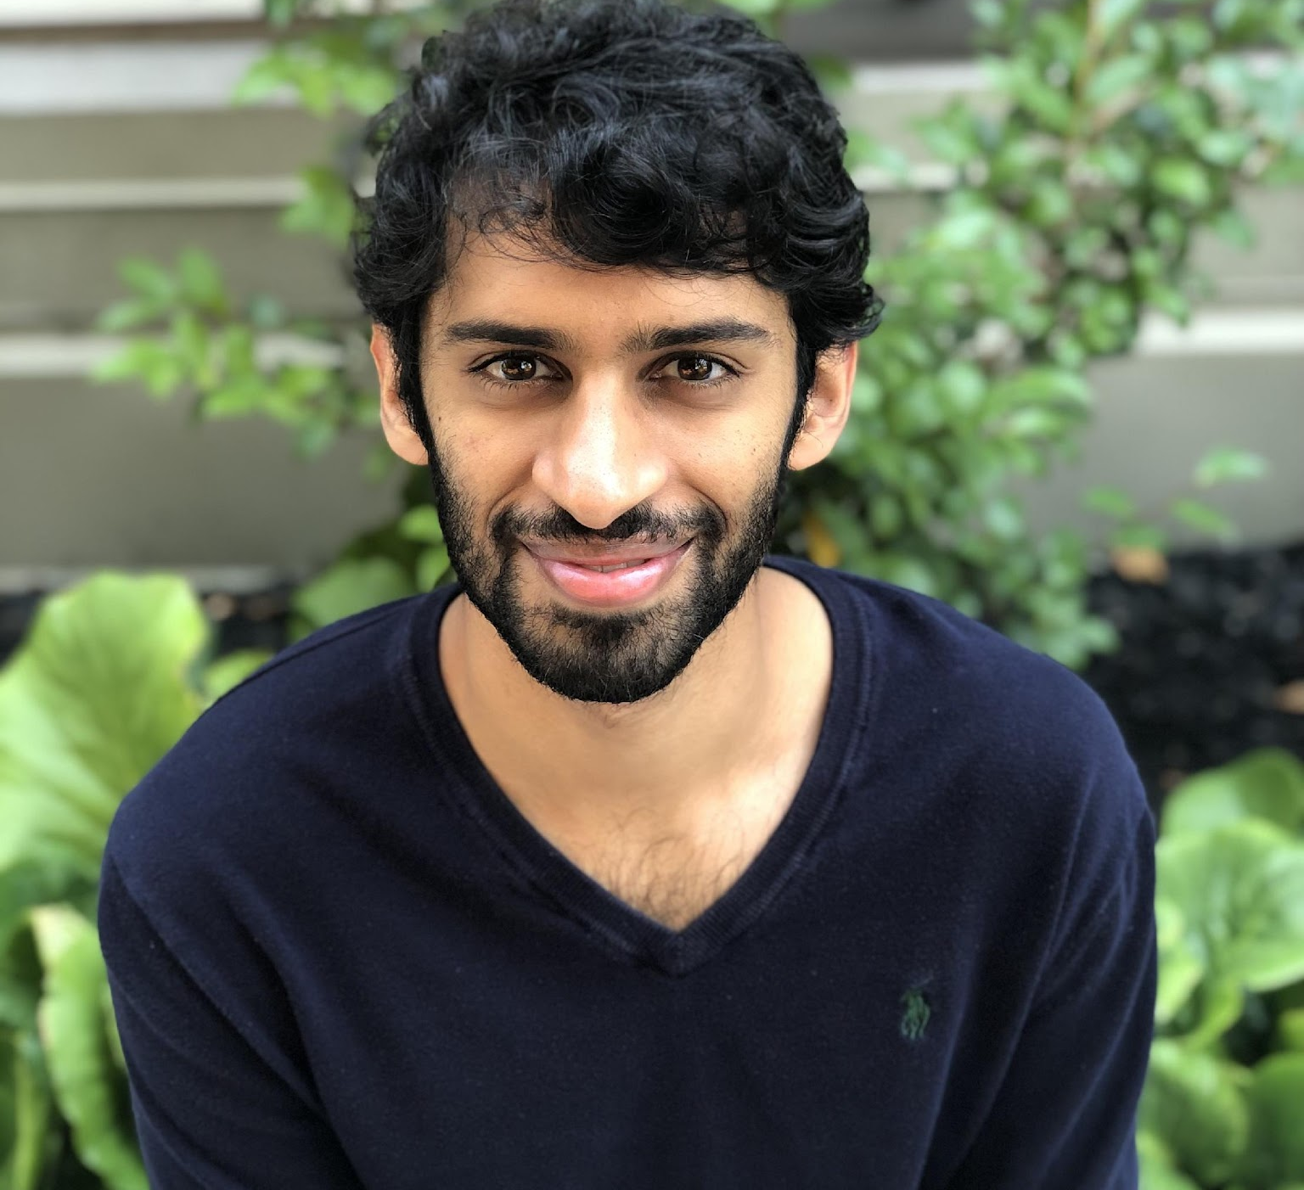
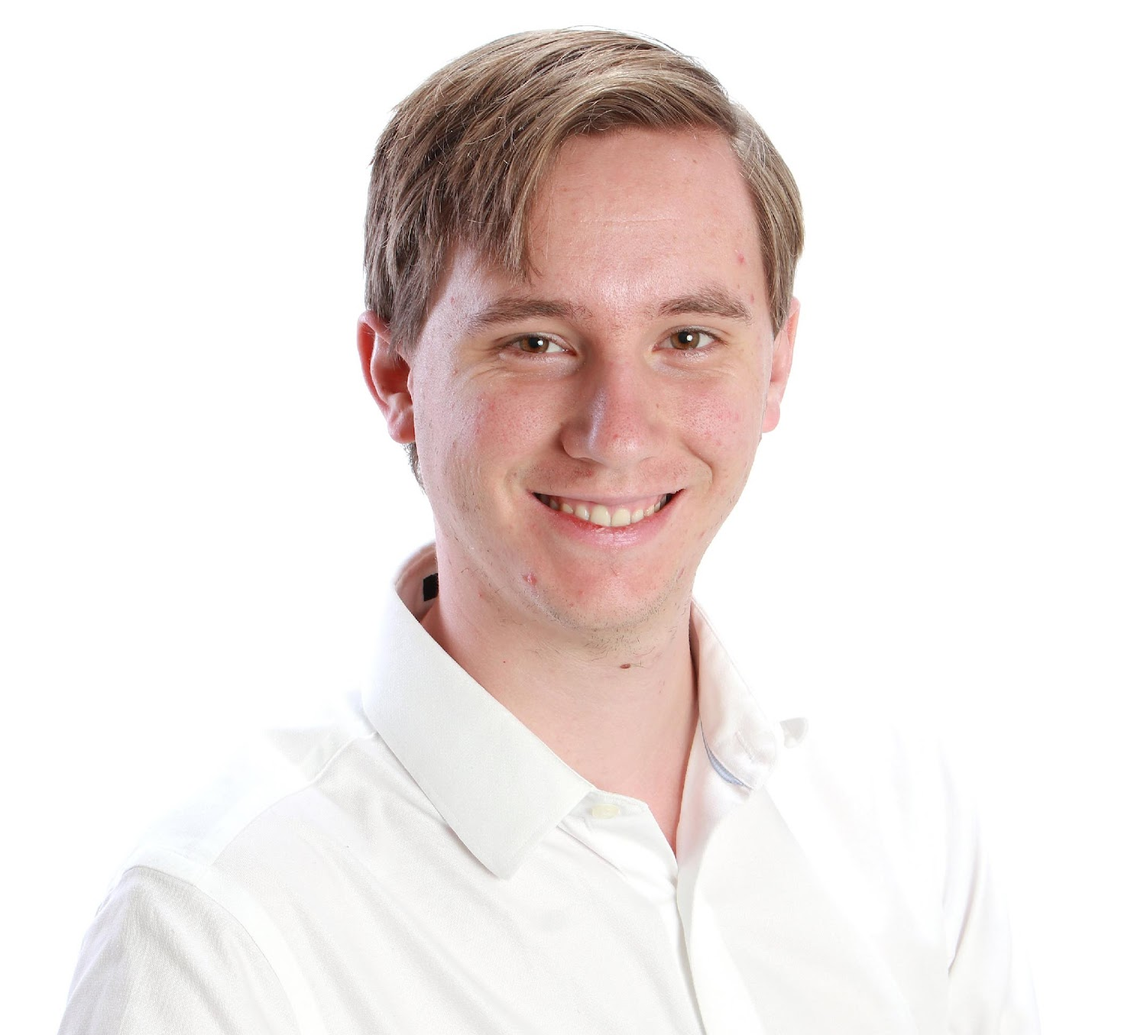
Team
Avi Thaker
Co-Founder
Daniel Sonner
Co-Founder
7 years consulting for hedge funds
5 Machine Learning Patents Granted, 2 Pending
Built document understanding tools utilized by many top banks
Harvey Mudd, Microsoft, GSK, Goldman Sachs
Series 65
4+ Years Systems engineering at Pure Storage
1 Patent
Computer Science, Harvey Mudd
World Champion Bridge Player¹
Series 3, Series 65

Slide 3
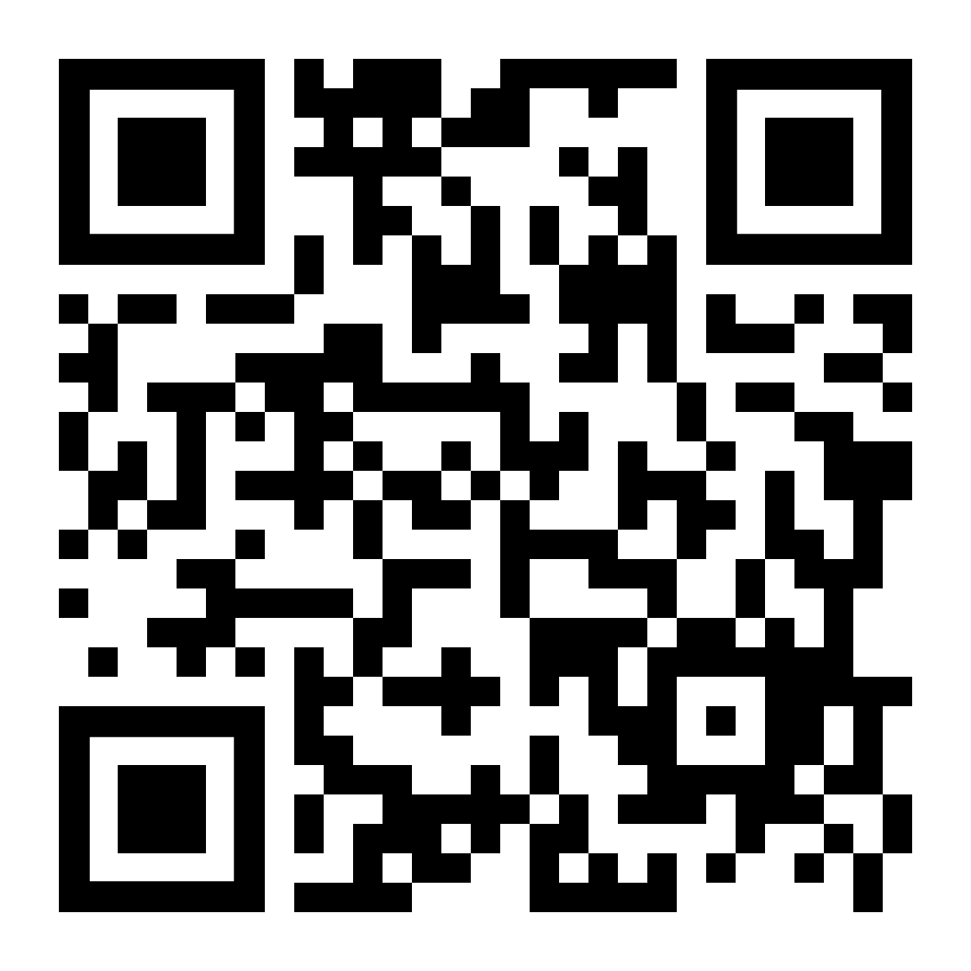
Participate in the Winnings
Fill out this form and you will receive
f(P)=max($20,0.50×P)
f(P) is the final amount.
$20 is the fixed dollar amount.
0.50×P represents 50% of the profits.

Slide 4
What is an AI Agent
Autonomous - can operate and make decisions on their own to complete a task
Planning and Execution - develop its own plan to achieve its goals and execute upon those actions
Tool Use - interact with various tools, APIs, web browsers, etc.
There are varying levels of complexity of agents. We will start simple and provide you the framework to build your own agents.
Agents can have narrow or broad scopes (domain expert / generalist).

Slide 5
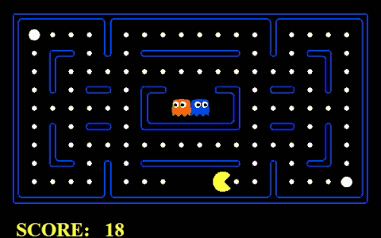
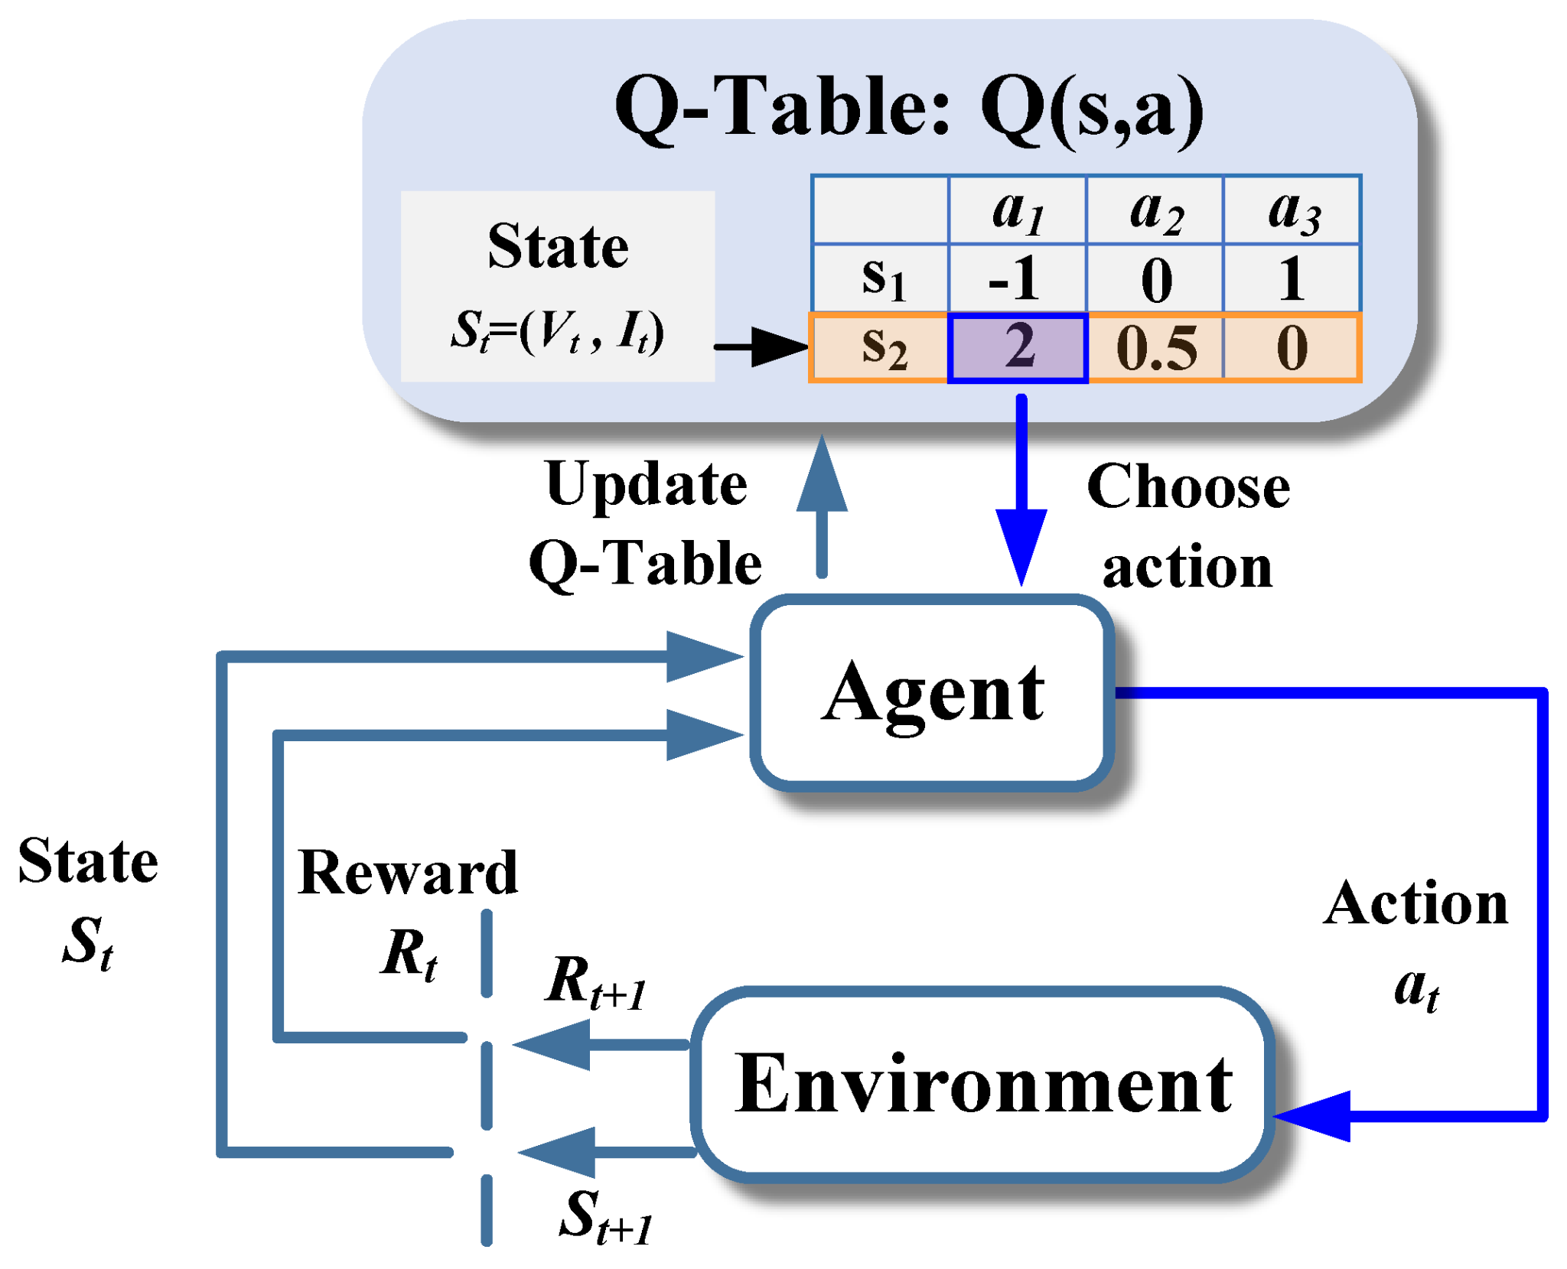
How does an Agent Learn?
An agent is an actor in an environment, who gets a reward/penalty based upon actions taken.
The agent plays many games and “learns” each time.
The agent learns to maximize its reward.
Video games were the first agents to be trained, and a great way to frame thinking about them! (as early as 1948 in NIM).

Slide 6
Prediction Markets in 2026
Event contracts: binary markets that settle at $1 (YES) or $0 (NO) - the price (1¢–99¢) IS the market-implied probability
CFTC-regulated: Kalshi’s Oct 2024 court win opened election markets - institutions followed (ICE, brokers, retail apps)
Kalshi traded $23.8B in 2025; the 2026 midterms are the marquee event, with House control alone near $19M traded
Every price is a probability: a natural playground for agents - forecasting, cross-venue arbitrage, and market making.
Event outcomes are largely uncorrelated to equities - a genuinely new source of diversifying returns.

Slide 7
Making Markets in Binaries
One book per contract: buying YES at P is identical to selling NO at 100 - P; ticks are 1¢
Quote both sides and earn the spread - makers pay no fee on most series; takers pay ≈7% × P × (1 − P) per contract
The enemy is adverse selection: probabilities jump on news (polls, rulings, debates) faster than you can pull quotes
Risk is bounded per contract (max loss is known up front), but inventory turns binary near resolution - size accordingly.
Today: a simple agent quoting the 2026 House control market on Kalshi, live.

Slide 8
Our Agent
Environment:
A Kalshi order book (state: best YES bid/ask, book depth, our inventory - sampled each second)
Market: CONTROLH-2026 - which party controls the House after the midterms
Actions:
Quote two-sided around a microprice (size-weighted mid), skewed by inventory
Agent picks the posture — SYMMETRIC / LEAN BUY / LEAN SELL; the leaned side joins the touch (inventory capped, killed flat at the end)
Reward:
Spread captured minus adverse selection, subject to inventory risk (holding through news is painful).
Try it yourself: https://github.com/athaker/econ_136/blob/master/kalshi-market-making-demo.py

Slide 9
Let’s try it with real money!
Please don’t try this at home. This is a demo only. This is not financial advice.

Slide 10
The Code: https://github.com/athaker/econ_136/blob/master/kalshi-market-making-demo.py

Slide 11
But why does this matter?
Agents/AI have been around for forever, and applied to finance for decades. Institutional flows are showing that uncorrelated assets are paramount for long term growth.

Slide 12
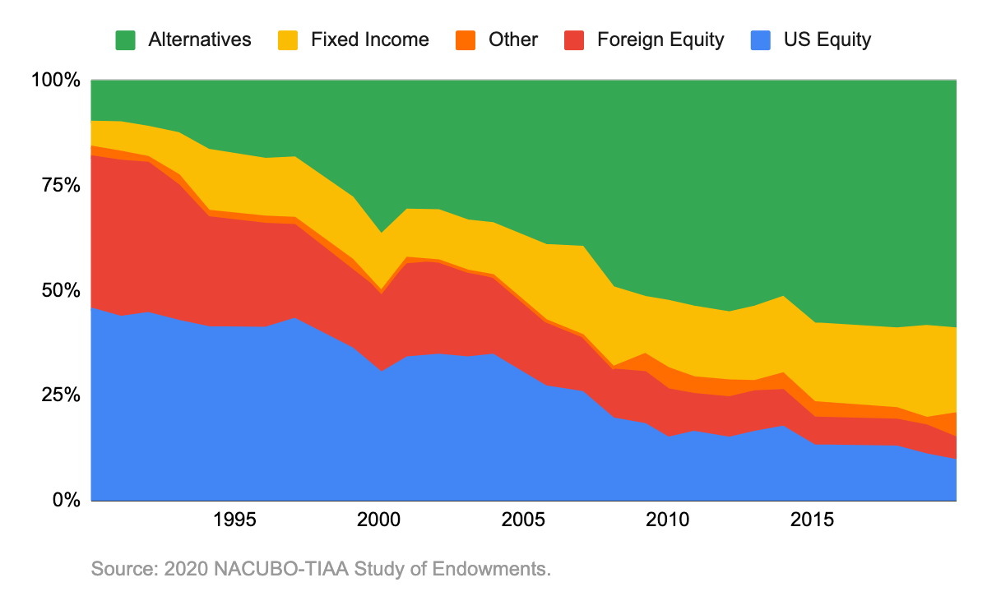
Institutions are Moving to Alts
About 50% of alts are AI powered!

Slide 13
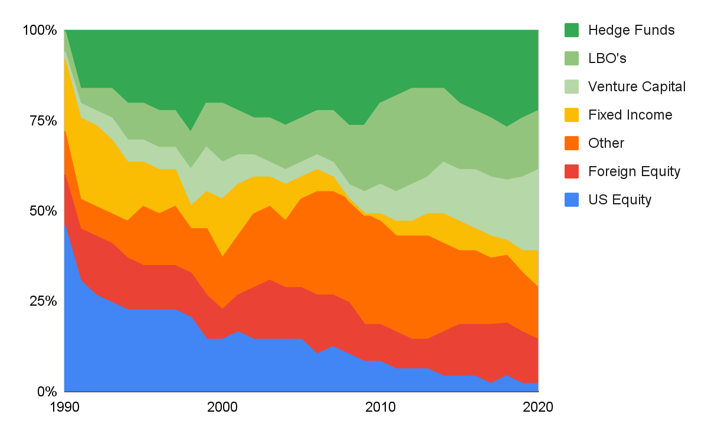
Yale Leads the Pack

Slide 14
How does this affect me?

Slide 15
Drawdowns are Painful
Portfolio Loss | Gain to Restore Loss | Percentage Change of recovery from loss within N years
 |  | 1 | 2 | 3 | 4 | 5 | 10
-10.00% | 11.11% | 52.50% | 74.40% | 86.10% | 78.40% | 77.80% | 93.50%
-20.00% | 25.00% | 25.00% | 48.70% | 68.40% | 67.60% | 72.20% | 93.50%
-35.00% | 53.85% | 0.00% | 17.90% | 34.20% | 56.80% | 61.10% | 93.50%
-50.00% | 100.00% | 0.00% | 0.00% | 7.90% | 13.50% | 36.10% | 80.60%
-65.00% | 185.71% | 0.00% | 0.00% | 0.00% | 2.70% | 5.60% | 61.30%

Slide 16
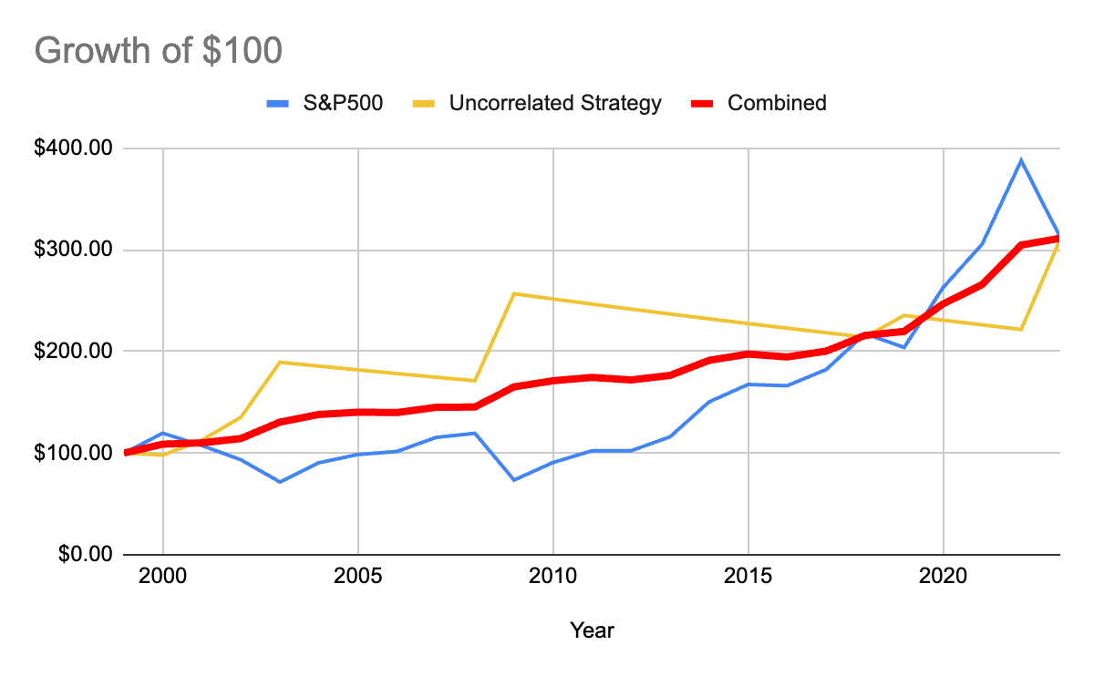
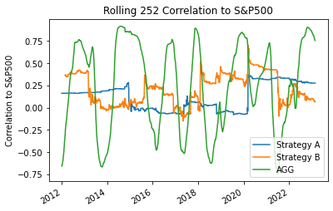
Portfolio Construction can Reduce Pain
Metric | S&P500 | Uncorrelated | Blended | Rebalanced
Average | 6.47% | 5.79% | 5.19% | 6.13%
STD | 17.78% | 15.73% | 9.18% | 4.51%
Sharpe | 0.36 | 0.37 | 0.56 | 1.36
Seek truly diversified investments that exhibit long term uncorrelation. Bonds (AGG) often are very correlated.

Slide 17
Getting started!

Slide 18
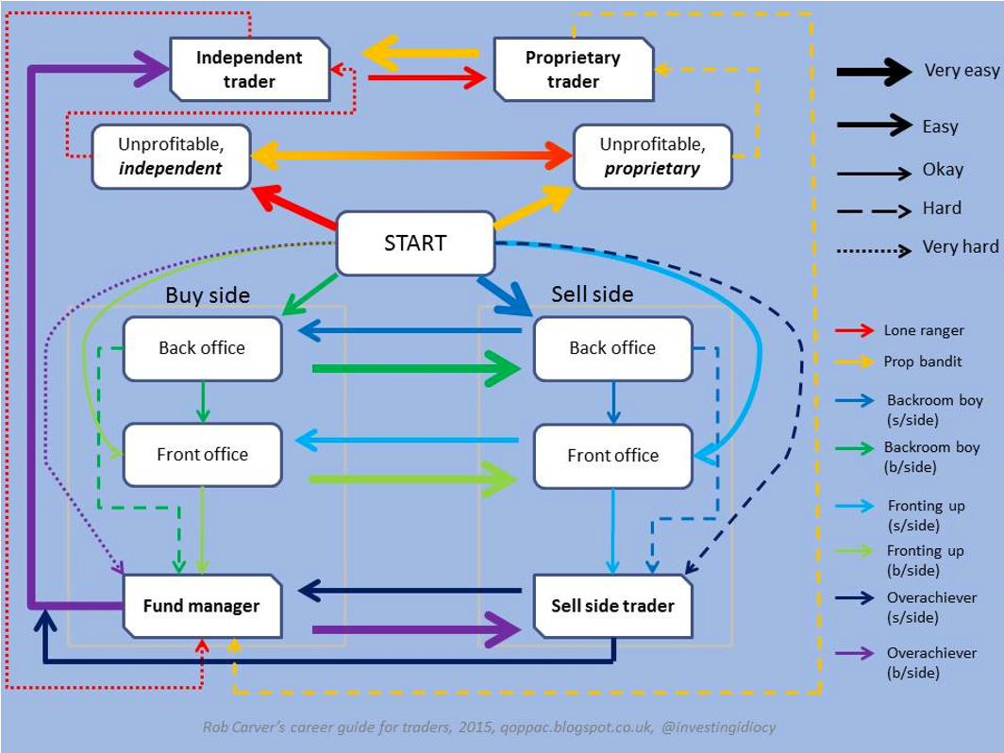
A Visual Guide

Slide 19
Be Careful of Fees: Robinhood PFOF - September 2024
Type | Net Paid/Received for Market Orders (USD) | Net Payment Paid/Received for Market Orders(cents per hundred shares) | Net Payment Paid/ Received for Marketable Limit Orders (USD) | Net Payment Paid/Received for Marketable Limit Orders(cents per hundred shares) | Net Payment Paid/Received for Non-Marketable Limit Orders(USD) | Net Payment Paid/Received for Non-Marketable Limit Orders(cents per hundred shares) | Net Payment Paid/Received for Other Orders(USD) | Net Payment Paid/Received for Other Orders(cents per hundred shares)
S&P500 | $476,120.14 | $0.54 | $506,842.39 | $0.45 | $159,669.04 | $0.49 | $406,231.62 | $0.33
Non S&P500 | $2,595,718.32 | $0.17 | $2,764,997.73 | $0.10 | $1,214,001.70 | $0.10 | $746,273.38 | $0.17
Options | $267,735.21 | $0.35 | $26,281,705.80 | $0.36 | $21,002,467.90 | $0.47 | $4,900,789.94 | $0.41
Robinhood Financial LLC - Held NMS Stocks and Options Order Routing Public Report

Slide 20
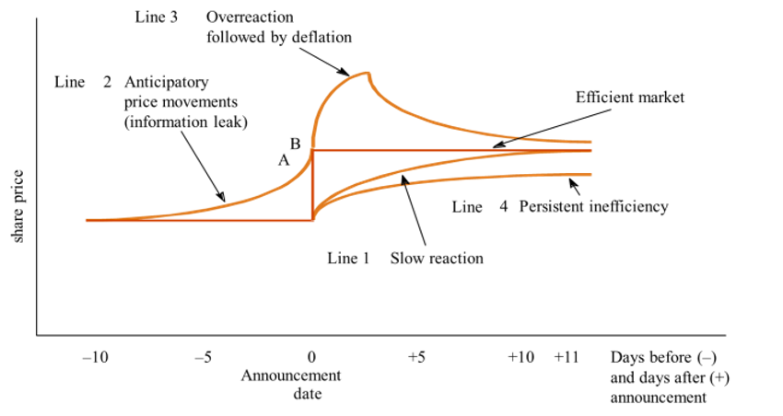
The Efficient Market
Impossible to “beat the market”
  Market efficiency causes prices to incorporate and reflect all relevant information
    Prices adjust quickly to new information
    Prices should reflect all available information
  Securities always trade at their fair value
  The only way to obtain higher returns is to purchase riskier investments
  Cannot predict trends, history does not indicate future
The market is becoming increasingly more efficient
Warren Buffett? Citadel? Virtu?
  When filing for its IPO in March 2014, it was disclosed that during five years Virtu Financial made profit 1,277 out of 1,278 days, losing money just one day.

Slide 21
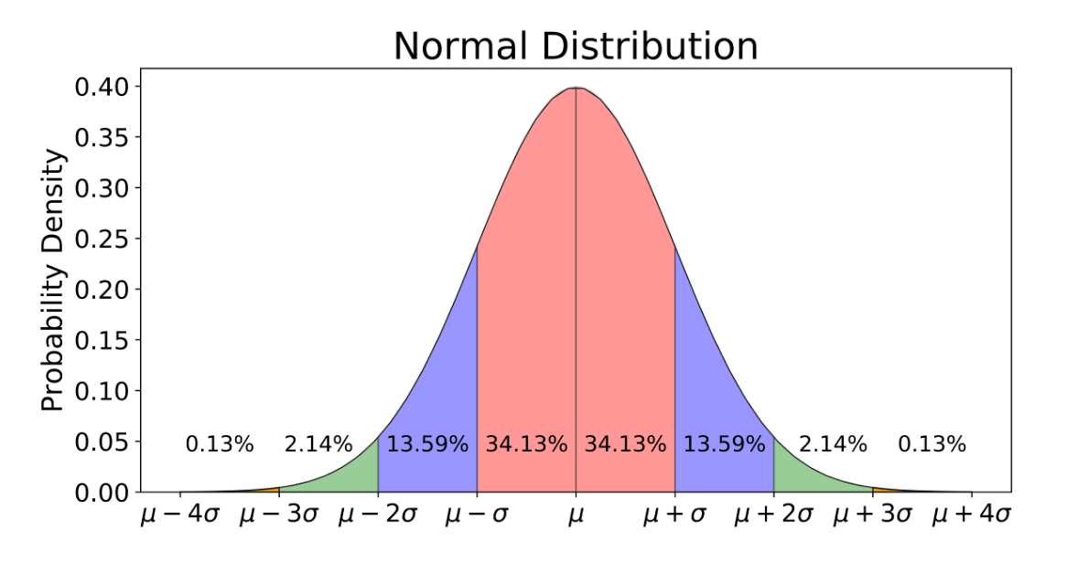
Statistical Sampling
Some investors are simply lucky
If you were to have a bunch of monkeys throw darts at a wall and use that to pick stocks you will have some major outperformers.
“In statistical terms, I figure I have traded about 2 million contracts, with an average profit of $70 per contract (after slippage of perhaps $20). This average is approximately 700 standard deviations away from randomness.”
~ The Education of a Speculator

Slide 22
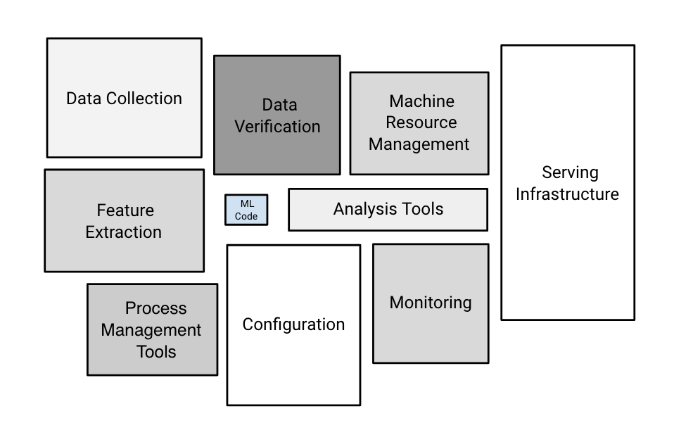
AI/ML is only One Part
Arguably the most important thing in Deep Learning / AI
High quality data drives model performance
Models today are often trained on the whole internet
Identify what you are good at and that will drive performance
https://developers.google.com/machine-learning/crash-course

Slide 23
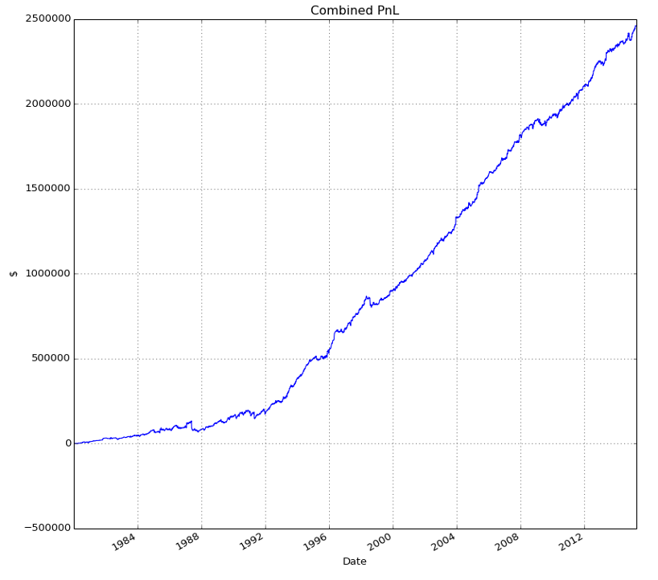
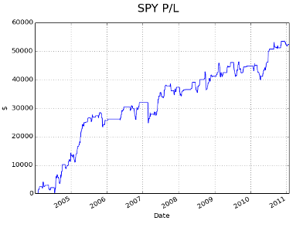
Backtesting a Strategy
Does the strategy work across many assets?
How many years does it work for?
Risk Tolerance?
Maximum Drawdown?
Fees? Trading frequency?
Sharpe:1.299
PPC:0.338
Wins:255
Losses:202
Trades:463.0
In Sample: SPY 2004-2010
Out of Sample: Assets Randomly Selected:
ADBE XLNX BBBY CFN EMC ADP AFL DE T SPLS DG ADS
ALL MET CL PX WYN

Slide 24
Accumulation/Distribution (AD)
Average Directional Movement (ADX)
Absolute Price Oscillator (APO)
Aroon Oscillator (ARO)
Average True Range (ATR)
Bollinger Band (BBANDS)
Directional Movement Indicators (DMI)
Exponential (EMA)
Fill Indicator (FILL)
Ichimoku (ICH)
Keltner Channel (KC)
Linear Regression (LR)
Moving Average Convergence Divergence (MACD)
On Balance Volume (OBV)
Relative Strength Indicator (RSI)
Parabolic Sar (SAR)
Simple Moving Average (SMA)
Triple Exponential Moving Average (TEMA)
Triangular Moving Average (TRIMA)
Triple Exponential Moving Average Oscillator (TRIX)
Time Series Forecast (TSF)
TT Cumulative Vol Delta (TT CVD)
Ultimate Oscillator (ULTOSC)
Volume Delta (Vol ∆)
Volume Weighted Average Price (VWAP)
Technical Indicators
Technical indicators are mostly useless on their own
Must identify a market phenomenon and statistically validate it
Simplicity and understandability usually are better

Slide 25

Domain Specific Agents
There are so many, you can make money if you understand a field well.

Slide 26
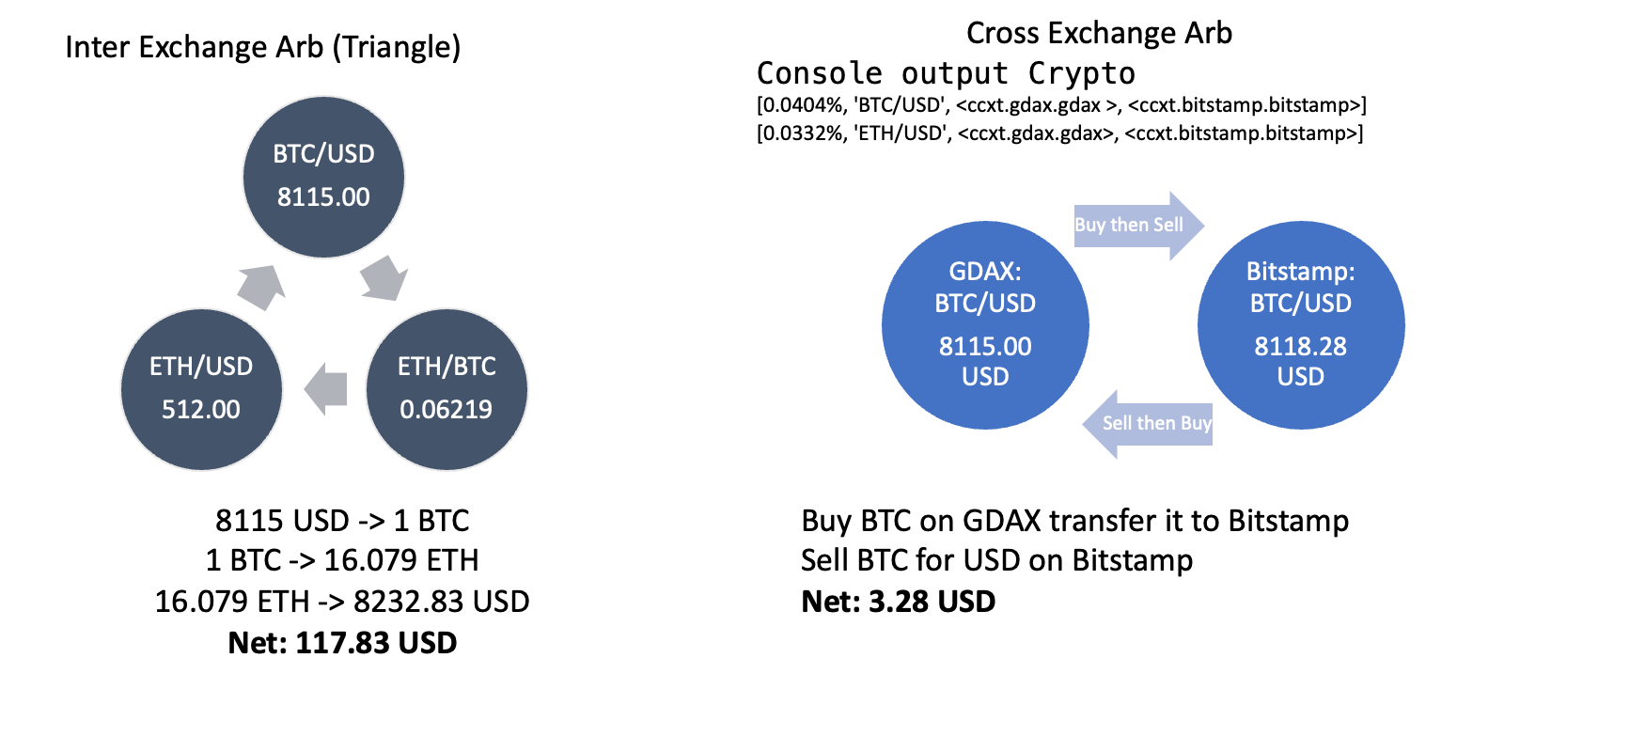
Arbitrage

Slide 27
Prediction Market Arbitrage
The same event trades on multiple venues: Kalshi, Polymarket, and brokers routing to them (Robinhood, IBKR, Webull)
If YES is 58¢ on one venue and 62¢ on another: buy YES cheap, buy NO rich — lock in a guaranteed $1 payout for < $1
Frictions are the edge and the enemy: fees, capital sitting on both venues, USD vs USDC rails, withdrawal timing
Read the rules: “identical” markets can differ in settlement source and date — resolution risk breaks naive arbs.
Books re-converge in seconds. Agents win this race; humans watching two browser tabs do not.

Slide 28
Market Making
Increase liquidity – rewarded with the spread
Be on both sides of the book
Can be dangerous in times of volatility — on event contracts the mid IS a probability, and it jumps on news
Bids | Price | Asks
 | 51¢ | 2,1
 | 50¢ | 3,7,8
 | 49¢ | 5,2,15
 | 48¢ | 1,2,5
1,2 | 47¢
2,5,8 | 46¢
3,8,1,5,3 | 45¢
2,3 | 42¢

Slide 29
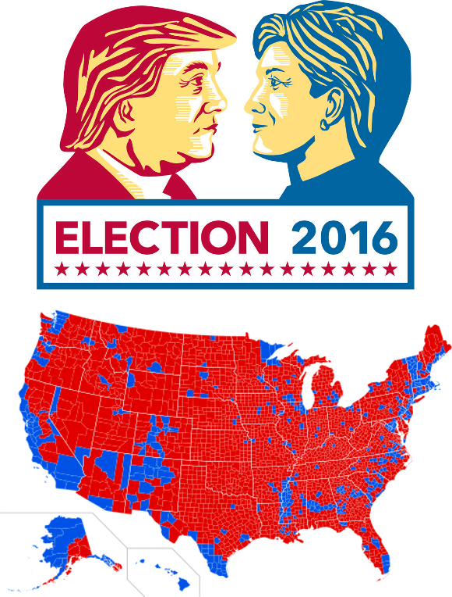
Election Prediction
2024: we used a DNN + engineered features to predict the election and the expected market reaction
Python utilizing Tensorflow
Identify the sources of data and the resulting outputs
2026: the market IS the forecast — today we quote it live instead of predicting it
Our code here:
https://github.com/athaker/econ_136/tree/master/2024

Slide 30
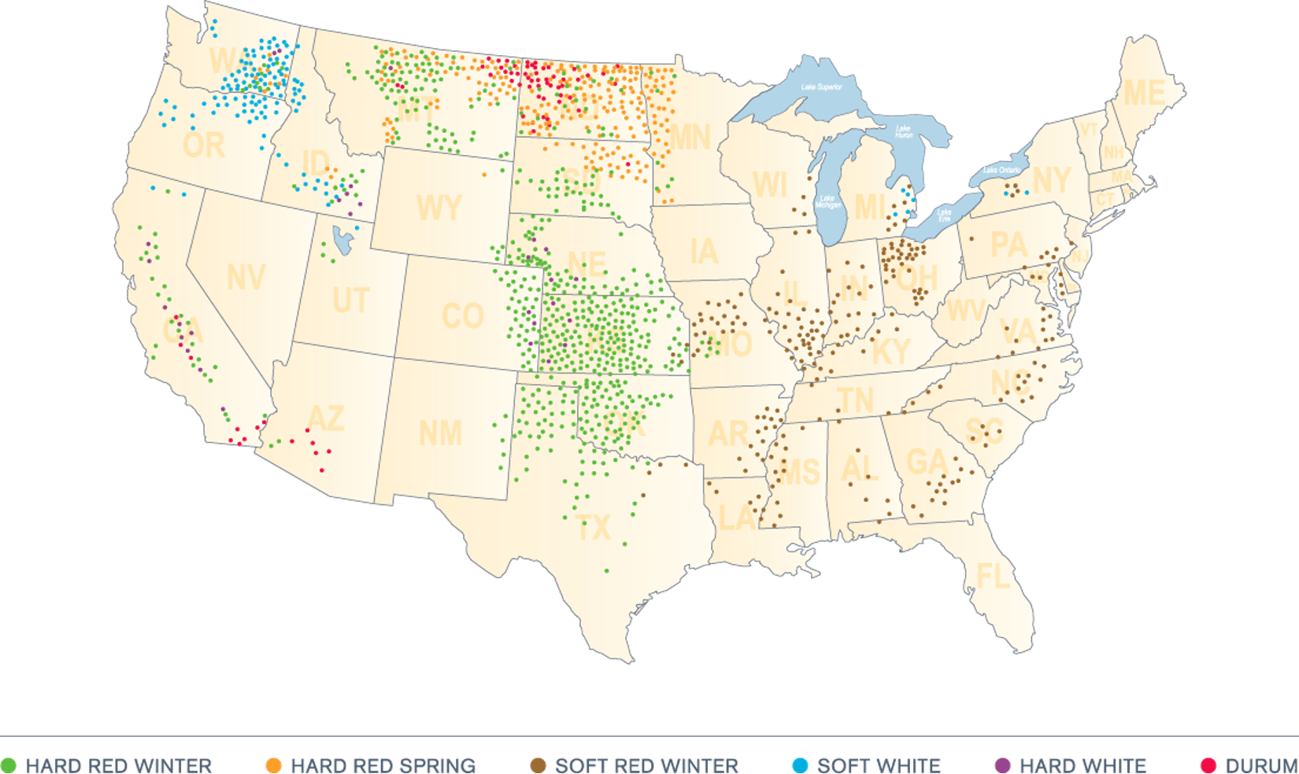
Aerial Imagery
Thesis:
  Crop health can be influence the spot price of a tradable good
Execution:
  Take aerial imagery of Hard Red Winter wheat farms, use that as a proxy for health
  Google Earth gives us free historical imagery over time
Machine Learning:
  ML models can ”learn” the influence of crop health from market prices
  Use pretrained models that have been trained on large datasets
Our Model Here: https://github.com/athaker/econ_136/tree/master/archived_lectures/2019

Slide 31

Thank You!

Slide 32
Why The Name Tauroi
Tau + ROI
Tau = 𝛕 Time constant in electrical engineering - properly estimating time can generate systematic profits
ROI = Return on investment
Tauroi = Tauroi Khalkeoi were mechanical bronze bulls in greek mythology

Slide 33
Unit | Last | Bid | Ask | Size | Net | Percentage
AMD | 13.7 | 13.69 | 13.7 | 100 | 1370 | 16.31%
INTC | 35.16 | 35.16 | 35.17 | 100 | 3516 | 41.85%
AAPL | 140.64 | 140.63 | 140.64 | 25 | 3516 | 41.85%
Creation Unit | 84.02 | 84.01 | 84.03 | 100 | 8402 | 100.00%
ETF / Index Arbitrage
This is a common strategy, and typically need flow
Arbitrage happens when ETF trades at a discount or premium to the NAV
  Institutional: When ETF price > NAV, the AP will sell shares it received during creation and make a spread between the cost of the assets it bought for the ETF issuer and the selling price from the ETF shares. AP can also buy the underlying shares that compose the ETF directly at lower prices, sell ETF shares on the open market at the higher price, capturing the spread.
  Individuals: When the ETF is selling at a premium (or discount), individuals can buy (short) the underlying securities in the same proportions and short (or buy) the ETF. Limited by liquidity and spread
    If inside the spread need to know if the ETF goes to share price or share price goes to ETF price
Do this at an international level with ADR’s
Example | Price
Calculated Ask | 84.03
Calculated Bid | 84.0075
ETF Bid | 84.04
ETF Ask | 84.05

Slide 34
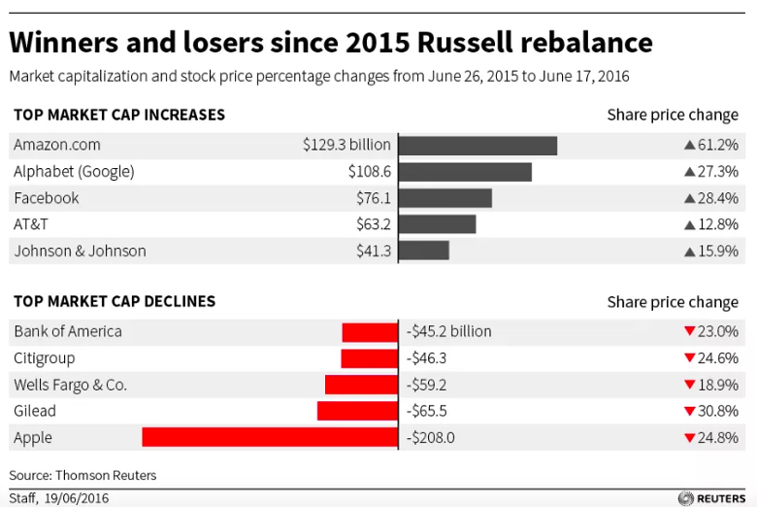
Deal Flow
Bank will trade all of the positions on behalf of FTSE Russell (moves ~20 Billion in a few hours) for a single client
Buys up in anticipation of the trade and sells their own shares to the client
Massive market moves
Legalized insider trading and market manipulation due to sheer size of orders
Goldman actually pays Russell (and the like) for their order flow!
Robinhood and Citadel!

Slide 35
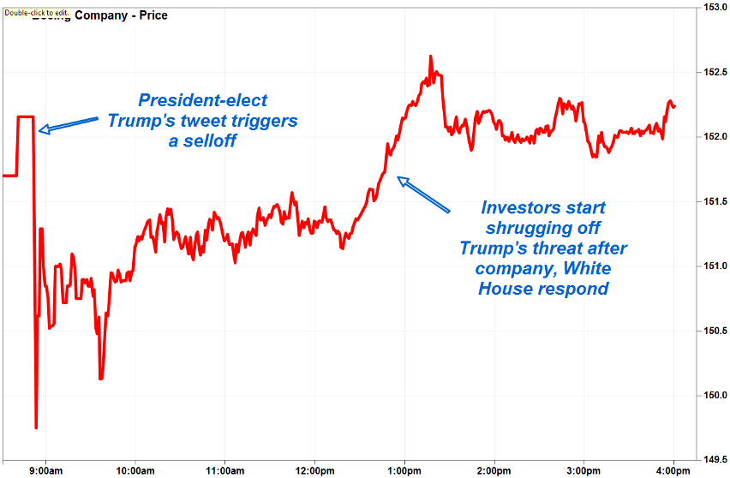
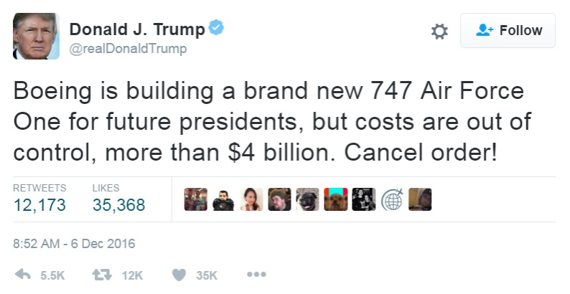
Sentiment
Thesis:
  Twitter and other news sources (Reuters, etc.) can give me an information advantage
Execution
  Train an ML model to understand Donald Trumps Tweets, trade the resulting market sentiment
Example:
  https://www.kaggle.com/c/two-sigma-financial-news

Slide 36
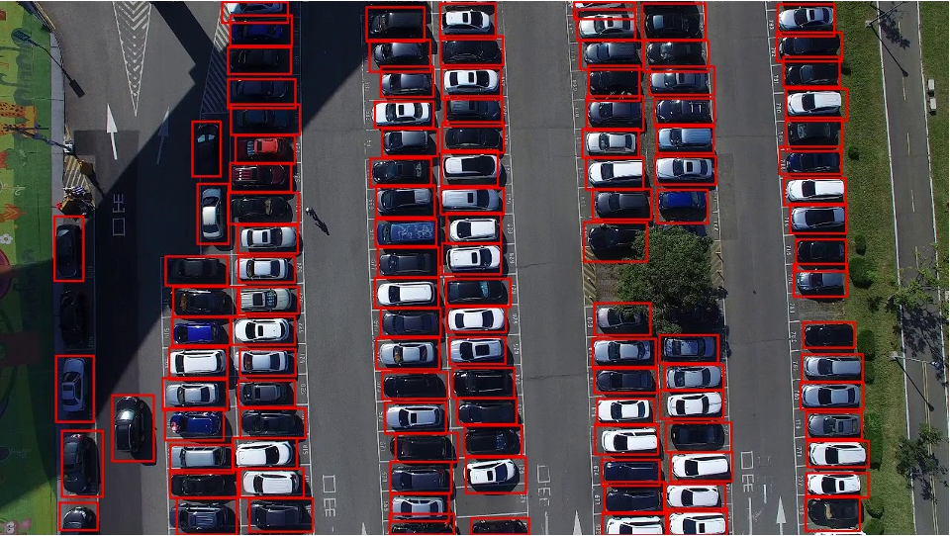
Drone Car Counting
Thesis:
  Storefront business’s financial performance strongly correlated with number of visitors
Execution:
  Use image processing to count the number of cars over time in parking lots
Possible to forecast better than market

Slide 37
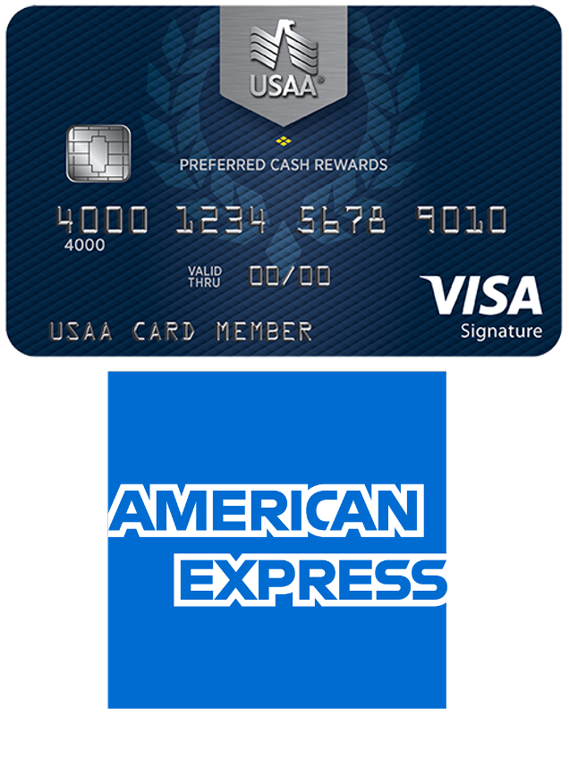
Alt Data Spend
Thesis:
  Consumer spending directly correlates with business performance
Execution:
  Buy aggregated customer data from financial companies
Offline attribution
  See if a person searches online and then buys from a store

Slide 38
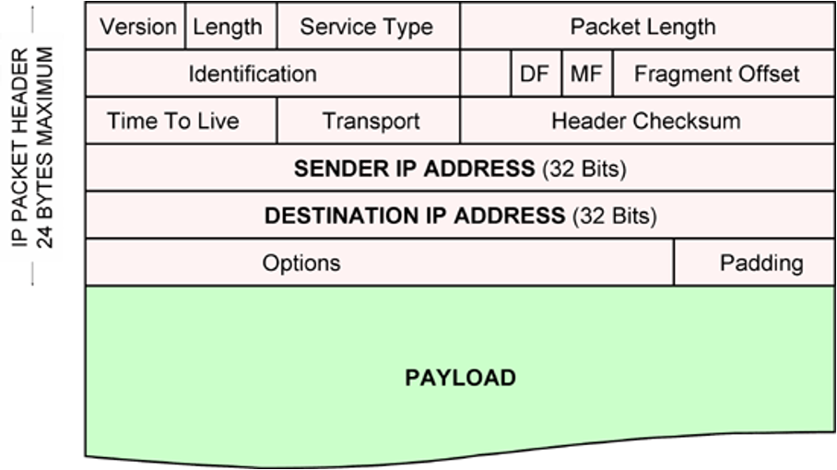
Packet Spoofing
Thesis:
  Being first in the queue at the start of the day will give me a queuing advantage as I can make the market or understand where the market is trading at
Execution:
  Malformed packets may not look like an order with intent to cancel – this will give me an information / time advantage
  “Rule 575, Disruptive Practices Prohibited, prohibits the entering of an order or causing the entry of an order with the intent to cancel the order before execution or to modify the order to avoid execution. This practice is commonly known as spoofing.”
cmegroup.com

