Slide 1
Costa Rican Household Poverty Level Prediction
Applied Machine Learning Fall 2018
Project Phase-1
Abhijit Thakre
Dhanya Mathew
Mani Kumar Kagita
Lenin Arivukadal

Slide 2
Problem Statement
Costa Rican Household Poverty Level Prediction is a Kaggle competition for a social cause to help Inter-American Development Bank to identify which households have the highest need for social welfare assistance.
The objective is to develop a machine learning model that can predict the poverty level of households using both individual and household characteristics.
Data is provided on the individual level including their unique features and their household information. The study includes constructing the prediction model to predict poverty level for the head of the household rather than the individual level.
Kaggle competition link:
https://www.kaggle.com/c/costa-rican-household-poverty-prediction

Slide 3
Literature Review
Walkthrough the problem statement in detail from the discussion forums to select the best features that fits into the machine learning model.
Found out multiple approaches that could be used to solve this challenge.
Helped us realize in advance that our dataset needs a lot of data pre-processing.
Discovered imbalanced class problem in the data when categorized the individuals in the dataset based on the Poverty levels.

Slide 4
Road Map
Download Data
Exploratory Data Analysis
Data Pre-Processing
Feature Engineering
Feature Selection
Baseline Model
Model different classifiers

Slide 5
Dataset
Dataset consists of both train and test data. Training dataset contains 143 variables/features and 9557 rows. Test dataset contains 142 features and 23856 rows
Core data fields:
Id - a unique identifier for each row.
Target - the target is an ordinal variable indicating groups of income levels. 1 = extreme poverty 2 = moderate poverty 3 = vulnerable households 4 = non vulnerable households
idhogar - this is a unique identifier for each household. This can be used to create household-wide features, etc. All rows in a given household will have a matching value for this identifier.
parentesco1 - indicates if this person is the head of the household.

Slide 6
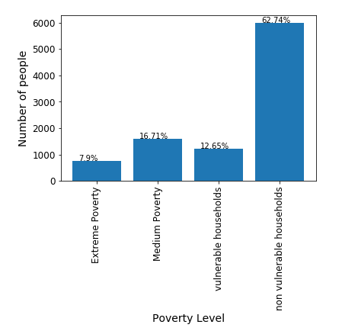
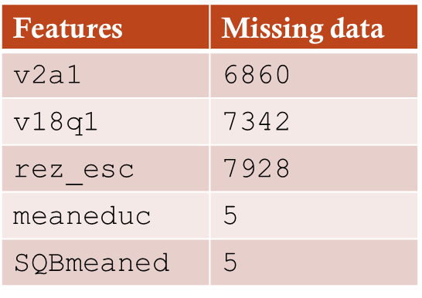
Insights of the Training Data
Training dataset consists of 143 columns and 9557 rows.
Data shows variations of poverty level target based on various individual and household features.
Majority households are classified under non-vulnerable than in any other category. The extreme poverty class is the smallest.
Lot of missing data for features v2a1, v18q1, rez_esc
is being observed. Filled the missing data with appropriate
values as per the data description and understandings.

Slide 7
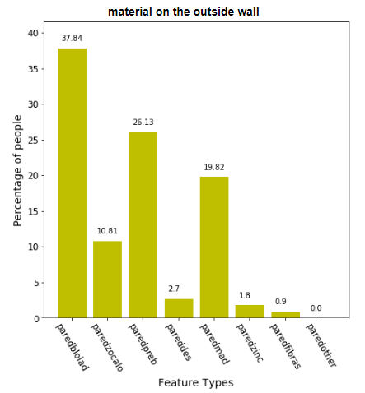
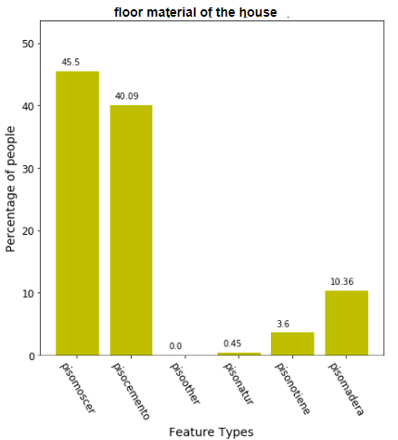
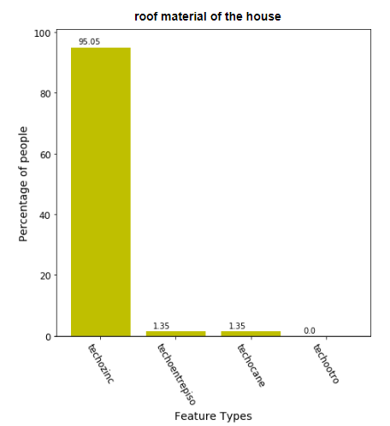
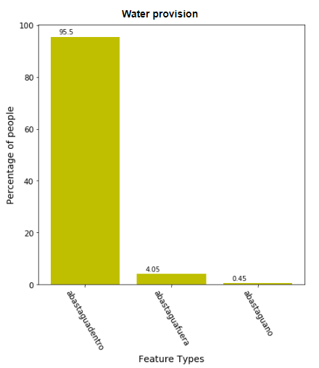
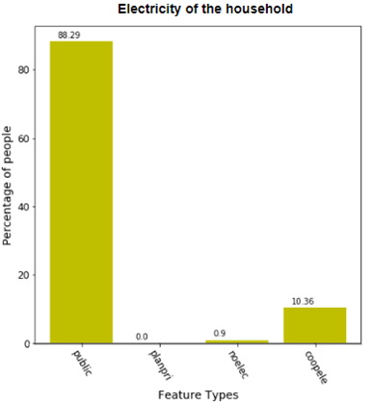
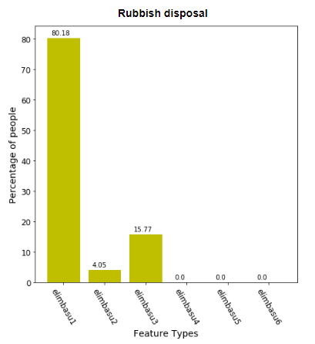
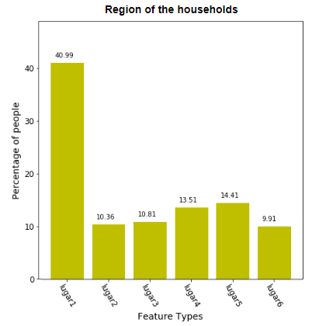
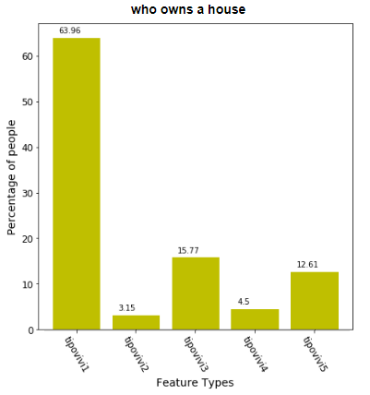
Variations of extreme poverty level based on household features
Extreme poverty levels are plotted in the figure below based on various household features to compare how features are affecting on the poverty levels. This comparison between various target categories help to eliminate or combine similar features for best feature selection.

Slide 8
Slides under construction ☺

