Slide 1
six Month Industrial Training
NAME : RAJAN PAUL
BRANCH : Electronics and communication engineering
ROLLNO : 1916225
COURSE : Ai with Python

Slide 2

About company
ShapeMySkills Pvt. Ltd. is one of the Best Training Institute in Noida, Delhi NCR
In Numerous leading technologies such as Python, Machine Learning, Deep Learning, Digital Marketing, PLC/SCADA, VLSI, PHP & many more, the company offers specialized training programs
For more details you can visit :- ShapeMySkills Pvt. Ltd.

Slide 3
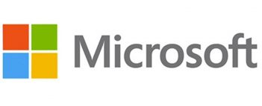


SERVICES
Consultancy For Government Projects
Paid Internships
Technical Education
Manpower Consultancy
100% job Oriented Training
PARTNERS

Slide 4
Course Summery
AI with Python
Python
Machine Learning
Data Science
Basics
Libraries
NumPy
Matplotlib
Pandas
Operators
Loops
Conditional Statements
Recursion

Slide 5
Course completion till now
Python
Basics
Advance
Datatypes
Operators
Loops
Recursion
Functions
Conditional Operators etc.
Libraries
NumPy
Matplotlib
Pandas

Slide 6
PYTHON
Python is computer programming language which is developed by ‘GUIDO VAN ROSSUM(1991)
It is high level language--which is understood by humans.
It is case-sensitive language--that can differentiate between lower and uppercase letters.
It is general purpose programming language.
It is object oriented programming language.
It is dynamically typed language.

Slide 7
APPLICATIONS OF PYTHON
Web development.
Game development.
Machine learning and artificial intelligence.
Data science and data visualization.
Desktop GUI.

Slide 8
VARIABLES IN PYTHON
Variables are containers for storing data values. A variable is created once you assigned a value to it.
RULES TO DECLARE VARIABLES.
variable name must start with a letter or underscore.
variable name can’t start with a number.
variable name can only contain alpha-numeric characters and underscore.
variable names are case-sensitive.

Slide 9
DATA TYPES
NUMERICAL DATA TYPE -- Numerical data type includes int,float and complex.
STRING -- Collection of characters is known as string data type.(For eg. “hello world”)
LIST -- List is the collection of same and different data types. It is separated by commas. and enclosed in square brackets. List is mutable(can be changed).
TUPLE -- Tuple can store different data types. In tuple there is ordered sequence of elements. It is enclosed in round brackets or without brackets also. It is separated by commas. It is immutable data type(can’t be changed)
SET -- Set is the collection of different data types but can’t store list and set. It is enclosed in curly brackets. In set duplication is not allowed.
DICTIONARY -- Dictionaries are used to store data values in key:value pairs. Key is unique. It is enclosed in curly brackets.

Slide 10
OPERATORS IN PYTHON ARITHMETIC OPERATORS
OPERATORS | NAME | EXAMPLE
+ | Addition | a+b
- | subtraction | a-b
* | Multiplication | a*b
/ | Division | a/b
// | Floor division | a//b
% | modulus | a%b
** | exponential | a**b

Slide 11
3.COMPARISON OPERATORS
OPERATORS | NAME | EXAMPLE
== | Equal | a==b
!= | not equal | a!=b
> | greater than | a>b
< | less than | a<b
>= | greater than equal to | a>=b
<= | smaller than equal to | a<=b

Slide 12
LOGICAL OPERATORS
OPERATOR | DESCRIPTION | EXAMPLE
and | return TRUE if both statements are true. | x < 5 and x < 10
or | return TRUE if one of the statement is true. | x < 5 or x < 4
not | reverse the result, returns False if the result is true | not(x < 5 and x < 10)

Slide 13
IDENTITY OPERATORS
OPERATOR | DESCRIPTION | EXAMPLE
is | Returns True if both variables are the same object | x is y
is not | Returns True if both variables are not the same object | x is not y

Slide 14
MEMBERSHIP OPERATOR
OPERATOR | DESCRIPTION | EXAMPLE
in | Returns True if a sequence with the specified value is present in the object | a in b
not in | Returns True if a sequence with the specified value is not present in the object | a not in b

Slide 15
BITWISE OPERATOR
OPERATOR | NAME | DESCRIPTION
& | AND | Sets each bit to 1 if both bits are 1
| | OR | Sets each bit to 1 if one of two bits is 1
^ | XOR | Sets each bit to 1 if only one of two bits is 1
~ | NOT | Inverts all the bits
>> | Signed right shift | Shift right by pushing copies of the leftmost bit in from the left, and let the rightmost bits fall off
<< | Zero fill left shift | Shift left by pushing zeros in from the right and let the leftmost bits fall off

Slide 16
LOOPS
A for loop is used for iterating over a sequence (that is either a list, a tuple, a dictionary, a set, or a string).
For eg.
fruits = ["apple", "banana", "cherry"]
for x in fruits:
print(x)

Slide 17
NumPy
NumPy is fundamental package for scientific computing in Python.
NumPy is a python library that provides a multidimensional array object , various derived objects.
NumPy working process is faster than list.
NumPy vs Python List
Advantages of using NumPy Arrays over Python lists:
1. Consumes Less memory.
2. fast as compare to the Python List.
3. Convenient to use.

Slide 18
NumPy Array
An array is a grid of values and it contains information about the row data , how to locate an element and how it interpret an element.
1. One dimensional array
2. Two dimensional array
3. Three dimensional array
Importance of NumPy in python
1. Wide variety of mathematical operations on array.
2. It supplies an enormous of high-level mathematical functions that operate on these array and matrices.
3. Mathematical , Logical , shape , manipulation ,sorting , selecting, I/O discrete Fourier Transform, Basic linear Algebra, Basic statistical operation and much more.

Slide 19
Installing NumPy :
pip install numpy
Importing NumPy :
Import numpy as np

Slide 20
Creating NumPy Arrays
import numpy as np
x = [1,2,3,4,5]
b = np.array(x)
print(b)
print(type(b))
Output :[1 2 3 4 5]
<class 'numpy.ndarray'>
b = np.array( [1,2,3,4,5]) # if we use only b instead of print(b) then it also shows its type.
b
Output : array([1, 2, 3, 4, 5])

Slide 21
One Dimensional Array:
ar1 = np.array( [1,2,3,4,5])
print(ar1)
print(type(ar1))
print(ar1.ndim)
Output : [1 2 3 4 5]
<class 'numpy.ndarray’>
1
Two Dimensional Array:
ar2 = np.array( [[1,2,3,4],[1,2,3,4]]) # Number of elements should be same in the list.
print(ar2)
print(type(ar2))
print(ar2.ndim)
Output : [[1 2 3 4]
[1 2 3 4]]
<class 'numpy.ndarray’>
2

Slide 22
Three Dimensional Array
ar3 = np.array( [[[1,2,3,4],[1,2,3,4]]])
print(ar3)
print(type(ar3))
Output : [[[1 2 3 4]
[1 2 3 4]]]
<class 'numpy.ndarray’>
Multidimensional array
arn = np.array( [1,2,3,4] , ndmin = 10)
print(arn)
print(type(arn))
print(arn.ndim)
Output : [[[[[[[[[[1 2 3 4]]]]]]]]]]
<class 'numpy.ndarray’>
10

Slide 23
NumPy Data Types
Data Types in Python
By default Python have these data types:
strings - used to represent text data, the text is given under quote marks. e.g. "ABCD“
integer - used to represent integer numbers. e.g. -1, -2, -3
float - used to represent real numbers. e.g. 1.2, 42.42
Boolean - used to represent True or False.
complex - used to represent complex numbers. e.g. 1.0 + 2.0j, 1.5 + 2.5j

Slide 24
Data Types in NumPy:
NumPy has some extra data types, and refer to data types with one character, like i for integers, u for unsigned integers etc.
Below is a list of all data types in NumPy and the characters used to represent them.
i - integer
b - boolean
u - unsigned integer
f - float
c - complex float
m - timedelta
M - datetime
O - object
S - string
U - unicode string
V - fixed chunk of memory for other type ( void )

Slide 25
Checking the Data Type of an Array
The NumPy array object has a property called dtype that returns the data type of the array:
import numpy as np arr = np.array([1, 2, 3, 4]) print(arr.dtype)
Output : int32
Creating Arrays With a Defined Data Type
We use the array() function to create arrays, this function can take an optional argument: dtype that allows us to define the expected data type of the array elements:
arr = np.array([1, 2, 3, 4], dtype='S') print(arr) print(arr.dtype)
Output : [b'1' b'2' b'3' b'4’]
|S1

Slide 26
Converting Data Type on Existing Arrays :
The best way to change the data type of an existing array, is to make a copy of the array with the astype() method.
The astype() function creates a copy of the array, and allows you to specify the data type as a parameter.
The data type can be specified using a string, like 'f' for float, 'i' for integer etc. or you can use the data type directly like float for float and int for integer
Example :
import numpy as np
arr = np.array([1.1, 2.1, 3.1])
newarr = arr.astype('i')
print(newarr)
print(newarr.dtype)
Output : [1 2 3]
int32

Slide 27
Random Numbers in NumPy :
Random number does NOT mean a different number every time. Random means something that can not be predicted logically.
Generate Random Number :
NumPy offers the random module to work with random numbers.
Random Function | Description
1. rand () | The function is used to generate a random number between 0 and 1.
2. randn () | The function is used to generate a random number close to zero. This may return positive or negative number as well.
3. ranf () | It returns an array of specified shape and fit it with random floats in the half open interval [0.0,1.0).
4. randint () | The function is used to generate a random number between a given range.

Slide 28
Create NumPy Array with random numbers :
1. Rand() :
var = np.random.rand(4) # rand() is used to generate random values between 0 and 1
print(var)
Output : [0.07509631 0.1314205 0.69593782 0.82285063]
var2 = np.random.rand(2,4) # Two dimensional Array , np.random.rand(rows , columns)
print(var2)
Output : [[0.99296754 0.095885 0.08734275 0.62719104]
[0.64840416 0.950283 0.31829515 0.68916373]]
var3 = np.random.rand(2,2,1) # Three dimensional Array ,np.random.rand(height, rows , columns)
print(var3)
Output : [[[0.33846003]
[0.17289909]]
[[0.60314381]
[0.97224094]]]

Slide 29
2. Randn() :
var_1 = np.random.randn(4) # randn() is used to generate a random value close to zero.
print(var_1)
Output : [-0.76672611 0.3952321 -0.18708851 -0.91948629]
var_2 = np.random.randn(4,3) # Two dimensional Array , np.random.randn( rows , columns)
print(var_2)
[[ 0.00841774 -0.38091091 0.20647908]
[ 0.28103064 0.695374747 2.08140332]
[-0.36583714 0.45504541 -2.26938817]
[-0.83702194 -0.67713827 -0.09832978]]
var_2 = np.random.randn(2,1,3) # Three dimensional Array , np.random.randn(height , rows , columns)
print(var_2)
Output : [[[-1.03280966]]
[[ 0.15391546]]]

Slide 30
Intro. to Data Visualization Simple Graphs in Python using
MATPLOTLIB & PYPLOT

Slide 31
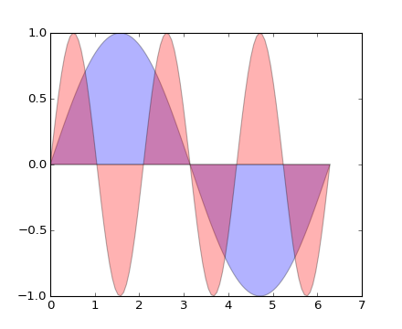
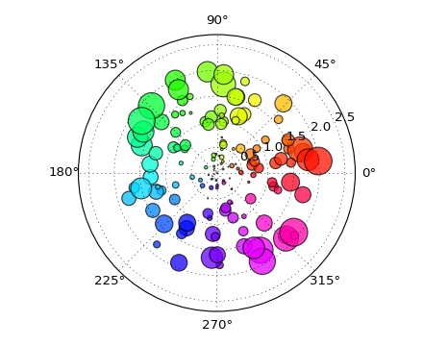
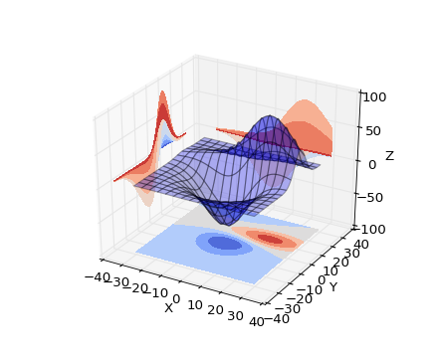
What is data visualization?
Data visualization is the graphical representation of information and data.
Can be achieved using visual elements like figures, charts, graphs, maps, and more.
Data visualization tools provide a way to present these figures and graphs.
Often, it is essential to analyze massive amounts of information and make data-driven decisions.
converting complex data into an easy to understand representation.

Slide 32
Matplotlib
Matplotlib is one of the most powerful tools for data visualization in Python.
Matplotlib is an incredibly powerful (and beautiful!) 2-D plotting library.
It is easy to use and provides a huge number of examples for tackling unique problems
In order to get matplotlib into your script, first you need to import it, for example:
import matplotlib.pyplot as plt
However, if it is not installed, you may need to install it:
Easiest way to install matplotlib is using pip.
Type the following command in the command prompt (cmd) or your Linux shell;
pip install matplotlib
Note that you may need to run the above cmd as an administrator

Slide 33
matplotlib
Strives to emulate MATLAB
matplotlib.pyplot is a collection of command style functions that make matplotlib work like MATLAB.
Each pyplot function makes some change to the figure:
e.g.,
creates a figure,
creates a plotting area in the figure,
plots some lines in the plotting area
Note that various states are preserved across function calls
Whenever you plot with matplotlib, the two main code lines should be considered:
Type of graph
this is where you define a bar chart, line chart, etc.
Show the graph
this is to display the graph

Slide 34
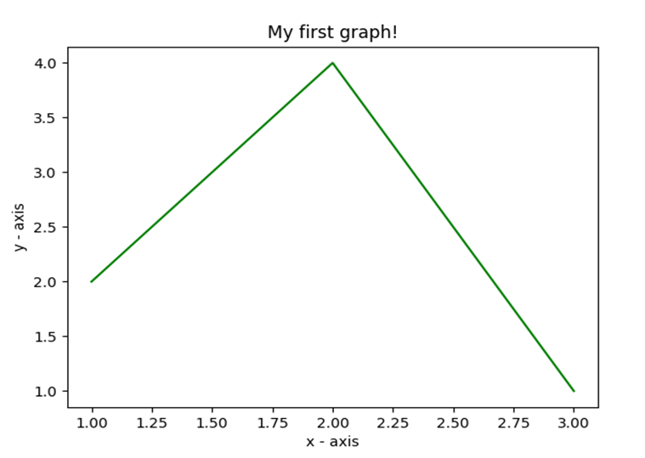
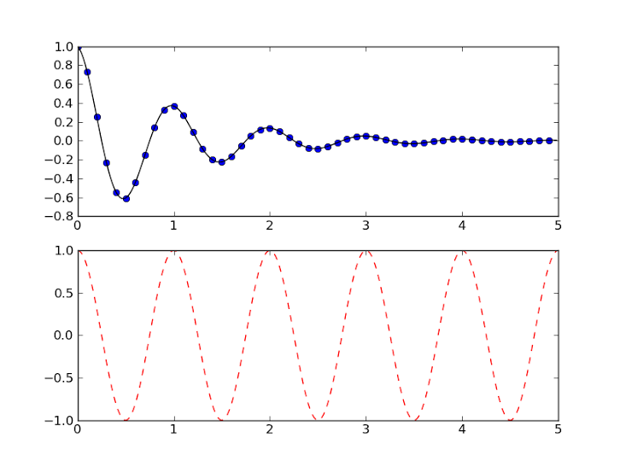
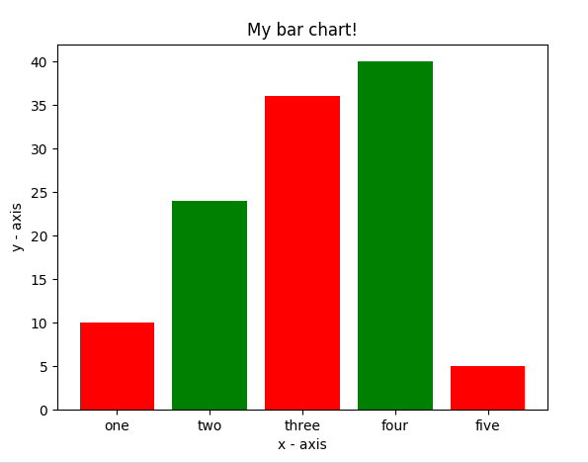
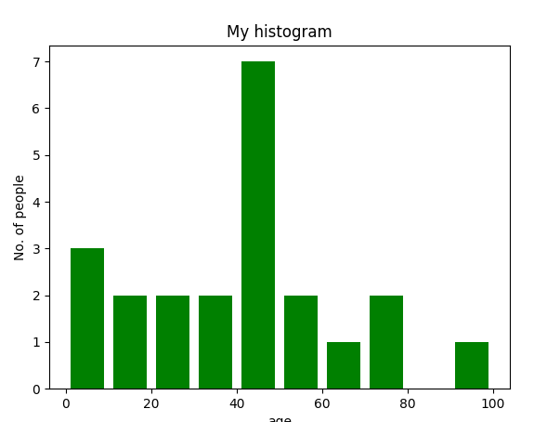
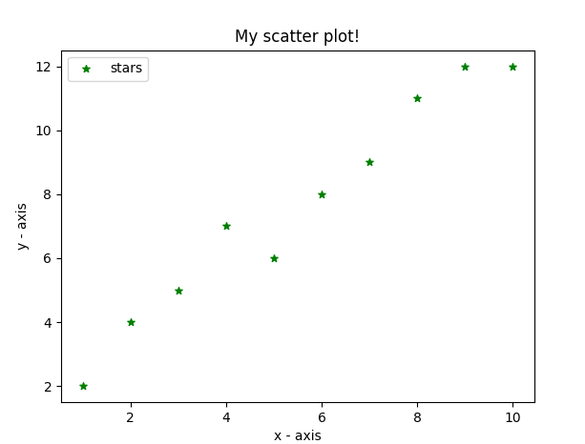
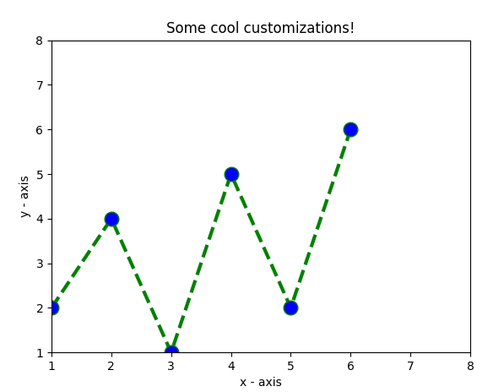
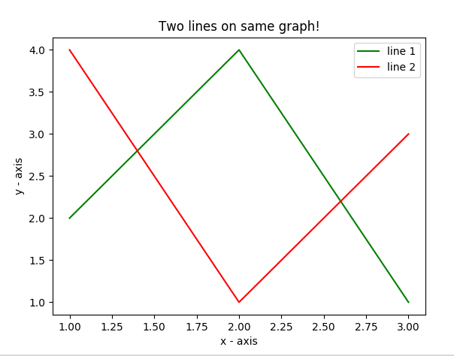
E.g. Matplotlib
Matplotlib allows you to make easy things
You can generate plots, histograms, power spectra, bar charts, errorcharts, scatterplots, etc., with just a few lines of code.

Slide 35
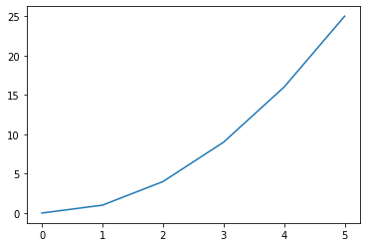
Line Graphs
import matplotlib.pyplot as plt
create data for plotting x_values = [0, 1, 2, 3, 4, 5 ] y_values = [0, 1, 4, 9, 16,25]
#the default graph style for plot is a line plt.plot(x_values, y_values)
#display the graph plt.show()

Slide 36
pyplot
text() : adds text in an arbitrary location
xlabel(): adds text to the x-axis
ylabel(): adds text to the y-axis
title() : adds title to the plot
clear() : removes all plots from the axes.
savefig(): saves your figure to a file
legend() : shows a legend on the plot
All methods are available on pyplot and on the axes instance generally.

Slide 37
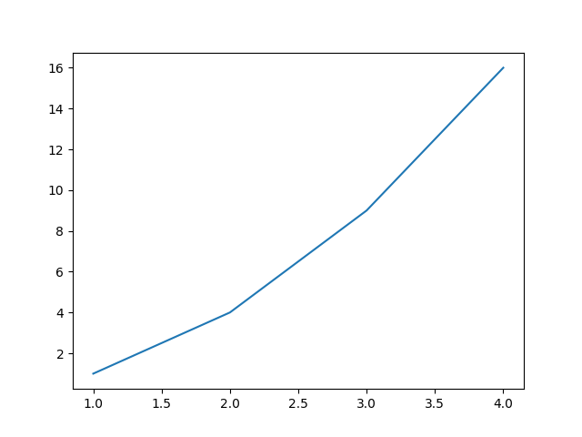
Plot
import matplotlib.pyplot as plt
x = [1, 2, 3, 4]
y = [1, 4, 9, 16]
plt.plot(x, y)
no return value?
We are operating on a “hidden” variable representing the figure.
This is a terrible, terrible trick.
Its only purpose is to pander to MATLAB users.
I’ll show you how this works in the next lecture

Slide 38

Simple line
# importing the required module
import matplotlib.pyplot as plt
# x axis values
x = [1,2,3]
# corresponding y axis values
y = [2,4,1]
# plotting the points
plt.plot(x, y)
# naming the x axis
plt.xlabel('x - axis')
# naming the y axis
plt.ylabel('y - axis')
# giving a title to my graph
plt.title('My first graph!')
# function to show the plot
plt.show()
Define the x-axis and corresponding y-axis values as lists.
Plot them on canvas using .plot() function.
Give a name to x-axis and y-axis using .xlabel() and .ylabel() functions.
Give a title to your plot using .title() function.
Finally, to view your plot, we use .show() function.

Slide 39
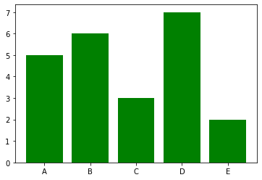
Bar graphs
import matplotlib.pyplot as plt
#Create data for plotting
values = [5, 6, 3, 7, 2]
names = ["A", "B", "C", "D", "E"]
plt.bar(names, values, color="green")
plt.show()
When using a bar graph, the change in code will be from plt.plot() to plt.bar() changes it into a bar chart.

Slide 40
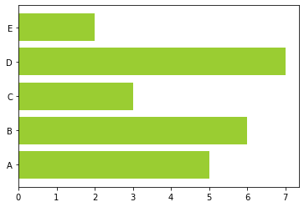
Bar graphs
We can also flip the bar graph horizontally with the following
import matplotlib.pyplot as plt
#Create data for plotting values = [5,6,3,7,2] names = ["A", "B", "C", "D", "E"]
# Adding an "h" after bar will flip the graph plt.barh(names, values, color="yellowgreen") plt.show()

Slide 41
Bar Chart
import matplotlib.pyplot as plt
# heights of bars
height = [10, 24, 36, 40, 5]
# labels for bars
names = ['one','two','three','four','five']
# plotting a bar chart
c1 =['red', 'green']
c2 =['b', 'g'] # we can use this for color
plt.bar(left, height, width=0.8, color=c1)
# naming the x-axis
plt.xlabel('x - axis')
# naming the y-axis
plt.ylabel('y - axis')
# plot title
plt.title('My bar chart!')
# function to show the plot
plt.show()
Here, we use plt.bar() function to plot a bar chart.
you can also give some name to x-axis coordinates by defining tick_labels

Slide 42
Histogram
import matplotlib.pyplot as plt
# frequencies
ages=[2,5,70,40,30,45,50,45,43,40,44,60,7,13,57,18,90,77,32,21,20,40]
# setting the ranges and no. of intervals
range = (0, 100)
bins = 10
# plotting a histogram
plt.hist(ages, bins, range, color='green',histtype='bar',rwidth=0.8)
# x-axis label
plt.xlabel('age')
# frequency label
plt.ylabel('No. of people')
# plot title
plt.title('My histogram')
# function to show the plot
plt.show()

Slide 43
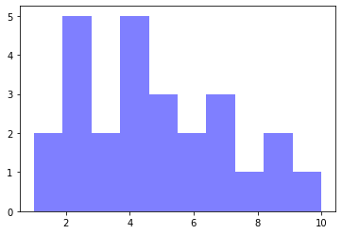
Histograms
import matplotlib.pyplot as plt
#generate fake data
x = [2,1,6,4,2,4,8,9,4,2,4,10,6,4,5,7,7,3,2,7,5,3,5,9,2,1]
#plot for a histogram
plt.hist(x, bins = 10, color='blue', alpha=0.5)
plt.show()
Looking at the code snippet, I added two new arguments:
Bins — is an argument specific to a histogram and allows the user to customize how many bins they want.
Alpha — is an argument that displays the level of transparency of the data points.

Slide 44
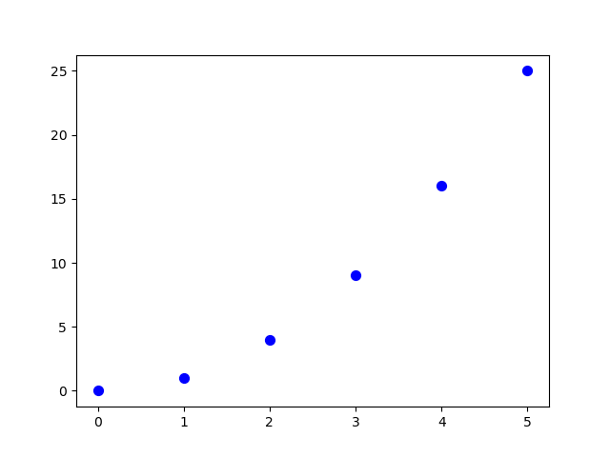
Scatter Plots
import matplotlib.pyplot as plt
#create data for plotting
x_values = [0,1,2,3,4,5] y_values = [0,1,4,9,16,25]
plt.scatter(x_values, y_values, s=30, color=“blue") plt.show()
Can you see the pattern? Now the code changed from plt.bar() to plt.scatter().

Slide 45
Scatter plot
import matplotlib.pyplot as plt
# x-axis values
x = [1,2,3,4,5,6,7,8,9,10]
# y-axis values
y = [2,4,5,7,6,8,9,11,12,12]
# plotting points as a scatter plot
plt.scatter(x, y, label= "stars", color="green", marker="*", s=30)
# x-axis label
plt.xlabel('x - axis')
# frequency label
plt.ylabel('y - axis')
# plot title
plt.title('My scatter plot!')
# showing legend
plt.legend()
# function to show the plot
plt.show()

Slide 46
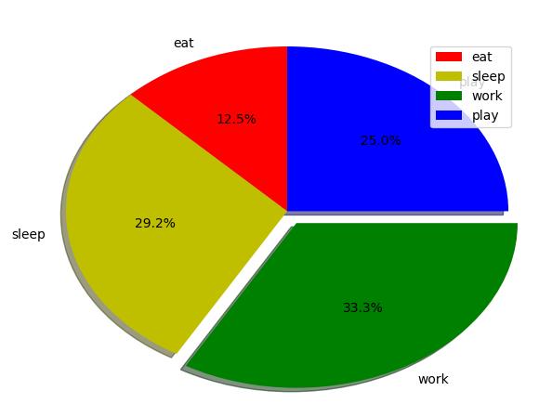
Pie-chart
import matplotlib.pyplot as plt
# defining labels
activities = ['eat', 'sleep', 'work', 'play']
# portion covered by each label
slices = [3, 7, 8, 6]
# color for each label
colors = ['r', 'y', 'g', 'b']
# plotting the pie chart
plt.pie(slices, labels = activities, colors=colors,
startangle=90, shadow = True, explode = (0, 0, 0.1, 0),
radius = 1.2, autopct = '%1.1f%%')
# plotting legend
plt.legend()
# showing the plot
plt.show()

Slide 47
Thank You

