Slide 1
Implementation and Hardware Accelerated Verification of a Connected Component Labeling Architecture
Diploma Thesis
Examiner: Prof. Dr.-Ing. S. Simon
Supervisor: M. Sc. Yousef Baroud
Notes:
Hello every one, my name is… I’ll present you now my thesis with the title:

Slide 2
Outline
Motivation
Goals
Proposed Design
  CCL Reference implementation
  Hardware Verification Architecture
Software
Results
Conclusion
Notes:
This is the outline for my presentation 21…22…23 at the end you can see a demo of the implemented architecture if you are interested
-> Now we start with the motivation

Slide 3
Motivation
Proof correctness of image processing algorithm
Testing with list of testcases – incomplete
Using exhaustive testing
  Formal verification methods - do not work in every case
  Verification by simulation - slow
Testing requires >80% of development time [FGP10]
  Support the developer
Notes:
New algorithm -> check correctness
In Terms -> fulfilment of specification
Formal verification methods not work for most img algos
4x4 image exhaustive ~30min
->To support the developer with the testing we want to build a architecture to verify the correctness of a single pass CCL

Slide 4
Goals
Verify correctness of single pass CCL
Automatic output verification for input stimuli
Using exhaustive testing – reasonable image size
Reference CCL implementation
Speedup verification with FPGA
Send found errors to PC
Non exhaustive test for bigger image size
CCL-DUT
COMPARATOR
STIM-GEN
ERR
CCL-REF
Notes:
-> We heard now multiple times about CCL. I know most of you know what this is, so I just give a brief explination

Slide 5
Connected Component Labeling
Assign unique labels to connected pixels
1
1
1
1
1
1
4
4
4
Notes:
-> The most intuitive way to do the labeling for a raster scan image is a two pass ccl algorithm.

Slide 6
Connected Component Labeling
Proposed Design – 2-pass CCL
A
B
C
Neighborhood of pixel X
D
X
2-pass Connected Component Labeling
1
1
1
1
1
2
2
1
1
3
2
1
1
1
3
1
1
4
1
4
second-pass
5
4
4
4
4
4
5
4
first-pass
equivalence table
Bounding boxes
3
2
lookup table generation
3
1
5
4
Notes:
It is really intuitive
-> This algorithm is used for the reference CCL and next we will see how this is implemented

Slide 7
Proposed Design – CCL REF
1
2
1
1
1
1
1
3
2
2
1
1
1
1
1
4
3
2
3
1
1
4
3
1
4
4
5
4
5
4
5
4
4
4
CCL-REF
CONTROL UNIT
ERROR
LABELING
PX
EQUI
FIFO
PX BUF
LU TABLE
LABEL
RAM
BOUNDBOX
BOX
Notes:
Internal error: for ex. a fifo overflow or if more labels are required as expected
Don’t forget the the Finite state machine
->FSM!!! another more advanced way to do the labeling is implemented by the dut

Slide 8
Proposed Design – CCL-DUT
Single-pass CCL M. Klaiber et al. [KRW+12]
Used as a black box
CLK
ERROR
RESET
READY
BOX_VALID
PX_VALID
BOX_DATA
PX_VALUE
Notes:
Single pass, parallel, storage optimized implementation
Most of you know this approach better than I do.
Errors of failed assertions
->The last component to do the automatic exhaustive test is the comparator. It should report 4 different error types.

Slide 9
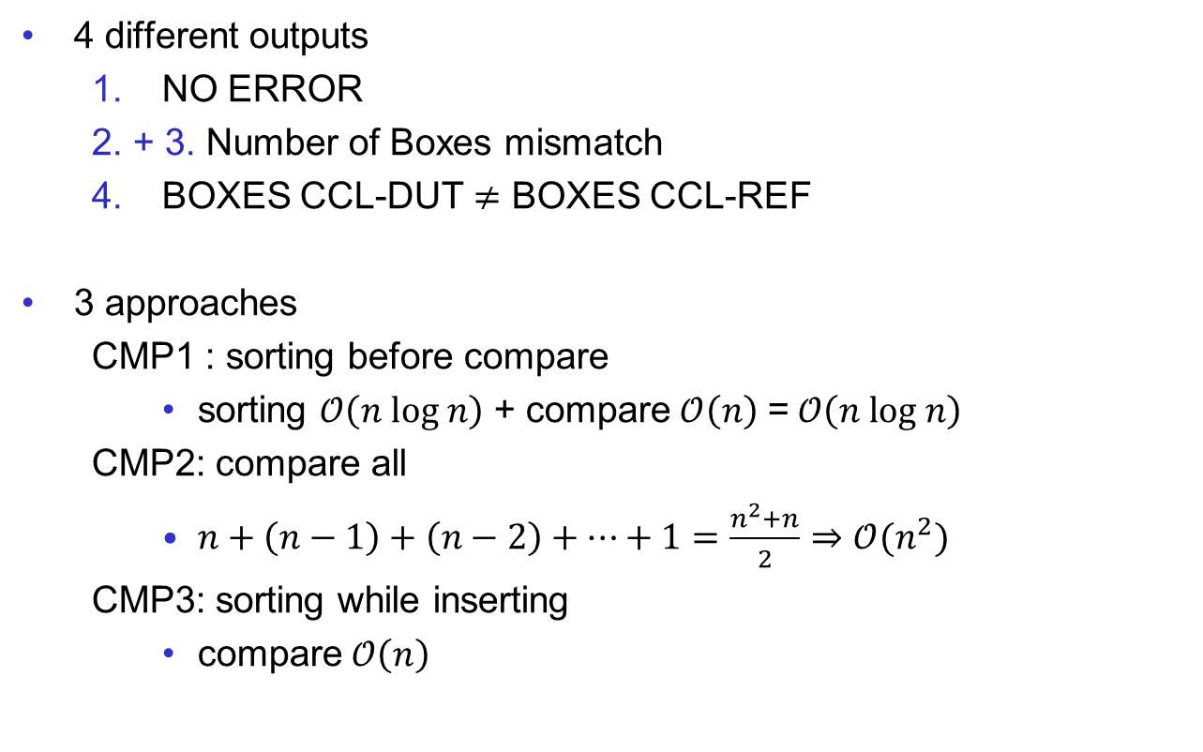


Proposed Design – Comparator
4 different outputs
  NO ERROR
  2. + 3. Number of Boxes mismatch
  4. BOXES CCL-DUT $≠$ BOXES CCL-REF
3 approaches
  CMP1 : sorting before compare
    sorting $𝒪\left(n \text{log} n\right)$ + compare$𝒪\left(n\right)$ =$𝒪\left(n \text{log} n\right)$
  CMP2: compare all
    $n+\left(n−1\right)+\left(n−2\right)+…+1=\frac{n^{2}+n}{2}⇒𝒪(n^{2})$
  CMP3: sorting while inserting
    compare$𝒪\left(n\right)$
3
8
9
1
4
4
1
9
8
3
$$?$$
$$=$$
Notes:
Recognise
Now we have three different approaches
->Only the Type2 and 3 has been implemented Type 3 is not explained here. Type 2 stores the left list in a fifo, since every value needs only be looked once. The right list is stored in a RAM

Slide 10
Proposed Design – Comparator 2
COMPARATOR
IN_REF
RAM
DATA_IN
DATA_OUT
ADR CNT
IN_ADR
OUT_ADR
ADR CNT
DATA_OUT
FIFO
IN_DUT
DATA_IN
READ
FILL LVL
CONTROL-UNIT
LAST_IN
Notes:
ADR-CNT
-> Now we can put all together and the we have a automatic verifier…

Slide 11
Proposed Design – Verifier Architecture
TOP
VERIFIER
CCL-DUT
COMPARATOR
STIM-GEN
U
FIFO
CCL-REF
COM-CONTROL
UDP-ENC
UDP/IP-Core
ETHERNET-MAC
UDP-DEC
Internal Error
CMP Error
Bounding Box
Notes:
Stimgen for input
Fifo to store the output
2 behaviors if fifo is full:
dropp errors
Stall verifier
COM Control sends Fifo data -> UDP ->IP -> ETH to PC
Set start/end stimulus
~3% utilization of Virtex-6
-> We can use the free space to speedup the architecture by implementing more verifiers in parallel

Slide 12
Verification Architecture - Speedup
Intuitive parallelization of CCL-DUT, CCL-REF and COMPARATOR
VERIFIER
ARBITER
ARBITER
CCL-DUT
COMPARATOR
U
CCL-REF
N
2
1
Notes:
We choosen the most intuitive way to speed the architecture up
Replicating units
Utilization now is nearly 100% and speedup factor of ~70
->Can we further increase the performance?

Slide 13
Verification Architecture – Speedup 2
Images with different complexity
          5x5 Image – one input for 9 boxes
Notes:
-> This can be used to implement smaller instances to process the simple images and for the complexer images we instantiate a instances which can process every input image type.

Slide 14
Verification Architecture – Speedup 2
VERIFIER
ARBITER
ARBITER
RERUN
FIFO
CCL-REF
COMPARATOR
U
CCL-DUT
CCL-REF
COMPARATOR
U
CCL-DUT
Notes:
This advanced architecture has not been implemented
-> we now know how the hardware architecture looks like. Let’s now give a look on the software….

Slide 15
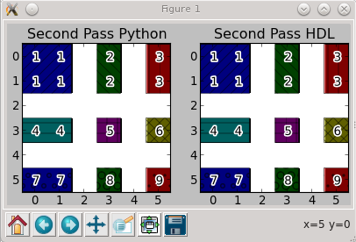

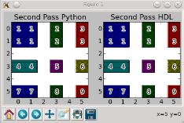
Software - Verifier
Interface to testbench of CCL-DUT/CCL-REF
VHDL image reader library (PBM)
Compares with results of software CCL implementation
Run simulation for a single image or for a list of images
../img/test33.pbm
../img/test34.pbm
../img/test35.pbm
../img/test36.pbm
../img/test37.pbm
../img/test38.pbm
../img/test39.pbm errors:2
../img/test40.pbm
Verification failed
Software CCL
VHDL-Testbench
DUT/REF
Box output
Result of image test list
Software Verifier
Single image test
Notes:
Before we come to the software which communicates with the HW arch
-> Now we come to the software which interfaces the architecture on the FPGA…

Slide 16
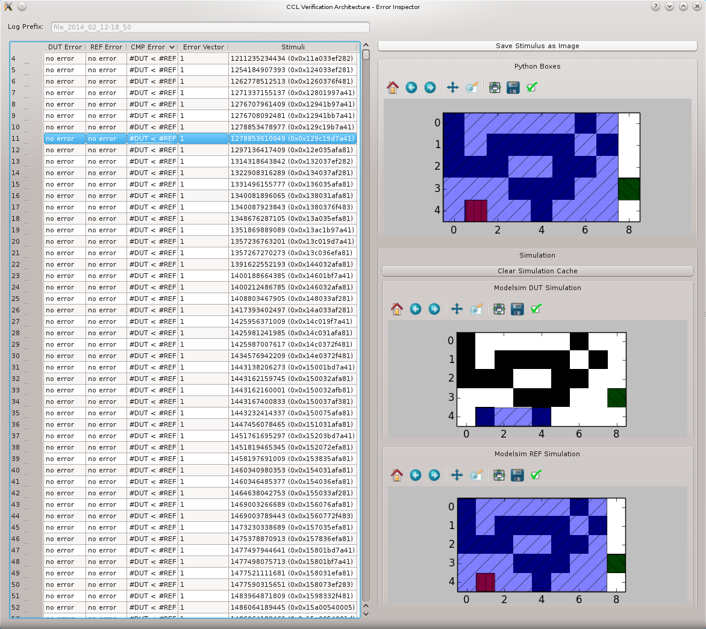
Software – Error Inspector
Notes:
A Data Logger command line tool reads and stores the found errors as JSON
This JSON logs can be viewed with the error inspector
->Here we only can analyze error image by error image. To get a global view on the errors a visualization as a heatmap has been implemented

Slide 17
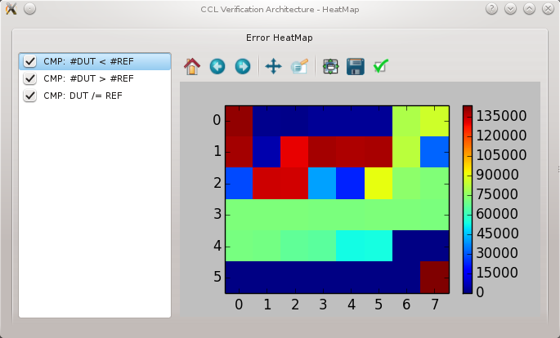
Software – Error Heatmap
Notes:
We can see here which pixels was involved in error images
-> More of the software can be seen in the demo and we go on with the result section.

Slide 18

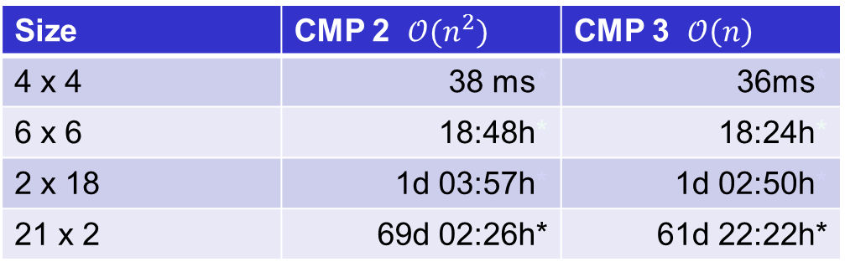
Results Speed
Exhaustive test run for different image sizes
Xilinx Virtex-6 LX-240 (xc6vlx240t-ff1759-2) run on 125 MHz
ModelSim simulation ~30 min for 4 x 4 image (Intel i7-3770)
6 x 6 requires $2^{20}$ longer $⇒$ ~60 years
Size | CMP 2 $𝒪(n^{2})$ | CMP 3 $𝒪\left(n\right)$
4 x 4 | 38 ms* | 36ms*
6 x 6 | 18:48h* | 18:24h*
2 x 18 | 1d 03:57h* | 1d 02:50h*
21 x 2 | 69d 02:26h* | 61d 22:22h*
* Interpolated value
Notes:
Here you can see the runtime for exhaustive testing for different image sizes
Diff CMP, CMP is as expected faster
-> This runtime could be reduced with the parallelization

Slide 19
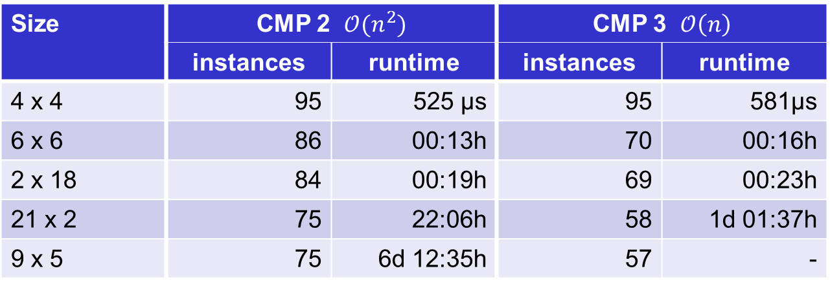
Results Speed – Parallel Instances
Exhaustive test run for different image sizes
Maximum number of instances
Size | CMP 2 $𝒪(n^{2})$ |  | CMP 3 $𝒪\left(n\right)$
 | instances | runtime | instances | runtime
4 x 4 | 95 | 525 µs | 95 | 581µs
6 x 6 | 86 | 00:13h | 70 | 00:16h
2 x 18 | 84 | 00:19h | 69 | 00:23h
21 x 2 | 75 | 22:06h | 58 | 1d 01:37h
9 x 5 | 75 | 6d 12:35h | 57 | -
Notes:
You can see the maximum number of instances which fit into the fpga
Now the CMP2 is faster…
->So we could reduce the runtime to a point where it is possible to process a 9x5 image in lesser than a week
(missing value ~8.5 days)

Slide 20
Results Speed - Runtime
Exhaustive test runtime in years
Notes:
8x8
FPGA ~10,000 years
Software ~16 Billion years
Started at the big bang
It will be done in ~2 Billion years
Universe ~14 Billion years
To reduce fpga runtime to ~1day -> ~4 million FPGA required
-> Now let’s see how many errors are found in the DUT

Slide 21
Results
>12 revisions of CCL-DUT exhaustive tested (6 x 6)
Notes:
More than 12 revisions of the DUT has been tested
2 we introduced the reporting of internal errors
-> we also tested different image sizes a overview…

Slide 22
Results
Notes:
… of the found errors can be found in this chart
Problem with sizes 2 to the power of…
-> also a image size of 63x61 has been tested…

Slide 23

Result – Non exhaustive test
Test image generator
  Predefined pattern
  Random noise
1000 images 63 x 61
  Different pattern density
  Different noise level
No errors found
Figure 1: Predefined pattern
Figure 2: Sample image
Notes:
… but not in a exhaustive way.
Test run in Software
->Now we come to the conclusion

Slide 24
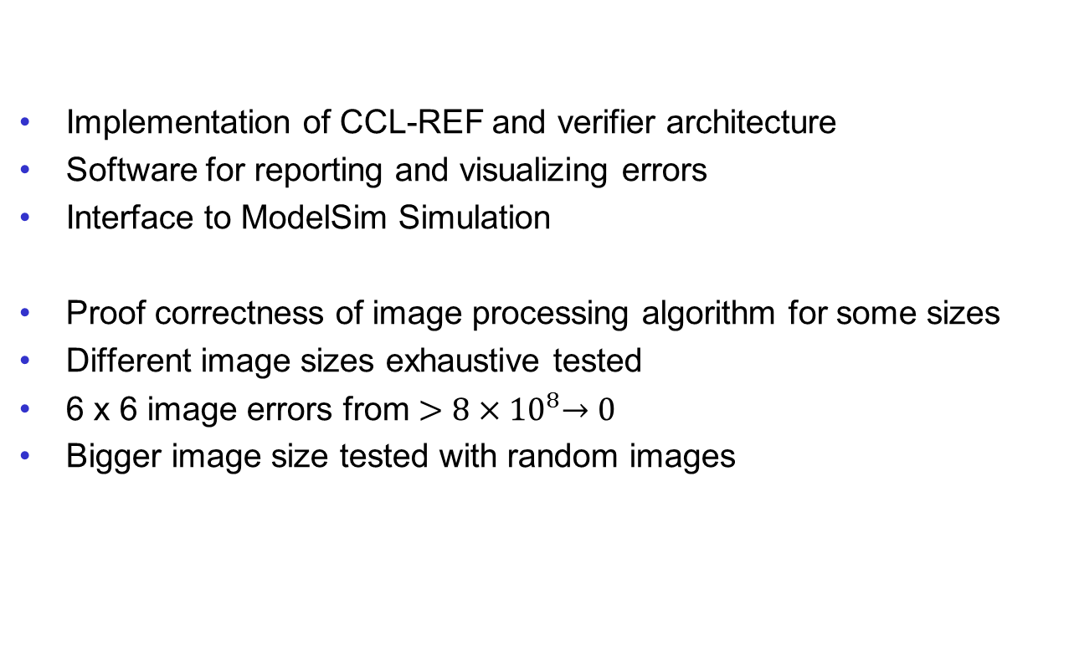
Conclusion
Implementation of CCL-REF and verifier architecture
Software for reporting and visualizing errors
Interface to ModelSim Simulation
Proof correctness of image processing algorithm for some sizes
Different image sizes exhaustive tested
6 x 6 image errors from $>8{×10}^{8}→0$
Bigger image size tested with random images
Notes:
800 million errors
-> before I end a short outlook what can be done on this topic

Slide 25
Future Work Recommandation
CCL-REF instances for different complex images
Fully pipelined CCL-REF
Extend to generic verification architecture

Slide 26
Questions/Demo
Questions?

Slide 27
[KRW+12] M. Klaiber, L. Rockstroh, Z. Wang, Y. Baroud, S. Simon. A memory- efficient parallel single pass architecture for connected component labeling of streamed images. In Field-Programmable Technology (FPT), 2012 International Conference on, pp. 159–165. IEEE, 2012.
[FGP10] M. Fujita, I. Ghosh, M. Prasad. Verification techniques for system-level design. Morgan Kaufmann, 2010

Slide 28

Result - Speed
$average clocks per pixel= \frac{T_{exhaustive}×f_{CLK}}{{IMG}_{h}×{IMG}_{w}×2^{{IMG}_{h}×{IMG}_{w}}}$
lesser is better

Slide 29

Result - Speed
$average clocks per pixel= \frac{T_{exhaustive}×f_{CLK}}{{IMG}_{h}×{IMG}_{w}×2^{{IMG}_{h}×{IMG}_{w}}}$

Slide 30
Size of CCL-REF
Entity | Max Clock | Register | Logic LUTs | Memory LUTs
LABELING | 313 MHz | 52 | 151 | 8
LU TABLE | 250 MHz | 116 | 225 | 8
BOUNDBOX | 330 MHz | 42 | 117 | 24
CCL with BOUNDBOX | 250 MHz | 233 | 569 | 42

Slide 31
Comparison of CMP
Size | Max Box | CMP | Speed | LUTs
8x6 | 12 | Type 2 | 291 MHz | 221
 |  | Type 3 | 227 MHz | 1828
9x5 | 15 | Type 2 | 230 MHz | 301
 |  | Type 3 | 170 MHz | 2430
6x6 | 9 | Type 2 | 289 MHz | 197
 |  | Type 3 | 251 MHz | 750
4x4 | 4 | Type 2 | 343 MHz | 110
 |  | Type 3 | 355 MHz | 156

Slide 32
Size of Verification Architecture
Size | Max Clock | Register | LUTs | BRAMs
4 x 4 | 125 MHz | 3180 | 5646 | 5
6 x 6 | 125 MHz | 3649 | 6680 | 5
21 x 2 | 125 MHz | 3827 | 7052 | 5
9 x 5 | 125 MHz | 3876 | 7339 | 5

Slide 33


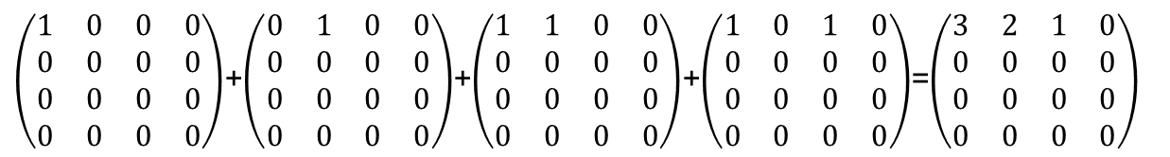
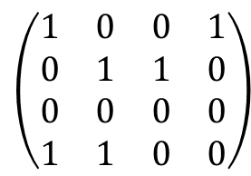
Error Heatmap Calculation
Stimulus: ${\text{38412}}_{10}$
$${\text{1001011000001100 }}_{2}$$
$$\left(\begin{matrix}1 & 0 & 0 & 1 \\ 0 & 1 & 1 & 0 \\ 0 & 0 & 0 & 0 \\ 1 & 1 & 0 & 0\end{matrix}\right)$$
3
2
1
0
In verification stimuli 1, 2, 3, 5 error occurred
$\left(\begin{matrix}1 & 0 & 0 & 0 \\ 0 & 0 & 0 & 0 \\ 0 & 0 & 0 & 0 \\ 0 & 0 & 0 & 0\end{matrix}\right)$+$\left(\begin{matrix}0 & 1 & 0 & 0 \\ 0 & 0 & 0 & 0 \\ 0 & 0 & 0 & 0 \\ 0 & 0 & 0 & 0\end{matrix}\right)$+$\left(\begin{matrix}1 & 1 & 0 & 0 \\ 0 & 0 & 0 & 0 \\ 0 & 0 & 0 & 0 \\ 0 & 0 & 0 & 0\end{matrix}\right)$+$\left(\begin{matrix}1 & 0 & 1 & 0 \\ 0 & 0 & 0 & 0 \\ 0 & 0 & 0 & 0 \\ 0 & 0 & 0 & 0\end{matrix}\right)$=$\left(\begin{matrix}3 & 2 & 1 & 0 \\ 0 & 0 & 0 & 0 \\ 0 & 0 & 0 & 0 \\ 0 & 0 & 0 & 0\end{matrix}\right)$

Slide 34


Proposed Design – Comparator 3
SHIFT-SELECTOR
IN_REF
$$…$$
BOX 1
BOX 2
$$…$$
BOX n
ERR-GEN
BOX 1
BOX 2
$$…$$
BOX n
IN_DUT
$$…$$
SHIFT-SELECTOR

