Slide 1

E-PetitionViz
An integrated tool to understand e-petitions and support policy decision

Slide 2
E-PetitionViz
PhD Candidate
7 years of experience in:
-Data Analysis
-Data management
-Fieldwork management
-Policy evaluation
-Big Data
About me
Data Visualization
AI
Natural Language Processing

Slide 3
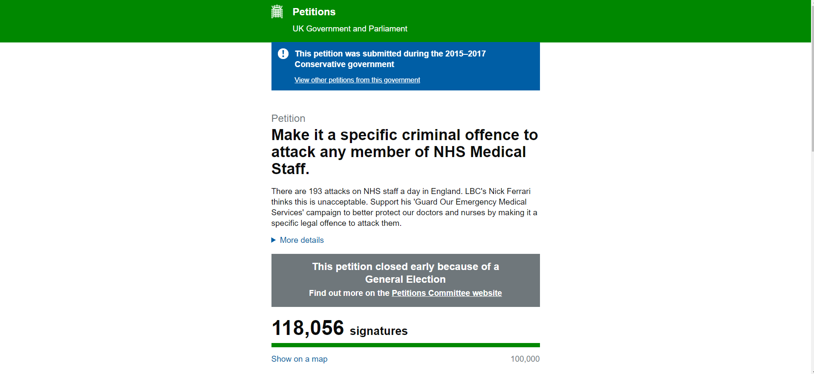
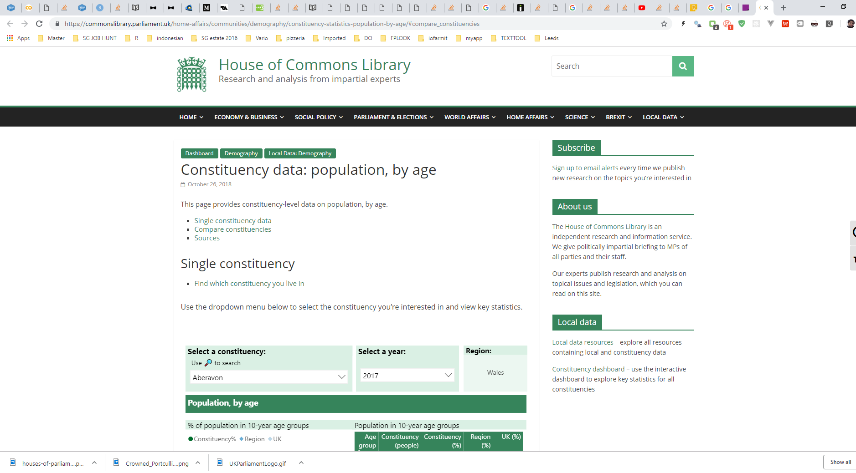
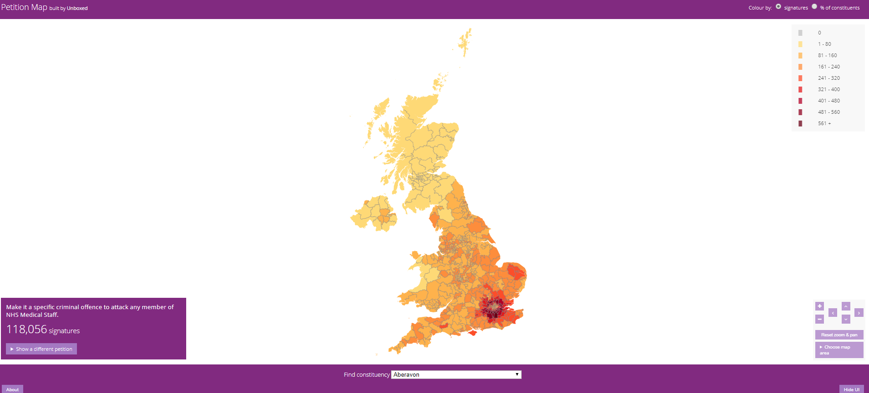
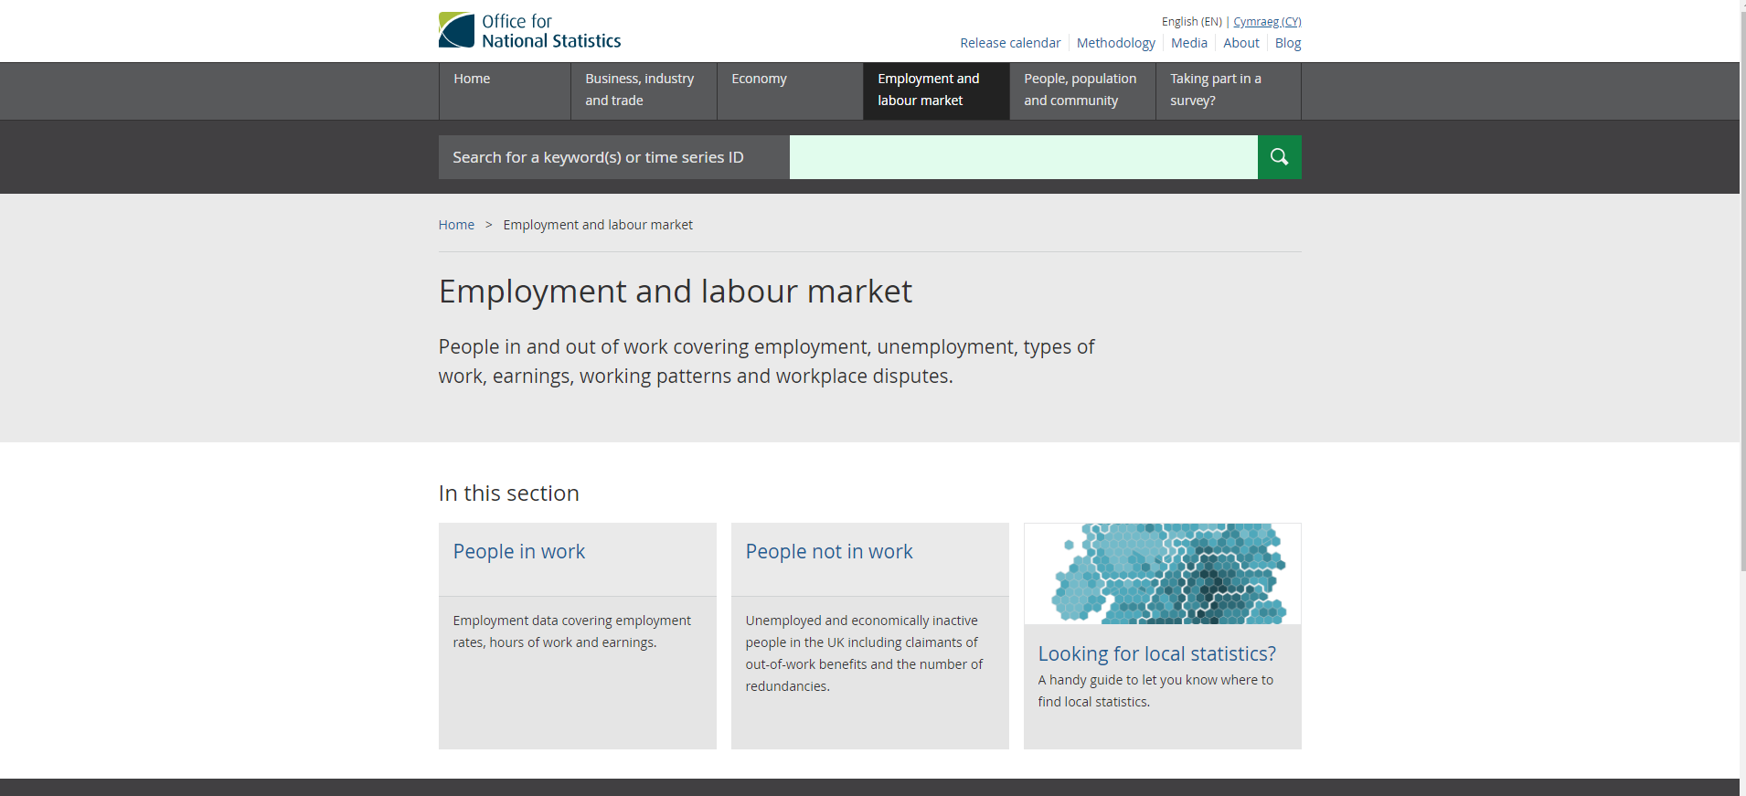
The Current Status
E-PetitionViz
Data are on different sites over different systems and with different formats (JSON,CSV,XLSX, MAPS)

Slide 4
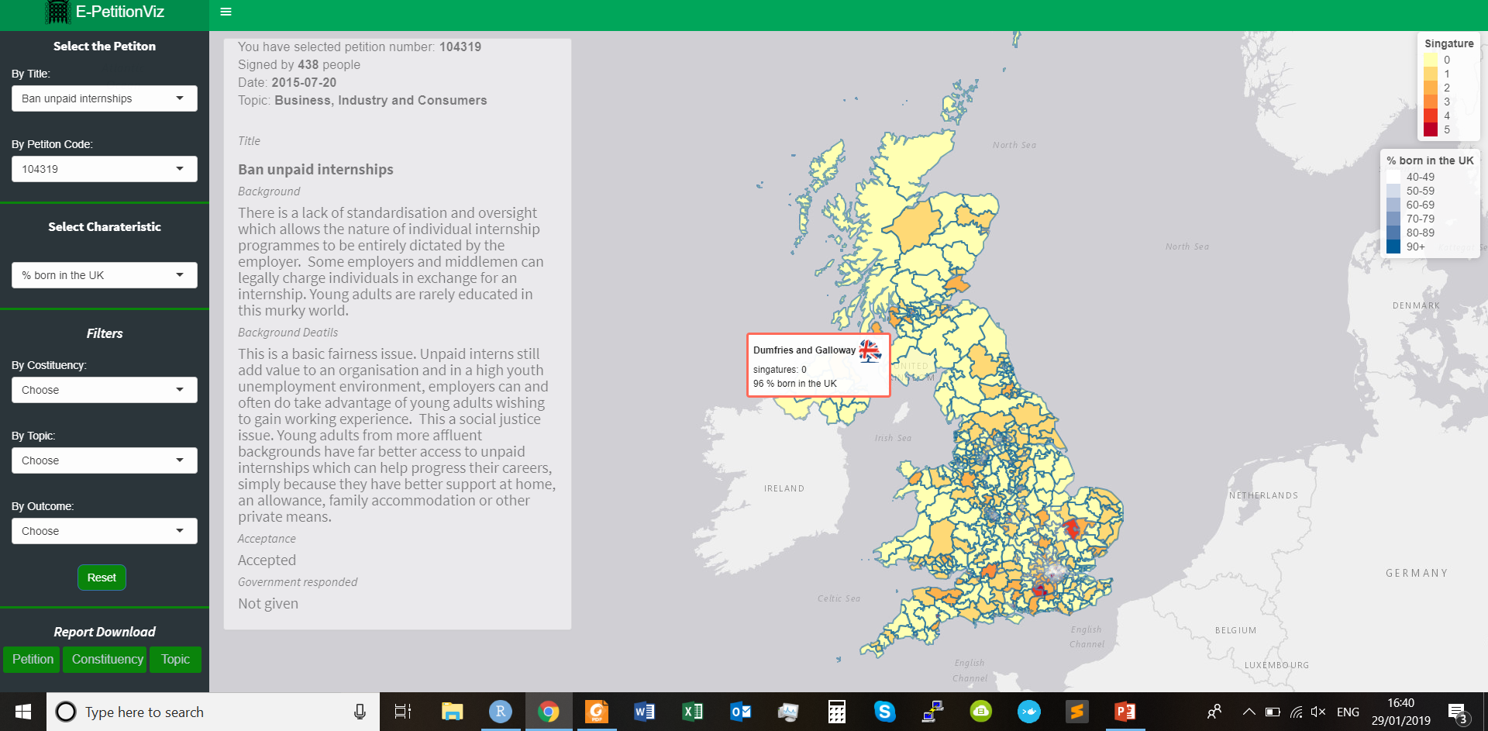
Let’s bring them all together…
E-PetitionViz

Slide 5
What the App Does
E-PetitionViz
Links petitions data to the wealth of additional information (e.g. average income, demographics, election outcomes etc.)
available for constituencies from official government sources.
Integrates this information in a meaningful and visually accessible way
Produces detailed reports (by petition and/or constituency) to
allow practitioners to make the best use of existing information.

Slide 6
Usefulness & Users
E-PetitionViz
Easily convey the information about the petitions and the characteristics of the people
Parliamentary staff
Policy makers
MPs

Slide 7
E-PetitionViz
Time for the Demo….

Slide 8
Questions
E-PetitionViz
Do you think
it could be useful for you?
Do you have any suggestions
to improve it further?

Slide 9
E-PetitionViz
Thank You

Slide 10
E-PetitionViz
Thank You

Slide 11
E-PetitionViz
Thank You

Slide 12
PRICING:
18951.65
monthly full=1900(server, maintenance, changes[any], license)
monthly no change=1400(server, maintenance, license)
monthly server=900(server, license)
BRAKEDOWN:
License: 600
Server: 300
Maintenance: 500 [updating system, crash management, balancing]
Changes:
Add Database:500
Add Feature: 400 to 1000
E-PetitionViz

