Slide 1

The New Features Of KWin
Antonis Tsiapaliokas
KDE Plasma Developer
kok3rs@gmail.com

Slide 2
Plasma Package Structure
$PackageName-$PackageVersion/
metadata.desktop
contents/
    code/
      files containing scripting code
      the main file that will be loaded at plasmoid start (unless you specify a different name in metadata.desktop)
    images/
        image files in svg, png or jpeg format
    locale/
        translation files in a standard localization hierarchy; e.g. German translation would appear in locale/l10n/de/
    ui/
        user interface files, such as Qt Designer layouts
        config.ui the main configuration dialog layout
    config/
        KConfigXt files describing the configuration
        main.xml the main configuration description

Slide 3
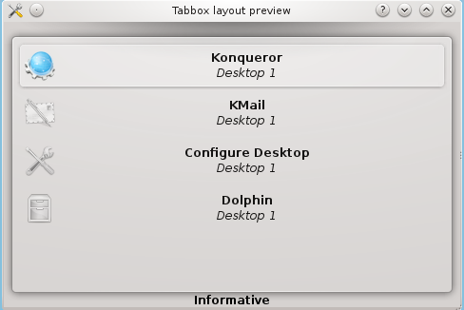
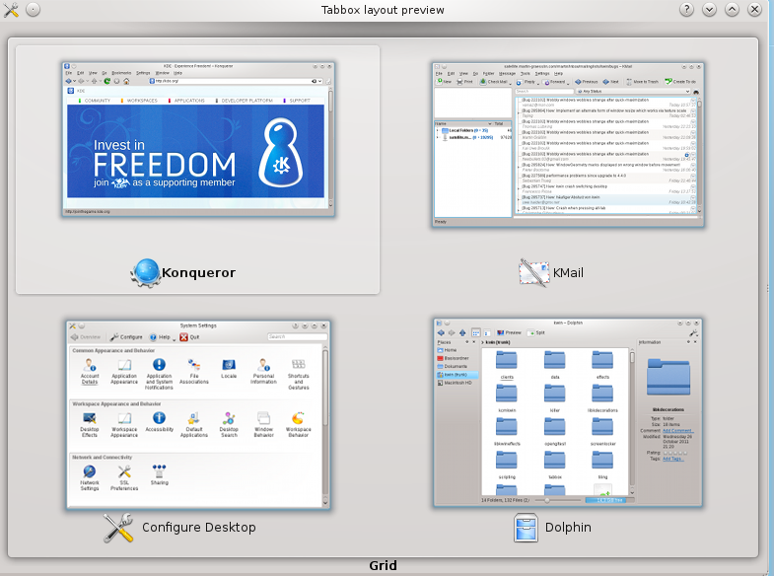
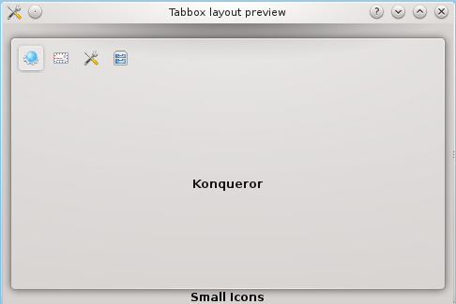
Window Switcher
Based on Plasma Structure
Reuse of code
You can create your own Window Switcher Package

Slide 4
Kwin Scripts
Based on Plasma Structure
Window Rules (keep above,isMaximized etc)
They can be tested with the following ways:
1)Kwin Interactive Console
1)qdbus org.kde.plasma-desktop /MainApplication showInteractiveKWinConsole
2)Kickoff (Alt+F2) -> “wm console”
2)Plasmate

Slide 5
Kwin Scripts Example
var keepAboveMaximized = new Array();
function manageKeepAbove(client, h, v) {
if (h && v) {
// maximized
if (client.keepAbove) {
keepAboveMaximized[keepAboveMaximized.length] = client;
client.keepAbove = false;
}
} else {
// no longer maximized
var found = keepAboveMaximized.indexOf(client);
if (found != -1) {
client.keepAbove = true;
keepAboveMaximized.splice(found, 1);
}
}
}
workspace.clientMaximizeSet.connect(manageKeepAbove);

Slide 6
Plasma Scripting Example
var panel = new Panel
panel.addWidget("launcher") //This will add the kickoff
panel.addWidget("org.kde.showActivityManager") //This will add the Activities
panel.addWidget("tasks") // This will add the Task Manager
panel.addWidget("digital-clock") //This will add the digital clock
systray = panel.addWidget("systemtray")
systray.writeConfig("plugin","notifier") // This will add the Device Notifier to //systemtray

Slide 7
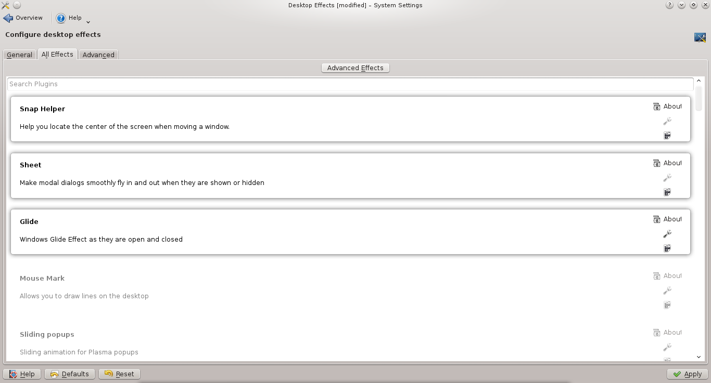
Kwin Effects

Slide 8
KWin Contact
Mailing List: kwin@kde.org
Irc: #kwin at irc.freenode.org
Wiki: community.kde.org/KWin

