Slide 1
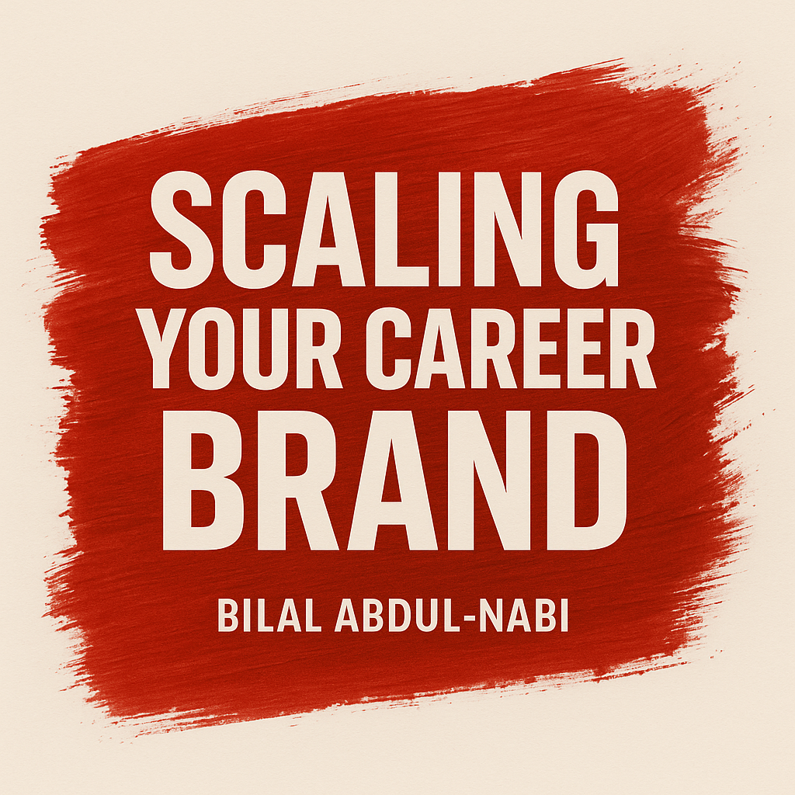
How to grow visibility, trust, and impact in your career
Notes:
Good afternoon everyone — thank you so much for being here. And first, I want to give a big thank you to Athar and to Purchase College for inviting me to speak today. It’s a privilege to be here with you.
Let me start with a quick question — how many of you have ever worked really hard on something, only to feel like no one noticed? Maybe a class project, a job, or even a personal goal that took a ton of effort — but it didn’t quite get the recognition you hoped for.
That’s something almost everyone experiences at some point, and it’s really what today’s talk is about.
This session — Scaling Your Career Brand — is about how to make sure the great work you’re already doing doesn’t stay invisible. It’s about how to grow visibility, trust, and impact in your career — the three ingredients that make your work scale beyond just effort.
We’re going to look at practical habits, tools, and real examples that can help you build a reputation system that grows with you — not just for your next job, but for your entire career.

Slide 2

About Me
Bilal Abdul-Nabi - Senior SWE @ UPS
12 years developing software professionally
Origin: The Boogie Down Bronx
https://www.lebiru.com
https://github.com/lebiru
https://www.linkedin.com/in/bilalakabi/
Notes:
So a little about me before we get started. My name is Bilal Abdul-Nabi, and I’m a Senior Software Engineer at UPS. I’ve been developing software professionally for about twelve years now — across everything from enterprise systems to startups to my own side projects.
I’m originally from the Boogie Down Bronx — so if you hear a little bit of New York energy come through, that’s why.
Outside of work, I run a personal tech brand called Lebiru, where I share articles, tools, and projects focused on software engineering, productivity, and building technical careers. You can find all of that on my site, GitHub, or LinkedIn.
The reason I’m here today isn’t just to talk about code, though — it’s to talk about the systems behind your career. The same way we scale technology, we can scale our own visibility and impact. And that’s what this talk is all about.

Slide 3
What You Will Gain from This Talk
Understand what a career brand is
Learn 5 habits to grow visibility, trust, and impact
Discover tools to amplify your work
Do a quick worksession to define your brand
Notes:
So here’s what you can expect to get out of today’s session.
First, we’ll talk about what a career brand actually is — not in the marketing sense, but in the practical, day-to-day sense of how your work gets seen, trusted, and remembered.
Second, we’ll go over five habits that help you grow visibility, trust, and impact — the same three ingredients that make your work scale beyond effort.
Third, we’ll look at some tools that can amplify your work — things like portfolios, wikis, and side projects that make your contributions visible to more people.
And finally, we’ll end with a short work session — something interactive where you’ll get to define your own career brand using a quick reflection exercise.
By the end, my goal is for you to walk away not just with ideas, but with a simple framework you can actually use to grow your career starting today.

Slide 4
Agenda
Foundations
Habits
Tools
Worksession
Q&A
Notes:
Here’s how we’re going to spend our time today.
We’ll start with the Foundations, where I’ll make the case for why career branding matters — and why the old model of ‘work hard and wait to be noticed’ doesn’t really work anymore.
Then we’ll move into Habits — five specific, practical things you can start doing right now to grow your visibility, trust, and impact.
After that, we’ll cover Tools — the systems and platforms that help your brand scale, from portfolios and wikis to analytics and feedback loops.
Then we’ll get hands-on with a short Worksession, where you’ll define your own career brand in a quick, mad-lib-style exercise.
And finally, we’ll wrap with Q&A, so you can ask about anything we cover — or even about career growth in general.
The goal is to keep this interactive and useful, so don’t hesitate to participate or share thoughts along the way.

Slide 5
Foundations
The Case for Scaling Your Career Brand

Slide 6
Poll #1
What do you think drives career growth the most?
Notes:
“Alright, quick poll for you all. Think about your future career — what do you believe really drives promotions and growth?
Is it hard work? Is it networking and relationships? Is it visibility of contributions? Or is it just luck?
Take a moment and vote — no wrong answers here, I’m curious how this group sees it.”
[After showing poll results]
“Now, here’s the reality: hard work is important, but by itself, it’s often invisible. Networking helps, but it’s limited to who you know. Luck plays a role, but you can’t plan for it.
What consistently makes the difference is visibility plus trust plus impact. When people see your work, trust its quality, and feel its impact — that’s when your career scales. That’s the foundation of your career brand.”

Slide 7
What is Career Branding?
Hard work without visibility is unmeritable – effort only scales when others can see it.
Recognition fuels growth – careers accelerate when colleagues and leaders trust your impact.
Habits is your reputation system – the habits you build today compound into opportunities tomorrow.
Notes:
When we think about careers, most of us are taught that if you just work hard, people will notice and opportunities will follow. But the truth is, hard work by itself is often invisible. Effort only really scales when others can actually see it.
The second point is that recognition fuels growth. Promotions, new projects, leadership opportunities — they don’t just come from output, they come when colleagues and leaders recognize your impact and trust your contributions.
Finally, branding isn’t about flashy self-promotion. It’s really your reputation system. The habits you build — documenting, sharing, teaching, automating — all compound over time. That compounding effect creates visibility, builds trust, and opens doors. Career branding is what turns hard work into lasting opportunity.

Slide 8
The New Career Reality
Remote and global teams - less in-person recognition
Open-source and digital communities - amplify visibility
Flattened org charts - fewer promotions by tenure alone
Rapidly evolving skills - continuous adaptation matters
Notes:
Careers don’t look the way they used to.
First, we’re working on remote and global teams. That means your manager or teammates don’t always see you working hard — there’s less in-person recognition. If you want your contributions noticed, you have to be intentional about making them visible.
Second, we have open-source and digital communities. Today, you can share your work beyond just your company. Contributing online or publishing something small can reach people worldwide — visibility scales in ways it never used to.
Third, companies now run with flatter org charts. There are fewer layers of management and fewer automatic promotions just for time served. Tenure alone isn’t enough anymore — growth depends on showing real impact.
And finally, skills evolve so quickly that what you know today might not be enough tomorrow. Continuous learning isn’t optional — it’s how you stay relevant and valuable.
Put simply: the old model of ‘work hard, wait, and eventually get promoted’ doesn’t hold up in this environment. Visibility, adaptability, and impact are what matter now.

Slide 9
Why care about Career Branding?
Average time-to-promotion is longer now - ~4 years vs ~2.5 a decade ago ¹
70% or more of jobs being filled are through networking or the hidden job market ²
Visibility + sponsorship outweigh performance alone ³
Notes:
One of the strongest signals that the old career model doesn’t work is the data we see today.
First, the average time to promotion has gotten longer. A decade ago, promotions happened roughly every two and a half years. Today, it’s closer to four years. That means waiting around for recognition by tenure alone is a slower path than ever.
Second, research shows that 70 percent or more of jobs are filled through networking or the hidden job market. In other words, most opportunities never even get posted publicly. They’re filled by people who already have visibility and trust within their networks.
Third, studies from Harvard Business Review highlight that visibility and sponsorship often outweigh performance alone. It’s not just about doing the work — it’s about making sure others see it, trust it, and are willing to back you for bigger opportunities.
So the evidence is clear: hard work is still important, but without career branding — without visibility, trust, and impact — it doesn’t scale into growth.

Slide 10
The Career Brand Formula
Visibility + Trust + Impact = Career Brand
Notes:
Visibility
What it means: People know what you do and the value you bring.
How to build it: Documentation, talks, wikis, blogs, side projects, sharing progress.
Why it matters: If no one sees your contributions, they don’t scale. Visibility is the entry point.
Trust
What it means: People believe your work is reliable, consistent, and thoughtful.
How to build it: Deliver quality consistently, share context, document trade-offs, mentor others.
Why it matters: Visibility without trust is noise. Trust turns visibility into credibility.
Impact
What it means: The measurable difference your work makes.
How to build it: Automate pain points, create tools others adopt, improve systems, save time or money.
Why it matters: Impact shows that your work isn’t just activity — it moves the needle for others.

Slide 11
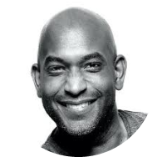
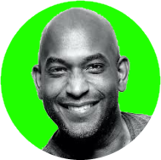
“Work on things that matter and share what you learn.”
Kelsey Hightower
Distinguished Engineer @ Google

Slide 12
Habits
Compounding Small Actions for Big Returns

Slide 13
Poll #2
Have you written documentation before?
Notes:
Okay, let’s do a quick check-in. How many of you have actually written documentation before?
This could be anything — class notes you shared with a group project, a readme for code you posted, even instructions you left for someone covering your shift at work.
Take a moment to vote.
[Pause for responses]
See, almost everyone has done some form of documentation, even if you didn’t call it that. The point is — you’re already practicing one of the key habits of career branding. The difference is, when you make it intentional and consistent, documentation goes from something that helps a few classmates to something that builds your visibility and trust at scale

Slide 14
Habit #1: Write Living Documentation
Type | Purpose | Value
Wiki | Living knowledge base (FAQs, how-tos) | Searchable, collaborative
Playbook | Best practices & strategies | Consistency in decisions
Runbook | Step-by-step operational tasks | Reliable execution
Postmortem | Retrospective after failure | Lessons & prevention
API / Reference | Technical specs & endpoints | Enables adoption
Design Doc / ADR | Records trade-offs & decisions | Preserves context
Onboarding Guides | For new hires | Scales mentorship
Production Support Rotation | On-call handbooks & runbooks | Ensures reliable support
Notes:
“One of the fastest ways to scale your career brand is through documentation. When you write something down in a way that outlasts you, it becomes reusable — it saves others time, and it keeps adding value long after you’ve moved on.
There are different types of documentation, each with a different purpose. Wikis, for example, are living knowledge bases. They capture FAQs and how-tos in one searchable, collaborative place. Playbooks are about strategies — they help teams make consistent decisions.
Runbooks are more operational — step-by-step guides that anyone can follow reliably. Postmortems capture what happened after a failure, so teams can learn and prevent it in the future.
API references and design docs serve a different purpose — they preserve technical details and decision trade-offs so others can adopt or extend your work without guessing. Onboarding guides make it easier for new hires to get up to speed quickly, scaling mentorship. And finally, production support documentation — like on-call handbooks and rotation guides — ensures reliability when it matters most.
Each of these document types not only saves time and prevents mistakes, they also make your contributions visible. People start associating you with clarity and leadership, which builds trust and impact. That’s why documentation is such a powerful habit — it’s one of the simplest ways to create a career brand that keeps working for you.

Slide 15
Habit #2: Become a Subject Matter Expert
Pick one system - own it - deepen knowledge.
Why it matters: Specialists are magnets for trust and visibility.
What it looks like: You become the "go-to" person when questions arise.
How to build it: Study deeply - learn history, edge cases, and trade-offs.
Proof of expertise: Document clearly, answer questions, lead knowledge-sharing.
Career impact: Being an SME opens doors to leadership, mentorship, and recognition.
Notes:
This habit is all about depth. A lot of early-career professionals try to spread themselves thin across every new tool and technology. But the real value comes when you pick one system, own it, and really deepen your knowledge.
Why does that matter? Because specialists are magnets for trust and visibility. When a problem comes up in that system, people know exactly who to turn to — and that visibility is priceless.
What does this look like in practice? You become the ‘go-to’ person when questions arise. People come to you not just for quick answers, but for context, for trade-offs, and for guidance on how to move forward.
How do you build that? Study deeply. Don’t just learn how the system works today — learn its history, why it was designed that way, and where its weak points are. Know the edge cases, the failure modes, the trade-offs behind past decisions.
Proof of expertise comes in how you share that knowledge. Document your findings, answer questions in channels or meetings, and lead knowledge-sharing sessions. It’s not enough to know — you have to make your expertise visible.
The career impact is huge. Being an SME often opens doors to leadership roles, mentorship opportunities, and recognition. It shows that you’re not just another contributor, but someone who anchors knowledge in the organization and scales it for others.

Slide 16
Habit #3: Lead Knowledge Sharing Workshops
Visibility + Leadership
Why it matters: Teaching others amplifies your expertise and positions you as a leader.
What it looks like: Running a workshop or short talk that helps peers solve problems.
How to build it: Start small - present lessons learned from a project or demo a tool you use.
Proof of expertise: Slide decks, recordings, or notes that others can revisit.
Career impact: Knowledge sharing builds visibility, establishes leadership, and creates lasting influence.
Notes:
This habit is about turning your knowledge into something that scales. Teaching others doesn’t just help them — it actually amplifies your own expertise and positions you as a leader.
Why does it matter? Because when you teach, you make your work visible. You show not only that you know something, but that you can explain it in a way others can use. That’s a huge signal of leadership.
What does this look like? It can be as simple as running a short workshop, giving a lightning talk, or leading a brown-bag session. The goal isn’t to be perfect — the goal is to help your peers solve problems.
How do you build this habit? Start small. Share lessons learned from a project. Demo a tool you use every day that saves you time. It doesn’t need to be a big formal presentation. Small, consistent efforts compound over time.
Proof of expertise comes in what you leave behind: your slides, a recording, or even just notes that others can revisit later. That’s what transforms a one-time talk into something reusable.
And the career impact is clear: every time you share knowledge, you gain visibility, you establish yourself as a leader, and you create lasting influence in your organization or community. People remember the person who helped them level up.

Slide 17
Habit #4: Automate Pain Points
One small tool - saves hundreds of hours
Why it matters: Repetitive tasks waste time and energy across teams.
What it looks like: Building a script, dashboard, or utility that eliminates a recurring bottleneck.
How to build it: Identify patterns in daily work - ask “what do I or my team do over and over?”
Proof of expertise: Tools that are adopted by teammates and reduce repetitive work.
Career impact: Automation scales your influence - your one solution can save hours for dozens of people.
Notes:
This habit is about looking for inefficiencies and turning them into opportunities. Repetitive tasks waste time, energy, and attention across teams. If you’re the one who steps in and says, ‘Let’s automate this,’ you instantly multiply your value.
What does it look like? It could be as simple as writing a script that cleans up data, building a small dashboard that tracks system health, or creating a utility that eliminates a recurring bottleneck. These tools don’t have to be perfect or large-scale — often, the simplest ones create the biggest wins.
How do you build this habit? Start by identifying patterns. Ask yourself: what am I doing over and over? What’s something my team keeps repeating that could be automated? If it feels tedious, chances are it can be turned into a tool.
Proof of expertise comes from adoption. When teammates start using your tool, when they save time because of something you built, that’s when your work becomes visible and trusted.
And the career impact is powerful: automation scales your influence. One small tool can save hours for dozens of people. That kind of leverage is what makes your contributions stand out and creates a reputation for being the person who makes work better for everyone.

Slide 18
Habit #5: Reflect and Sharpen Your Goals
Step back - evaluate - realign
Why it matters: Effort without direction leads to wasted growth. Reflection ensures your energy compounds in the right direction.
What it looks like: Periodically reviewing your progress, adjusting your learning path, and realigning with long-term career goals.
How to build it: Set checkpoints - at the end of a semester, project, or year - ask “Am I moving toward the role or impact I want?”
  After an internship, identify which skills gave you the most energy and growth.
  At the end of a project, write down lessons learned and gaps to improve.
  Every 6 - 12 months, update your resume/portfolio to reflect what you’ve built.
Proof of expertise: Clear progression in skills, projects, and career direction over time.
Career impact: Reflection + adjustment prevent stagnation, ensuring long-term growth and alignment.
Notes:
This last habit is about making sure all the effort you’re putting in is actually moving you in the direction you want to go. Effort without direction can lead to wasted growth. Reflection is what ensures your energy compounds in the right direction.
What does this look like? It means periodically taking a step back to review your progress. Adjust your learning path, re-check your priorities, and make sure your goals are aligned with where you ultimately want your career to go.
How do you build this habit? Set regular checkpoints. At the end of a semester or a big project, ask yourself: Am I moving toward the role or the impact I want? After an internship, look at which skills gave you the most energy and which ones stretched you the most. At the end of a project, jot down lessons learned and the gaps you still want to fill. And every six to twelve months, update your resume or portfolio to reflect what you’ve built — that exercise alone forces you to see your progress and your trajectory.
The proof of this habit is clear progression. Over time, you can look back and see that your skills, projects, and direction have evolved. And the career impact is huge: reflection and adjustment prevent stagnation. They keep you aligned, growing, and ready for the next opportunity.
Reflection is what turns habits into a strategy. Without it, you might be running hard but in the wrong direction.

Slide 19

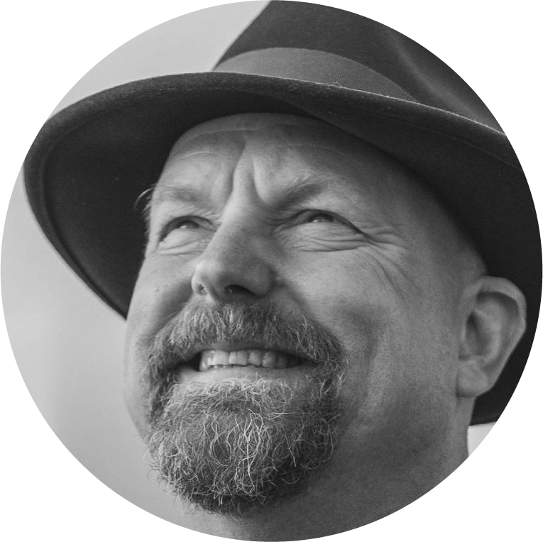
“I’m not a great programmer; I’m just a good programmer with great habits.”
Kent Beck
Creator of Extreme Programming

Slide 20
Tools
5 Tools to Scale Your Career Brand

Slide 21
Poll #3
Do you have a personal website?
Notes:
Here’s another quick one — how many of you have a personal website?
This could be anything from a full portfolio site, to a simple page with your resume, to even a GitHub Pages site.
[Pause for responses]
If you don’t have one yet, that’s okay — most people don’t start with one. But think about this: a personal website is like your digital home base. It’s the one place online where you control the story. Recruiters, hiring managers, even peers will look you up. When they do, what will they find?
A personal site doesn’t have to be flashy. Even a simple site with your projects, resume, and a way to contact you already puts you ahead of the curve. It’s one of the simplest tools to make your career brand visible outside the classroom or the workplace.

Slide 22
Your Career Tool Ecosystem
Portfolio Website
Knowledge Repository
Career Tool Ecosystem
Feedback / Analytics
Side Projects
Content Platforms
Notes:
“This is where the tools come together. Think of it as your career tool ecosystem. Each tool plays a role, and together they create a system that compounds your visibility, trust, and impact.
Your portfolio website is your home base — it tells your story and showcases your work.
Your knowledge repository is how you scale your expertise across teams and time — living documentation that outlasts you.
Side projects demonstrate initiative and problem-solving — they’re small but high-impact.
Content platforms like LinkedIn, GitHub, or a blog take all of that and amplify it to a wider audience.
And finally, feedback and analytics close the loop — they show you what’s working, where to adapt, and how to grow smarter over time.
Together, these tools aren’t separate. They reinforce each other. A side project can become a blog post, which you showcase on your website, which builds visibility and trust, which then feeds back into more opportunities. That’s the power of building an ecosystem rather than just using tools in isolation.”

Slide 23
Portfolio Website
Your digital home base
Showcases projects, blog posts, and your professional story.
Scales your visibility beyond your current job.
Notes:
Your portfolio website is your digital home base. It’s the one place you fully control, and it tells your professional story. A simple site that shows your projects, blog posts, or even just your resume already sets you apart. The key is that it scales your visibility — when someone Googles you, this is what they’ll find, and it can reach far beyond your current job or class.

Slide 24
Knowledge Repository
Living documentation (internal or public)
Scales your expertise across teams and time.
Each doc = visibility + trust compounding.
Notes:
Documentation is one of the most underrated tools for career branding. A knowledge repository — whether it’s a wiki, a set of FAQs, or project notes — becomes living documentation. It scales your expertise across teams and across time. And every doc you write builds both visibility and trust, because people rely on it long after you’ve moved on.

Slide 25
Side Projects
Small apps, scripts, or utilities
Demonstrates initiative and technical creativity.
Scales your impact by solving pain points once for many.
Notes:
Side projects are powerful because they demonstrate initiative and creativity. These don’t have to be huge — a small app, a script, or a utility that solves a pain point can make a big impact. The beauty of side projects is that they scale — you solve something once, and others can benefit from it again and again. They also show employers that you can take ideas from concept to execution.

Slide 26
Content Platforms
LinkedIn, GitHub, Gumroad, Blog.
Amplify what you build and learn.
Scales reputation across communities and industries.
Notes:
Platforms like LinkedIn, GitHub, Gumroad, or even a personal blog are amplifiers. They take what you’ve built and put it in front of a larger audience. A GitHub repo, a LinkedIn post, or a Gumroad template can reach hundreds or thousands of people. The point is that your reputation no longer lives only inside one company — these platforms let your brand scale across communities and industries.

Slide 27
Feedback & Analytics Loops
Tools to gather insights (GitHub stars, LinkedIn analytics, Google Analytics, survey polls).
Helps refine and grow your brand strategically.
Scales improvement - you adapt as your audience grows.
Notes:
The last tool is about learning from feedback. Whether it’s GitHub stars, LinkedIn analytics, Google Analytics, or even survey polls, these signals help you refine and grow your brand. You can see what resonates, what doesn’t, and then adapt. That’s what scaling really means — not just putting things out there, but improving as your audience grows.

Slide 28
Worksession
Your Career Brand Starts Today!

Slide 29
Worksession - Your Career Brand
Write down three words you want people to associate with your Career Brand.
Turn to your neighbor, share your 3 words.
What is one action step you can take this semester to grow your career brand?

Slide 30
Key Summary
Hard work isn’t enough - if nobody sees it, it doesn’t scale.
Your career brand = visibility + trust + impact.
Build it through 5 habits:
  Document to outlast yourself
  Go deep and become an SME
  Teach and share knowledge
  Automate recurring pain points
  Reflect and sharpen your goals
Use your Career Tool Ecosystem (website, wikis, projects, platforms, feedback loops) to amplify your brand.
The result: a scalable career where opportunities, recognition, and growth compound over time - just like well-designed systems.

Slide 31
Q&A
Thank You!
https://www.lebiru.com
https://github.com/lebiru
https://www.linkedin.com/in/bilalakabi/

Slide 32
Appendix
LinkedIn. “Soft Skills Tied to Faster Promotions.” LinkedIn Business Talent, 1 Aug. 2023, https://www.linkedin.com/business/talent/blog/employee-experience/soft-skills-tied-to-faster-promotions.
U.S. Department of Labor. Soft Skills: The Competitive Edge. Office of Disability Employment Policy, Apr. 2020, https://www.dol.gov/agencies/odep/publications/fact-sheets/soft-skills-the-competitive-edge.
Harvard Business Review. “How to Do Sponsorship Right.” HBR, 15 Nov. 2022, https://hbr.org/2022/11/how-to-do-sponsorship-right.

