Slide 1
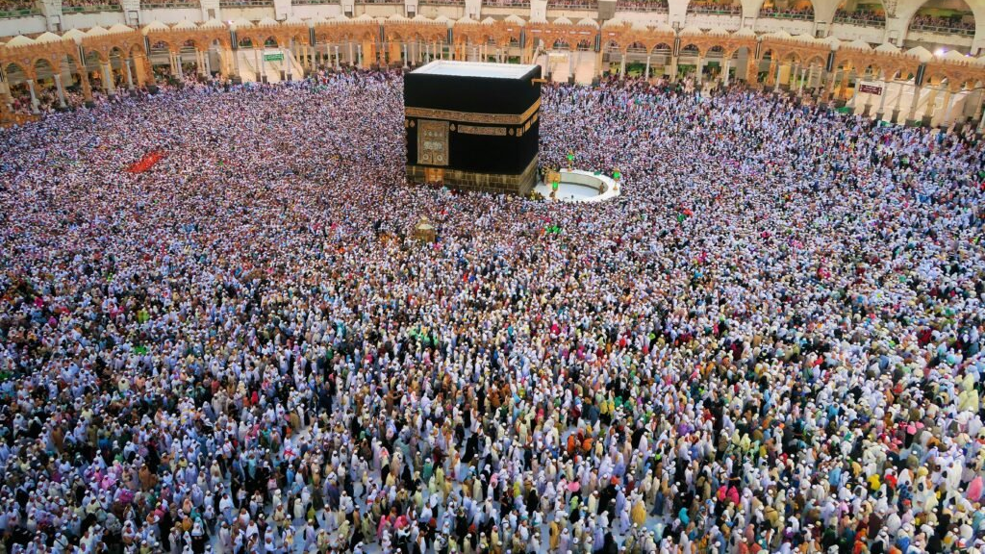
Hajj 2025 Reflections
Athar Abdul-Quader

Slide 2
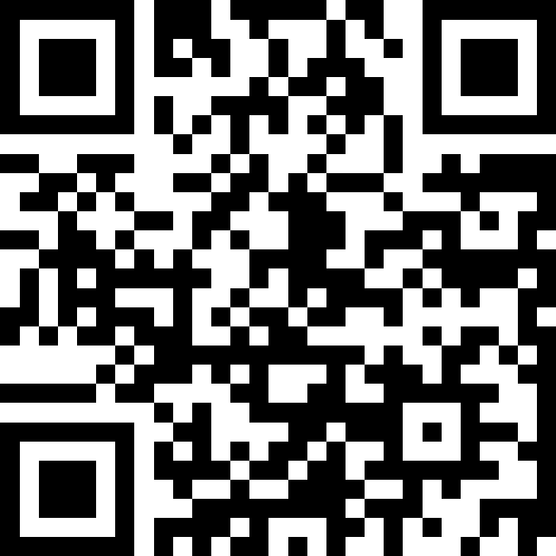
Q & A
Scan the QR code to the right.
If someone else has asked your question already, just upvote it.
Feel free to post questions anonymously, pseudonymously, or include your name if you wish.
Can interrupt me during the presentation with live questions as well.
slido.com #3420430 (if QR code doesn’t work)
Notes:
https://app.sli.do/event/nAMEFBJutnintv4x6nePTb

Slide 3
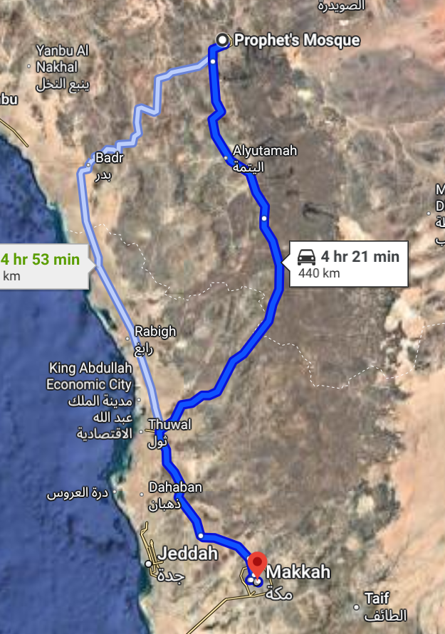
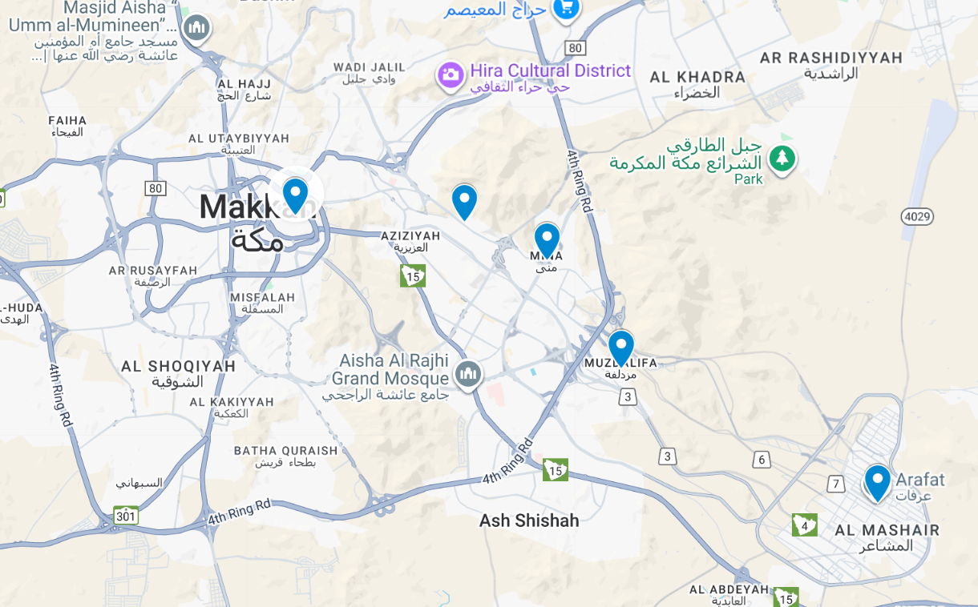
Overview
What do we know about Hajj?
Notes:
One of the pillars of Islam.
Obligation for every Muslim who is capable (physically + financially + etc) at least once in your life
The ritual actual pre-dates Islam (the Prophet used the time of Hajj to proselytize the new religion – most of those coming were not Muslim)
Dhul Hijjah: 12th month of the year
Actual days of Hajj 8 – 12 (or 13)
9th: Day of Arafah (most important day)
10th: Eid ul Adha (celebrated everywhere, not just at the Hajj)
This year: June 4 – 9
Most extend their trip before and/or after so that they can visit Medina and spend more time in the holy places. Mine: May 31 to June 13
Time for reflection, disconnecting, getting away from the world, connecting deeply with the Creator. Ultimate “retreat”. Enjoyed the company of scholars and others who helped us along our spiritual journeys.
https://www.google.com/maps/dir/Prophet's+Mosque,+Al+Haram,+Madinah+42311,+Saudi+Arabia/Masjid+al-Haram,+Al+Haram,+Makkah+24231,+Saudi+Arabia/@24.5482465,32.3903212,2843009m/data=!3m1!1e3!4m14!4m13!1m5!1m1!1s0x15bdbfaa728d4c15:0x39c9cca9e8b98e2f!2m2!1d39.6111977!2d24.4675187!1m5!1m1!1s0x15c204b74d3fb493:0x55d1f94f8e094785!2m2!1d39.8254209!2d21.4236577!3e0?entry=ttu&g_ep=EgoyMDI1MDkyNC4wIKXMDSoASAFQAw%3D%3D
https://www.google.com/maps/dir/Masjid+al-Haram,+Al+Haram,+Makkah+24231,+Saudi+Arabia/Mina+Train+Station+-3+Jamarat,+King+Abdul+Aziz+-+38th+Road,+Makkah+Saudi+Arabia/Muzdalifa,+Makkah+Saudi+Arabia/Mount+Arafat,+Makkah+Saudi+Arabia/@21.3977366,39.8223365,30319m/data=!3m2!1e3!4b1!4m26!4m25!1m5!1m1!1s0x15c204b74d3fb493:0x55d1f94f8e094785!2m2!1d39.8254209!2d21.4236577!1m5!1m1!1s0x15c20470c772041d:0xe2782e4e2bd1492f!2m2!1d39.8708955!2d21.4183186!1m5!1m1!1s0x15c206bb0a7b931b:0xd8605df1962f286b!2m2!1d39.914466!2d21.3878387!1m5!1m1!1s0x15e9fd6b657f80a1:0x75796408a2d7b040!2m2!1d39.984116!2d21.3548853!3e0?entry=ttu&g_ep=EgoyMDI1MDkyNC4wIKXMDSoASAFQAw%3D%3D

Slide 4
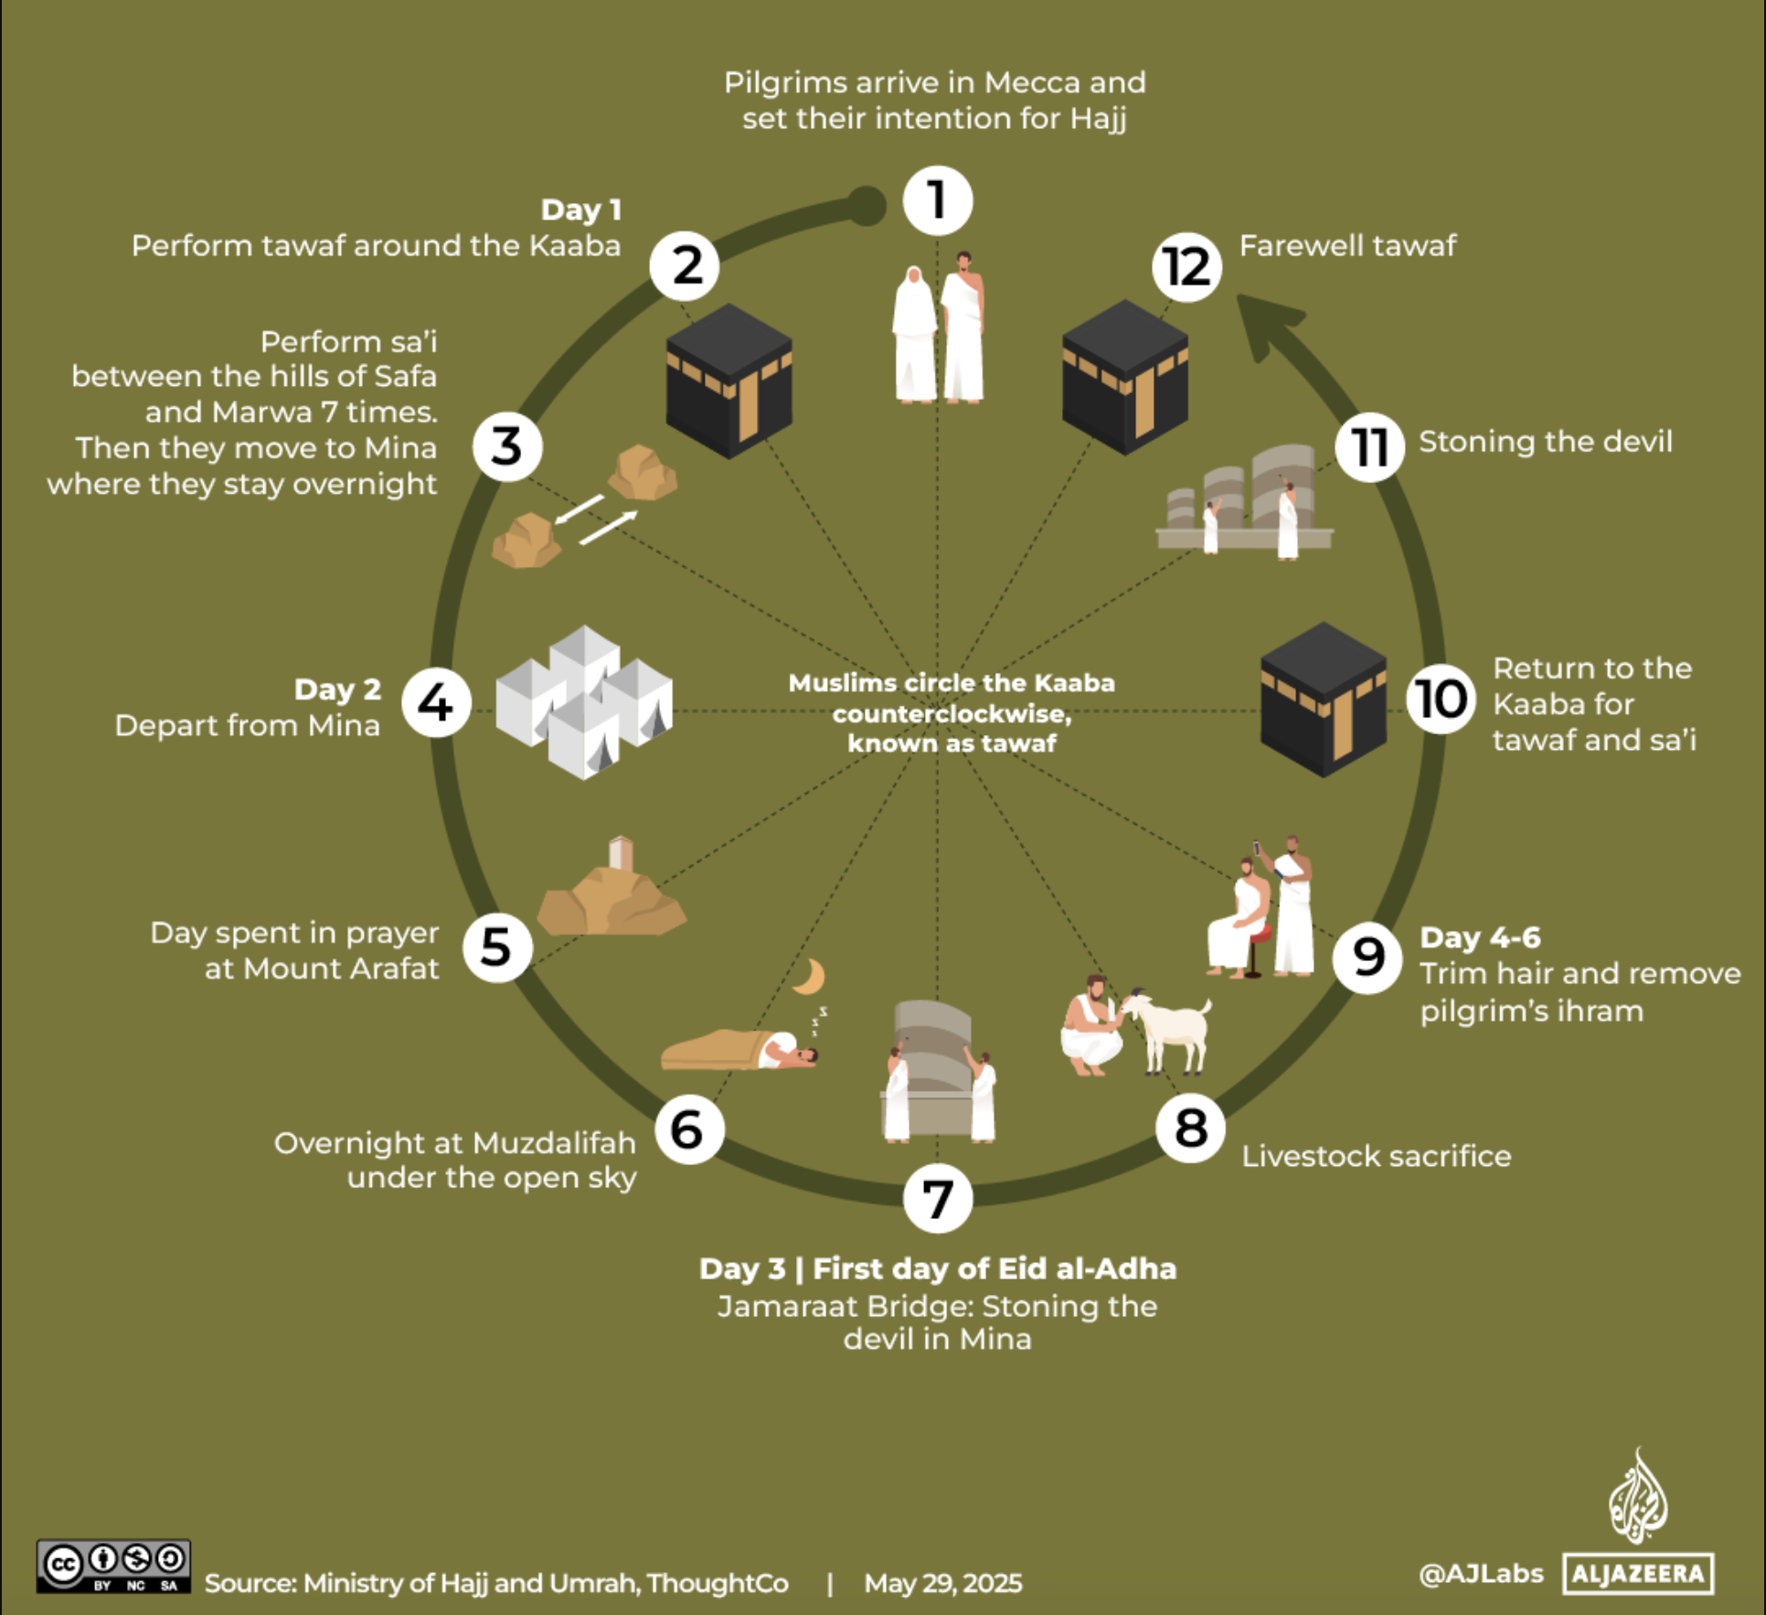
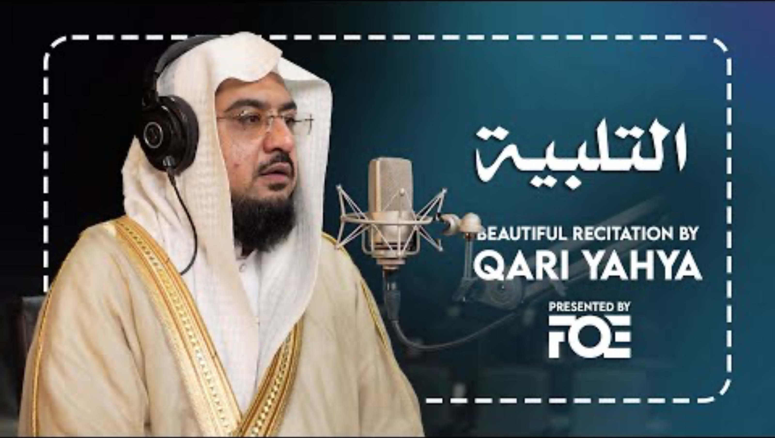
Basic Rites
Notes:
Ihram (men vs women), intention, talbiyyah: https://www.youtube.com/watch?v=uZjGl1ofMRM
Mina: tents. (stay, rest, pray, reflect)
Aside: prayer (salat) vs supplication (dua)
Mount Arafat: supplicate. Most important day of the year.
God brags about them coming to him “disheveled and dusty”
Overnight Muzdalifah (open)
Then the day of Eid: stoning, sacrifice.
Back to Mina. Shave head. Change out of ihram clothes.
Visit Kaa’bah for tawaf and saee.

Slide 5
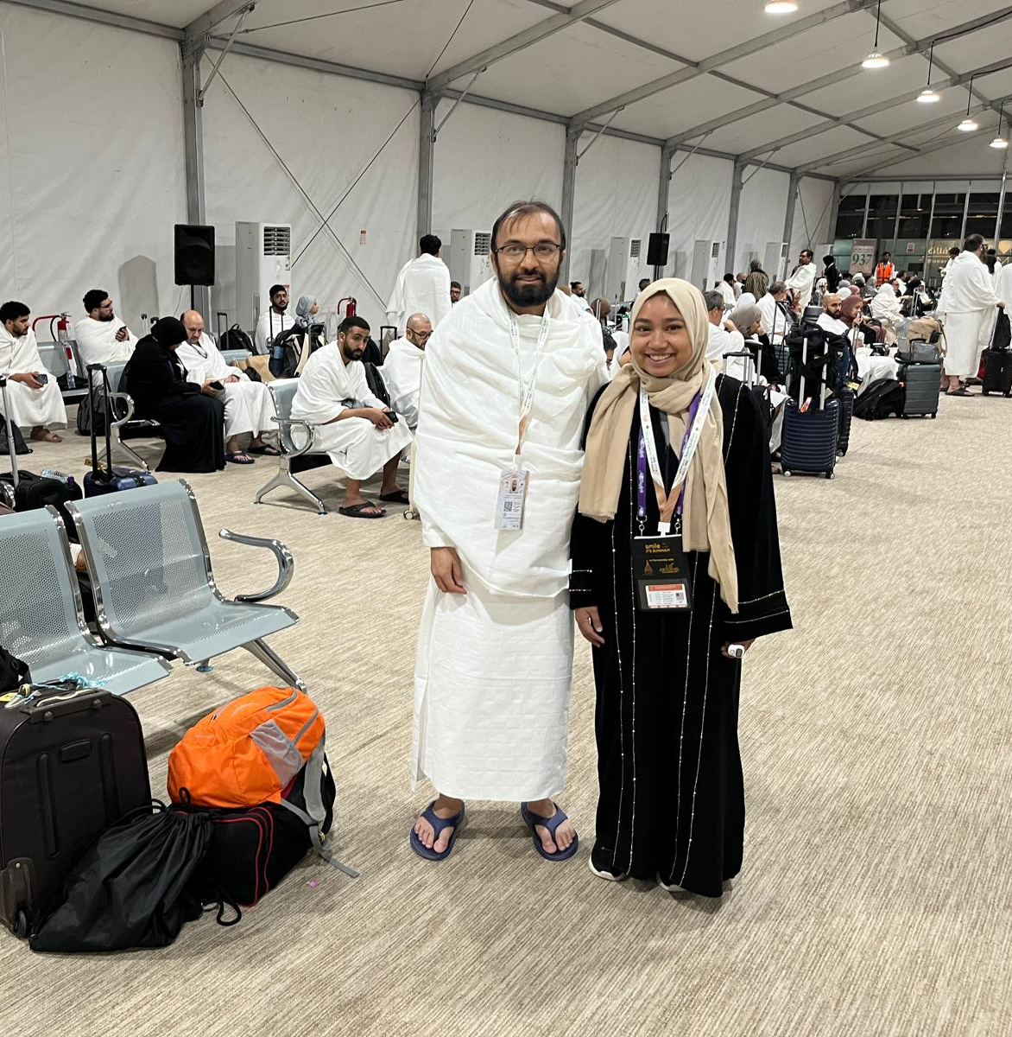
Ihram
Every one of the thousands at the airport, about to leave for Jedda, was dressed this way. You could be a king or a peasant and no one would know.
-- Malcolm X (Autobiography)
Notes:
Spiritual Theme: Humility
Men vs women issues.
Practical issues: how long are we wearing it, allowed vs not allowed (fragrances, grooming hair/nails, footwear, etc).
General discomfort: difficulty of walking, constantly feeling exposed, etc. Perhaps some wisdom in men having to go through that, women not.
Supposed to forget about the world. But also: be more grateful for the really simple things: how grateful was I for pockets after this!
Also meant to remind us of the kaffin (white sheets to cover us) when we are placed in the grave.

Slide 6
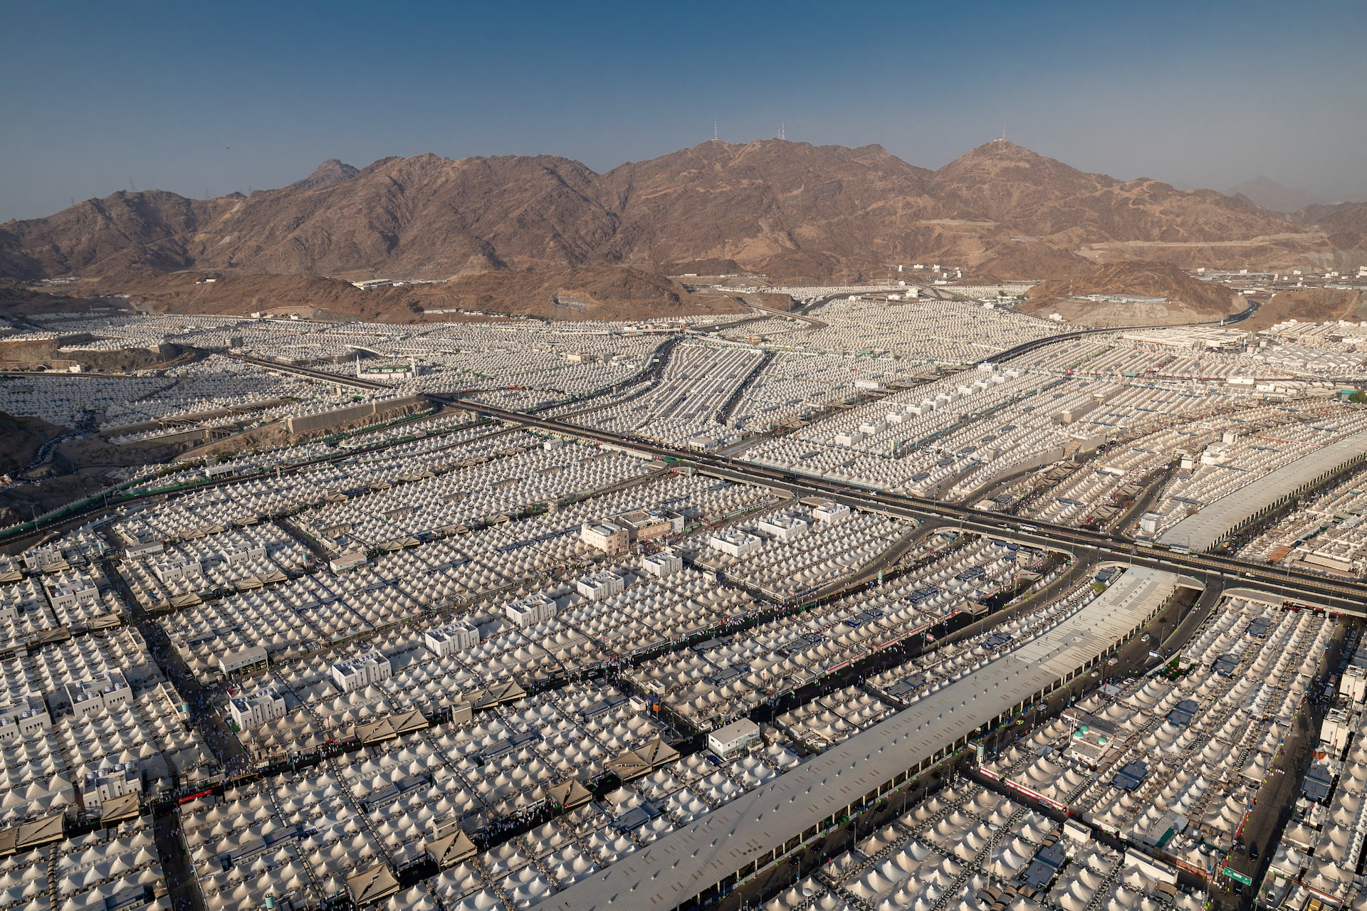
Mina (Camps)
Clip from Hajj Council
Notes:
https://www.instagram.com/reel/DKfTscgST3F/
Need to be broken down before going to Arafat.
Mina is meant to break you down.
But: ours was actually quite nice. ”In all my years of doing Hajj, this was the first time I got here and I was able to just sit and recite Qur’an.” -- Dr. Tahir Wyatt (Didn’t need hours to get your bearings, we just could immediately get into worship and reflection.)

Slide 7
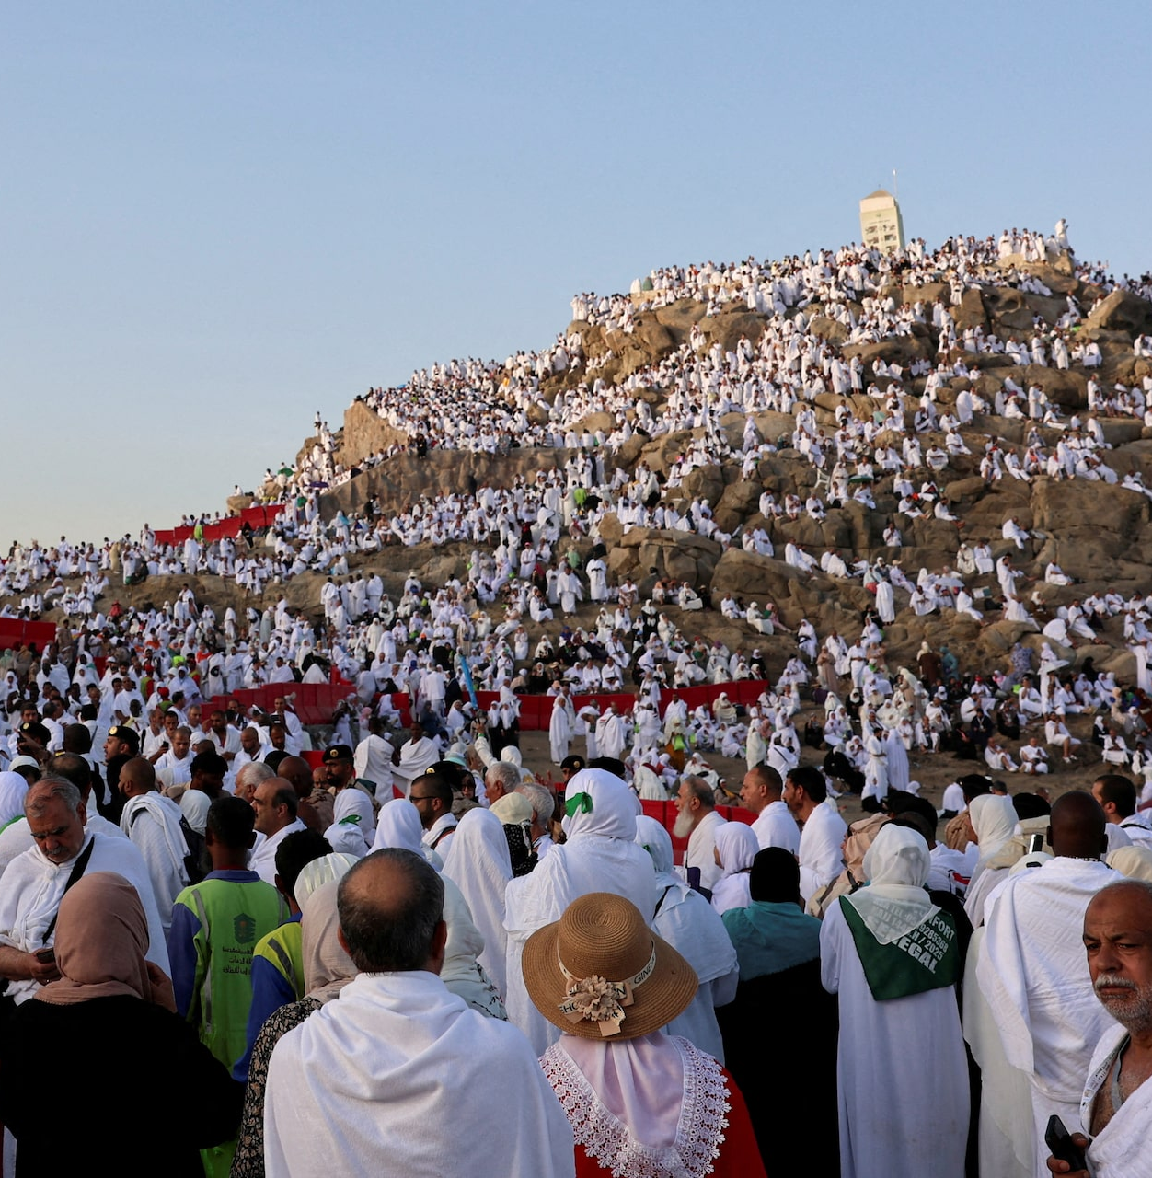
Mount Arafat
Most important part of Hajj.
Also: the least physically taxing.
“Hajj is Arafah” – Prophet Muhammad (pbuh)
Signifies: before time, the place where all souls were gathered before God.
Hadith: “Allah boasts to His angels of the pilgrims on the day of Arafat: ‘Look at my servants, coming to Me disheveled and dusty!’”
Notes:
Many who are not attending Hajj fast this day.
We were constantly reminded by the scholars: get Arafah right. “This is the most important day of your lives.”
Don’t waste a second.
Plan out your supplications (show them my dua list).

Slide 8
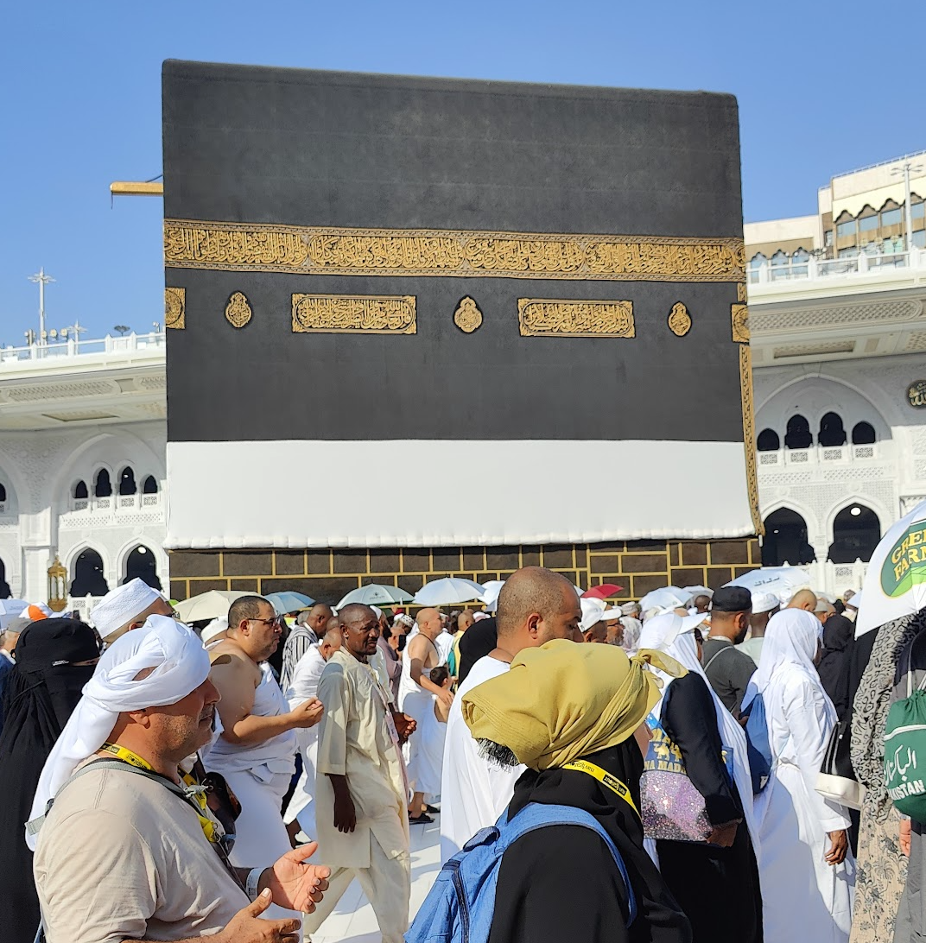
The Legacy of Prophet Abraham: Tawaf, Sa’ee
Story of Hajar and Ishmael (Islamic version):
God commanded Abraham to leave them in the Arabian desert.
When they ran out of water, she ran to Mount Safa, crying out to Allah. Then ran to Mount Marwa. Repeated this x7.
Finally, the Zamzam well sprung forth where the baby was.
Later: Abraham came back and built the Ka’abah with Ishmael.
Made a prayer that God sends another prophet from among Ishmael’s lineage: Muhammad.
Tawaf: circling the Ka’abah 7 times.
Sa’ee: run back and forth between Safa and Marwa 7 times.
Note: these two rituals comprise the “minor pilgrimage” (Umrah), which can be done at any time of the year.
Notes:
She asked him: what are you doing, why are you leaving us? He didn’t respond. She repeated this over and over again. And then finally asked, did your Lord ask you to leave us? And he nodded, so she said, “Go then, He will take care of us.”
And remember when Abraham raised the foundation of the House with Ishmael, ˹both praying,˺ “Our Lord! Accept ˹this˺ from us. You are indeed the All-Hearing, All-Knowing.
Our Lord! Make us both ˹fully˺ submit to You¹ and from our descendants a nation that will submit to You. Show us our rituals, and turn to us in grace. You are truly the Accepter of Repentance, Most Merciful.
Our Lord! Raise from among them a messenger who will recite to them Your revelations, teach them the Book and wisdom, and purify them. Indeed, You ˹alone˺ are the Almighty, All-Wise.”
2:127-129
— Dr. Mustafa Khattab, The Clear Quran
https://quran.com/2/127

Slide 9
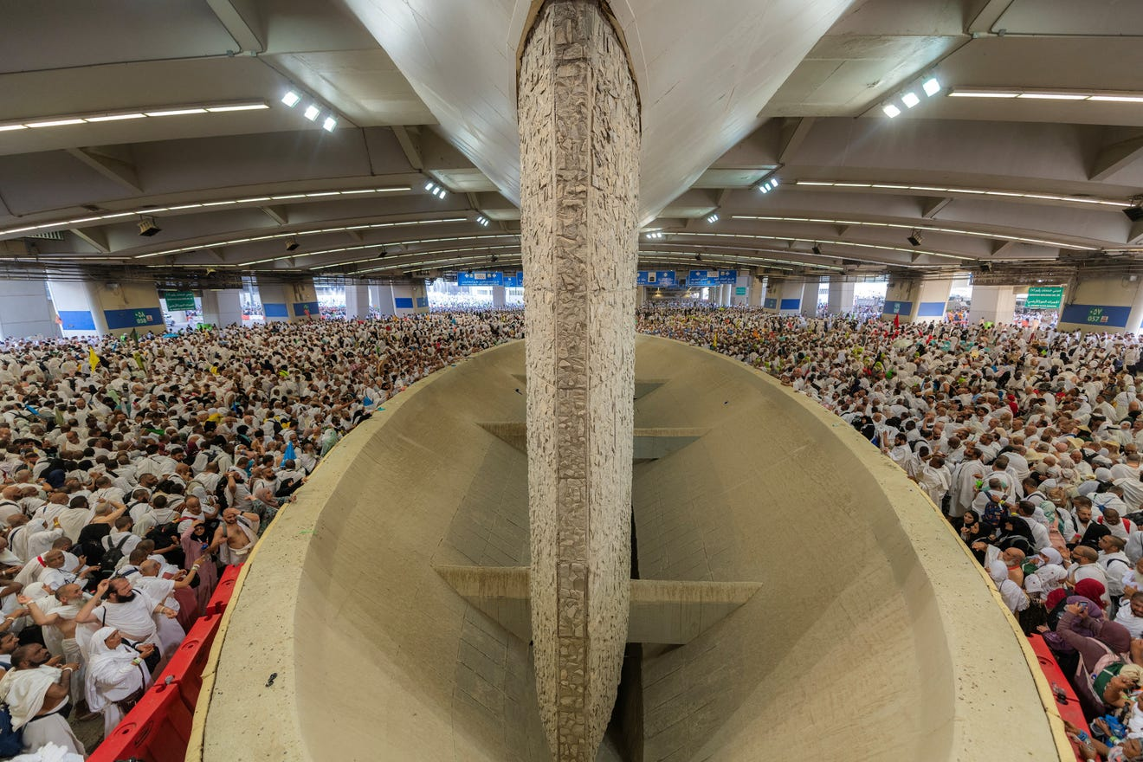
The Legacy of Prophet Abraham, II: Sacrifice, Stoning
Prophet Abraham commanded to sacrifice his son.
We honor this with a sacrifice (usually a lamb or goat) every year on Eid ul Adha.
Stoning the devil: three pillars to stone.
Represent three temptations of the devil.
First, to Abraham, to convince him not to sacrifice his son.
Then to Hajar, to get her to stop Abraham.
Then to Ishmael, to get him to avoid being sacrificed.
Each time: they threw 7 stones to repel the devil.
Notes:
In the Judeo-Christian narrative, he’s commanded to sacrifice Isaac. In the Islamic narrative it’s Ishmael.

Slide 10
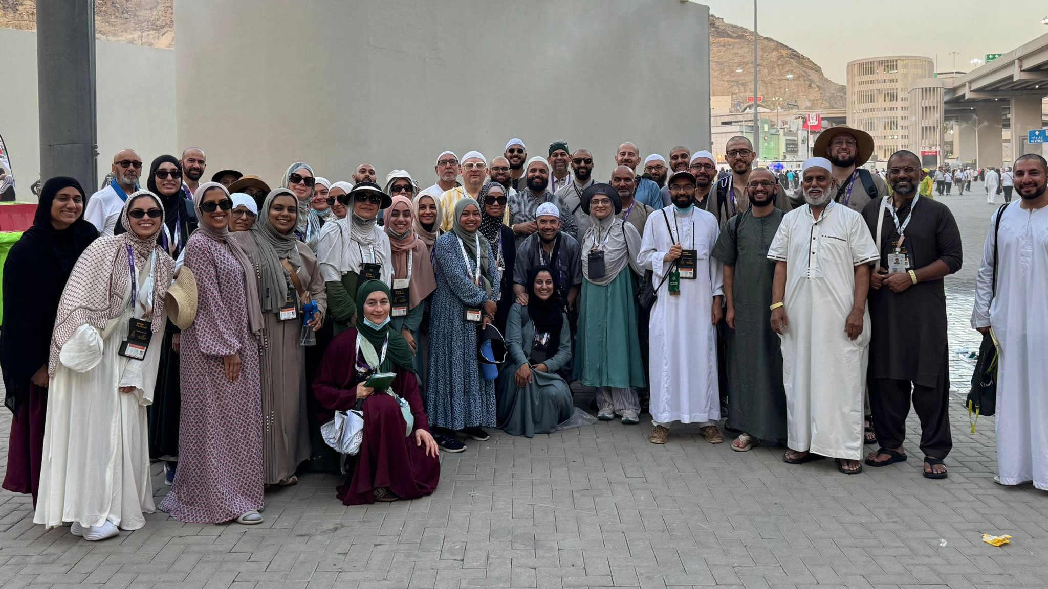
Notes:
After we finished our final rites of Hajj (the last day of stoning). This is a subset of our group, about a third left the previous day.

Slide 11
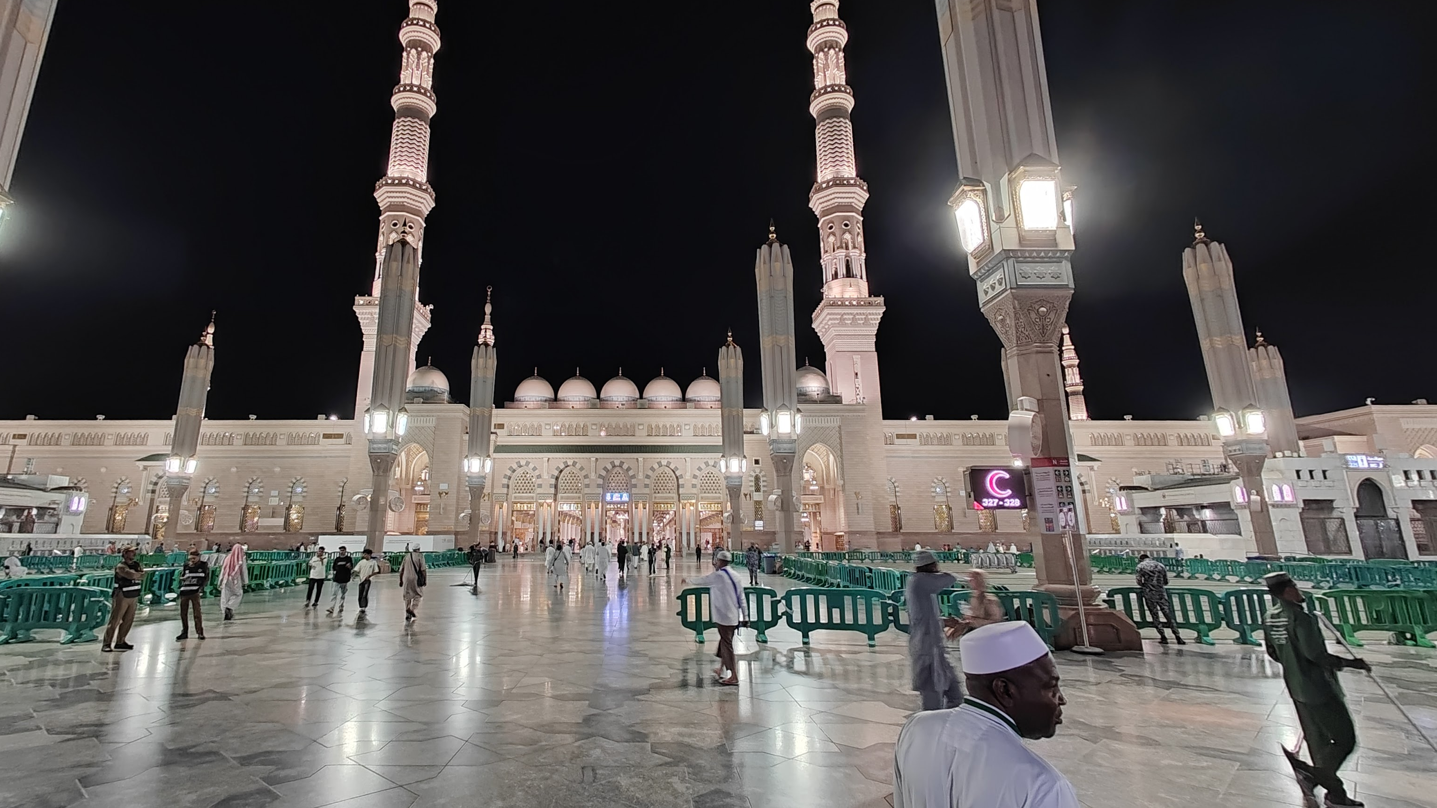
Medina
Notes:
Medina is the second holiest city in Islam. Brief aside on the story of the Hijrah: after receiving revelation, he started inviting people to the religion. His followers were very few for the first decade or so, he even had to send some away to modern day Ethiopia for their protection. But every year he would try to invite more people to the religion. One year, a small group of people from Medina came to Makkah for the Hajj, as I mentioned it was a ritual predating Islam. This small group were the new leaders of Medina. They accepted the religion and asked that he send someone to come back with them and teach them the religion. By the next year, most of the city had embraced Islam and they came back with about 70 people and invited the Prophet and other Muslims to move to Medina. This seminal event is called the Hijrah, and marks the beginning of the Islamic calendar, 1447 lunar years ago.
During Hajj, most visit Medina either before or after. We stayed before for a very short time: only about two days.
If there’s one word to describe Medina, it’s “tranquil”. It’s the most peaceful, calm place I’ve ever been. Really a great way to decompress and start to disconnect from the world.
”The city where belief returns.” It was great to start there, because as nervous as everyone was, everyone’s faces were radiant, shining with excitement and serenity.
Unexplainable feeling of joy and love.

Slide 12
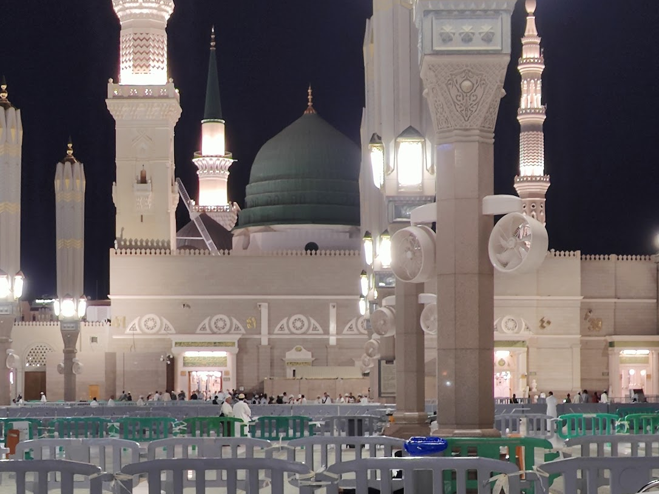
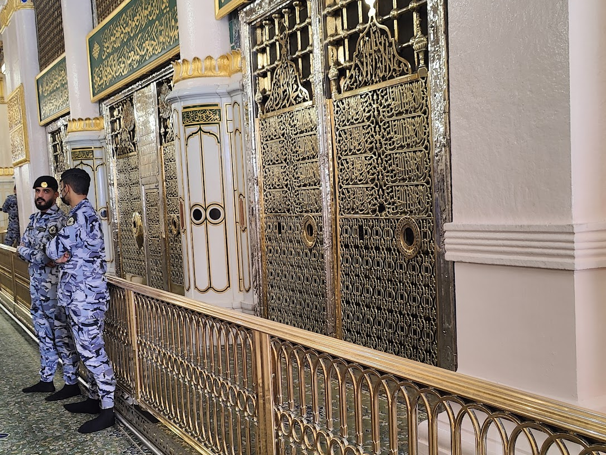
Notes:
The Prophet (pbuh) is buried underneath that green dome. The guards are stationed in front of the burial chambers of the Prophet and two of his closest companions, Abu Bakr and Umar (the first two ‘rightly guided khalifas’).
This used to be part of his house, separate from the main mosque.

Slide 13
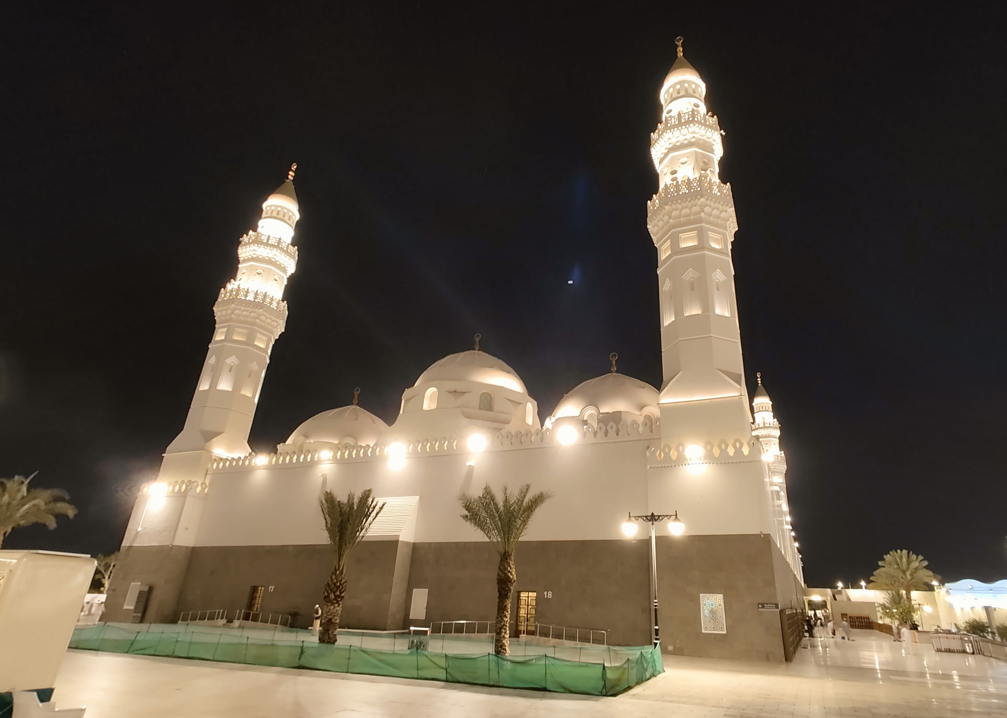
Medina Sightseeing
First mosque: Quba
Site of major battle: Uhud
Graveyard of some of the major companions (Al-Baqi), right next to the
Bougie stuff
Notes:
Many people who come to Medina also visit a few major sites, including Masjid Quba, the first mosque in Islam.
There is also Masjid Qiblatayn, which literally means “the mosque of the two qiblahs”. The qiblah is the direction that Muslims pray in. Initially, Muslims were commanded to pray toward the direction of Masjid al-Aqsa in Jerusalem. The story goes that the Prophet was commanded to change the prayer direction to Makkah in the late morning. He sent word to tell everyone who wasn’t around there. By the time a messenger reached Masjid Qiblatayn, they had already started praying the afternoon prayer. So they had to turn around in the middle of the prayer: al-Aqsa is to the north of Medina and the Ka’abah is toward the south, so they had to turn 180 degrees more or less.
The other major site nearby is Mount Uhud, the site of a really important battle during the time of the Prophet. His uncle was killed in this battle, and the Prophet would later refer to him as the “leader of the martyrs”.

Slide 14
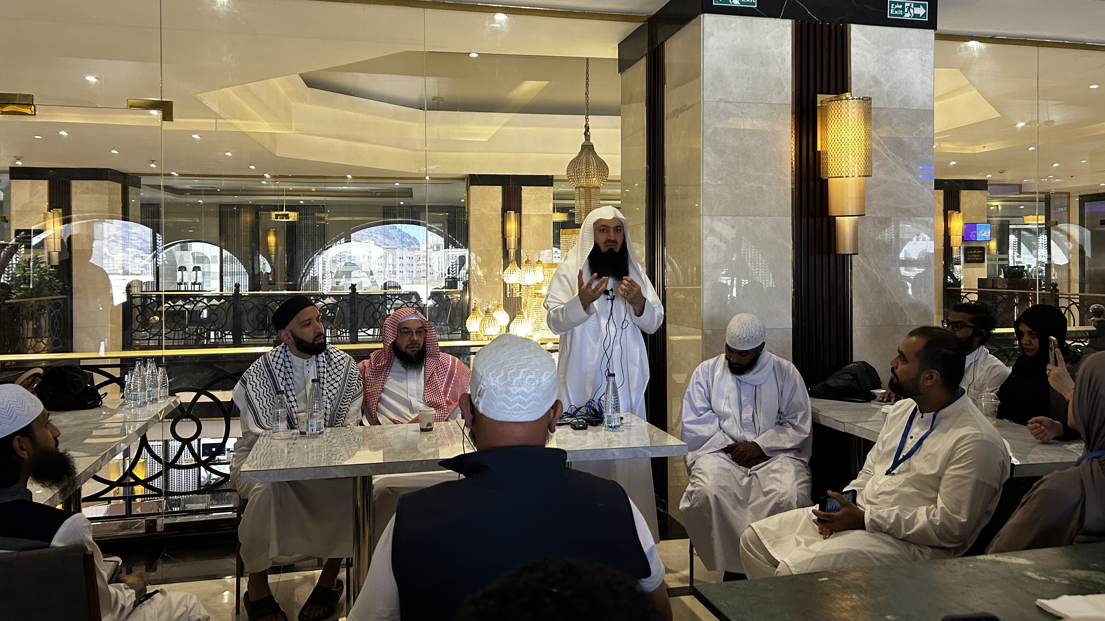

Slide 15
Timeline
Nov.–Jan.
info sessions, prepare $$$
February
Booked
Feb.–May
Preparations (logistical + spiritual)
31 May – 2 June
Medina
3 June
Arrive in Makkah (Umrah)
4–9 June
Actual days of Hajj
10–13 June
Unwinding in Makkah
Notes:
Logistics? What did we pack?
Electrolytes Liquid IV, Vitamin C (Emergen-C)
Power bank
Unscented soaps
In addition to regular international travel stuff (extra copies of passports, visas, enough clothes, etc)
We spent a lot of our time (in Medina, in Makkah, in the camps, and during the last couple of days in Makkah) receiving religious lectures, spiritual reminders, etc. We had some excellent religious leadership on our trip.

Slide 16
Questions?
Thank you!

