Slide 1
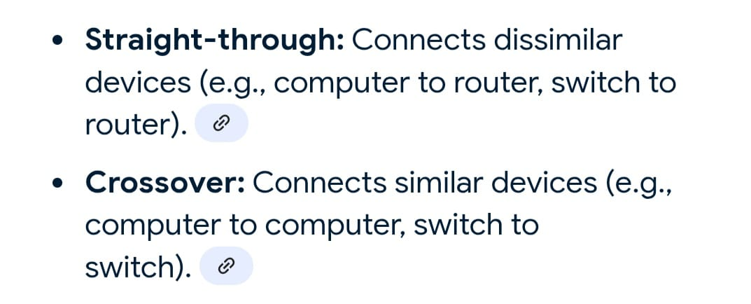
Problem Statement:
Setting up small wired computer network: Set up a small wired network of 2 to 4 computers using Hub/Switch. It includes Preparation of Cables and setting up wired network.

Slide 2
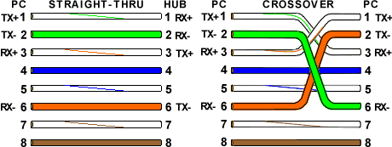

Slide 3
To transfer data between two laptops using an RJ45 (Ethernet) cable, you need to connect the laptops, enable file sharing, and then transfer the files. This involves configuring network settings on both laptops to allow them to see each other and then using the file explorer to copy files.

Slide 4
1. Connect the Laptops:
Locate the Ethernet port on each laptop.
Plug one end of the RJ45 cable into each laptop's Ethernet port.

Slide 5
2. Configure Network Settings:
Enable Network Discovery:
Open the Control Panel on both laptops.
Go to Network and Internet -> Network and Sharing Center.
Click on "Change advanced sharing settings".
Under "Private" or "Current Profile", turn on Network discovery and File and printer sharing.
Turn off password protected sharing if desired (this can simplify the process).
Click "Save changes".

Slide 6
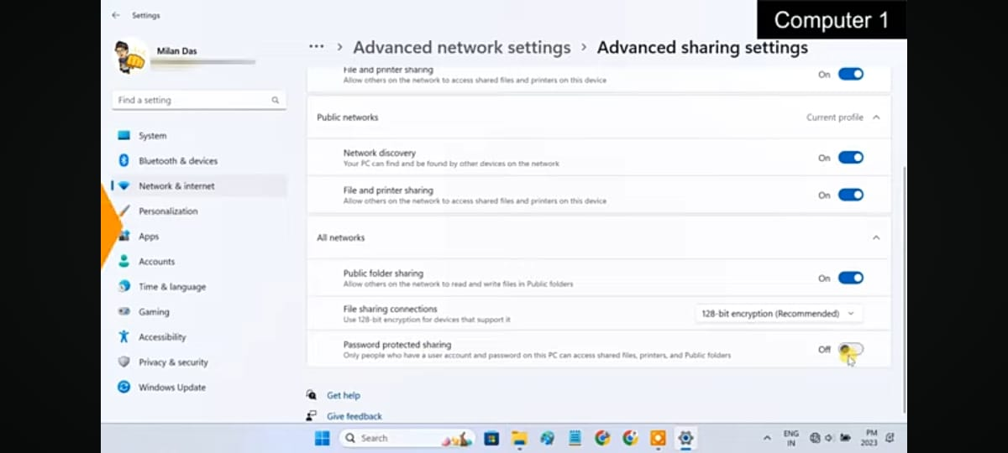

Slide 7
Assign Static IP Addresses (Optional, but recommended for reliability):
In the Network and Sharing Center, click on "Change adapter settings".
Right-click on the Ethernet connection and select "Properties".
Double-click on "Internet Protocol Version 4 (TCP/IPv4)".
Select "Use the following IP address" and assign IP addresses in the same subnet (e.g., 192.168.1.1 and 192.168.1.2 with a subnet mask of 255.255.255.0).
Click "OK" on all dialog boxes.

Slide 8
Assign Static IP Addresses (Optional, but recommended for reliability):
In the Network and Sharing Center, click on "Change adapter settings".
Right-click on the Ethernet connection and select "Properties".
Double-click on "Internet Protocol Version 4 (TCP/IPv4)".
Select "Use the following IP address" and assign IP addresses in the same subnet (e.g., 192.168.1.1 and 192.168.1.2 with a subnet mask of 255.255.255.0).
Click "OK" on all dialog boxes.

Slide 9
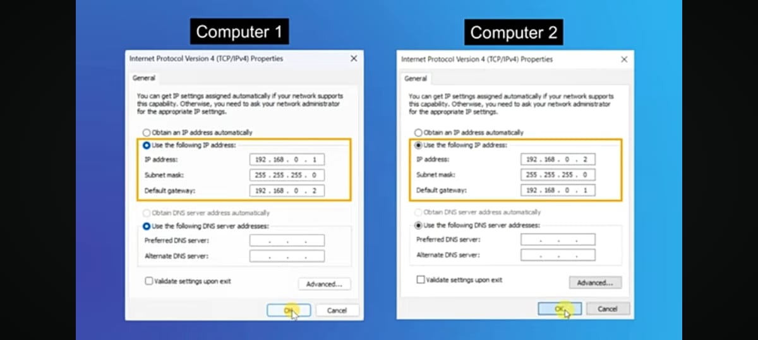

Slide 10
3. Share Folders:
Choose the folder(s) you want to share: Right-click on the folder and select "Give access to" -> "Specific people".
Add "Everyone" to the list of users and grant them "Read/Write" permissions.
Click "Share".

Slide 11
4. Access Shared Files:
On the receiving laptop, open File Explorer.
Type \\<IP address of the sending laptop> in the address bar (e.g., \\192.168.1.1) and press Enter.
You should see the shared folders. You can now copy files from the shared folder to your local drive.

Slide 12
Important Notes:
If either laptop doesn't have an Ethernet port, you'll need a USB to Ethernet adapter.
Ensure both laptops are on the same network (either through static IP addressing or by connecting to the same network).
If you encounter issues with file sharing, ensure that firewalls are not blocking network traffic between the two laptops.
For large file transfers, the Ethernet connection is generally faster than Wi-Fi.
You can also use third-party tools like Any Viewer for file transfer, but the above method is a standard way to share files using a LAN cable.

Slide 13
https://www.youtube.com/watch?v=Zsd53y0nlz0&t=2s

