Slide 1
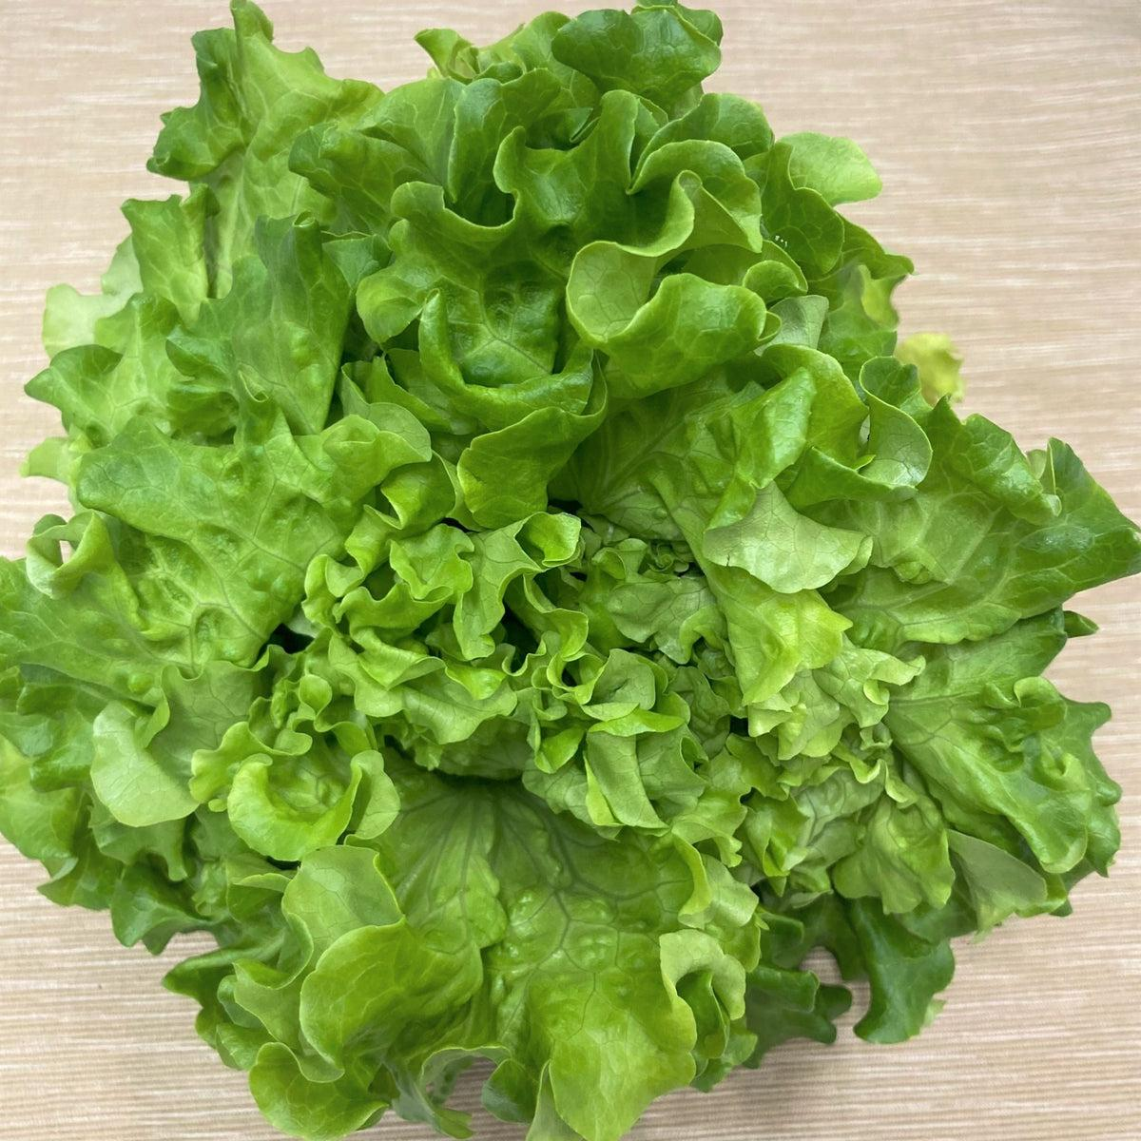
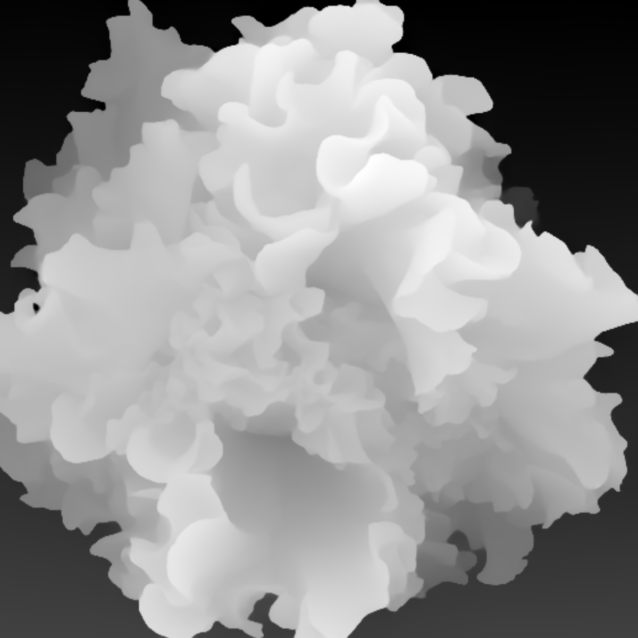
MobileViT_2
MobileViT_3
SSD Detections
Classification
Fusion
BBox
Fusion
DSC
DSC
DSC
DSC
Phenotypes
MobileViT_2
MobileViT_3
Extra Layer

