Slide 1
Sales Performance Dashboard

Slide 2
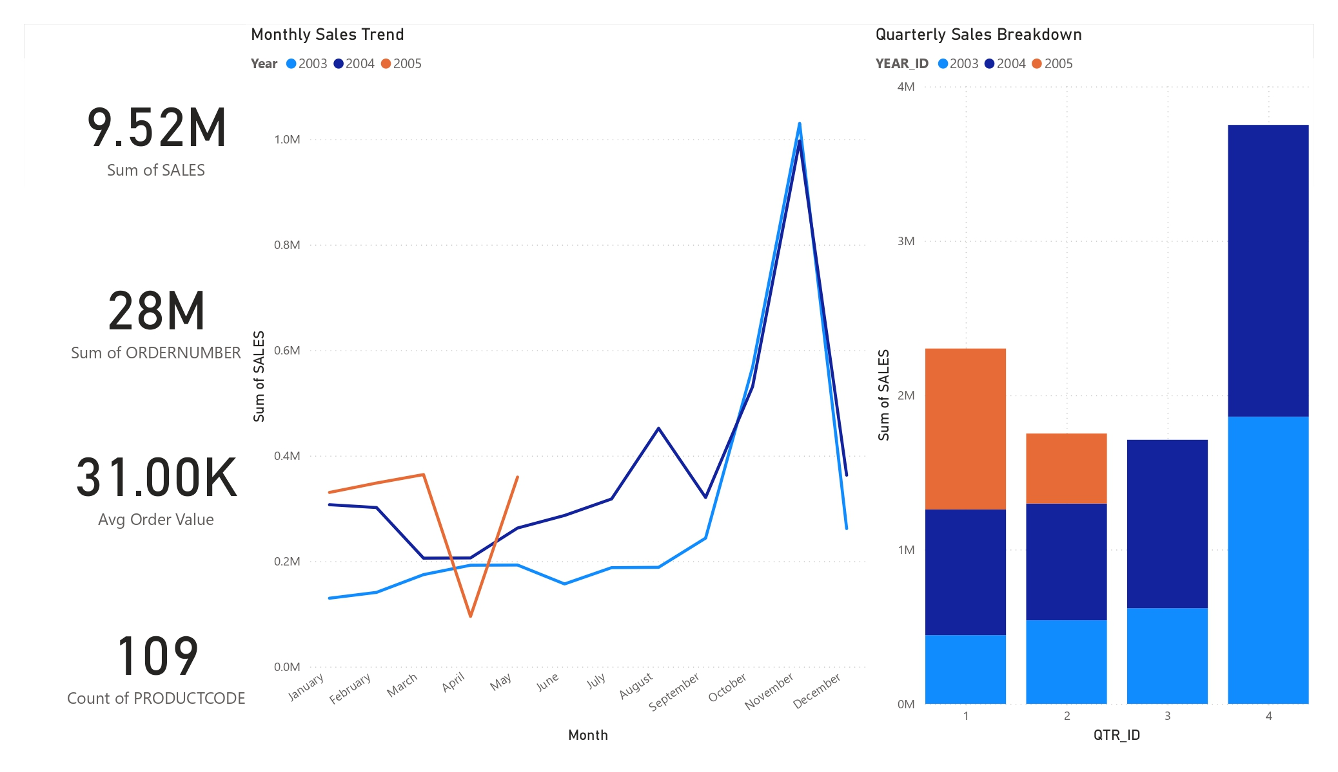
Dashboard Snapshot

Slide 3
Data Extraction
Total Revenue: $9.52m (SUM of sales)
Total Orders: 28m (DISTINCTCOUNT of ordernumber)
Avg. Order Value: $31K (SUM(sales)/COUNT(ordernumber)

Slide 4
Data-Driven Insights
Top Product: "Classic Cars" ($350K revenue, 24% of total)
Best Market: "USA" (55% of sales)
Busiest Month: "November" (30% higher sales vs. average)

Slide 5
Actionable Next Steps
Expand Classic Cars Inventory (Top-performing product line)
Target USA Marketing (55% revenue concentration)
Prepare for November Surge (30% seasonal spike)

Slide 6
THANK YOU

