Slide 1
Reinforcement Learning for Spacecraft Mode Control: Midterm update
Harris . Teil . Hammad . Mills

Slide 2
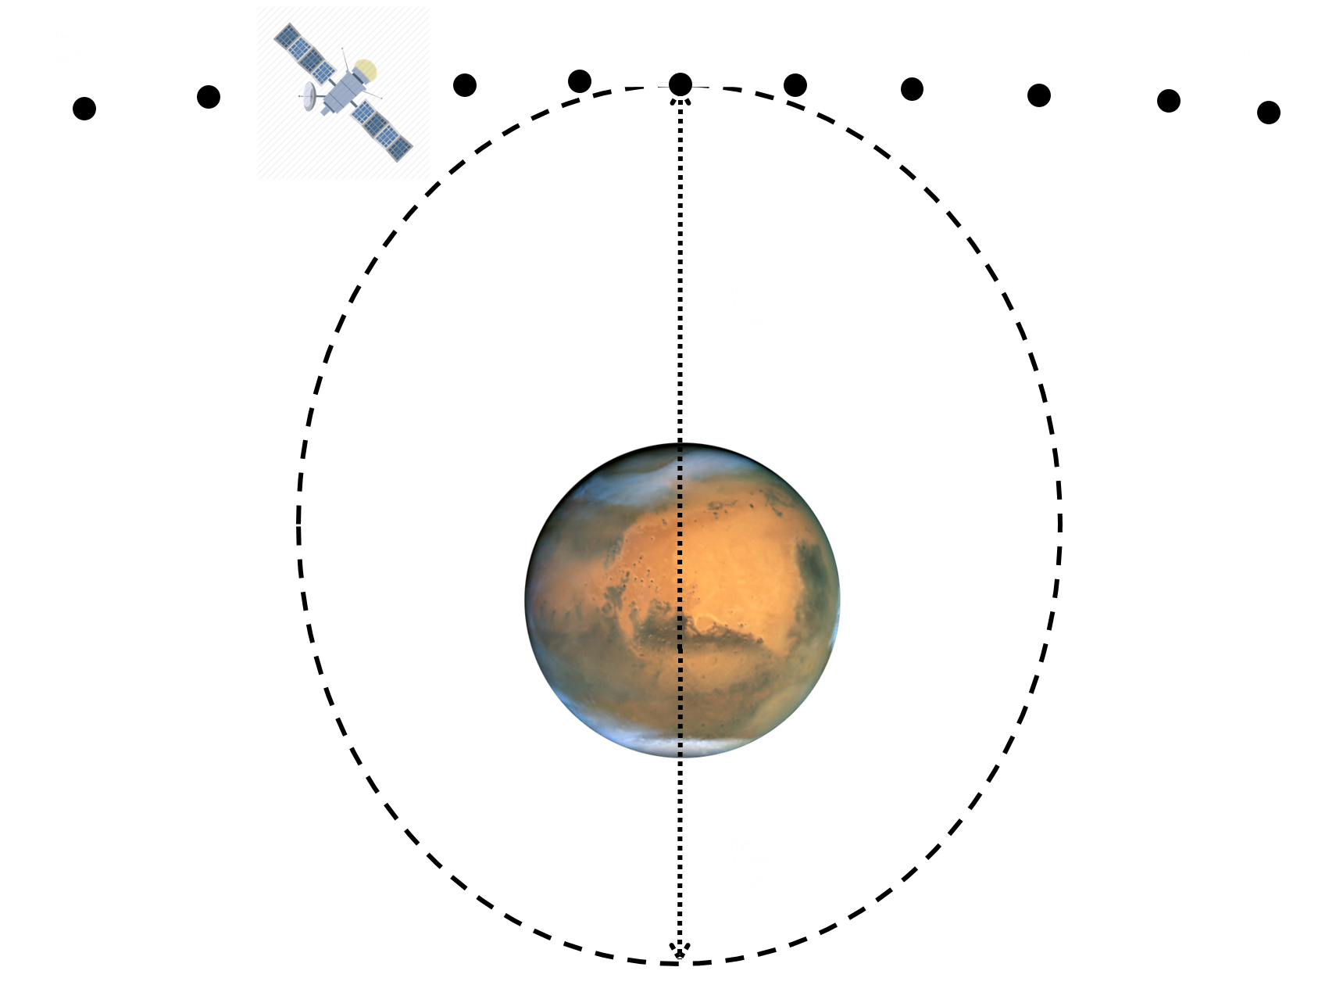
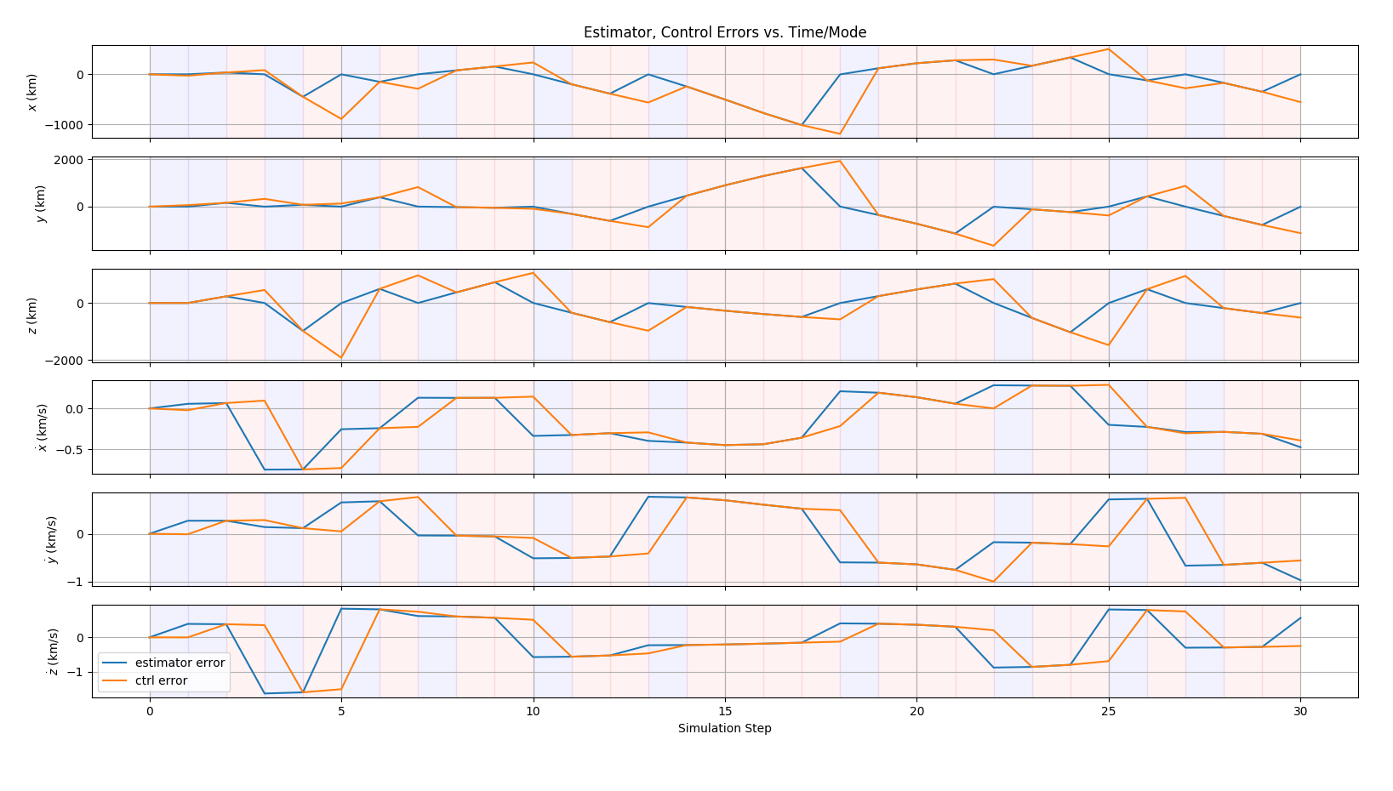
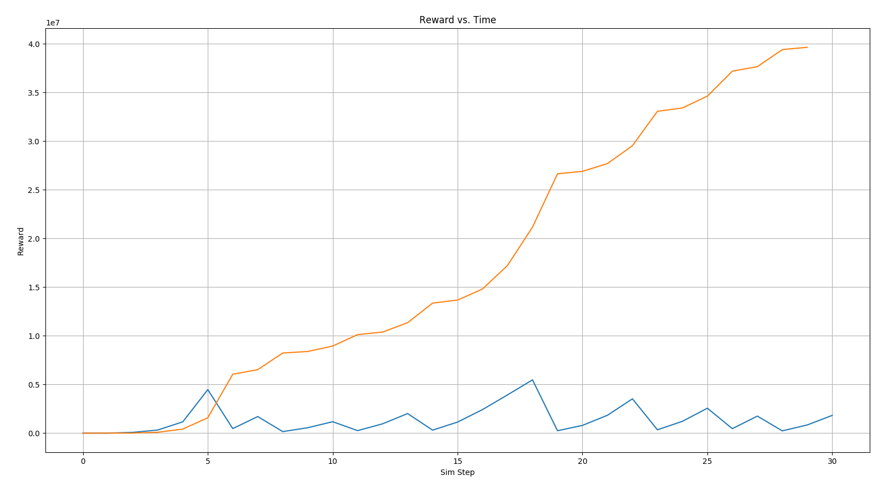

Environment Modeling
Status
Reformulated problem as a Partially-Observable Markov Decision Process
Implemented the full, nonlinear problem as a POMDP within the OpenAI Gym framework
Operational mode models tested on schedule
Currently using a quadratic reward/cost model indexed to fuel use, control error, and final error: $r_{i}=e_{i}^{T}Qe_{i}+R{\left|u\right|}^{2}$, $r_{f}={\left|δ_{oe}\right|}^{2}$ where $e_{i}$ is the control error, $\left|u\right|$ is the control usage and $\left|δ_{oe}\right|$ is the difference between the final and desired orbit.
To-Do Items
Explore different “unmodeled” perturbations
Construct baseline case for comparison (“How do we think it should work?”)
Check, improve runtime to speed learning process
Figure 1: OD/Control Environment run with random actions. Top figure shows control/estimation error per mode, bottom figure shows corresponding costs over time
Notes:
Motivation:
Space mission operation costs

Slide 3
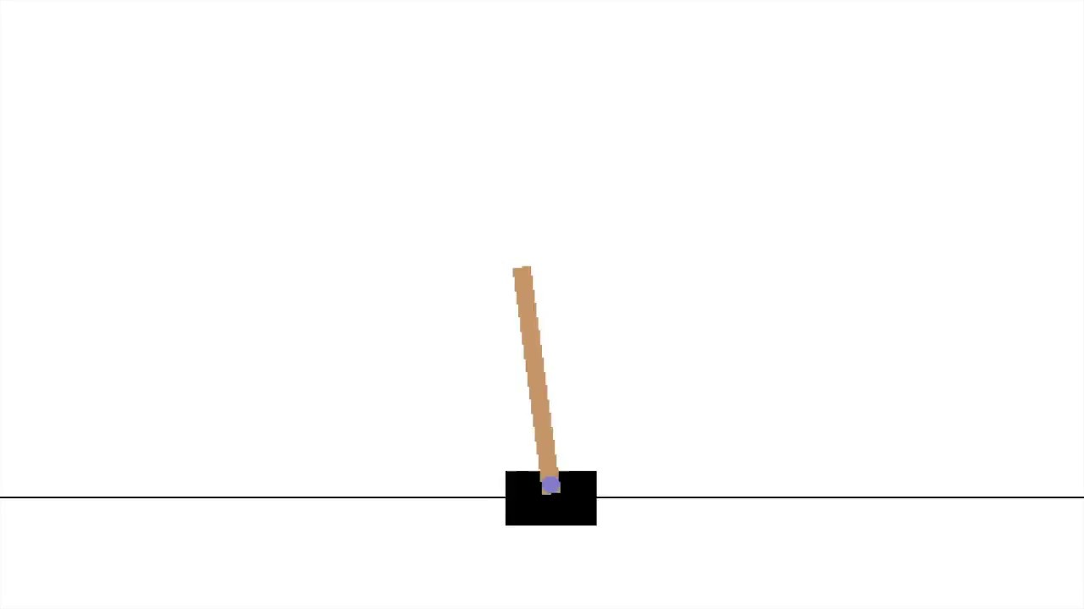
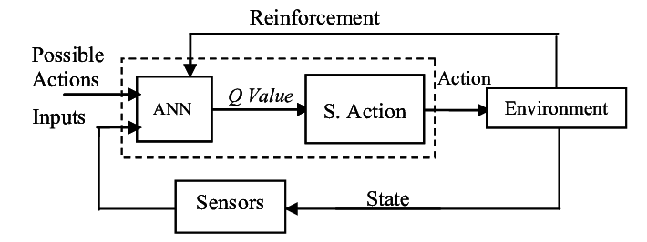
Learning Methods
Progress
Currently running a lookup table version of Q Learning on OpenAI gym environments
Demonstrated success at learning simple environments with a discrete state, action space
Developed class to record and replay learning runs in gym environments
To-Do’s
Implement Q Learning using a neural net to regress the reward function over the environment action space.
Confirm performance using gym environments with a continuous state space (like the inverted pendulum cart problem)
Iterate and tune learning algorithm in the 6 DoF spacecraft environment
Figure 2: OpenAI “Cartpole” environment.
Figure 3: Block diagram for neural-network based Q-learning process.
Notes:
Motivation:
Space mission operation costs

Slide 4
Outlook and Questions
Remaining Items:
Adapt q-learning methods to the new scenarios
Explore other reinforcement learning techniques
Add complexity to the models in order to test the performance of RL in this space
Environment Questions:
Is the problem learnable given the parameters? Many of the functions are tunable, and depending on the values used, they may not allow for learning.
How fast is the integrated simulation? In order to do many runs, the scenarios must run fast enough to allow for iteration
Learning Questions:
How complex does the reward function neural net need to be to perform well (# of layers, # of neurons in each layer, cost function)?
How can we tune the reward function to facilitate faster learning?
When should the learning algorithm focus on exploring vs refining the current best strategy?
Which environment parameters do we need to focus on?
Current Solutions:
Start with simple cases without uncertainty. Take trivial steps to ensure that the problem is solve-able, such as having fast control/estimation responses.
If simulation speed is a problem, reduce time fidelity or simulation duration
Test learning approaches and confirm their ability to learn “learnable” environments already available in OpenAI Gym before testing them on our spacecraft environment

