Slide 1
Reinforcement Learning for Spacecraft Mode Control
Harris . Teil . Hammad . Mills

Slide 2

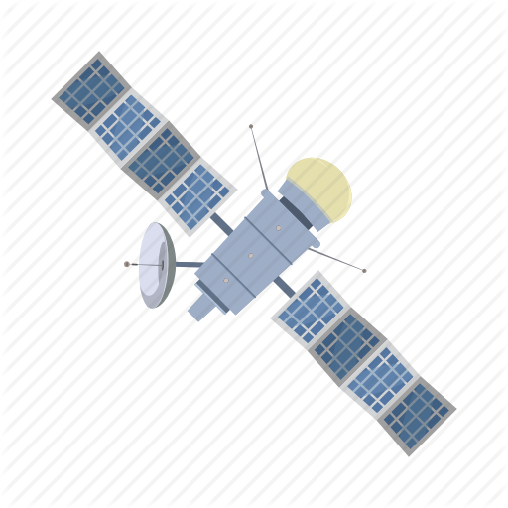


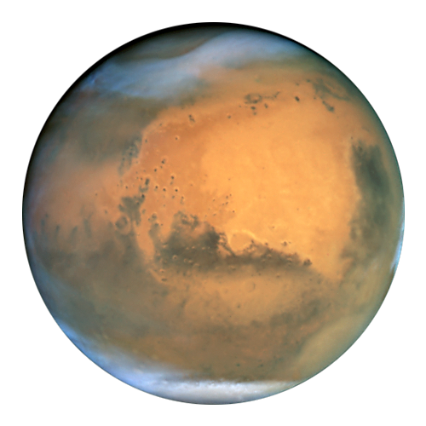

Gym Environment
Setting up the gym: creating actions the spacecraft can take and scenarios to apply these actions to learn optimal decisions.
Actions
Orbit Determination (OD): increase knowledge of position and velocity, without control
Control orbit: reduce error between estimated trajectory and reference trajectory, slowly losing knowledge of position
Thrust (apply large thrust to enter orbit)
Safe-Mode (Mitigate error, without control or orbit determination)
Environments
Station Keeping (SK): control and OD only to stay on the reference trajectory .
Orbit Insertion (OI): Apply no error on trajectory and apply variable thrust along the reference arc
SK+OI+SK: chain initial station keeping with orbit insertion, followed by more station keeping.
Notes:
Motivation:
Space mission operation costs

Slide 3
Learning Methods
Progress
Currently running a lookup table version of Q Learning on OpenAI gym environments.
Demonstrated success at learning simple environments with a discrete state space.
Developed class to record and replay learning runs in gym environments.
To-Do’s
Implement Q Learning using a neural net to regress the reward function over the environment action space.
Confirm performance using gym environments with a continuous state space (like the inverted pendulum cart problem).
Iterate and tune learning algorithm in the 6 DoF spacecraft environment.
Notes:
Motivation:
Space mission operation costs

Slide 4
Timeline and Questions
Timeline:
Finish development and testing of the environment
Adapt q-learning methods to the new scenarios
Add complexity to the models in order to test the limits of the learnability
Environment Questions:
Is the problem learnable given the parameters? Many of the functions are tunable, and depending on the values used, they may not allow for learning.
How fast is the integrated simulation? In order to do many runs, the scenarios must run fast enough to allow for iteration
Learning Questions:
How complex does the reward function neural net need to be to perform well (# of layers, # of neurons in each layer, cost function)?
How can we tune the reward function to facilitate faster learning?
When should the learning algorithm focus on exploring vs refining the current best strategy?
Current solutions:
Start with the simplest case. Minimal variables and errors, and progressively increase the complexity. Ensure that control time is much faster than error propagation.
If the simulation runs slowly, allow for bigger time steps to at least allow for coarse learning.
Generalize learning approaches and confirm their ability to learn “learnable” environments already available in OpenAI Gym before testing them on our spacecraft environment.

