Slide 1
Reinforcement Learning
for Spacecraft Mode Control
Harris . Teil . Hammad . Mills

Slide 2
Project Description
Motivation
High operations cost makes autonomy a priority
On-board autonomy eliminates need for ground contact
ML techniques could provide planning robust to dynamic environment
Project Description
Apply reinforcement learning to determine the best series of actions for a spacecraft to enter and maintain an orbit about a planet in deep space.
The goal is to minimize error relative to a nominal orbit and perform the prescribed science mission.
Notes:
Motivation:
Space mission operation costs

Slide 3
Proposed Work
Training Data
Training data will be simulated with linear relative error and state dynamics models.
High performance nonlinear orbital mechanics models will be used for later phases.
Why use Machine Learning?
Reinforcement learning has had success in vehicle autonomy and control.
Approach
Linear
Develop models for learning environment. (Consider error states that grow and shrink linearly)
Temporal difference Q-learning
Model-Based Maximum Likelihood methods
Nonlinear
Apply learned algorithms to “true” nonlinear system.

Slide 4
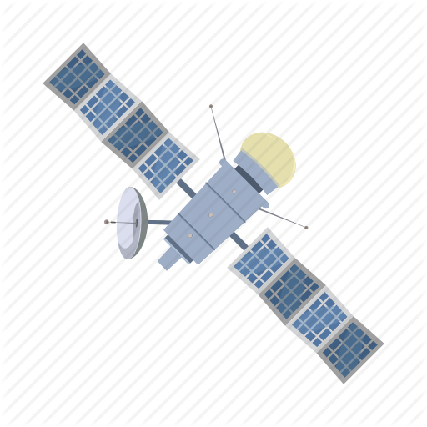






Problem Statement
State Description
$X=[r, v]^{T}∈ℝ^{6}$: true state
$X_{0}=[r_{0},v_{0}]^{T}$: reference trajectory
$\hat{X}∈ℝ^{6}$: state estimate
$x=X−\hat{X}$: estimation error
$E∈\{0, 1\}$: error indicator
Action Model
Orbit Determination - $x→0$
Orbit Control - $\hat{X}→X_{0}$
Mission Maneuver - $∆V≫0$
Science Operations - obtain reward
Safe Mode - $E→0$
$t_{i}$
$t_{f}$
$r_{a}$
$r_{p}$

